Slide 1
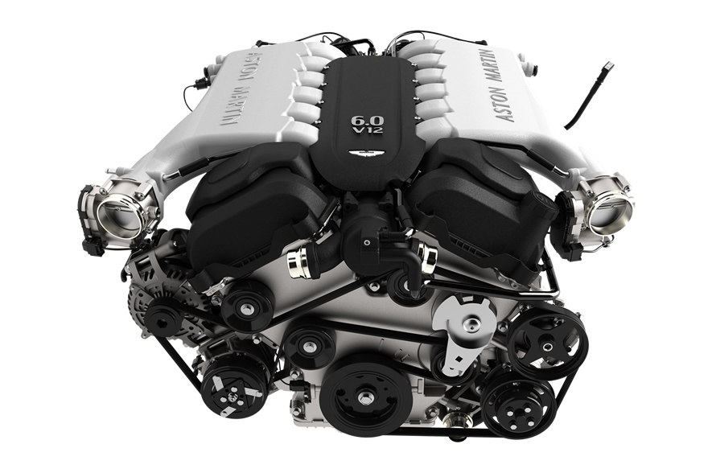
Engine – the power plant of an automobile - the prime mover

Slide 2
Heat engines
Internal combustion engines(I C engines)
combustion takes place within the engine.
External combustion engines(E C engines)
combustion takes place outside the engine
Eg. Steam engines, steam turbine, Stirling engine etc.

Slide 3
Why IC engines?
No heat exchangers involved – improved efficiency – mechanical simplicity
Maximum temperatures exists for very short periods only – higher fluid temperatures possible – higher thermal efficiency
Higher efficiency at lower pressures – less Wt/Power ratios.
Can be designed for smaller outputs with reasonable cost efficiency.

Slide 4
Another classification
Rotary engines
- Only rotating parts
Reciprocating engines
- Contains reciprocating patrs
Reciprocating IC engines are most widely used for automobiles.

Slide 5
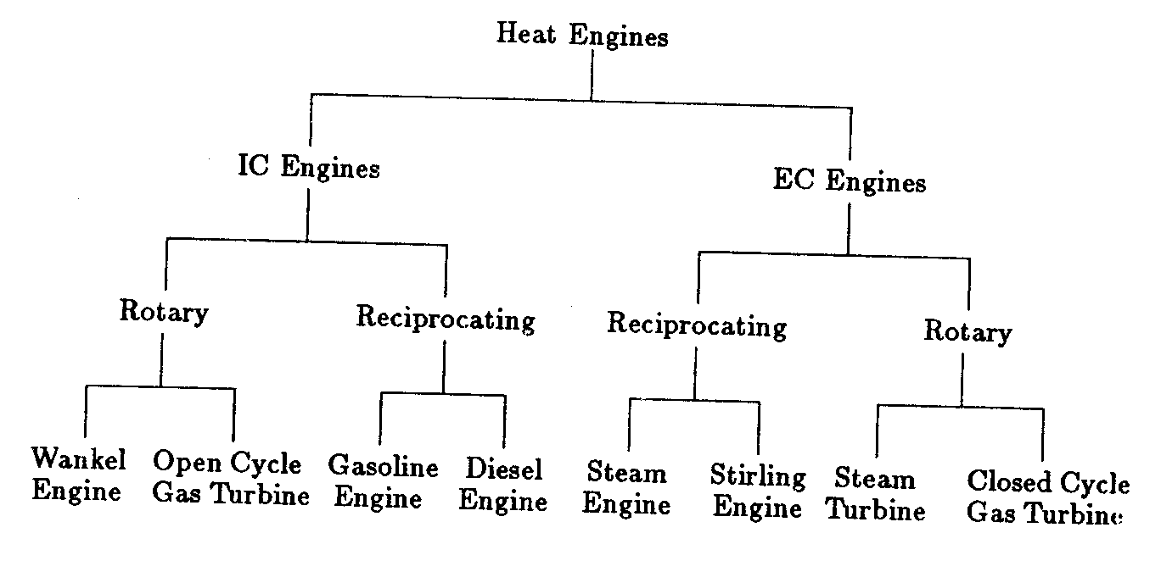

Slide 6
Drawbacks of reciprocating I C ngines
vibration caused by the reciprocating components.
not possible to use a variety of fuels in these engines.
fuels are relatively more expensive.

Slide 7
Further classification of IC engines
Based on
Number and arrangement of cylinders
Engine cycle
Number of strokes
Fuel Used
Type of Ignition
Valve arrangement
Type of cooling

Slide 8
Based on the Number and arrangement of cylinders
Single cylinder engine
Multi cylinder engines
  In line
  Opposed type
  V type
  Radial engine

Slide 9
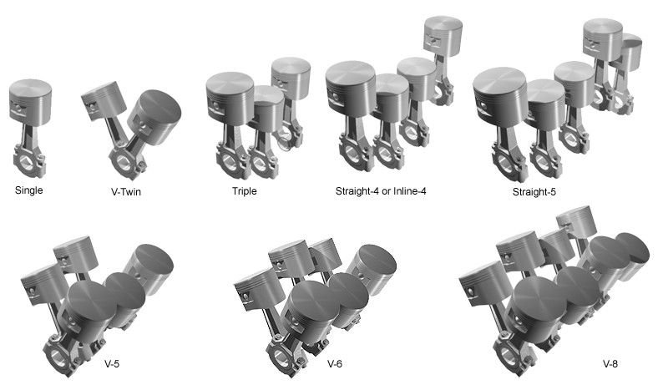

Slide 10
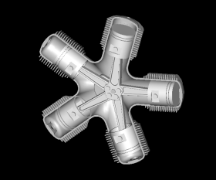

Slide 11
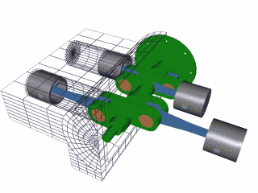
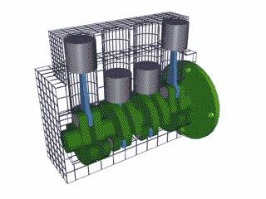
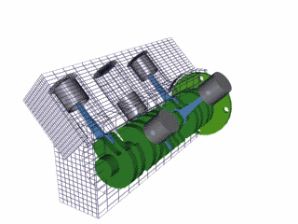

Slide 12
Wankel engine

