Slide 1
Cooling System
Only a part of the total fuel energy supplied to the Internal Combustion engine is converted into useful work.
Rest of the fuel energy is rejected as follows:
  Heat from the engine boundaries
  Exhaust heat
  Heat rejected to the coolant

Slide 2
Methods of Engine Cooling
Air cooling
Water cooling
Liquid cooling
Steam cooling

Slide 3
Air Cooling
The heat is dissipated directly to air.
Fins or flanges are used on outer side of cylinder to increase area exposed to air.
The rate of cooling or heat transfer can be expressed using following equation.
Q= KA t M / L
Q = rate of heat transfer
K = average thermal conductivity
A = surface heat transfer area
t = temperature difference between the hot and cold surfaces
M = mass flow rate of air
L = length of the heat flow path

Slide 4
For better air cooling, the surface area of the metal which is in direct contact with the air is increased by increasing the number of fins.
Advantages are
Lighter in weight
No topping up of coolants
No leaks to guard against
Anti-freeze not required
Can be operated in cold climate
Earlier warm up

Slide 5
Some disadvantages are:
Less efficient cooling
Uneven cooling
Low heat transfer co-efficient – low HUCR
Limited use or can be used in small engines
No noise reduction ;fin vibration

Slide 6
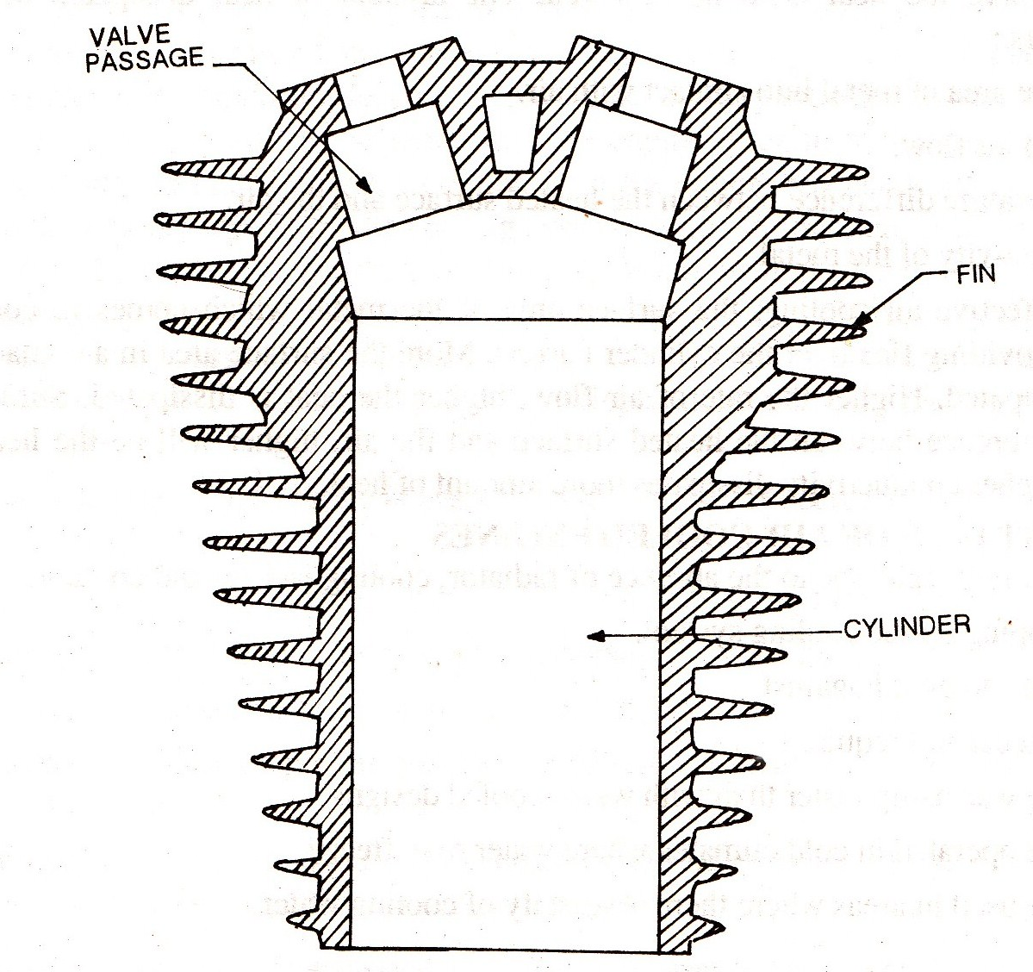
Cooling Fins
Increase the surface area of cylinder.
Casted or integrated on cylinder or separate finned barrels are inserted.

Slide 7
Fins are usually made of about:
Cylinder wall thickness at root, tapering down to one-half of root thickness
Length varies from 1/4 to 1/3 times cylinder diameter.
Distance between two fin centers is 1/4 to 1/3 times of fin length.
Total length of finned cylinder barrel is 1 to 1.5 times cylinder bore.
According to experimental considerations 1400 to 2400cm² of cooling fin area is required per HP output

Slide 8
Fan Cooling
Used in large air cooled engines.
Fan having two or three blades is driven at engine speed or twice engine speed and air flow is directed to cylinder to facilitate cooling.
Cooling mainly depends on engine speed and not upon the forward speed of the vehicle.

Slide 9
Water Cooling
Water is circulated around through water jackets around cylinder to facilitate cooling.
The water is then passed through radiator where cooling of water take place by two methods.
Air drawn through the radiator by a fan
Air flow developed by vehicle forward motion
Different types of water cooling are:
Thermosiphon system
Pump circulation system

Slide 10
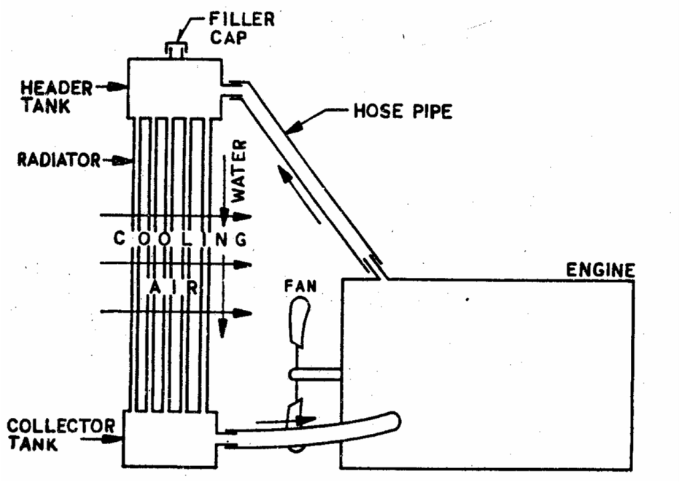
Thermo siphon System
Circulation of water is due to the difference in densities of hot and cold region of cooling water.
No pump is used.
Advantages are simple and cheap.
Major disadvantage is slow cooling.

Slide 11
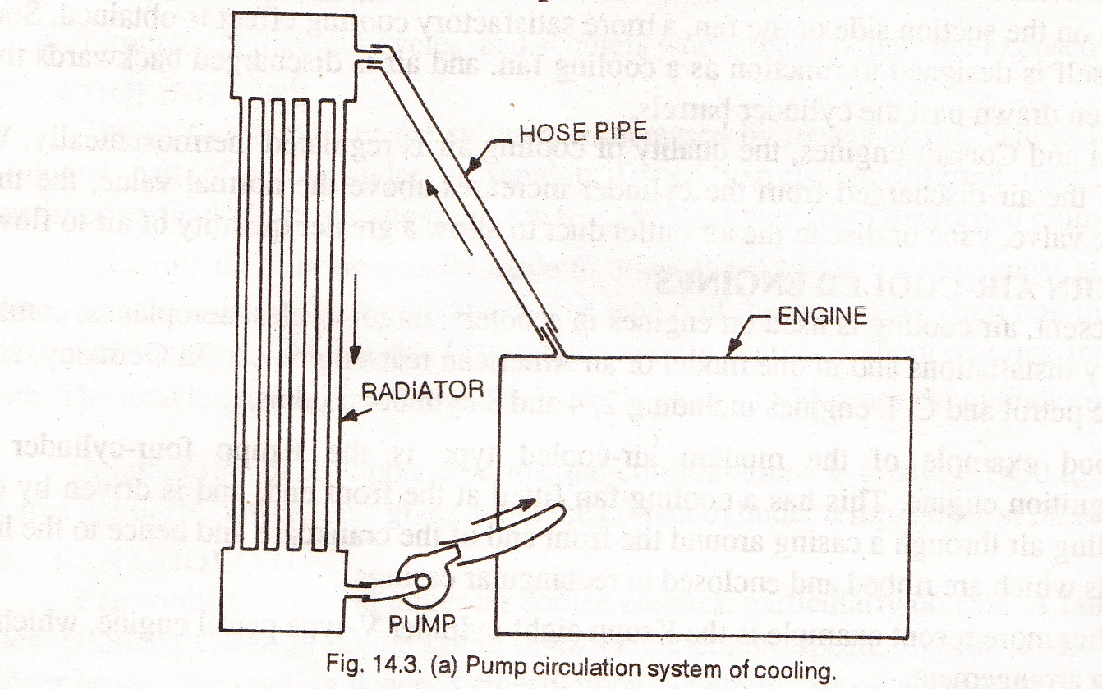
Pump Circulation System
A water pump is provided between the lower tank of the radiator and the water inlet of the engine body.
The water pump driven by the engine crankshaft by means of a belt.
The water is circulated with the pump force and thereby obtaining a rapid cooling.

Slide 12
At the starting time the engine does not need cooling until the temperature exceeds the working range of the engine. Therefore in modern engines the cooling system consists of a by-pass, through which water circulates in the water jackets with out entering the radiator at the time of starting and below operating temperature.
The system also consists of a thermostat, which is opened automatically by means of high temperature whenever engine desires cooling.

Slide 13
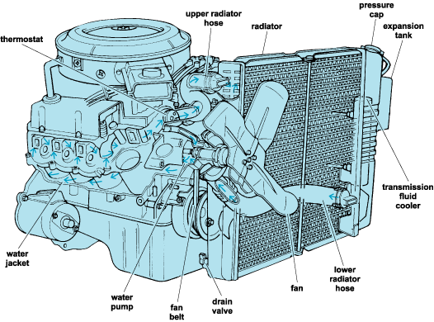

Slide 14
Advantages are:
Efficiency of cooling can be improved.
Water can be circulated through hottest spots.
Radiator can be placed anywhere conveniently
Needs only small radiator
Rapid cooling is possible

Slide 15
Liquid Cooling
The liquids such as glycerin and ethylene glycol are used as coolant because they have higher boiling point.
Advantages are:
Increases heat carrying capacity of the system.
Reduces weight of coolant as well as weight of radiator.

Slide 16
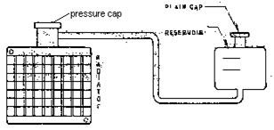
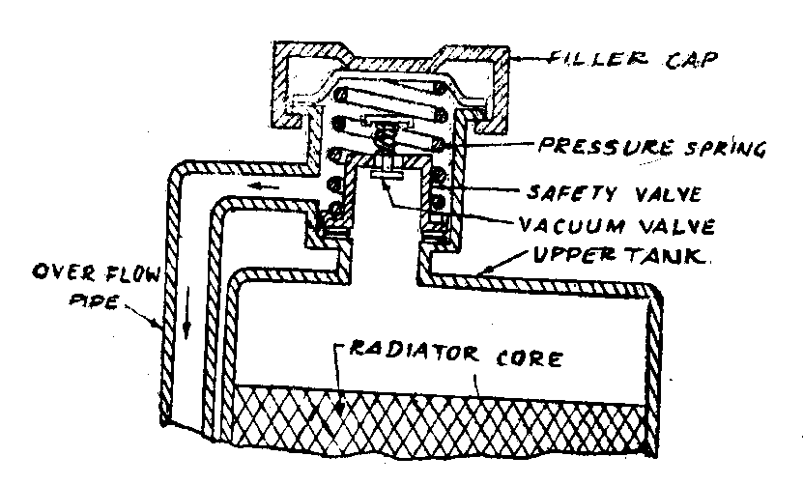
Pressure sealed cooling system
The boiling point of the cooling water in the open atmosphere is always 100 degree C, which can be raised to higher pressures by sealing the cooling system.
Therefore the closed system reduces the weights of the coolant and the radiator and increases the thermal efficiency of the engine.
The pressure of the system can be raised by means of a special radiator cap which maintains pressure from 0.5 to 1 kg/cm²
cap consists of Pressure valve or blow off valve, vacuum valve over flow pipe and gasket for sealing purposes.

Slide 17
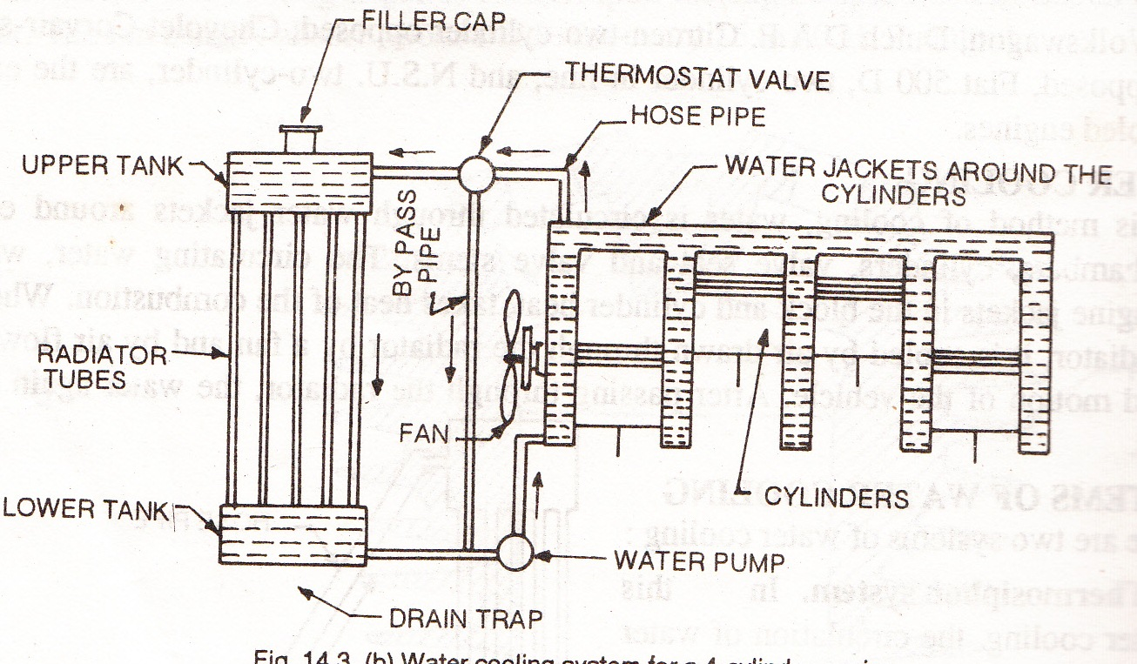

Slide 18
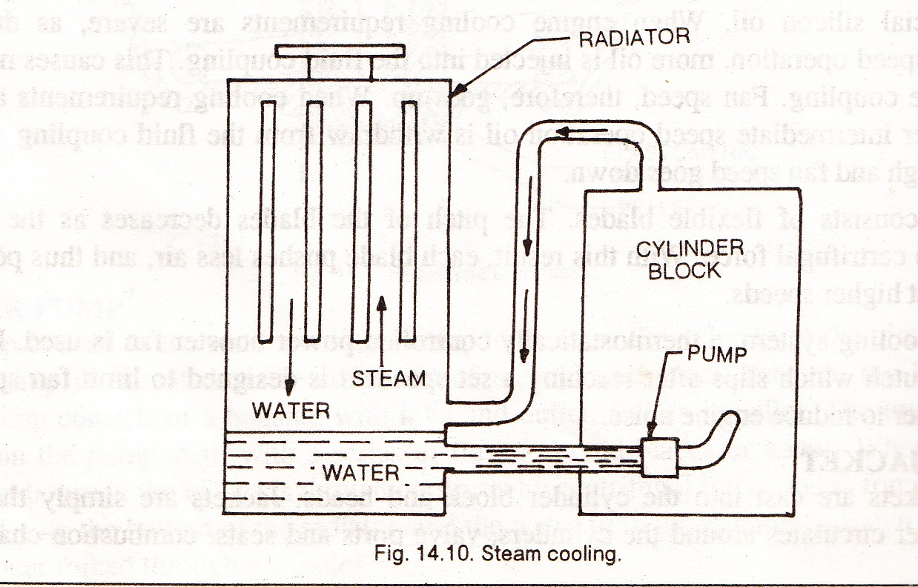
Steam cooling
Similar to water cooling.
Components are same except radiator.
Radiator act as a condenser.
Also uses pump for circulating water.
Water in the cylinder jackets is converted to steam.
The steam is condensed in the radiator and the water is again circulated.

