Slide 1
Automobile electrical systems

Slide 2
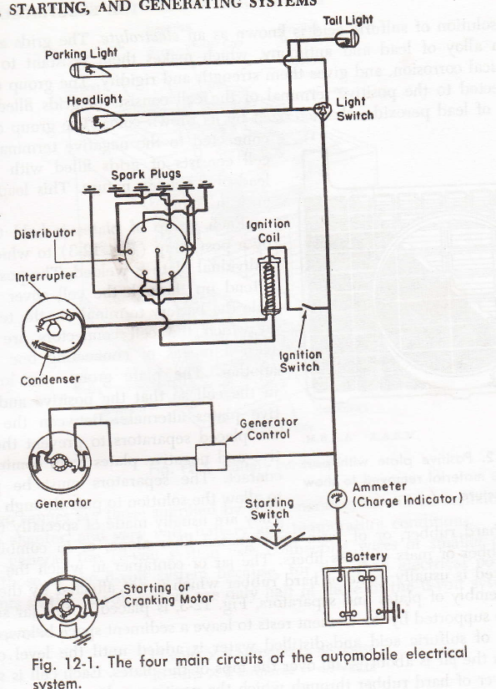
T
The four main circuits of
automobile electrical system
The generating circuit
The starting circuit
The ignition circuit
The lighting circuit

Slide 3
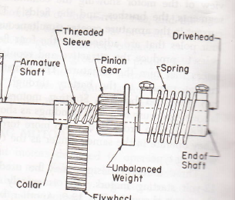
Starting motor drives
Bendix Drive

Slide 4
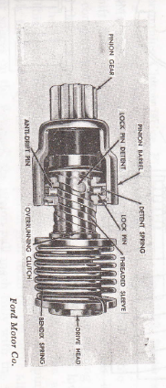
Folo –Thru Bendix Starter Drive

Slide 5
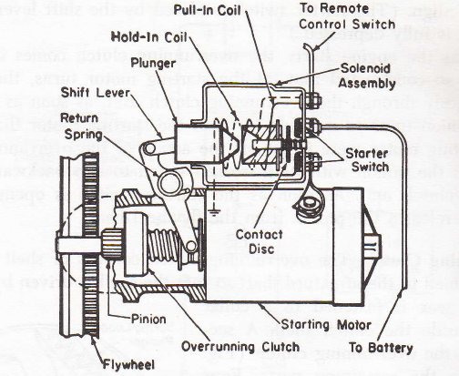
Overrunning clutch drive with solenoid shift

Slide 6
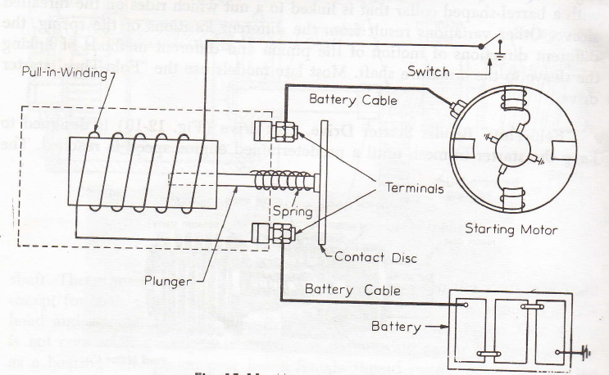
Magnetic Bendix – Drive Starter switch

Slide 7
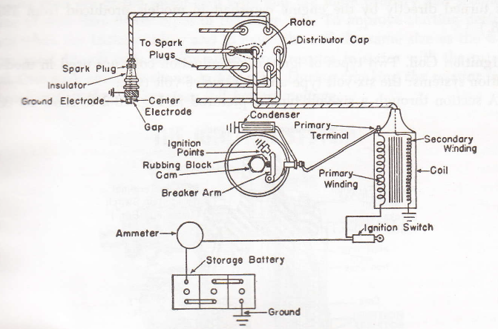
Battery ignition systems

Slide 8
Transistor assisted ignition system
High voltage transistor – relieves the contact breaker points from the duty of making and breaking primary circuit
Only does the On & off of transistor – at proper time in relation to the engine speed
Condenser is eliminated
Arcing of the contact point is avoided
Promotes easier starting, better ignition, high engine speeds

Slide 9
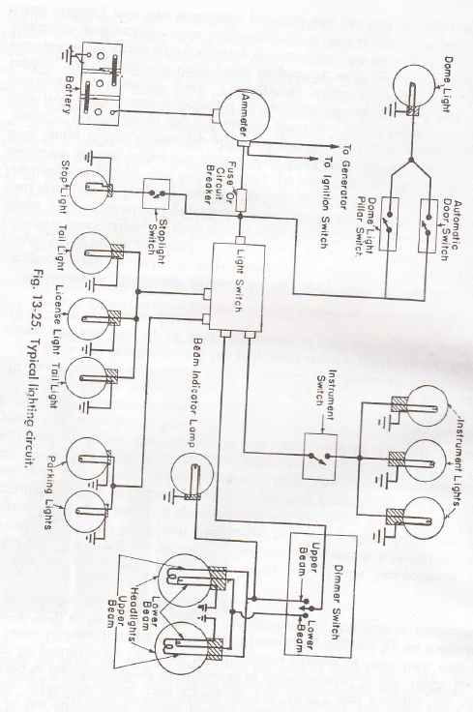
Lighting

Slide 10
Battery life
Overcharging -> Overheating -> gas bubbling
-> Too much concentration of electrolyte
Continuous undercharging -> sulfated condition -> loss of active material
Lack of water -> too much concentration of electrolyte -> low level of electrolyte
Mechanical breakage -> loose holders -> movement of vehicle.
Excessive loads
Freezing of electrolyte

Slide 11
Battery charging
Slow charge method
  low current for long period
  can be fully charged by this method
  can be safely used under all possible conditions
Quick charge method
  Large current with a short period of time
  cannot fully charge battery
  should not be used in all conditions

Slide 12
Generators
Shunt wound generators
D C generators ; Alternators
Cut – out ->automatic switch -> opens and closes the circuit between generator and battery -> prevents discharging of battery thru generating circuit
Voltage regulator -> keeps the maximum voltage of the generator from exceeding a pre determined value.-> operates when load requirements are reduced and battery approaches charged condition
Current regulator-> controls the maximum current output of the generator -> prevents the generator damage from overload -> operate when the load requirements are high and battery is low

