Slide 1
WELCOME

Slide 2
ADAPTIVE DATABASE SCHEMA DESIGN FOR MULTI-TENANT DATA MANAGEMENT
Topic approval:02/08/2013 Sruthi AK
Slide approval:02/09/2013 Roll no-60
Topic and slide approved by: S7R
Mrs Jisha P Abraham

Slide 3
CONTENTS
ADAPT
Introduction
Existing Systems
Example
Proposed System
Details
Conclusion
References

Slide 4
INTRODUCTION
ADAPT
Software as a Service(SaaS)
Multi-Tenant(MT) database
Need for MT database
Challenge

Slide 5
EXISTING SYSTEMS
ADAPT
Independent Databases and Independent Database Instances(IDII)
Independent Tables and Shared Database Instances(ITSI)
Shared Tables and Shared Database Instances(STSI)

Slide 6
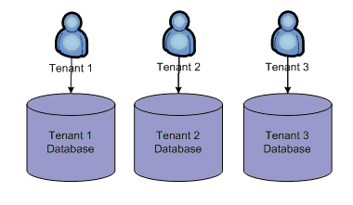
IDII
ADAPT
Hardware shared
Maintenance cost
Poor scalability
Courtesy: Multi tenant Architecture by Puri Keemthi

Slide 7
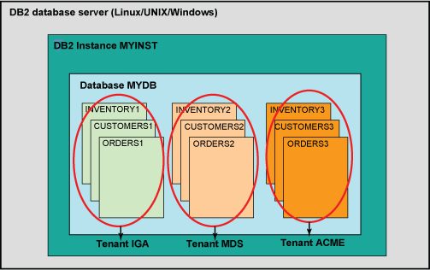
ITSI
ADAPT
Hardware, database instances shared
Limited scalability
Courtesy:Designing a database for multi-tenancy on the cloud

Slide 8
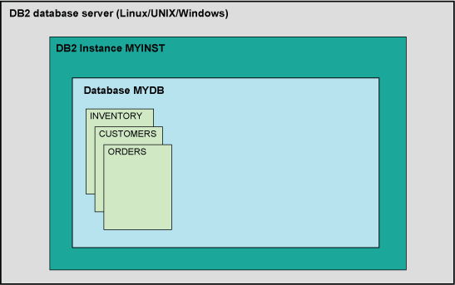
STSI
ADAPT
Hardware, database instances, tables shared
Poor performance
High space overhead
Courtesy:Designing a database for multi-tenancy on the cloud

Slide 9
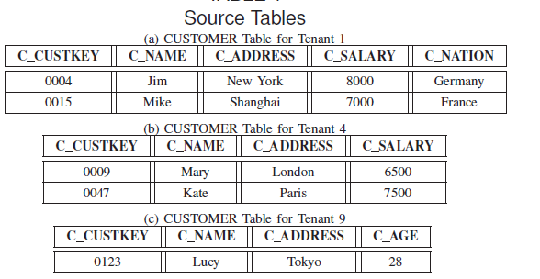
EXAMPLE
ADAPT
Courtesy:IEEE Transactions on Knowledge and Data Engineering

Slide 10
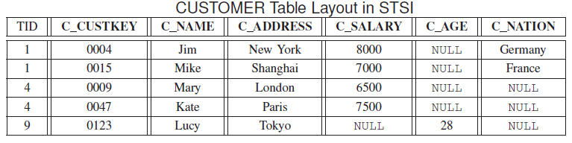
EXAMPLE(Contd…)
ADAPT
Courtesy:IEEE Transactions on Knowledge and Data Engineering

Slide 11
PROPOSED SYSTEM
ADAPT
Adaptive Database Schema Design(ADAPT)
Important Attributes
    Common Attributes
    Star Attributes
    Uncommon Attributes
Base table
Supplementary table

Slide 12
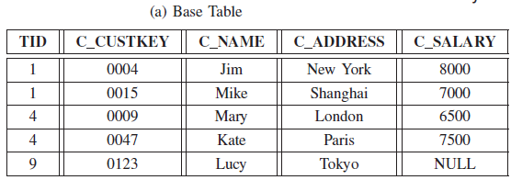

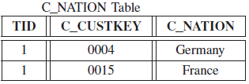
EXAMPLE
ADAPT
Courtesy:IEEE Transactions on Knowledge and Data Engineering

Slide 13
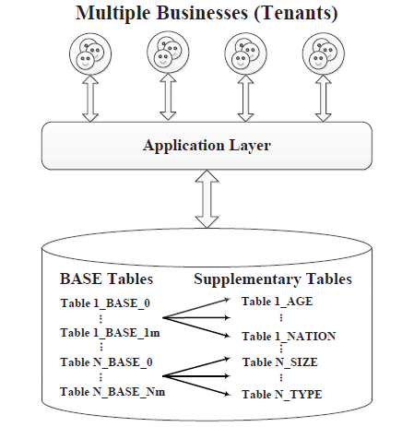
ARCHITECTURE
ADAPT
Courtesy:IEEE Transactions on Knowledge and Data Engineering

Slide 14
ADAPT DETAILS
ADAPT
Common Attribute Selection and Clustering
    Selection
    Clustering
Dependent Attribute Selection

Slide 15


CLUSTERING
ADAPT
Attribute Undirected Weighted Graph
Attribute Node Vector
V1=(1 0 1 0 1 1)
Weight of Edge

Slide 16

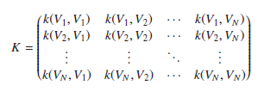

DETERMINE THE NUMBER OF BASE TABLES
ADAPT
Attribute Node Vector Mapping
Construct Kernel Matrix
Find Elbow in Kernel Matrix

Slide 17
DEPENDENT ATTRIBUTE SELECTION
ADAPT
Dependent Attributes
Expensiveness of Attribute
Cost
Weight
Dependent Attribute Selection
    For One Source Table
    For Multiple Source Tables

Slide 18
EXPENSIVENESS OF ATTRIBUTES
ADAPT
Selection
Insertion
Update
Deletion

Slide 19
SELECTION
ADAPT
Query without Uncommon Attributes
Query with Uncommon Attributes in the WHERE Clause
Query with Uncommon Attributes only in the SELECT Clause

Slide 20


ONE SOURCE TABLE
ADAPT
Space Budget( )

Slide 21


MULTIPLE SOURCE TABLES
ADAPT
Source Table Graph
Page Rank Algorithm

Slide 22
ADVANTAGES
ADAPT
High Scalability
High Performance
Low Space Requirements
Adequate Flexibility and High Availability

Slide 23
CONCLUSION
ADAPT
Adaptive Database Schema Design
Scalability
Performance
Space Requirements

Slide 24
REFERENCES
ADAPT
S. Aulbach, T. Grust, D. Jacobs, A. Kemper, and J. Rittinger.Multi-tenant databases for software as a service: schema-mappingtechniques. In SIGMOD Conference, pages 1195–1206, 2008.
S. Aulbach, M. Seibold, D. Jacobs, and A. Kemper. Extensibilityand data sharing in evolving multi-tenant databases. In ICDE, pages99–110, 2011.
C.-P. Bezemer and A. Zaidman. Multi-tenant saas applications:maintenance dream or nightmare? In EVOL/IWPSE, pages 88–92,2010.

Slide 25
REFERENCES
ADAPT
O. Schiller, B. Schiller, A. Brodt, and B. Mitschang. Native supportof multi-tenancy in rdbms for software as a service. In EDBT, pages117–128, 2011.
http://en.wikipedia.org/wiki/Determining the number of clusters in a data set
http://en.wikipedia.org/wiki/Multitenancy

Slide 26
THANK YOU

Slide 27
QUESTIONS?

