Slide 1
WELCOME

Slide 2
EXPERT DISCOVERY AND INTERACTIONS IN MIXED
SERVICE- ORIENTED SYSTEMS
Topic Approval On:5/7/2013
Slide Approval On:25/7/2013
Topic Approved By: Mr Eldho
Slide Approved By: Mrs Jisha P Abraham
Swathy Sugathan K
Roll no:62
S7R

Slide 3
CONTENTS
Introduction
Current system
Proposed system
Discovery and including experts
Basic concepts
Implementation algorithms
Conclusion
References

Slide 4
INTRODUCTION
Web based services
Combination of HPSs and SBSs
Expert web
ExpertHits algorithm

Slide 5
CURRENT SYSTEM
Human provided services(HPSs)
Software based services(SBSs)
Bottlenecks in case of multiple users
Not flexible
Takes more time

Slide 6
PROPOSED SYSTEM
Composition of HPSs and SBSs
Flexible
Avoids bottlenecks
Faster
Discovery of right expert

Slide 7
THE EXPERT WEB
Collection of connected experts
Provide help and support
2 Types of members
Humans
software-based services

Slide 8
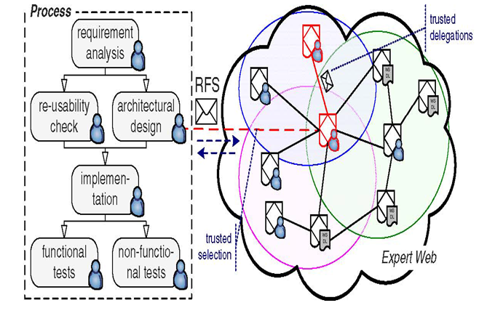
EXPERT WEB CONSTRUCTION
FIG.1 COURTESY : IEEE TRANSACTIONS ON SERVICES COMPUTING 2012

Slide 9
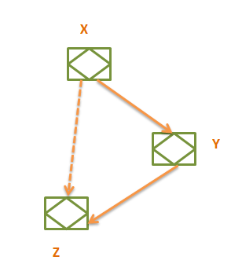
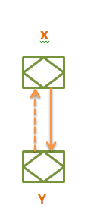
KNOWS OF RELATION
Fig.2 knows of relation
Fig.3 Triadic relation

Slide 10
HUBS AND AUTHORITIES
Hubs
Receive RFS
Delegate work to other experts
Authorities
Receivers of the delegated RFS
Notes:
ji

Slide 11
BASIC CONCEPTS IN
EXPERTS DISCOVERY
Who is the right expert
How queries processed
How RFS delegation takes place

Slide 12
OUTLINE DISCOVERY ALGORITHM
Input: Query context Q
Find expert matching demanded set of skills.
Calculate hub-expertise of expert in Q
a) Calculate hub score in Q
b) Calculate authority score in Q
Output: Ranked experts in Q

Slide 13
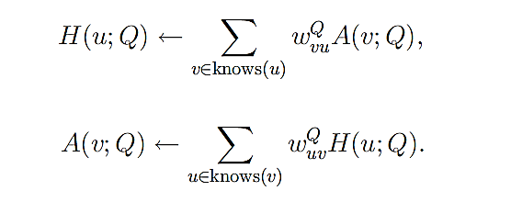
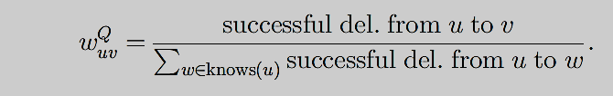
HUB SCORE AND AUTHORITY SCORE
Connection Strength

Slide 14
QUERY MATCHING
Query represent subset of the tree
Matching against user profiles
Finding best match

Slide 15
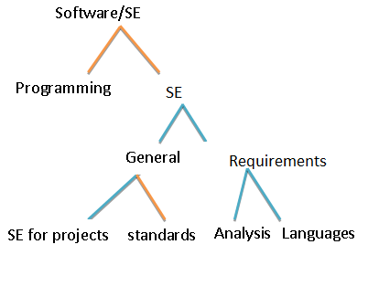
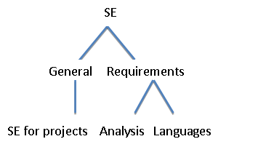
QUERY MATCHING TREE
Fig 4:Excerpt skill tree
Fig 5: Query specifying the demanded skills

Slide 16
STRONG AND WEAK PREFERENCES
Weak matching preferences
No similarities in skill properties
Strong matching preferences
Similarities in skill properties

Slide 17
TOPIC TREE MATCHING ALGORITHM
Input : Query Q with properties q_{p}
Step 1 : Get all e ϵ E , provide a match.
Step 2 : Find query root node
Step 3 : Find overlap of properties at level i
  Perform q_{p}(L_{i}) ∩ e_{p}(L_{i})
Output: Ranked experts.

Slide 18
ALGORITHM EXPLANATION
Use a metric
Calculate the overlap of two sets A and B
Define overlap similarity
Discover right expert

Slide 19
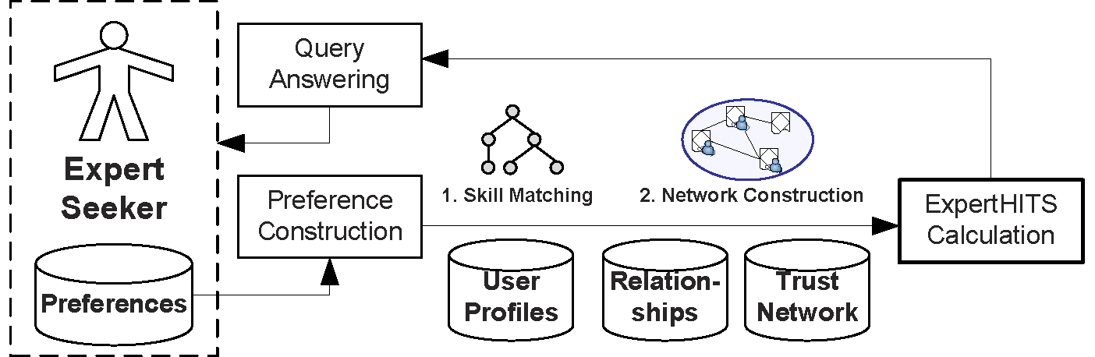
EXPERSHITS CALCULATION
FIG.6 COURTESY : IEEE TRANSACTIONS ON SERVICES COMPUTING 2012

Slide 20

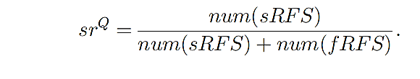
RESPONSE TIME AND EFFICIENCY
RESPONSE TIME
SUCCESS RATE

Slide 21
CONCLUSION
Right expert discovery
Flexibility
More efficiency

Slide 22
REFERENCES
D. Schall, H.-L. Truong, and S. Dustdar, “Unifying Human and Software Services in Web-Scale Collaborations,” IEEE Internet Computing,May/June 2008.
D. Schall, “Human Interactions in Mixed Systems—Architecture, Protocols, and Algorithms,” PhD dissertation, Vienna Univ. ofTechnology, 2009.

Slide 23
REFERENCES
P. Jurczyk and E. Agichtein, “Discovering Authorities in Question Answer Communities by Using Link Analysis,” Proc. 16th ACM Conf. Information and Knowledge Management (CIKM ’07), 2007.
D. Kovac and D. Trcek, “Qualitative Trust Modeling in SOA,” J. Systems Architecture, vol. 55, no. 4, pp. 255-263, 2009.

Slide 24
THANK YOU

Slide 25
QUESTIONS ?

