Slide 1
WELCOME

Slide 2
UNPRIVILEGED BLACK-BOX DETECTION OF USER-SPACE KEYLOGGERS
Topic Approval On:23/08/2013
Slide Approval On:09/09/2013
Topic And Slide Approved By:Mr. Aby Abahai T.
Sruthylal H
Roll no:61
S7R

Slide 3
CONTENTS
Unprivileged Black-Box Detection of User-Space Keyloggers
Introduction
Existing system
Proposed system
Architecture
Pattern generation algorithms
Analysis
Conclusion
References

Slide 4
INTRODUCTION
Unprivileged Black-Box Detection of User-Space Keyloggers
Keylogger
    Monitor user activity
User-space
    all user mode applications work
Black-box
    Based on behavioral characteristics

Slide 5
TYPES OF KEYLOGGERS
Unprivileged Black-Box Detection of User-Space Keyloggers
Hardware
Software
    Based on privilege
    Based on settings

Slide 6
TYPES OF KEYLOGGERS(Contd)
Unprivileged Black-Box Detection of User-Space Keyloggers
Based on privilege
    Kernel space keylogger
    User space keyloggers
Based on settings
    External keyloggers
    Hardware keyloggers
    Hypervisor-keyloggers

Slide 7
EXISTING SYSTEM
Unprivileged Black-Box Detection of User-Space Keyloggers
Using a system with proactive protection
Using a virtual keyboard

Slide 8
ADVANTAGES OF USER-SPACE KEYLOGGERS
Unprivileged Black-Box Detection of User-Space Keyloggers
Ease of implementation
Cross-version
Unprivileged installation
Unprivileged execution

Slide 9
PROPOSED SYSTEM
Unprivileged Black-Box Detection of User-Space Keyloggers
Unprivileged technique
Black-Box
Correlating the input with the output

Slide 10
ARCHITECTURE
Unprivileged Black-Box Detection of User-Space Keyloggers
Five components
Three domains
            OS domain
            Stream domain
            Pattern domain

Slide 11
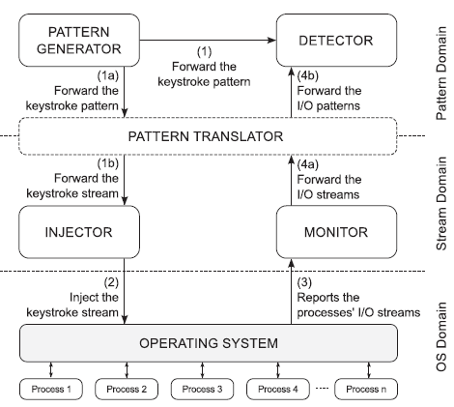
ARCHITECTURE(Contd)
Unprivileged Black-Box Detection of User-Space Keyloggers
FIG.1:Different component of architecture
COURTESY:IEEE TRANSACTIONS ON DEPENDABLE AND SECURE COMPUTING

Slide 12
INJECTOR
Unprivileged Black-Box Detection of User-Space Keyloggers
Inject a keystroke stream to simulate
Requirements
    Rely on unprivileged APIs
    Keystrokes at variable rate
    Resulting series should be the same

Slide 13
MONITOR
Unprivileged Black-Box Detection of User-Space Keyloggers
To record the output stream
Only unprivileged API calls
Performance counter per process win32_process
Total number of bytes WriteTransferCount
Queries information

Slide 14
PATTERN TRANSLATOR
Unprivileged Black-Box Detection of User-Space Keyloggers
Abstract keystroke patterns(AKP)
AKP into stream and vice versa
Average keystroke rate:
Ri=(Pi(Kmax-Kmin)+Kmin)/T
Sample pattern:
Pi=(Ri.T-Kmin)/(Kmax-Kmin)

Slide 15
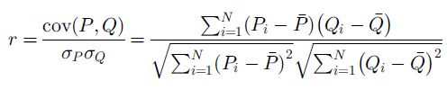
DETECTOR
Unprivileged Black-Box Detection of User-Space Keyloggers
To determine match in the patterns
Pearson product-moment correlation coefficient(PCC):
COURTESY:IEEE TRANSACTIONS ON DEPENDABLE AND SECURE COMPUTING

Slide 16

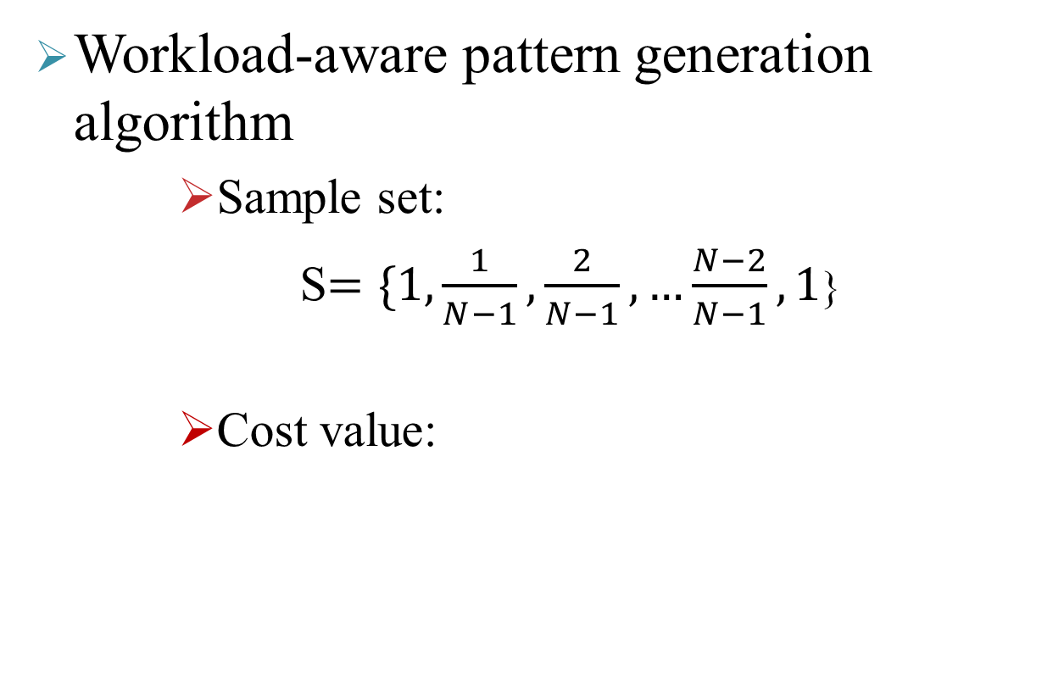
PATTERN GENERATION ALGORITHM
Unprivileged Black-Box Detection of User-Space Keyloggers
Workload-aware pattern generation algorithm
        Sample set:
    S$=\{1,\frac{1}{N−1},\frac{2}{N−1},…\frac{N−2}{N−1},1$}
        Cost value:
COURTESY:IEEE TRANSACTIONS ON DEPENDABLE AND SECURE COMPUTING

Slide 17
PATTERN GENERATION ALGORITHM (contd)
Unprivileged Black-Box Detection of User-Space Keyloggers
Workload agnostic pattern generation algorithm
    Random(RND)
    Random with fixed range(RFR)
    Impulse(IMP)
    Sine wave(SIN)
COURTESY:IEEE TRANSACTIONS ON DEPENDABLE AND SECURE COMPUTING

Slide 18
ANALYSIS OF MODERN KEYLOGGERS
Unprivileged Black-Box Detection of User-Space Keyloggers
Implemented in Windows and other OSes
Hook-based
All APIs are legitimate
All modern operating systems offer APIs

Slide 19
ANALYSIS(Contd)
Unprivileged Black-Box Detection of User-Space Keyloggers
TYPE | API | COMMENTS
Windows APIs
Type 1 | SetWindowsHookEx(WH_KEYBOARD_LL,…,0) GetAsyncKeyState() | The keylogging procedure is given as an argument Poll-based
Type 2 | SetWindowHookEx(WH_KEYBOARD,…,0) GetKeyboardState() GetKeyState() SetWindowLong(…,GWL_WNDPROC,…) Intercepting{Dispatch,Get,Translate}Message() | The keylogging procedure is given as an argument Poll-based Poll-based Overwrites the default procedure Manual instrumentation of Win32 APIs
Unix-like APIs
Type 1 | gdk_window_add_filter(NULL,…) Inb(0x60) XQueryKeymap() | The keylogging procedure is given as an argument GTK API Poll based and available only to the super user Poll-based.X11 API

Slide 20
ANALYSIS(Contd)
Unprivileged Black-Box Detection of User-Space Keyloggers
FIG.2:The delivery phases of a keystroke ,and the components potentially subverted
COURTESY:IEEE TRANSACTIONS ON DEPENDABLE AND SECURE COMPUTING

Slide 21
EVASION TECHNIQUES
Unprivileged Black-Box Detection of User-Space Keyloggers
Aggressive Buffering
Trigger-Based Behavior
Discriminatoin Attacks
Decorrelation Attacks

Slide 22
CONCLUSION
Unprivileged Black-Box Detection of User-Space Keyloggers
Accurate detection
Correlating input and output
Choosing best input pattern
Protection against the threat of keyloggers

Slide 23
REFERENCES
Unprivileged Black-Box Detection of User-Space Keyloggers
T. Holz, M. Engelberth, and F. Freiling, “Learning More About the Underground Economy: A Case-Study of Keyloggers and Dropzones,” Proc. 14th European Symp. Research in Computer Security, pp. 1-18, 2009
N. Grebennikov, “Keyloggers: How They Work and How to Detect Them,” http://www.viruslist.com/en/analysis?pubid=204791931, 2012

Slide 24
REFERENCES(Contd)
Unprivileged Black-Box Detection of User-Space Keyloggers
J. Benesty, J. Chen, and Y. Huang, “On the Importance of thePearson Correlation Coefficient in Noise Reduction,” IEEE Trans.Audio, Speech, and Language Processing, vol. 16, no. 4, pp. 757-765,May 2008
L. Goodwin and N. Leech, “Understanding Correlation: Factors that Affect the Size of r,” Experimental Education, vol. 74, no. 3,pp. 249-266, 2006

Slide 25
THANK YOU
Unprivileged Black-Box Detection of User-Space Keyloggers

Slide 26
QUESTIONS ?
Unprivileged Black-Box Detection of User-Space Keyloggers

