Slide 1
WELCOME

Slide 2
Hybrid aggregates: Combining SSDs and HDDs in a single storage pool
TOPIC APPROVAL:21/8/13
SLIDE APPROVAL:31/8/13
TOPIC AND SLIDE APPROVED
BY Ms.Jisha.P.Abreham
Sidharth m
S7R
Roll.no 58
Dept.of CS MACE

Slide 3
Contents
Introduction
Existing system
Proposed System
Concepts
Performance
Conclusion

Slide 4
Introduction
Why SSD?
High input-output rate
Low intial access time.
Disadvantages
Cost per capacity is high

Slide 5
Existing System
No distinction between SSD and HDD
Sometimes data in SSD will be idle

Slide 6
Proposed System
OS recognises SSD from HDD
SSD capacity will be less
Frequently accessed data in SSD

Slide 7
The Prototype
    Tested on DataONTAP os
    The file system used was WAFL

Slide 8
Concepts
  SSD and HDD are in different RAID arrays
    RAID topology maps
  Special Disk RPM
    RAID codes were modified

Slide 9
Design choices
  Use existing system as much as possible
  Avoid changes to on-disk structures
  Wide spectrum of SSD to HDD capacities
  Permit flexible policies for data placement

Slide 10
Mechanisms
Data migration to SSD
Modified write allocator
WAR
Data eviction from SSD
WAR
Sequential cleaning

Slide 11
Modified write allocator
For sequentiality
Requests for a bucket of blocks

Slide 12
Write After read
Migrate data during read
Dirty bit
After each consistency points

Slide 13
Segment Cleaning
Used for cold data
Works at block level
Triggered by capacity utilization

Slide 14
Policies used
Metadata in SSD
Hot,random-read detection
Tiering via run-length
Capacity based data eviction
All the policies present single system
At time only one policy is active

Slide 15
Metadata in SSD
All metadata in SSD
Extremely simple
Extra capacity unused
Basis for all other policies

Slide 16
Hot,Random-read detection
For frequent random reads
‘Spectral Bloom filters’

Slide 17
Spectral Bloom filters
Extension of bloom filters
with n bits
Probabilistic Data structure
Value is incremented on each access
decremented periodically

Slide 18
Tiering via run-length
  metadata in SSD
  Remaining for regular data
  Short span requests

Slide 19
Capacity Based Data Eviction
Targetting specific capacity utilization
Triggers segment cleaning
Segment cleaning is increased at 85%

Slide 20
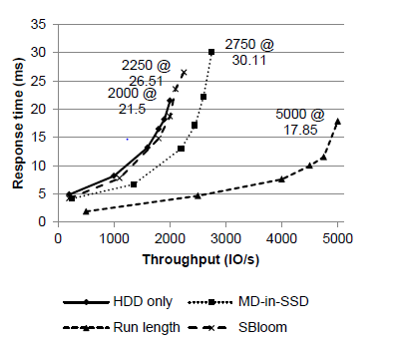
Evaluation
Fig 1:performance evaluation of the system
Courtesy:operating systems review-acm special interest group
Hybrid aggregates:combining SSD and HDD into single storage pool

Slide 21
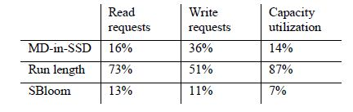
Hybrid aggregates:combining SSD and HDD into single storage pool
Capacity utilization
Table1:capacity utilization
The run length policy has better capacity utilization

Slide 22
Hybrid aggregates:combining SSD and HDD into single storage pool
Conclusion
Increase the cost effectiveness
Run-length policy shows better performance
For very small SSD MD-SSD is good
The changes required was not much

Slide 23
Hybrid aggregates:combining SSD and HDD into single storage pool
References
Burton H. Bloom. Space/time trade-offs in hash coding with allowable errors. Communications of the ACM, 130 (7):0 422-426, July 1988. ISSN 0001-0782. 10.1145/362686.362692.
Saar Cohen and Yossi Matias. Spectral bloom filters. In International Conference on Management of Data (SIGMOD), pages 241-252. ACM Press, 2003. ISBN 1-58113-634-X. 10.1145/872757.872787.

Slide 24
Dushyanth Narayanan, Eno Thereska, Austin Donnelly, Sameh Elnikety, and Antony Rowstron. Migrating server storage to SSDs: Analysis of tradeoffs. In European Systems Conference (EuroSys), pages 145-158. ACM Press, 2009. ISBN 978-1-60558-482-9. 10.1145/1519065.1519081.
NetAPPs website
www.netapps.com

Slide 25
Hybrid aggregates:combining SSD and HDD into single storage pool
THANK YOU

Slide 26
Hybrid aggregates:combining SSD and HDD into single storage pool
QUESTIONS???

