Slide 1
WELCOME

Slide 2
Multisource Video On-Demand Streaming in Wireless Mesh Networks
Title approval :12/09/13
Slide approval :08/10/13
Approval by :
Mrs. Jisha P Abraham
Miss Deepthi Vargheese
RONY JOSEPH
S7R
Roll no. 48

Slide 3
Contents
    Introduction
    Existing System
    Limitation of Existing System
    Proposed System
    Concepts
    Implementation
    Conclusion

Slide 4
Multisource Video On Demand Streaming In wireless Mesh Networks
Introduction
Video usage in internet
Increased streaming
Video streaming
    Live streaming
    On demand streaming

Slide 5
Multisource Video On Demand Streaming In wireless Mesh Networks
Directory caches without tracking non-coherent memory blocks
Introduction (Contd..)
    Video on Demand systems (VoD)
    Multisource streaming
    Wireless mesh networks

Slide 6
Multisource Video On Demand Streaming In wireless Mesh Networks
Directory caches without tracking non-coherent memory blocks
Existing System
    Wired System
        Multipath,
        Multisource VoD
        Great success

Slide 7
Multisource Video On Demand Streaming In wireless Mesh Networks
Multisource VoD
Popular internet service
Stream from peer and server
Peer-Peer technology
    Eg:- PPLive, PPStream
Buffer from peer

Slide 8



Multisource Video On Demand Streaming In wireless Mesh Networks
Multisource VoD-Example
Media server
Courtesy:-IEEE, Multisource streaming, 2012
User

Slide 9
Multisource Video On Demand Streaming In wireless Mesh Networks
Limitation
Wireless Interference
High bit error rate
Network Delay

Slide 10
Multisource Video On Demand Streaming In wireless Mesh Networks
Wireless Interference
Surrounding Interacts
    Block, noise, echoes
Same frequency devices clash

Slide 11
Multisource Video On Demand Streaming In wireless Mesh Networks
Directory caches without tracking non-coherent memory blocks
Proposed System
    Two Heuristics Algorithms
        Select Multiple paths
    Joint Routing-Rate Allocation Algorithms
        Consider wireless interference

Slide 12
Multisource Video On Demand Streaming In wireless Mesh Networks
Directory caches without tracking non-coherent memory blocks
Basic Concepts
    Wireless Mesh Networks
    Weighted Cumulative Expected Transition
    Time (WCETT)

Slide 13
Multisource Video On Demand Streaming In wireless Mesh Networks
Wireless Mesh networks (WMN)
Works in Mesh topology
Portable, easy installation
WMN
    Mesh node, Mesh Client, Gateway
Data routing

Slide 14
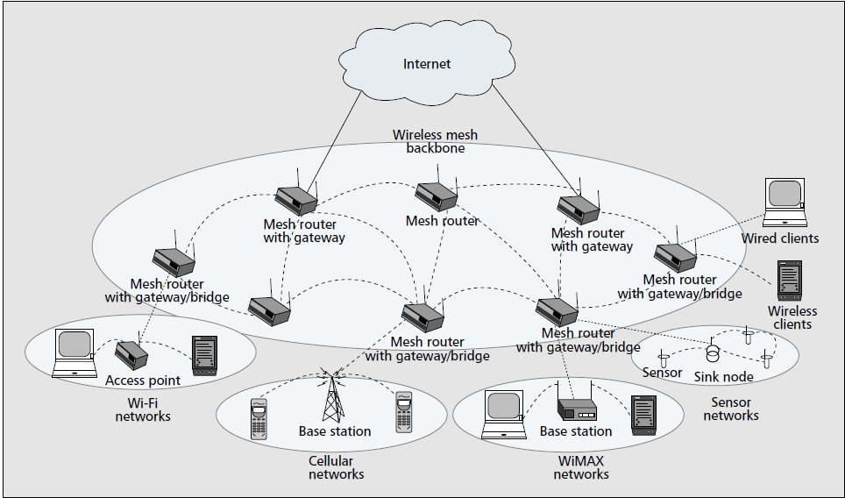
Multisource Video On Demand Streaming In wireless Mesh Networks
Wireless Mesh networks (Contd..)
Courtesy:- IEEE, VoD streaming in wireless networks

Slide 15
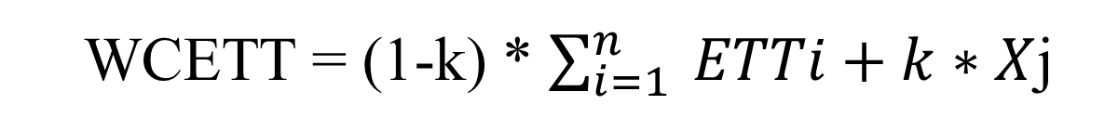
Multisource Video On Demand Streaming In wireless Mesh Networks
WCETT
Popular metric in wireless networks
Calculate efficiency
WCETT = (1-k) * $\sum_{i=1}^{n}{ ETTi+k∗X}$j

Slide 16
Multisource Video On Demand Streaming In wireless Mesh Networks
Directory caches without tracking non-coherent memory blocks
Heuristic Algorithm
Iterative Path Discovery Algorithm (IPD)
    Path in iteration
Parallel Path Discovery Algorithm (PPD)
    Complete path

Slide 17
Multisource Video On Demand Streaming In wireless Mesh Networks
Directory caches without tracking non-coherent memory blocks
Iterative Path Discovery Algorithm
T(V,E)- current vertices and edges of network topology
S - set of all senders
T’(V,E’)=T(V,E), S’=S
2. l(e)=0
3. Select all the paths to P which satisfies
WCETT(p)<= ¥ * Wᵀ(s, r)
4. Minimum interference path is selected
P*

Slide 18
IPD (Contd…)
Set of paths in P* is decremented from T’
Repeat until P is empty

Slide 19
Multisource Video On Demand Streaming In wireless Mesh Networks
Directory caches without tracking non-coherent memory blocks
Parallel Path Discovery Algorithm
Similar to IPD
Select the path using Breadth First Search
For High streaming quality

Slide 20
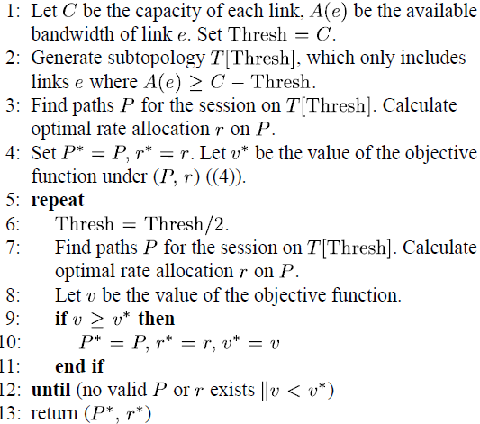
Multisource Video On Demand Streaming In wireless Mesh Networks
Joint Routing and Rate Allocation Algorithm

Slide 21
EXAMPLE
{V1,V4,S}
{V2,V4,S}
{V3,S}
{V4,S}
{V5,S}
V1
V2
V4
V3
V5
S

Slide 22
Multisource Video On Demand Streaming In wireless Mesh Networks
IMPLEMENTATION
Multiple path in IPD and PPD
  IPD- fast, PPD- Better streaming
Balance video stream
JRA reduces network congestion
Optimize Vod requests

Slide 23
Multisource Video On Demand Streaming In wireless Mesh Networks
Directory caches without tracking non-coherent memory blocks
Conclusion
    Optimize existing VoD requests
    Allow more requests
    Increased video quality
    Minimized congestion

Slide 24
Multisource Video On Demand Streaming In wireless Mesh Networks
Directory caches without tracking non-coherent memory blocks
References
1. D. A. Tran, K. A. Hua, and T. T. Do, “A peer-to-peer architecture for
media streaming,” IEEE J. Sel. Areas Commun., vol. 22, no. 1, pp.
121–133, Jan. 2004.
2. I. F. Akyildiz, X. Wang, and W. Wang, “Wireless mesh networks: A
survey,” Comput. Netw., vol. 47, no. 4, pp. 445–487, 2005.

Slide 25
Directory caches without tracking non-coherent memory blocks
3. M. R. Pearlman, Z. J. Haas, P. Sholander, and S. S. Tabrizi, “On the
impact of alternate path routing for load balancing in mobile ad hoc
networks,” in Proc. ACM MobiHoc, 2000, pp. 3–10.
4. S. J. Lee and M. Gerla, “Split multipath routing with maximally disjoint paths in ad hoc networks,” in Proc. IEEE ICC, 2001, vol. 10, pp.
3201–3205.

Slide 26
Directory caches without tracking non-coherent memory blocks
5. M. Marina and S. Das, “On-demand multipath distance vector routing
in ad hoc networks,” in Proc. IEEE ICNP, 2001, pp. 14–23.
6. D. B. Johnson and D. A. Maltz, “Dynamic source routing in ad hoc
wireless networks,” in Proc. Mobile Comput., 1996, pp. 153–181

Slide 27
QUERIES….?

Slide 28
THANK YOU…

