Slide 1
WELCOME

Slide 2
Hashing Based Fast Palmprint Identification for Large-Scale Databases
Topic Approval:22-7-2013
Slide Approval:2-8-2013
Topic And Slides Approved By:
Ms.Jisha P Abraham
Richa Kuriakose
Roll No:47
S7R

Slide 3
Contents
Hashing Based Fast Palmprint Identification for Large-Scale Databases
Introduction
Existing system
Issues
Proposed system
Conclusion
References

Slide 4
Introduction
Hashing Based Fast Palmprint Identification for Large-Scale Databases
Biometric technology
Hashing
High speedup

Slide 5
Existing system
Hashing Based Fast Palmprint Identification for Large-Scale Databases
Brute-force search
  first(P)
  next(P,c)
  valid(P,c)
  output(P,c)
Hierarchial matching approach

Slide 6
Issues
Hashing Based Fast Palmprint Identification for Large-Scale Databases
Low Speedup
Image quality
Accuracy – 1/size of database
  false rejection rate
  false acceptance rate

Slide 7
Proposed system
Hashing Based Fast Palmprint Identification for Large-Scale Databases
Hash function properties:-
  Discriminant – Imposter collisions
  Consistent – Genuine collisions(GC)
  Random – make partitions

Slide 8
Orientation Pattern(OP) hashing
Hashing Based Fast Palmprint Identification for Large-Scale Databases
    Extraction
    competitive code method
    Preprocessing
    Build hash, offset &size tables
    Searching
    Check collisions

Slide 9
Competitive Code(CC) Method
Hashing Based Fast Palmprint Identification for Large-Scale Databases
6 Gabor filters
θ_{k} = k/6
3-bit code

Slide 10
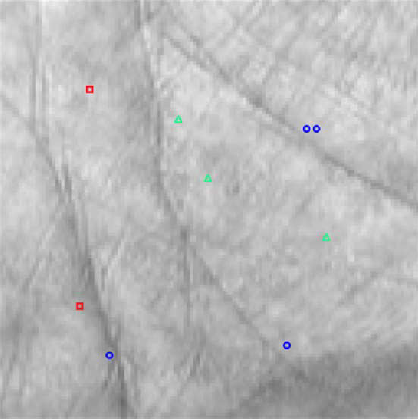
Orientation Pattern
Hashing Based Fast Palmprint Identification for Large-Scale Databases
OP 1(K=2)
P={100,803}
V={3,6}
OP 2(K=3)
P={205,400,604}
V={1,3,2}
P={250,251,952,966}
V={6,5,4,4}
OP 3(K=4)
Courtesy:IEEE,Trans.Inf.Forensics Security

Slide 11
OP construction
Hashing Based Fast Palmprint Identification for Large-Scale Databases
s=D/K;
P={p₁ ,p₁ +s,…, p₁ +(K-1)*s}
V={of}

Slide 12
PREPROCESSING
Hashing Based Fast Palmprint Identification for Large-Scale Databases
Input: All CCs in the database
initialize S=0
initialize O=1
take CC
identify bin numbers
insert into bin
update S and O
Output: Hash(H), size(S) & offset(O) tables

Slide 13

Illustration
Hashing Based Fast Palmprint Identification for Large-Scale Databases
(1) … (6)
O =1 O =8120
S =1749 S =1548
. S[1][1]=1749
Offset table O [1024]
Size table

Slide 14
SEARCHING
Hashing Based Fast Palmprint Identification for Large-Scale Databases
Checking Collisions
initialize collision indicators(ci)=FALSE
compute OP
until size of OP do
calculate distance
if distance=0 then
ci=TRUE
update counter(c) of collisions

Slide 15
SEARCHING
Hashing Based Fast Palmprint Identification for Large-Scale Databases
if distance !=0
compare distances
choose least distance
others discarded
end

Slide 16
Illustration
Hashing Based Fast Palmprint Identification for Large-Scale Databases
Query:
P={34,23,40} V={3,2,4}
Database:
1) P₁ ={45,67,24} V₁={3,4,6}
2) P₂={30,23,41} V₂={3,2,4}
P~P₂ > P~P₁

Slide 17
Principal OP hashing
Hashing Based Fast Palmprint Identification for Large-Scale Databases
  Principal lines
  Minimum response time(RT)
  Less OF & high GC

Slide 18
Stages of POP
Hashing Based Fast Palmprint Identification for Large-Scale Databases
Extraction
  OF+RT
  Ofs sorted
POP construction
  s=L/K where L=D/10(set value)

Slide 19
Conclusion
Hashing Based Fast Palmprint Identification for Large-Scale Databases
10 times faster
POP faster than OP
Accuracy of POP>OP=Brute-force
Image quality

Slide 20
References
Hashing Based Fast Palmprint Identification for Large-Scale Databases
D.Zhang,W.Kong,J.You and M.Wong, “On-line palmprint identification”,IEEE Trans. Pattern Anal. Mach. Intell.,vol. 25,no. 9,pp. 1024-1050,Sep. 2003.
M. Baveja,H. Yuan,and L.Wein, “Asymptotic biometric analysis for large gallery sizes”,IEEE Trans. Inf. Forensics Security,vol.5,no. 4,pp. 955-964,
Dec. 2010.

Slide 21
References
Hashing Based Fast Palmprint Identification for Large-Scale Databases
A.Gyaourova and A.Ross, “Index codes for multibiometric pattern retrieval”, IEEE Trans. Inf. Forensics Security,vol. 7,no. 2,pp.518-529,Apr. 2012.
J.You,W. Li, and D.Zhang and K. Cheung, “On hierarchical palmprint coding with multiple features for personal identification in large databases”,IEEE Trans. Circuit Syst. Video Technol.,vol. 14,no. 2,pp. 234-243, Feb. 2004.

Slide 22
References
Hashing Based Fast Palmprint Identification for Large-Scale Databases
W. Li,J.You and D.Zhang, “Texture-based palmprint retrieval using a layered search scheme for personal identification”,IEEE Trans.Multimedia,vol. 7.no. 5,pp. 891-898,Oct. 2005.
A. K. Jain,A. Ross and S. Prabhakar, “An introduction to biometric recognition”,IEEE Trans.Circuits Syst. Video Technol.,vol.14,no. 1,pp. 4-20,Jan. 2004.

Slide 23
Hashing Based Fast Palmprint Identification for Large-Scale Databases
THANK YOU

Slide 24
Hashing Based Fast Palmprint Identification for Large-Scale Databases
QUESTIONS?

