Slide 1
WELCOME
FAIR TORRENT: A DEFICIT BASED ALGORITHM TO ENSURE FAIRNESS IN P2P SYSTEMS

Slide 2
Fair Torrent:
A Distributed Algorithm to Ensure Fairness in P2P Systems
FAIR TORRENT: A DEFICIT BASED ALGORITHM TO ENSURE FAIRNESS IN P2P SYSTEMS
Topic approval : 17/7/2013
Topic and slide approved by :
Mrs Jisha P Abraham
By
Shabin Muhammed
Roll No:55, S7R

Slide 3
CONTENTS
FAIR TORRENT: A DEFICIT BASED ALGORITHM TO ENSURE FAIRNESS IN P2P SYSTEMS
Introduction
P2P systems
Challenges
FairTorrent Algorithm
Conclusion
References

Slide 4
INTRODUCTION
FAIR TORRENT: A DEFICIT BASED ALGORITHM TO ENSURE FAIRNESS IN P2P SYSTEMS
Peer-to-Peer system
Computer network
Similar computation power
Decentralised

Slide 5
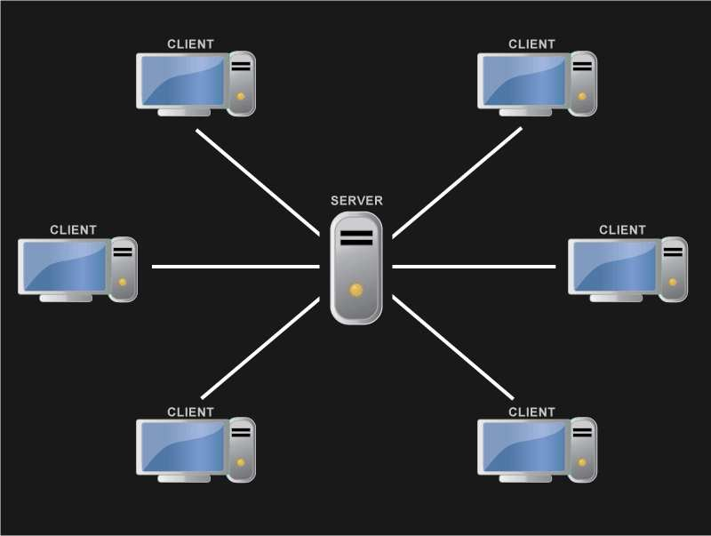
Conventional download
FAIR TORRENT: A DEFICIT BASED ALGORITHM TO ENSURE FAIRNESS IN P2P SYSTEMS
Central server
Usage of b/w
Slower

Slide 6
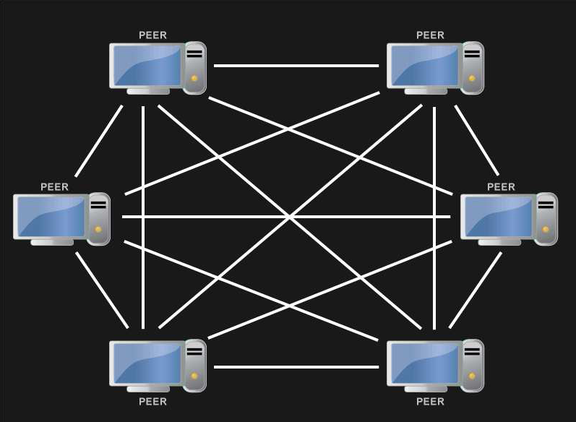
P2p File sharing
FAIR TORRENT: A DEFICIT BASED ALGORITHM TO ENSURE FAIRNESS IN P2P SYSTEMS
No central server
Harness upload
bandwidth
BitTorrent
protocol

Slide 7
terminologies
FAIR TORRENT: A DEFICIT BASED ALGORITHM TO ENSURE FAIRNESS IN P2P SYSTEMS
Tracker
Seeds
Leechers
File swarm
Tracker
Leecher A
Seeder A
Leecher B
Seeder B

Slide 8
A trivial example
FAIR TORRENT: A DEFICIT BASED ALGORITHM TO ENSURE FAIRNESS IN P2P SYSTEMS
{1,2,3,4,5,6,7,8,9,10}
Seeder:
John
{}
{1,2,3}
{1,2,3,5}
{}
{1,2,3}
{1,2,3,4}
{1,2,3,4,5}
Downloader
Joe
Downloader
Fan Bin

Slide 9
challenges
FAIR TORRENT: A DEFICIT BASED ALGORITHM TO ENSURE FAIRNESS IN P2P SYSTEMS
Free Riders and Low-Contributing peers
Dishonest peers
Problem of unfairness

Slide 10
EXISTING Algorithms
FAIR TORRENT: A DEFICIT BASED ALGORITHM TO ENSURE FAIRNESS IN P2P SYSTEMS
BitTorrent – Tit for Tat (TFT)
BitTyrant – Block-based TFT
PropShare – Proportional Response algorithm.

Slide 11
COMMON FLAWS
FAIR TORRENT: A DEFICIT BASED ALGORITHM TO ENSURE FAIRNESS IN P2P SYSTEMS
Rate based
Require long rounds
Optimistic unchocking
Assume previous B/W reciprocation

Slide 12
FAIR TORRENT
FAIR TORRENT: A DEFICIT BASED ALGORITHM TO ENSURE FAIRNESS IN P2P SYSTEMS
Deficit-based
No rounds
No random allocations

Slide 13
Data structures
FAIR TORRENT: A DEFICIT BASED ALGORITHM TO ENSURE FAIRNESS IN P2P SYSTEMS
Deficit counter
Sorted peer list
Data_block

Slide 14
FAIR TORRENT ALGORITHM
FAIR TORRENT: A DEFICIT BASED ALGORITHM TO ENSURE FAIRNESS IN P2P SYSTEMS
Procedure 1:RECVBLOCK(peer j, data_blk P)
if isLeecher(j) and Valid_blk(p) then
Recvij = Recvij + size(p);
DFij = DFij – Size(p);
SortedPeerList.ReInsert(j);
end if

Slide 15
FAIR TORRENT ALGORITHM(contd)
FAIR TORRENT: A DEFICIT BASED ALGORITHM TO ENSURE FAIRNESS IN P2P SYSTEMS
Procedure 2: SENDBLOCK(allowed_bytes B)
n =0; sz=Size(SortedPeerList);
while(B>0)and (n<sz) do
j = SortedPeerList[n];
while !(HPRF(j) and CWT(j))
n = n+1; j = SortedPeerList[n];
end while
if (n < sz) then
use_bytes= max(B,BytesToSend(j));

Slide 16
FAIR TORRENT ALGORITHM(contd)
FAIR TORRENT: A DEFICIT BASED ALGORITHM TO ENSURE FAIRNESS IN P2P SYSTEMS
bytes_written=Send(j,use_bytes)
B = B - bytes_written;
if BytesToSend(j) == 0 then
Sentij= Sentij+block_size;
DFij = DFij + block_size;
SortedPeerList.ReInsert(j);
end if
n = n + 1;
end if
end while

Slide 17
FAIR TORRENT PROPERTIES
FAIR TORRENT: A DEFICIT BASED ALGORITHM TO ENSURE FAIRNESS IN P2P SYSTEMS
Seed Behavior
Leecher Behavior
Rate convergence
Data availability

Slide 18
TESTING
FAIR TORRENT: A DEFICIT BASED ALGORITHM TO ENSURE FAIRNESS IN P2P SYSTEMS
Compared against 4 other implementation:
BitTorrent Python client
Vuze Java BitTorrent client
PropShare client
BitTyrant client.

Slide 19
Test Parameters
FAIR TORRENT: A DEFICIT BASED ALGORITHM TO ENSURE FAIRNESS IN P2P SYSTEMS
Distribution
50 leecher
10 seeds
Upload capacity 50kB/s
Download capacity 100kB/s
32MB file

Slide 20
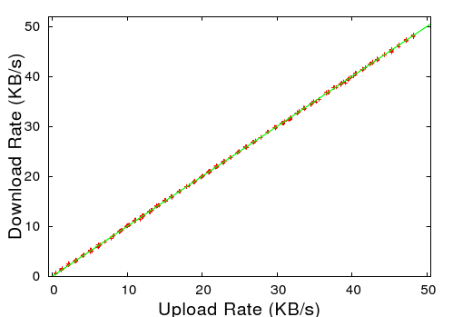
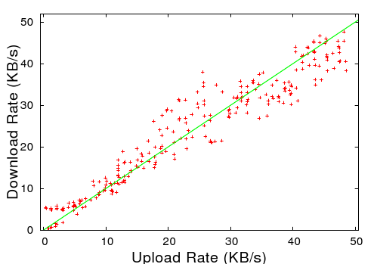
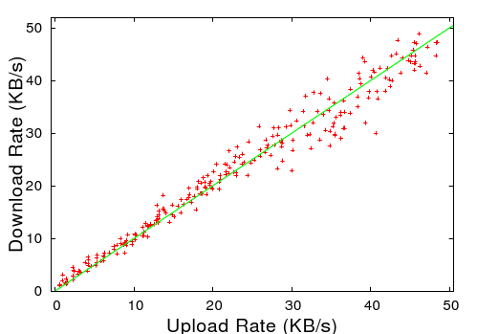
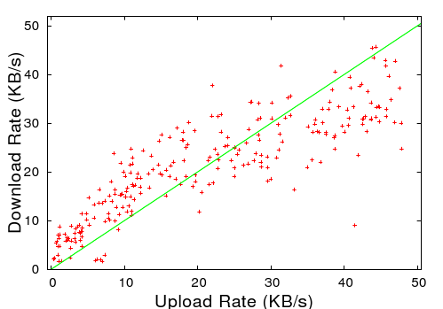
Test results
FAIR TORRENT: A DEFICIT BASED ALGORITHM TO ENSURE FAIRNESS IN P2P SYSTEMS
FairTorrent
BitTorrent
Vuze
BitTyrant

Slide 21
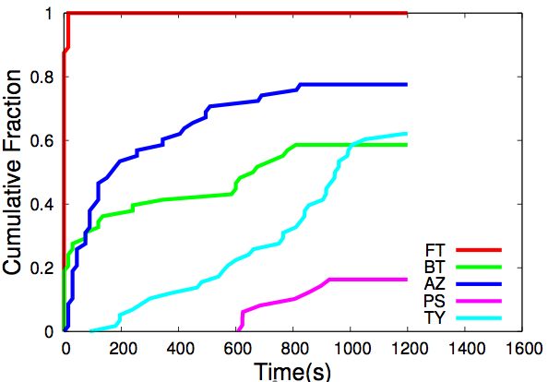
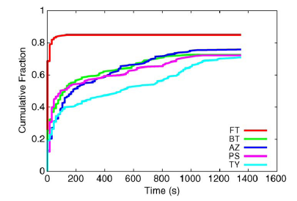
Rate Convergence
FAIR TORRENT: A DEFICIT BASED ALGORITHM TO ENSURE FAIRNESS IN P2P SYSTEMS
Fig: Rate convergence for all
Peers including free riders.
Fig :High uploaders’ rate convergence.

Slide 22
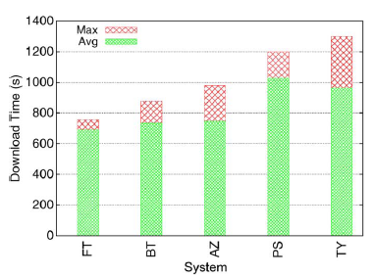
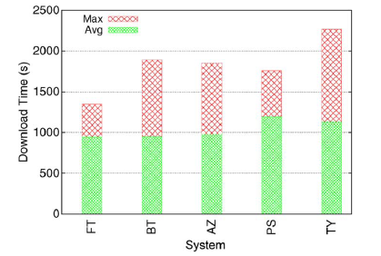
Download time
FAIR TORRENT: A DEFICIT BASED ALGORITHM TO ENSURE FAIRNESS IN P2P SYSTEMS
High uploaders’ download time.
Download time of all leechers.

Slide 23
Conclusions
FAIR TORRENT: A DEFICIT BASED ALGORITHM TO ENSURE FAIRNESS IN P2P SYSTEMS
Near optimal fairness
Faster rate-convergence
Resilient to strategic peers
Least download time

Slide 24
REFERENCES
FAIR TORRENT: A DEFICIT BASED ALGORITHM TO ENSURE FAIRNESS IN P2P SYSTEMS
[1] Alex Sherman, Jason Nieh, and Clifford Stein “ FairTorrent: A Deficit-Based DistriButed Algorithm to Ensure Fairness in Peer-to-Peer ystems”IEEE/ACM TRANSACTIONS ON NETWORKING, VOL. 20, NO. 5, OCTOBER 2012
[2] A. Bharambe, C. Herley, and V. Padmanabhan, “Analyzing andimproving a BitTorrent networks performance mechanisms,” in Proc.25th IEEE INFOCOM, Apr. 2006, pp. 1–12.
[3] B. Fan, D. Chiu, and J. Lui, “The delicate tradeoffs in BitTorrent-like file sharing protocol design,” in Proc. 14th IEEE ICNP, Nov. 2006, pp.239–248.

Slide 25
REFERENCES(CONTD)
FAIR TORRENT: A DEFICIT BASED ALGORITHM TO ENSURE FAIRNESS IN P2P SYSTEMS
[4] K Berer and Z Despotovic, “Managing trust in P2P” information system in PROC ACM CIKM, Nov,2001, pp..310-317
[5] A. Bharambe, C Herley and V Padmanabhan, “Analysing and improving BitTorrent perfomance mechanism” in Proc 25th IEEE INFOCOM ,Apr, 2006 pp.. 1-12
[6] B. Cohen, “Incentive build robustness in BitTorrent” in Proc. 14th IEEE ICNP, Nov. 2006, pp.239–248.
[7] F Conrnelli, E Damiani, S D C di Vermcati, S Prabhoschi, and P Samarati “Choosing Reputable servents in P2P networks”

Slide 26
THANK YOU
FAIR TORRENT: A DEFICIT BASED ALGORITHM TO ENSURE FAIRNESS IN P2P SYSTEMS

Slide 27
QUESTIONS?
FAIR TORRENT: A DEFICIT BASED ALGORITHM TO ENSURE FAIRNESS IN P2P SYSTEMS

Slide 28
TeSTING(CONTD)
Four sets of experiments:
Clients with upload capacities across a uniform distribution
A high-contributing peer participating in a swarm with low contributors and free-riders
Clients leave networks upon completion.
Live BitTorrent swarms.

