Slide 1
WELCOME

Slide 2
ACCELERATION OF XML PARSING THROUGH PREFETCHING
Topic Approval On:02/9/2013
Slide Approval On:08/10/2013
Topic &Slide Approved By :Jisha P Abraham
Rasitha A K
Roll no:45
S7R

Slide 3
CONTENTS
Acceleration of XML Parsing Through Prefetching
Introduction
Current system
Proposed system
Prefetching Techniques
Overview of Hardware Prefetcher
Architecture of Hardware Prefetcher
Conclusion
References

Slide 4
INTRODUCTION
Acceleration of XML Parsing Through Prefetching
Extensible Markup Language (XML)
XML parsing
Caurtesy IEEE TRANSACTIONS ON COMPUTERS

Slide 5
INTRODUCTION (Cont..)
Acceleration of XML Parsing Through Prefetching
Parsing models
    Event-driven parser
      Eg. Simple API (Application Program Interface) for XML(SAX)
    Tree-based parser
      Eg. Document Object Model (DOM)
Dept of computer science, MACE Kothamangalam
Notes:
5

Slide 6
INTRODUCTION (Cont..)
Acceleration of XML Parsing Through Prefetching
Problem
  Parsing is an important step
  Both memory and computation intensive
  Memory access takes 30% of execution time
  Need to alleviate effect of long latency
Dept of computer science, MACE Kothamangalam
Notes:
6

Slide 7
CURRENT SYSTEM
Acceleration of XML Parsing Through Prefetching
Computational-side accelerators
  Accelerate computation of XML parsing
  Specialized instruction
Depending on parsing models

Slide 8
PROPOSED SYSTEM
Acceleration of XML Parsing Through Prefetching
Memory-side acceleration
Parsing Core
Consists of
  Computation accelerator
  Prefetcher
Act as Data Exchange Front-end (DEF)

Slide 9
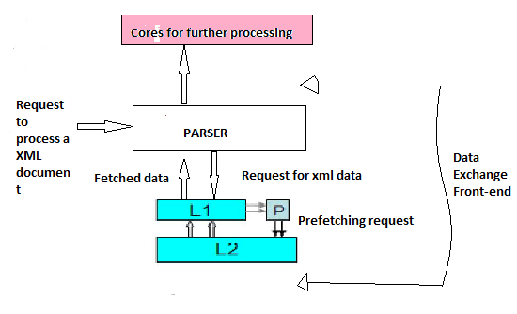
XML PARSING CORE OVERVIEW
Acceleration of XML Parsing Through Prefetching
Fig:XML parsing core which parse XML data and passing output to other core for further processing
Dept of computer science, MACE Kothamangalam

Slide 10
PREFETCHING TECHNIQUES
Acceleration of XML Parsing Through Prefetching
Two types of Prefetching
  Software prefetching
    Requires instruction
    Bring data at specified memory addresses into the cache
    Assisted by compiler algorithms to insert prefetching instructions in source code
Dept of computer science, MACE Kothamangalam

Slide 11
Acceleration of XML Parsing Through Prefetching
PREFETCHING TECHNIQUES (contd..)
Hardware Prefetching
  Frees the compiler from inserting the instructions
  Automatically determines the data access
  Decision based on recorded history information
  Adapt to phase changes in applications
  Revision of source code is not required
Dept of computer science, MACE Kothamangalam

Slide 12
Acceleration of XML Parsing Through Prefetching
PREFETCHING TECHNIQUES (contd..)
Prefetching algorithms
  Sequential prefetching
    Fit for programs with consecutive memory locations
  Stride prefetching
    Issues a request for addresses a+s (s is associated stride)
Dept of computer science, MACE Kothamangalam

Slide 13
Acceleration of XML Parsing Through Prefetching
PREFETCHING TECHNIQUES (contd..)
Correlating prefetching
  Predicts future addresses from tables that record the past memory program behavior
  Large tables are needed to record enough information
  Good prefetch result
Dept of computer science, MACE Kothamangalam

Slide 14
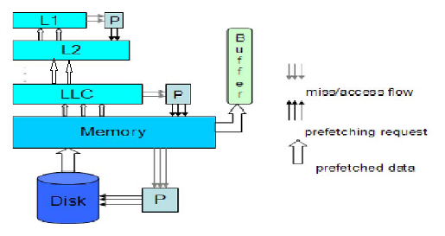
OVERVIEW OF HARDWARE PREFETCHER
Acceleration of XML Parsing Through Prefetching
Courtesy IEEE TRANSACTIONS ON COMPUTERS
Fig: System Integration of Hardware Prefetcher
Dept of computer science, MACE Kothamangalam

Slide 15
OVERVIEW OF HARDWARE PREFETCHER (Contd..)
Acceleration of XML Parsing Through Prefetching
Consists of
  L1 Cache
  L2 Cache
  Last-Level Cache (LLC)
  Prefetcher
  Buffer
Dept of computer science, MACE Kothamangalam

Slide 16
ARCHITECTURE OF HARDWARE PREFETCHER
Acceleration of XML Parsing Through Prefetching
Courtesy IEEE TRANSACTIONS ON COMPUTERS
Fig: Architecture of a Generic Prefetcher
Dept of computer science, MACE Kothamangalam

Slide 17
ARCHITECTURE OF HARDWARE PREFETCHER (Contd..)
Acceleration of XML Parsing Through Prefetching
Components are
  History Recorder
  Prefetching Engine (PE)
    Aggressiveness module
    Confidence module
  Request Filter
Dept of computer science, MACE Kothamangalam

Slide 18
IMPLIMENTATION FEASIBILITY
Acceleration of XML Parsing Through Prefetching
Hardware Cost
  No significant amount of hardware cost
Energy Consumption
  Additional dynamic Energy
  Reduction of Static Energy
Dept of computer science, MACE Kothamangalam

Slide 19
BENEFITS
Acceleration of XML Parsing Through Prefetching
Avoid unwanted data pollutions
Effectively feeding the data to computational accelerator
Accelerate the parsing process
Increases processor efficiency
Energy Efficient
Dept of computer science, MACE Kothamangalam

Slide 20
CONCLUSION
Acceleration of XML Parsing Through Prefetching
Goal is develop a parsing core
Reduce the processing time
Reduce Cache Misses
Improved Performance of XML Data processing
Effective and Efficient
Dept of computer science, MACE Kothamangalam

Slide 21
REFFERENCES
Acceleration of XML Parsing Through Prefetching
K. Chiu, M. Govindaraju, and R. Bramley, “Investigating theLimits of Soap Performance for Scientific Computing,” Proc.IEEE 11th Int’l Symp. High Performance Distributed Computing(HPDC-11), 2002.
M.R. Head, M. Govindaraju, R. van Engelen, and W. Zhang, “GridScheduling and Protocols—Benchmarking xml Processors for
P. Apparao et al., “Architectural Characterization of an XMLCentricCommercial Server Workload,” Proc. 33rd Int’l Conf.Parallel Processing, 2004.
Dept of computer science, MACE Kothamangalam

Slide 22
REFFERENCES (Contd..)
Acceleration of XML Parsing Through Prefetching
P. Apparao and M. Bhat, “A Detailed Look at the Characteristicsof xml Parsing,” Proc. First Workshop Building Block EngineArchitectures for Computers and Networks (BEACON ’04), 2004.
M. Nicola and J. John, “XML Parsing: A Threat to DatabasePerformance,” Proc. 12th Int’l Conf. Information and KnowledgeManagement, 2003.
Int’l HapMap Project: http://hapmap.ncbi.nlm.nih.gov/, 2013.
SAX Parsing Model: http://sax.sourceforge.net, 2013.
Dept of computer science, MACE Kothamangalam

Slide 23
THANK YOU
Efficient and effective Duplicate Detection In Hierarchical Data

Slide 24

Efficient and effective Duplicate Detection In Hierarchical Data
QUESTIONS ?

