Slide 1
WELCOME

Slide 2
Optimizing Nonindexed Join Processing on Flash Storage-based Systems
Topic Approval:26-8-2013
Slide Approval: 2-9-2013
Topic And Slides Approved By:
Ms. Jisha P Abraham
Sarika P
Roll No:54
S7R

Slide 3
Contents
Optimizing Nonindexed Join Processing on Flash Storage-Based Systems
Introduction
Existing system
Overview of DigestJoin
Page fetching problem
Page fetching strategies
Conclusion
References

Slide 4
Introduction
Optimizing Nonindexed Join Processing on Flash Storage-Based Systems
Flash disks
Join processing
Fast access performance
Small dimensions
Low power consumption
High shock resistance

Slide 5
Existing System
Optimizing Nonindexed Join Processing on Flash Storage-Based Systems
Most Join algorithms – Designed for magnetic hard disks
Avoids random I/O operations

Slide 6
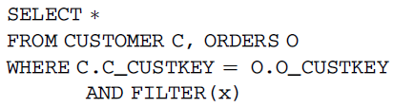
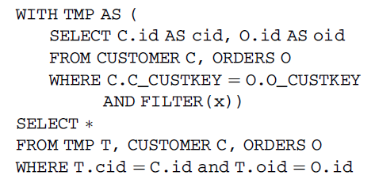
Optimizing Join Processing
Optimizing Nonindexed Join Processing on Flash Storage-Based Systems
Consider the following queries:
NaiveQuery:
ExpQuery:
Courtesy: IEEE Transactions on Computers,vol.62,july 2013

Slide 7
Comparison
Optimizing Nonindexed Join Processing on Flash Storage-Based Systems
Join results of NaiveQuery=ExpQuery
TMP-Projections pushed ahead of join
‘Computing join index on the fly’
Join result size<2000 – ExpQuery outperforms NaiveQuery
Our aim-Optimize ExpQuery

Slide 8
DigestJoin
Optimizing Nonindexed Join Processing on Flash Storage-Based Systems
Reduce intermediate result size
Two phases:
Projecting the join attributes
“Digest” table
Digest join result
Fetching the full tuples that satisfy join

Slide 9





Overview of DigestJoin
Optimizing Nonindexed Join Processing on Flash Storage-Based Systems
project
Join
Page
Fetching
Final Join
results
Courtesy: IEEE Transactions on Computers,vol.62,july 2013
project
Phase 1:Digest Table Joining
Phase 2:Page Fetching

Slide 10
Page Fetching
Optimizing Nonindexed Join Processing on Flash Storage-Based Systems
Careful scheduling required
a₁ | A.tid | B.tid
a₁¹ | A.tid¹ | B.tid¹
a₁² | A.tid² | B.tid²
a₁³ | A.tid³ | B.tid³
a₁⁴ | A.tid⁴ | B.tid⁴
A.tid¹
A.tid³
A.tid²
A.tid⁴
B.tid¹
B.tid³
B.tid²
B.tid⁴
Page 1
Page 2
  Page 3
Page 4
Schedule1: a₁¹ , a₁² , a₁³ , a₁⁴

Slide 11
Optimizing Nonindexed Join Processing on Flash Storage-Based Systems
Page Fetching(cont..)
Good schedule = reduced I/O cost
Schedule2 : a₁¹ , a₁³ , a₁² , a₁⁴
Each page fetched once

Slide 12
Page Fetching Problem
Optimizing Nonindexed Join Processing on Flash Storage-Based Systems
Join Graph
Denotes remaining pages to be fetched
G=(V₁UV₂,E)
(v_{a},v_{b})-tuple in page v_{a} joins with tuple in page v_{b}
Edge removed when fetched
Vertex removed when degree=0

Slide 13
Page Fetching Problem(cont..)
Optimizing Nonindexed Join Processing on Flash Storage-Based Systems
Transformed graph
G’=(V’,E’)
For each edge (v_{a},v_{b})Є E ,v’ in G’
1a-1b : 1 new page to fetch
1b-2a : 2 new pages to fetch
Find a tour with min. cost-NP complete

Slide 14
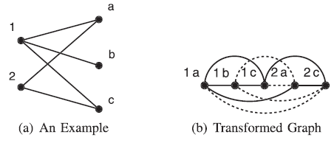
Join Graph & Transformed Graph
Join graph
Transformed graph
Courtesy: IEEE Transactions on Computers,vol.62,july 2013

Slide 15
Naive Fetching Strategy
Optimizing Nonindexed Join Processing on Flash Storage-Based Systems
Fetch pages in pipelined fashion
Soon after Digest Join phase
No need to assign input buffers
Cache disk pages

Slide 16
Naive Fetching Algorithm
Optimizing Nonindexed Join Processing on Flash Storage-Based Systems
Assign pages p1 and p2 as input buffers
Remaining memory - page cache with LRU
While joining dt1 and dt2, if there is a digest join result
(join_attribute_value,tid₁,tid₂)
page₁=page containing tid₁
page₂=page containing tid₂

Slide 17
Naive Fetching Algorithm
Optimizing Nonindexed Join Processing on Flash Storage-Based Systems
If page₁ is in PageCache extract tid₁ to t₁ else load page₁ to PageCache
If page₂ is in PageCache extract tid₂ to t₂ else load page₂ to PageCache
Join t₁ and t₂

Slide 18
Page-Based Fetching Strategy
Optimizing Nonindexed Join Processing on Flash Storage-Based Systems
Archive DigestJoin results
Cluster them
Allocate buffers p1,p2 for dt1,dt2 and rest as Output Buffer
While joining dt1 and dt2, if there is a digest join result
(join_attribute_value,tid₁,tid₂) send (tid₁,tid₂) to Output Buffer

Slide 19
Page-Based Fetching Strategy
Optimizing Nonindexed Join Processing on Flash Storage-Based Systems
If Output Buffer is full sort all tid₁ to ft₁ ,tid₂ to ft₂
Sort ft₁, ft₂ based on page number
While scanning ft₁ , ft₂ fetch result page into p2 and send tuples to Output Buffer
When Output Buffer is full sort all tuples and append to jct₁ and jct₂
Join jct₁ and jct₂

Slide 20
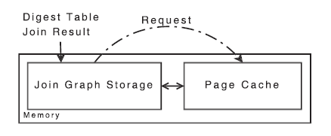
Graph-Based Fetching Strategy
Optimizing Nonindexed Join Processing on Flash Storage-Based Systems
Courtesy: IEEE Transactions on Computers,vol.62,july 2013
Allocate buffers p1,p2 for dt1,dt2 .
If there is a digest join result (join_attribute_value,tid₁,tid₂) join tid₁,tid₂
If step 2 fails call RequiredCacheSize().

Slide 21
Graph-Based Fetching Strategy
Optimizing Nonindexed Join Processing on Flash Storage-Based Systems
If rcs<current cache size JoinGraph++,PageCache--
If rcs>current cache size call SelectSegments() and FetchAndJoin()
Add (join_attribute_value,tid₁,tid₂) to JoinGraph
Call RequiredStoreSize()
JoinGraph--,PageCache ++

Slide 22
Conclusion
Optimizing Nonindexed Join Processing on Flash Storage-Based Systems
DigestJoin
Reduces intermediate result size
Exploit fast random read of flash disks
Page-based fetching-better latency performance
Graph-based fetching-fewer flash writes

Slide 23
References
Optimizing Nonindexed Join Processing on Flash Storage-Based Systems
J. Do and J.M. Patel, “Join Processing for Flash SSDs: Remembering Past Lessons,” Proc. Fifth Int’l Workshop Data Management New Hardware (DaMoN), pp. 1-8, 2009.
A. Ailamaki, D.J. DeWitt, M.D. Hill, and M. Skounakis, “Weaving Relations for Cache Performance,” Proc. 27th Int’l Conf. Very Large Data Bases (VLDB), pp. 169-180, 2001.
J.M. Cheng, D.J. Haderle, R. Hedges, B.R. Iyer, T. Messinger,C. Mohan, and Y. Wang, “An Efficient Hybrid Join Algorithm:A db2 Prototype,” Proc. Seventh Int’l Conf. Data Eng. (ICDE),pp. 171-180, 1991.

Slide 24
References
Optimizing Nonindexed Join Processing on Flash Storage-Based Systems
Y. Chang, J. Hsieh, and T. Kuo, “Endurance Enhancement of Flash-Memory Storage Systems: An Efficient Static Wear Leveling Design,” Proc. 44th Ann. Design Automation Conf. (DAC), pp. 212-217, 2007.
C.Y. Chan and B.C. Ooi, “Efficient Scheduling of Page Access in Index-Based Join Processing,” IEEE Trans. Knowledge and Data Eng., vol. 9, no. 6, pp. 1005-1011, Nov./Dec. 1997.
C.Y. Chan and B.C. Ooi, “Efficient Scheduling of Page Access in Index-Based Join Processing,” IEEE Trans. Knowledge and Data Eng., vol. 9, no. 6, pp. 1005-1011, Nov./Dec. 1997.

Slide 25
Optimizing Nonindexed Join Processing on Flash Storage-Based Systems
THANK YOU

Slide 26
Optimizing Nonindexed Join Processing on Flash Storage-Based Systems
QUESTIONS ??

