Slide 1
SANE: Semantic-Aware Namespace In Ultra-large-scale File Systems
Topic Approval:05/09/2013 Sarah Jose
Slide Approval:11/09/2013 Roll no.53
Topic and Slide Approved by : Jisha P. Abraham S7R

Slide 2
CONTENTS
SANE: Semantic-Aware Namespace In Ultra-large-scale File Systems
Introduction
Existing System
Issues
SANE
Architecture
Modules
Conclusion
References

Slide 3
INTRODUCTION
SANE: Semantic-Aware Namespace In Ultra-large-scale File Systems
Attributes
Semantic Relations
Namespace

Slide 4
EXISTING SYSTEM
SANE: Semantic-Aware Namespace In Ultra-large-scale File Systems
Based on hierarchical directory trees
  Manual search
  Time consuming

Slide 5
ISSUES
SANE: Semantic-Aware Namespace In Ultra-large-scale File Systems
Limited System Scalability
Reliance on end-users
Lack of semantics exploration

Slide 6
SANE
SANE: Semantic-Aware Namespace In Ultra-large-scale File Systems
Middleware
Semantic Correlations
Locality Sensitive Hashing(LSH)
Namespace

Slide 7
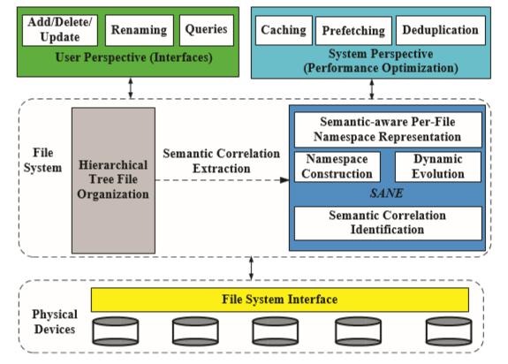
SANE ARCHITECTURE
SANE: Semantic-Aware Namespace In Ultra-large-scale File Systems
COURTESY:IEEE TRANSACTIONS ON PARALLEL AND DISTRIBUTED SYSTEMS
Fig. 1. SANE as a middleware in file systems

Slide 8
SANE ARCHITECTURE(Contd..)
SANE: Semantic-Aware Namespace In Ultra-large-scale File Systems
Modules
  Semantic Correlation Identification(SCI)
  Namespace Construction(NC)
  Dynamic Evolution(DE)

Slide 9
SEMANTIC CORRELATION IDENTIFICATION
SANE: Semantic-Aware Namespace In Ultra-large-scale File Systems
Locality Sensitive Hashing(LSH)
  Similar items into same hash buckets
  If d(u1,u2)<=R then Pr[h(u1)=h(u2)]>=P1
  If d(u1,u2)|>cR then Pr[h(u1)=h(u2)]<=P2
  R - Threshold distance,(R>0)
  c - Approximation ratio(c>1)
  P1,P2 - Probabilities(1>P1>P2>0)
  Hash function - h() , Distance function - d

Slide 10
SCI(Contd..)
SANE: Semantic-Aware Namespace In Ultra-large-scale File Systems
File Access coRrelation Mining and Evaluation Reference (FARMER) Algorithm
Stages
    Constructing graph - access sequence
    Mining - algorithm
    Sorting

Slide 11
FARMER
SANE: Semantic-Aware Namespace In Ultra-large-scale File Systems
Symbols used
  sd - semantic distance
  d - correlation degree
  f - access frequency
  l - list of files

Slide 12
FARMER ALGORITHM
SANE: Semantic-Aware Namespace In Ultra-large-scale File Systems
  for i = 0 to i < successor.length do
    compute sd
    compute f
    compute d
    if d > max.strength then
        l← add(successor[i].id,d)
    end if
  end for
  l.sort

Slide 13
SEMANTIC DISTANCE AND CORRELATION DEGREE
SANE: Semantic-Aware Namespace In Ultra-large-scale File Systems
sd(A,B)= |A∩B|
|max(A,B)|
Access Frequency
  f(A,B)=NAB/N
Correlation Degree
  d = sd(A,B).p + f(A,B).(1-p)
    p=tunable parameter(0.0 to1.0)

Slide 14
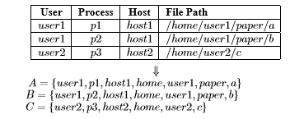
EXAMPLE
SANE: Semantic-Aware Namespace In Ultra-large-scale File Systems

Slide 15
NAMESPACE CONSTRUCTION
SANE: Semantic-Aware Namespace In Ultra-large-scale File Systems
t nearest neighbors
Mean and Standard deviation(MSD(f))
Initially t=1,MSD calculated

Slide 16
NAMESPACE CONSTRUCTION(Contd..)
SANE: Semantic-Aware Namespace In Ultra-large-scale File Systems
MSD(f)=d̅+α√∑^{t}_{i=1}(di- d̅)²/t
d̅ = ∑^{t}_{i=1} di
t
α - correlation factor, di=correlation degree
MSD - high, file added to namespace
Repeated until a decrease in MSD(f)

Slide 17
DYNAMIC EVOLUTION
SANE: Semantic-Aware Namespace In Ultra-large-scale File Systems
Two-set representation
  Namespace(f)
  Member(f)
Dynamic updation

Slide 18
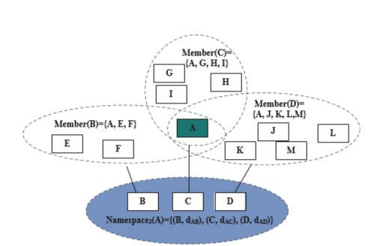
DYNAMIC EVOLUTION(Contd..)
SANE: Semantic-Aware Namespace In Ultra-large-scale File Systems
COURTESY:IEEE TRANSACTIONS ON PARALLEL AND DISTRIBUTED SYSTEMS
Fig. 2. Two-set representation of files

Slide 19
RETRIEVING FILES
SANE: Semantic-Aware Namespace In Ultra-large-scale File Systems
top-t neighbors
Presents correlated files

Slide 20
CONCLUSION
SANE: Semantic-Aware Namespace In Ultra-large-scale File Systems
Considers Semantic Correlations
Strong System Scalability
Better Searchability

Slide 21
REFERENCES
SANE: Semantic-Aware Namespace In Ultra-large-scale File Systems
I. Gorton, P. Greenﬁeld, A. Szalay, and R. Williams, “Data-intensive computing in the 21st century,” Computer, vol. 41, no. 4, pp. 30–32, 2008.
I. D. C. (IDC), “2010 Digital Universe Study: A Digital Universe Decade - Are You Ready?,” http://gigaom.ﬁles.wordpress.com/2010/05/2010- digital-universe-iview.

Slide 22
REFERENCES(Contd..)
SANE: Semantic-Aware Namespace In Ultra-large-scale File Systems
A. W. Leung, M. Shao, T. Bisson, S. Pasupathy, and E. L. Miller, “Spyglass: Fast, Scalable Metadata Search for Large-Scale Storage Systems,” Proc. FAST, 2009.
P. Indyk and R. Motwani, “Approximate nearest neighbors: towards removing the curse of dimensionality,” Proc. STOC, 1998.

Slide 23
REFERENCES(Contd..)
SANE: Semantic-Aware Namespace In Ultra-large-scale File Systems
M. Datar, N. Immorlica, P. Indyk, and V. Mirrokni, “Locality-sensitive hashing scheme based on p-stable distributions,” Proc. Annual Sympo- sium on Computational Geometry, pp. 253–262, 2004.
Z. Zhang and C. Karamanolis, “Designing a Robust Namespace for Distributed File Services,” Proc. SRDS, pp. 162–173, 2001.

Slide 24
SANE: Semantic-Aware Namespace In Ultra-large-scale File Systems
THANK YOU

Slide 25
QUESTIONS??
SANE: Semantic-Aware Namespace In Ultra-large-scale File Systems

