Slide 1
WELCOME
COMPUTER SCIENCE DEPARTMENT, MA COLLEGE OF ENGINEERING

Slide 2
FUNSQL
IT IS TIME TO MAKE SQL
FUNCTIONAL
TOPIC APPROVAL - 13/09/2013
SLIDE APPROVAL - 23/09/2013
TOPIC AND SLIDE APPROVED
By : Mrs. JISHA P ABRAHAM
NITHIN N.R
ROLL NO:43
S₇ R
COMPUTER SCIENCE DEPARTMENT, MA COLLEGE OF ENGINEERING

Slide 3
CONTENTS
FUNSQL It is time to make sql functional
Introduction
Existing System
Proposed System
Language Description
Compilation and Optimization
Performance Experiments
Conclusion
Reference
COMPUTER SCIENCE DEPARTMENT, MA COLLEGE OF ENGINEERING

Slide 4
INTRODUCTION
FUNSQL It is time to make sql functional
Traditional Relational databases
1.SQL
2.PLSQL
COMPUTER SCIENCE DEPARTMENT, MA COLLEGE OF ENGINEERING
Notes:
Inverted index -
Improves data retrieval
Maps from content to location
Book,celphone
Keyword - Used in search for retrieving relevant pages
specified by user

Slide 5
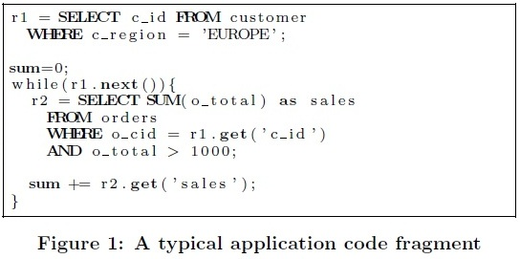
EXISTING SYSTEM
FUNSQL It is time to make sql functional
Structured Query Language(SQL)
COMPUTER SCIENCE DEPARTMENT, MA COLLEGE OF ENGINEERING
Notes:
Application code calculates sum of selected sales in europe

Slide 6
FUNSQL It is time to make sql functional
DEMERITS OF EXISTING SYSTEM
1. Complex statement
2. Poor performance
COMPUTER SCIENCE DEPARTMENT, MA COLLEGE OF ENGINEERING
Notes:
Complex stmt decomposition not posssible

Slide 7
PROPOSED SYSTEM
FUNSQL It is time to make sql functional
FUNSQL
  Functional Language extends SQL
  Decompose logic into functions
  Explicit Reuse of Intermediate Results
  Creation of Multiple Result sets
COMPUTER SCIENCE DEPARTMENT, MA COLLEGE OF ENGINEERING

Slide 8
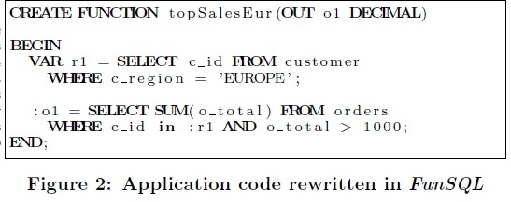
FUNSQL - EXAMPLE
FUNSQL It is time to make sql functional
COMPUTER SCIENCE DEPARTMENT, MA COLLEGE OF ENGINEERING

Slide 9
ADVANTAGES
FUNSQL It is time to make sql functional
More complex application logic
Decomposed efficiently
Optimized efficiently
COMPUTER SCIENCE DEPARTMENT, MA COLLEGE OF ENGINEERING

Slide 10
LANGUAGE DESCRIPTION
FUNSQL It is time to make sql functional
Basic constructs
1.Single Assignments
2.Function calls
Recursion
COMPUTER SCIENCE DEPARTMENT, MA COLLEGE OF ENGINEERING
Notes:
Demerits-
1.More space required if many single elements
2.If lb=ub, 2integers are still needed to represent interval
Next is operational algorithms

Slide 11
BASIC CONSTRUCTS
FUNSQL It is time to make sql functional
Support multiple parameters
  input: input to function, keyword-IN
  output: return values ,keyword-OUT
COMPUTER SCIENCE DEPARTMENT, MA COLLEGE OF ENGINEERING
Notes:
Demerits-
1.More space required if many single elements
2.If lb=ub, 2integers are still needed to represent interval
Next is operational algorithms

Slide 12
SINGLE ASSIGNMENT
FUNSQL It is time to make sql functional
Bind result of SQL statement
Consumes and return both variables
1.Scalar
2.Table
Read only queries
COMPUTER SCIENCE DEPARTMENT, MA COLLEGE OF ENGINEERING
Notes:
Return a value and consumes other scalar types

Slide 13
FUNCTION CALLS
FUNSQL It is time to make sql functional
Function- Group of SQL statements
Function call-call to a function
    Hand over input parameters
    Consumes output parameters
COMPUTER SCIENCE DEPARTMENT, MA COLLEGE OF ENGINEERING
Notes:
CALLS TO FUN HAND OVER INPUT PARA& CONSU OP PARA

Slide 14
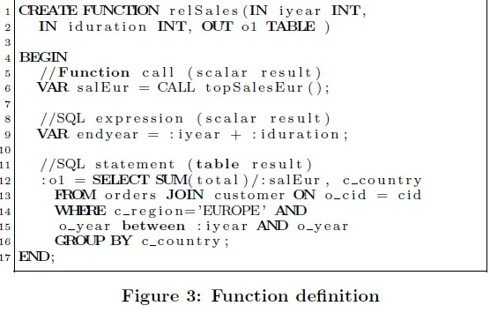
FUNCTION CALLS (CONT…)
FUNSQL It is time to make sql functional
COMPUTER SCIENCE DEPARTMENT, MA COLLEGE OF ENGINEERING
Notes:
CALLS TO FUN HAND OVER INPUT PARA& CONSU OP PARA

Slide 15
RECURSION
FUNSQL It is time to make sql functional
Function calls itself
Tail Recursive Function
COMPUTER SCIENCE DEPARTMENT, MA COLLEGE OF ENGINEERING
Notes:
MANY CASE ONLY RECURSION OR ITERATION IS PRESENT define an exit condition

Slide 16
FUNSQL It is time to make sql functional
TAIL RECURSIVE FUNCTION
Define exit condition
Define results at end
COMPUTER SCIENCE DEPARTMENT, MA COLLEGE OF ENGINEERING
Notes:
MANY CASE ONLY RECURSION OR ITERATION IS PRESENT define an exit condition

Slide 17
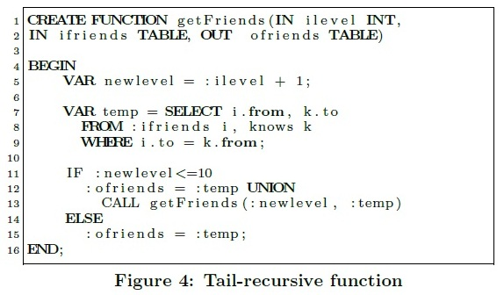
FUNSQL It is time to make sql functional
TAIL RECURSIVE FUNCTION (CONT..)
COMPUTER SCIENCE DEPARTMENT, MA COLLEGE OF ENGINEERING
Notes:
MANY CASE ONLY RECURSION OR ITERATION IS PRESENT define an exit condition

Slide 18
COMPILATION
FUNSQL It is time to make sql functional
Compilation of Funsql
Graph Based Execution Plan
  relational operators(SQL Statements)
  scalar expressions
Combine sub plans into big execution plan
COMPUTER SCIENCE DEPARTMENT, MA COLLEGE OF ENGINEERING

Slide 19
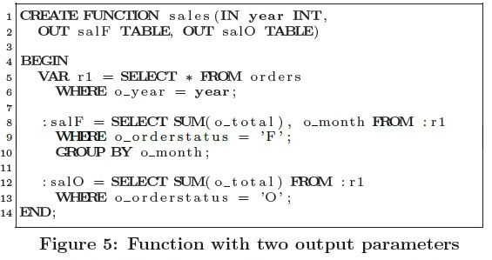
COMPILATION EXAMPLE
FUNSQL It is time to make sql functional
COMPUTER SCIENCE DEPARTMENT, MA COLLEGE OF ENGINEERING
Notes:
Compiled into graphbased execution plan it is trivial due to static single assignment

Slide 20
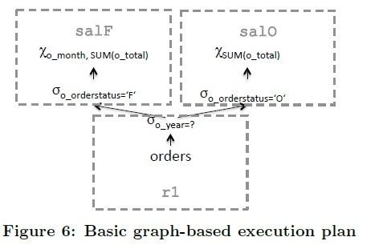
FUNSQL It is time to make sql functional
COMPILATION (CONT..)
COMPUTER SCIENCE DEPARTMENT, MA COLLEGE OF ENGINEERING

Slide 21
OPTIMIZATION
FUNSQL It is time to make sql functional
Increase efficiency
Selection pushdown-pushdown predicates
1. Rule1-unary operator
2. Rule2- set operator
3. Rule3-join operator
Projection pushdown
Recursion
Other Rules
COMPUTER SCIENCE DEPARTMENT, MA COLLEGE OF ENGINEERING
Notes:
OPTIMIZATION OF QUERIES R1 PROJECTION R2 UNION INTERSECTION R3 JOIN

Slide 22
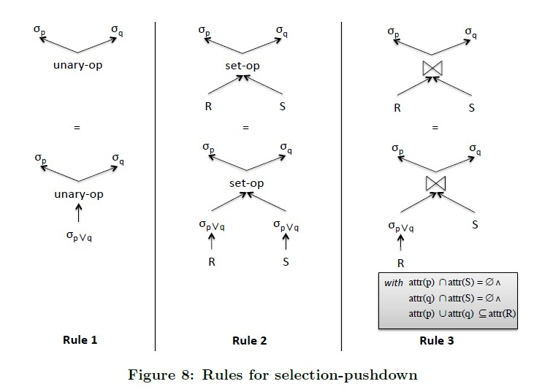
SELECTION PUSHDOWN
FUNSQL It is time to make sql functional
COMPUTER SCIENCE DEPARTMENT, MA COLLEGE OF ENGINEERING
Notes:
PUSHDOWN 2 PREDICATES A NEW OPERATOR IS USED

Slide 23
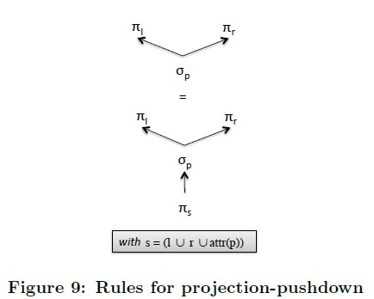
PROJECTION PUSHDOWN
FUNSQL It is time to make sql functional
Similar Rules
COMPUTER SCIENCE DEPARTMENT, MA COLLEGE OF ENGINEERING

Slide 24
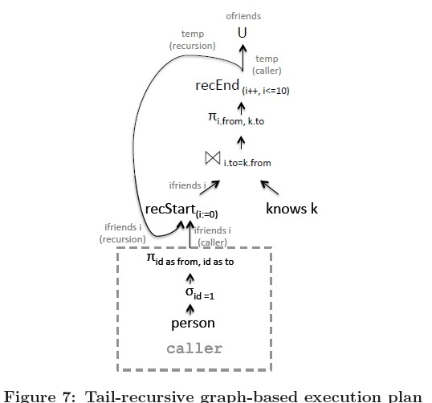
RECURSION
FUNSQL It is time to make sql functional
COMPUTER SCIENCE DEPARTMENT, MA COLLEGE OF ENGINEERING

Slide 25
OTHERRULES
FUNSQL It is time to make sql functional
Pushing down two aggregation operations
Replicating one operator
COMPUTER SCIENCE DEPARTMENT, MA COLLEGE OF ENGINEERING

Slide 26
PERFORMANCE EXPERIMENTS
FUNSQL It is time to make sql functional
Use TPC-H Benchmark
1.Experiment1-show the benefits of Funsql
2.Experiment2
3.Experiment3
COMPUTER SCIENCE DEPARTMENT, MA COLLEGE OF ENGINEERING
Notes:
1 is similler as funsql benefits

Slide 27
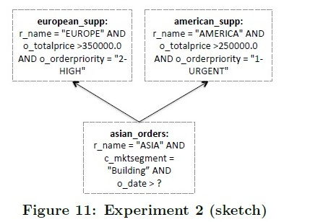
EXPERIMENT 2
FUNSQL It is time to make sql functional
Shows effectiveness logical optimizations
COMPUTER SCIENCE DEPARTMENT, MA COLLEGE OF ENGINEERING
Notes:
In graph based execution plans

Slide 28
FUNSQL It is time to make sql functional
Experiment 3
Similar to Experiment 2
Effectiveness of reusing intermediate results
Produce multiple outputs
COMPUTER SCIENCE DEPARTMENT, MA COLLEGE OF ENGINEERING
Notes:
2 without multiple queries

Slide 29
CONCLUSION
FUNSQL It is time to make sql functional
FUNSQL– more efficient
  Application logic decomposed efficiently
  More complex application logic in SQL
  Optimized efficiently
COMPUTER SCIENCE DEPARTMENT, MA COLLEGE OF ENGINEERING

Slide 30
REFERENCE
FUNSQL It is time to make sql functional
R. Chaiken, B. Jenkins, P.- A. Larson, B. Ramsey,
D. Shakib, S. Weaver, and J. Zhou. SCOPE: easy and
efficient parallel processing of massive data sets.
PVLDB,1(2),2008
J. Dean and S. Ghemawat. MapReduce: Simplied DataProcessing on Large Clusters. In OSDI, pages 137{150,2004.
COMPUTER SCIENCE DEPARTMENT, MA COLLEGE OF ENGINEERING

Slide 31
REFERENCE
FUNSQL It is time to make sql functional
M. Isard, M. Budiu, Y. Yu, A. Birrell, and D. Fetterly. Dryad: distributed data-parallel programs from sequential building blocks. In EuroSys, pages 59{72, 2007
Y. Yu, M. Isard, D. Fetterly, M. Budiu, U. Erlingsson,
P. K. Gunda, and J. Currey. DryadLINQ: A System for General-Purpose Distributed Data-Parallel Computing Using a High-Level Language. In OSDI, pages 1{14, 2008.
COMPUTER SCIENCE DEPARTMENT, MA COLLEGE OF ENGINEERING

Slide 32
THANK YOU
COMPUTER SCIENCE DEPARTMENT, MA COLLEGE OF ENGINEERING

Slide 33
QUESTIONS ???
COMPUTER SCIENCE DEPARTMENT, MA COLLEGE OF ENGINEERING

