Slide 1
WELCOME

Slide 2
DYNAMIC RESOURCE ALLOCATION USING VIRTUAL MACHINES FOR CLOUD COMPUTING ENVIRONMENT
Topic approval: 25/7/13 Sanusha A C
Slide approval: 22/8/13 Roll no-52
Topic and slide approved by: S7 R
Mrs Jisha P Abraham

Slide 3
CONTENTS
Introduction
Existing System
Proposed System
System Architecture
Skewness Algorithm
Conclusion
References
Dept. of CSE,MACE,Kothamangalam

Slide 4
INTRODUCTION
Cloud Computing
Resource Management
Dynamic Resource Allocation
Virtual Machine
Green Computing
Dynamic Resource Allocation Using Virtual Machine For Cloud Computing

Slide 5
EXISTING SYSTEM
Problems
Policy Issue
Resource need of VMs
  Heterogeneous
Dynamic Resource Allocation Using Virtual Machine For Cloud Computing

Slide 6
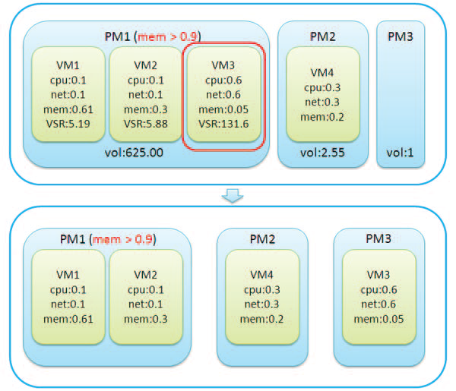
EXISTING SYSTEM contd.
Dynamic Resource Allocation Using Virtual Machine For Cloud Computing
Courtesy-Dynamic resource allocation using virtual machines
Blackbox algorithm

Slide 7
PROPOSED SYSTEM
Goals
  Overload Avoidance
  Green Computing
Dynamic Resource Allocation Using Virtual Machine For Cloud Computing

Slide 8
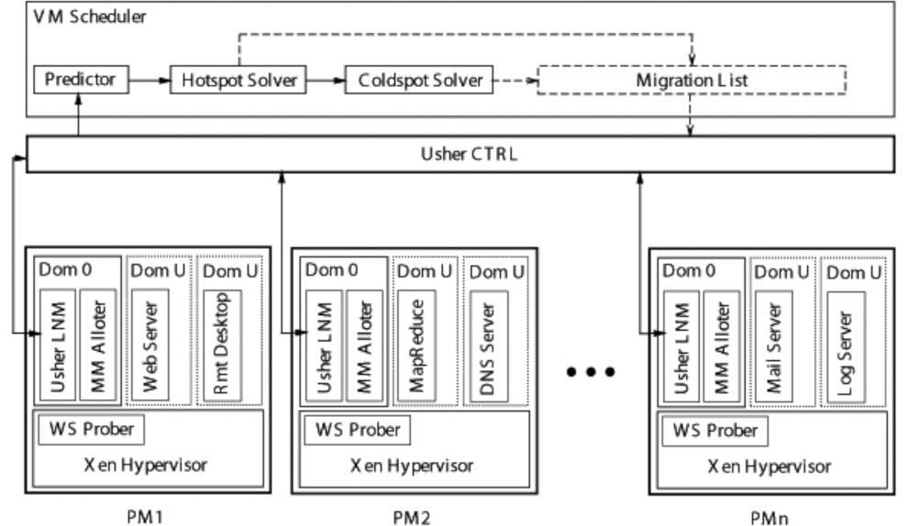
SYSTEM ARCHITECTURE
Picture courtesy -
Dynamic Resource Allocation Using Virtual Machine For Cloud Computing
Courtesy-Dynamic resource allocation using virtual machines

Slide 9
SYSTEM ARCHITECUTURE (contd.)
Components
  Virtual machine scheduler
  Usher control
  Physical machines
Dynamic Resource Allocation Using Virtual Machine For Cloud Computing
Dept. of CSE,MACE,Kothamangalam

Slide 10
RESOURCE NEED PREDICTION
EWMA
  Exponentially Weighted Moving Average
E(t)=ɑ *E(t-1)+(1- ɑ)*O(t) , 0≤ ɑ ≤1
E(t)-Estimated load at time t
O(t)-Observed load at time t
Dynamic Resource Allocation Using Virtual Machine For Cloud Computing

Slide 11
RESOURCE NEED PREDICTION contd.
Dynamic Resource Allocation Using Virtual Machine For Cloud Computing
FUSD-Fast Up Slow Down
E(t) = -|ɑ| *E(t-1)+(1+|ɑ|)*O(t) , -1≤ ɑ ≤0
= O(t)+|ɑ|*( O(t) - E(t-1) )

Slide 12
SKEWNESS ALGORITHM
SKEWNESS(P) = √∑ ((r_{i}/ṝ)-1)²
n-Number of resources
r_{i-} Utilization of the i^{th} resource
ṝ- Average utilization of all resources
Picture courtesy-Computers and Mathematics with Applications 59 (2010) 23802392
Dynamic Resource Allocation Using Virtual Machine For Cloud Computing
n
i=1

Slide 13
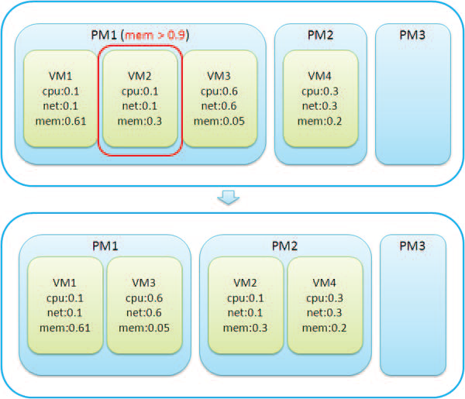
SKEWNESS ALGORITHM contd.
Dynamic Resource Allocation Using Virtual Machine For Cloud Computing
Courtesy-Dynamic resource allocation using virtual machines

Slide 14
SKEWNESS ALGORITHM contd.
Parts of skewness algorithm
  Load prediction
  Hot spot mitigation
  Green computing
Dynamic Resource Allocation Using Virtual Machine For Cloud Computing

Slide 15
HOT AND COLD SPOTS
Hot spot
  Utilization >hot threshold
  temperature(p)=∑(r-r_{t})² R→Set of overloaded resources in server p r_{t}→Hot threshold for resource r
Cold spot
  Utilization < cold threshold
Dynamic Resource Allocation Using Virtual Machine For Cloud Computing
rɛ R

Slide 16
HOT SPOT MITIGATION
Steps
Sort hot spots
  Temperature
Selection of VM
Find the destination server
Dynamic Resource Allocation Using Virtual Machine For Cloud Computing

Slide 17
GREEN COMPUTING
      Sort cold spots
        Memory size
      Selection of VM
      Find the destination server
Dynamic Resource Allocation Using Virtual Machine For Cloud Computing

Slide 18
ANALYSIS OF SKEWNESS ALGORITHM
Complexity of hot spot mitigation
  Sorting-O(nh*log(nh)) nh-Number of hotspots
  Selection-O(n) n-Number of physical machines
  Overall complexity-O(nh*n)
Dynamic Resource Allocation Using Virtual Machine For Cloud Computing

Slide 19
ANALYSIS OF SKEWNESS ALGORITHM contd.
Complexity of green computing
  Sorting-O(nc*log(nc)) nc-Number of cold spots
  Selection-O(n)
  Overall complexity-O(nc*n)
Dynamic Resource Allocation Using Virtual Machine For Cloud Computing

Slide 20
CONCLUSION
High resource utilization
Effectively saves energy
Adaptive multiplexing
Overload avoidance
Green computing
Dynamic Resource Allocation Using Virtual Machine For Cloud Computing

Slide 21
REFERENCES
M. Armbrust et al., “Above the Clouds: A Berkeley View of Cloud
Computing,” technical report, Univ. of California, Berkeley, Feb. 2009
L. Siegele, “Let It Rise: A Special Report on Corporate IT,” The Economist, vol. 389, pp. 3-16, Oct. 2008
C.A Waldspurger,”Memory Resouce Management in Vmware ESX Server,”proc OS design and inplementation,Aug,2002

Slide 22
REFERENCES Contd.
P. Barham, B. Dragovic, K. Fraser, S. Hand, T. Harris, A. Ho, R Neugebauer, I. Pratt, and A. Warfield, “Xen and the Art of Virtualization,” Proc. ACM Symp. Operating Systems Principles (SOSP ’03), Oct. 2003
“Amazon elastic compute cloud (Amazon EC2),” http://aws.amazon.com/ec2/, 2012
“TCP-W:Transaction Processing Performance Council,” http://www.tpc.org/tcpw/2012

Slide 23
QUESTIONS?

Slide 24
THANK YOU

