Slide 1
Elastrass: An elastic , scalable and self-managing transactional database for clouds
Elastras:transactional database for cloud
SLIDE APPROVAL: MS. JISHA P ABRAHAM
DATE: 19/8/2013
K A MUHAMMED NESWINE
ROLL NO: 38

Slide 2
CONTENTS
Elastras:transactional database for cloud
Introduction
Existing system
Proposed system- Elastras
Design principle and architecture
Live database migration
Albatross
Conclusion
References

Slide 3
INTRODUCTION
Elastras:transactional database for cloud
Features of DBMS in cloud
  Handle varying workloads
  Elastic
  Lightweight elastic scaling
  Efficient resource handling
  Load balancing
  Self managing

Slide 4
EXISTING SYSTEM
Elastras:transactional database for cloud
Key-value stores
  Scalable, elastic, highly-available
  Eg. Bigtable
Relational databases
  Low latency, high throughput at single node
  Elasticity , scale-out
  Eg. Cloud SQL Server

Slide 5
ELASTRAS
Elastras:transactional database for cloud
Elastic, self-managing, scalable
Combination of
  Relational- efficient transaction execution on small databases
  Key-value – scalability, elasticity, availibility

Slide 6
DESIGN PRINCIPLES
Elastras:transactional database for cloud
Separate system state from application state
Decouple data storage from ownership
Limit transaction to a single node

Slide 7
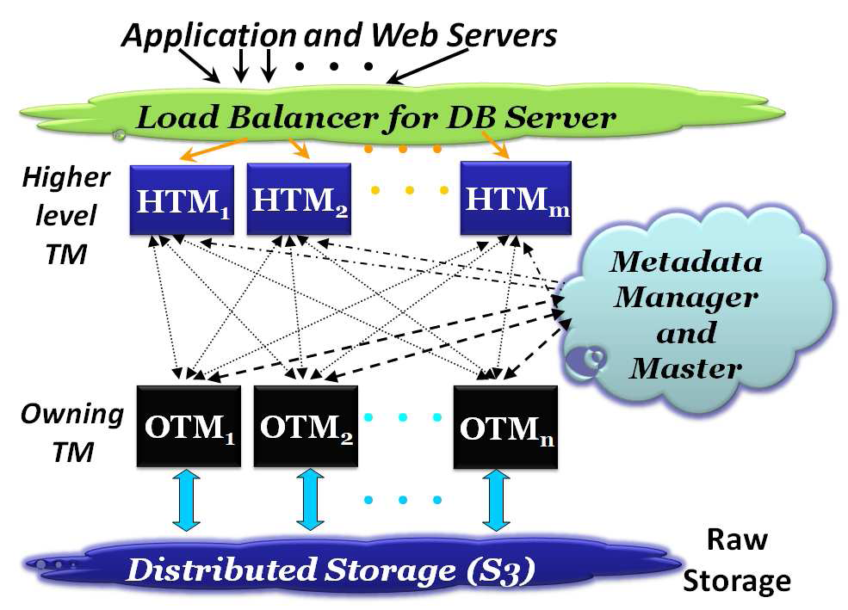
ELASTRAS ARCHITECTURE
Elastras:transactional database for cloud

Slide 8
Distributed fault-tolerant layer
Elastras:transactional database for cloud
Network- addresable storage layer
Append only storage layout
HDFS
  Highly fault-tolerant
  High throughput access to application data
  Used for applications having large data sets.

Slide 9
TRANSACTION MANAGER LAYER
Elastras:transactional database for cloud
Consists of cluster of OTMs
  Transaction manager
  Data manager
Fuctions
  Concurrency control and recovery
  Storage and cache management

Slide 10
Control layer
Elastras:transactional database for cloud
Two components
  TM master
  Metadata manager

Slide 11
LIVE DATABASE MIGRATION
Elastras:transactional database for cloud
Key features- elasticity , pay-per-use
Lightweight
Migration cost metrics
  Service unavailability
  No. of failed requests
  Impact on response time
  Data transfer overhead

Slide 12
ALBATROSS
Elastras:transactional database for cloud
Live database migration protocol
Three phases
  Begin migration
  Iterative copying
  Atomic handover

Slide 13
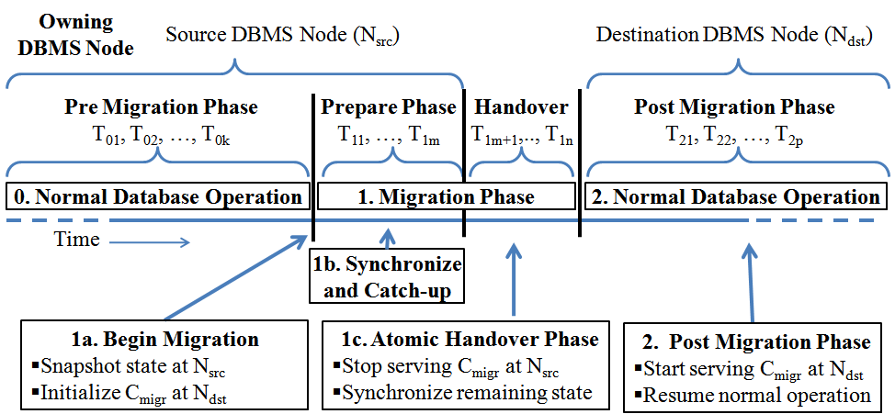
Elastras:transactional database for cloud
Image courtesy ACM university of california

Slide 14
Implementation details
Elastras:transactional database for cloud
Creating a database snapshot
Iterative copying phase and Copying the transaction state
Handover phase

Slide 15
FAILURE HANDLING
Atomic handover phase
  Changes to all transactions at source
  Synchronize state of partition b/w source and destination
  Transfer ownership to destination
Handover- transfer transaction
Use 2PC

Slide 16
ANALYSIS
Elastras:transactional database for cloud
Sharing of cache
  Trade-off b/w resource sharing & tenant isolation
Store OTM transaction log
  Failure recovery
  Albatross- store in DFS

Slide 17
CONCLUSION
Elastras:transactional database for cloud
Combination of multitenancy and elasticity for single database system
Self-managing
Fault-tolerant
Highly available

Slide 18
REFERENCES
1] P. A. Bernstein et al. Adapting Microsoft SQL Server for
Cloud Computing. In ICDE, 2011.
[2] P. A. Bernstein and E. Newcomer. Principles of Transaction
Processing. MK Publishers Inc., second edition, 2009.
[3] R. Bradford, E. Kotsovinos, A. Feldmann, and H. Schi ¨oberg.
Live wide-area migration of virtual machines including local
persistent state. In VEE, pages 169–179, 2007.
[4] F. Chang et al. Bigtable: A Distributed Storage System for
.

Slide 19
THANK YOU

