Slide 1
U-Skyline: A New Skyline Query for Uncertain Databases
Topic Approval:02/08/13
Slide Approval:10/09/13 Nija Saju
Topic and Slide Approved by: Roll no.40
Mrs.Jisha.P.Abraham S7R

Slide 2
CONTENTS
U-Skyline: A New Skyline Query for Uncertain Databases
Uncertain Databases and Skyline
P-Skyline
Issues
U-Skyline
U-Skyline Processing Algorithms
Overview
Conclusion
References

Slide 3
UNCERTAIN DATABASES AND SKYLINE
U-Skyline: A New Skyline Query for Uncertain Databases
Data Uncertainty
Tuples not dominated
Tuple p dominates q( p q)
    p not worse than q on all attributes
    p better than q on at least one attribute

Slide 4
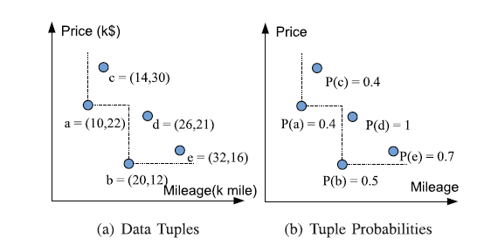
AN EXAMPLE
U-Skyline: A New Skyline Query for Uncertain Databases
Fig.1: Graph for vehicle data set
COURTESY:IEEE TRANSACTIONS ON KNOWLEDGE AND DATA ENGINEERING

Slide 5
SKYLINE-PROPERTIES
U-Skyline: A New Skyline Query for Uncertain Databases
Non-dominance
Incomparability
Coverage

Slide 6
P-SKYLINE
U-Skyline: A New Skyline Query for Uncertain Databases
Possible world
P({ a, b, d})=P(a). P(b). P(c). P(d). P(e)=0.036
Non-dominance probability
    Aggregating all possible worlds where tuple not dominated
    P_{non-dom} (d)= P(b). P(d)= 0.5

Slide 7
P-SKYLINE(Contd..)
U-Skyline: A New Skyline Query for Uncertain Databases
Non-dominance probability>= threshold value
Skyline set in vehicle set: {b,d} when threshold = 0.5

Slide 8
ISSUES
U-Skyline: A New Skyline Query for Uncertain Databases
Interplay/relationship - not considered
Can be an invalid skyline
Users not aware of proper threshold

Slide 9



U-SKYLINE
U-Skyline: A New Skyline Query for Uncertain Databases
U-Skyline probability
P_{u-sky}(S)= P(t_{i}). P(t_{j} ). 1
U-Skyline query
      Maximum U-Skyline probability

Slide 10
U-SKYLINE PROCESSING ALGORITHMS
U-Skyline: A New Skyline Query for Uncertain Databases
Candidate Skyline Search Algorithm
Dynamic Search Algorithm
Pruning and Early Termination Algorithm (P&ET)

Slide 11
CANDIDATE SKYLINE SEARCH ALGORITHM
U-Skyline: A New Skyline Query for Uncertain Databases
For any candidate skyline S in dataset D
    Compute P_{u-sky}(S )
Return S with max P_{u-sky}(S )

Slide 12
DYNAMIC PROGRAMMING CONCEPTS
U-Skyline: A New Skyline Query for Uncertain Databases
Tuple access order
Monotonic function- f(.)
      ∀t_{i} t_{j} , f(.) guarantees that f(t_{i}) ≤ f(t_{j})
f(t)=min_{i} (t.a_{i} )
SC_{i}-candidate skylines created while accessing t_{i}
SC-set of all SC_{i}

Slide 13
DYNAMIC PROGRAMMING ALGORITHM
U-Skyline: A New Skyline Query for Uncertain Databases
Sort dataset D based on monotonic function
Initialize candidate skyline sets as ϕ
Compare each tuple t_{i} with each tuple t_{x} lying above t_{i} in sorted dataset for dominating property
  For each candidate S_{j} in SC_{x} ,check dominance between S_{j} & t_{i}

Slide 14
DYNAMIC PROGRAMMING ALGORITHM(Contd..)
U-Skyline: A New Skyline Query for Uncertain Databases
    If S_{j} does not dominate t_{i} then
      Create new candidate including t_{i} with S_{j}
      U-skyline probability of new set:
      P_{u-sky} (S _{j}). P(t_{i})
      P_{u-sky} (S _{j}) modified as P_{u-sky} (S_{j}). P(t_{i})
      Add new set to candidate set SC_{i}
  Update SC as SC U SC_{i}
Return S_{i} in SC with max P_{u-sky}(S_{i})

Slide 15
SKYLINE PRUNING AND EARLY TERMINATION
U-Skyline: A New Skyline Query for Uncertain Databases
Prune and early terminate search
Score lower bound
L(S_{j} )=min_{ti€Sj} (max_{1≤m≤d} t_{i}.a_{m})
For t_{i} € D with f(t_{i})>L(S_{j}),
S_{j} t_{i}
bestUSky, bestUSkyP

Slide 16
PRUNING AND EARLY TERMINATION ALGORITHM
U-Skyline: A New Skyline Query for Uncertain Databases
Sort(D)
Initialize skyline sets as ϕ, L(ϕ) as ∞ & bestUSkyP as 0
Compare each tuple t_{i} with each tuple t_{x} lying above t_{i} in sorted dataset for dominating property
  For each candidate S_{j} in SC_{x}

Slide 17
P&ET(Contd..)
U-Skyline: A New Skyline Query for Uncertain Databases
    If f(t_{i}) is greater than L(S_{j}), then
        Delete S_{j} from SC_{x}
        Update bestUSkyP, bestUSky<- S_{j}
    Else-if P_{u-sky}(S_{j}) is lesser than bestUSkyP, then
        Delete S_{j} from SC_{x}
    Else-if S_{j} does not dominate t_{i}, then

Slide 18
P&ET(Contd..)
U-Skyline: A New Skyline Query for Uncertain Databases
      Create new candidate including t_{i} with S_{j}
      U-skyline probability of new set: P_{u-sky} (S_{j}). P(t_{i})
      P_{u-sky} (S_{j}) modified as P_{u-sky} (S_{j}). P(t_{i})
      Add new set to candidate set SC_{i}
  Update SC as SC U SC_{i}
Return bestUSky

Slide 19
DATASET REDUCTION AND PARTITION
U-Skyline: A New Skyline Query for Uncertain Databases
Improve efficiency
Two improvements
    Reduced Set Pruning Algorithm
        Reduced set
    Reduced Set Independent Partition Algorithm
        Divide-and-conquer strategy

Slide 20
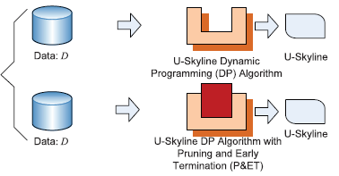
OVERVIEW- QUERY PROCESSING
U-Skyline: A New Skyline Query for Uncertain Databases
COURTESY:IEEE TRANSACTIONS ON KNOWLEDGE AND DATA ENGINEERING
Fig.2: U-skyline
Processing
Algorithms

Slide 21
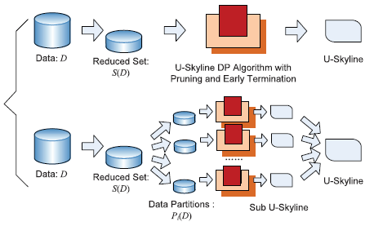
OVERVIEW-DATASET REDUCTION AND PARTITION
U-Skyline: A New Skyline Query for Uncertain Databases
COURTESY:IEEE TRANSACTIONS ON KNOWLEDGE AND DATA ENGINEERING
Fig.3: Input
Dataset
Reduction
And Partition

Slide 22
CONCLUSION
U-Skyline: A New Skyline Query for Uncertain Databases
Better coverage
U-skyline processing- NP hard
Alleviate computational strain
10-100 times faster

Slide 23
REFERENCES
U-Skyline: A New Skyline Query for Uncertain Databases
I. Bartolini, P. Ciaccia, and M. Patella, “SaLSa: Computing the Skyline without Scanning the Whole Sky,” Proc. 15th ACM Int’l Conf. Information and Knowledge Management (CIKM ’06), pp. 405-414, 2006
S. Borzsonyi, K. Stocker, and D. Kossmann, “The Skyline Operator,” Proc. 17th Int’l Conf. Data Eng. (ICDE ’01), pp. 421-430, 2001
C.C. Aggarwal, “On Unifying Privacy and Uncertain Data Models,” Proc. IEEE 24th Int’l Conf. Data Eng. (ICDE ’08), pp. 386-395, 2008

Slide 24
REFERENCES(Contd..)
U-Skyline: A New Skyline Query for Uncertain Databases
S. Abiteboul, P. Kanellakis, and G. Grahne, “On the Representation and Querying of Sets of Possible Worlds” Proc.ACMSIGMOD Int’l Conf. Management of Data (SIGMOD ’87), pp. 34-48, 1987
M.J. Atallah and Y. Qi, “Computing All Skyline Probabilities for Uncertain Data,” Proc. 28th ACM SIGMOD-SIGACT-SIGART Symp. Principles of Database Systems (PODS ’09), pp. 279-287, 2009
C.C. Aggarwal and P.S. Yu, “A Survey of Uncertain Data Algorithms and Applications,” IEEE Trans. Knowledge and Data Eng., vol. 21, no. 5, pp. 609-623, May 2009

Slide 25
QUESTIONS??
U-Skyline: A New Skyline Query for Uncertain Databases

