Slide 1
Welcome

Slide 2
Load Rebalancing For Distributed File System In Clouds
Topic Approval:05/07/2013
Slide Approval:22/07/2013
Topic and Slides Approved
By: Eldo Sir
Sankari Anil Raveendran
Roll No-50
S7R

Slide 3
Contents
Introduction
Load Balancing in DFS
Existing Systems
Proposed System
Implementation in Hadoop
Conclusion
References

Slide 4
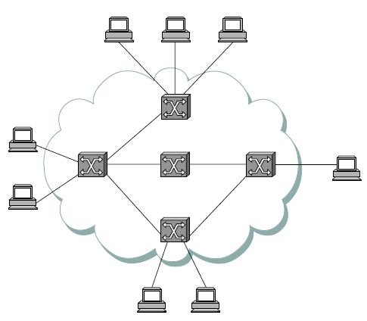
Cloud
Set of independent networks
Internet cloud
  Network of interconnected systems
  Routers
Fig1. Cloud
Courtesy: Computer Networks A Systems Approach-Larry L.Peterson and Bruce S.Davie,4th Edition .Morgan Kaufman
Dept. of Computer Science, MACE, Kothamangalam

Slide 5
Distributed File System
File system- repository to store information
  Centralized
  DFS
    Users and devices - physically distributed across locations

Slide 6
Load Balancing
Resource utilization
1 file in 1 node → load imbalance
  File→ File Chunks (fixed size pieces)
  File Chunks→ Chunk Servers (storage nodes)
Allocate chunks - as uniformly as possible
No node manages excess chunks
Reduce network traffic (movement cost)

Slide 7
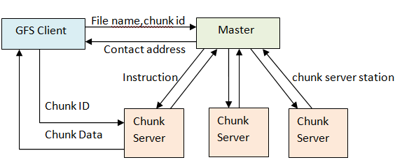
Existing Systems
Fig 2. Google File System

Slide 8
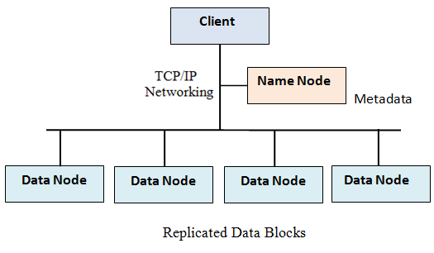
Existing Systems-2
Fig 3. Hadoop File System

Slide 9
Limitations
Central node
  to handle meta data information
Scalability
Performance bottle neck
Single point failure

Slide 10

Load Balancing Problem
F5
F3
F2
F1
N1
F5
F3
F2
F1
N2
F6
F4
F3
F1
N3
Fig 4.1. Initial distribution of chunks of 6 files F1, F2, F3, F4, F5 and F6 in 3 nodes N1, N2 and N3

Slide 11
Load Balancing Problem
F6
F4
F3
F1
N3
F3
F1
N1
F3
F1
N2
Fig 4.2. F2 and F5 are deleted
F6
F4
F3
F1
N3
F6
F4
F3
F1
N3
F6
F3
F1
N2
F6
F3
F1
N2
F3
F1
N1
F3
F1
N1
N4
Fig 4.3. F6 is appended
Fig 4.4. node N4 joins

Slide 12
Proposed System
Each node- global knowledge of loads of all nodes
Minimize load imbalance factor = |Li-A|
  Li- load of node i
  A- an ideal no (capacity of nodes)
Threshold- ∆L and ∆U
If load < (1- ∆L)A then underloaded (light)
If load >(1+∆U)A then overloaded (heavy)

Slide 13
Load Balancing Algorithm
Step 1: Start
Step 2: Identify the heaviest node j
Step 3: Identify the lightest node i
Step 4: i migrates its chunks to node i+1
Step 5: node i departs and rejoins as the successor of j
Step 6: i requests min{L j-A, A} chunks from j
Step 7: j grant the request
Step 8: If j is still heavy then goto step 3
Step 9: Repeat steps 2-8 till all nodes become light
Step 10: Stop

Slide 14
Demonstration

Slide 15
Properties of Algorithm
Low movement cost
  Fast convergence rate

Slide 16
Extension of Algorithm
Improvement- 1
  Balance loads in parallel
  Light nodes know which heavy nodes
  Pairing of nodes
  top-k1light nodes leave and rejoin as successors of the top-k2 overloaded nodes

Slide 17
Extension of Algorithm
Improvement- 2
  Pairing- challenging-without global knowledge
  Each node implements gossip-based aggregation protocol
    Vector- with load status
    V(ID, address, load status)

Slide 18
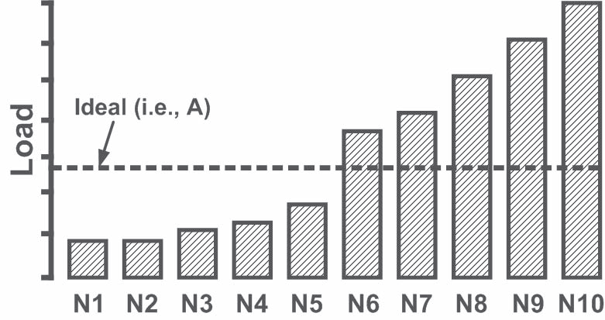
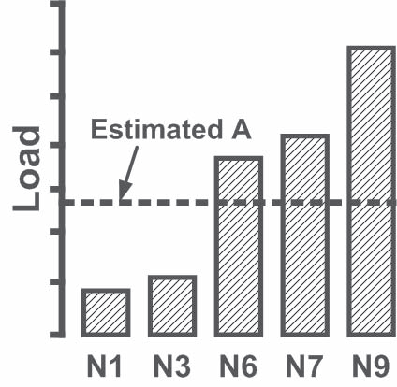
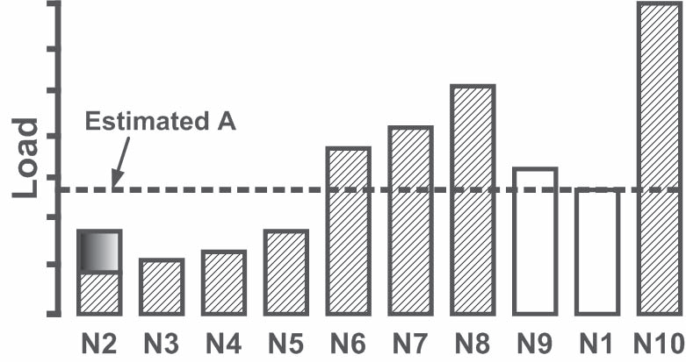
Demonstration
Courtesy: Load Rebalancing For Distributed File Systems In Clouds IEEE Transactions On Parallel And Distributed Systems, Vol. 24, 2013

Slide 19
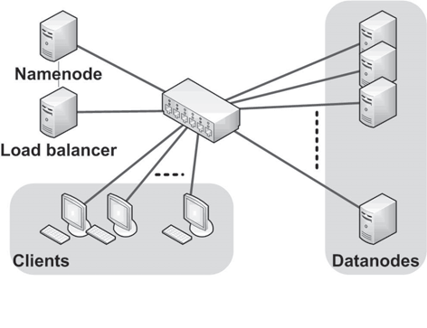
Implementation
Experimental Environment
Implemented in Hadoop HDFS
Assessed it against the load balancer in HDFS
Courtesy: Load Rebalancing For Distributed File Systems In Clouds IEEE Transactions On Parallel And Distributed Systems, Vol. 24, 2013
Fig. 6.1

Slide 20
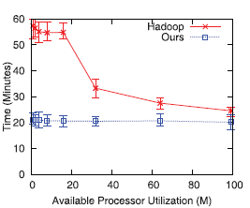
Implementation
Experimental Results
CPU Utilization | HDFS (min) | PROPOSAL(min)
1 % 20 % 40 % 60 % | 60 55 35 30 | 20 20 20 20
Table 1
Fig. 6.2
Courtesy: Load Rebalancing For Distributed File Systems In Clouds IEEE Transactions On Parallel And Distributed Systems, Vol. 24, 2013

Slide 21
Conclusion
Fast convergence rate
Low movement cost
Independent of load of central node
Future works in heterogeneous environment

Slide 22
References
S. Ghemawat, H. Gobioff, and S.-T. Leung, “The Google File System,” Proc. 19th ACM Symp. Operating Systems Principles (SOSP’03), pp. 29-43, Oct. 2003.
Hadoop Distributed File System, http://hadoop.apache.org/hdfs/, 2012.
M. Jelasity, A. Montresor, and O. Babaoglu, “Gossip-Based Aggregation in Large Dynamic Networks,” ACM Trans. Computer Systems, vol. 23, no. 3, pp. 219-252, Aug. 2005.

Slide 23
References
D. Karger and M. Ruhl, “Simple Efficient Load Balancing Algorithms for Peer-to-Peer Systems,” Proc. 16th ACM Symp. Parallel Algorithms and Architectures (SPAA ’04), pp. 36-43, June 2004.
Computer Networks A Systems Approach-Larry L.Peterson and Bruce S.Davie,4th Edition .Morgan Kaufman

Slide 24
Thank You

Slide 25
Questions?

