Slide 1
WELCOME

Slide 2
DESIGN & IMPLEMENTATION OF A SMART E-RECEPTIONIST
Mohammed Niyaz
S7R-37
Topic & Slide Approved by: Jisha P. Abraham
Date of Topic Approval: 07-10-2013
Date of Slide Approval: 09-10-2013

Slide 3
CONTENTS
DESIGN & IMPLEMENTATION OF A SMART E-RECEPTIONIST
Introduction
Traditional System
Proposed System
System Design
Architecture
Implementation
Conclusion
References

Slide 4
INTRODUCTION
DESIGN & IMPLEMENTATION OF A SMART E-RECEPTIONIST
Artificial intelligence
Face detection
Speech recognition
Notes:
Ai branch of cs that studies & develops intelligent machines & s/w.
Includes reasoning, knowledge, planning, learning , comm, perception &bability to move obj.
Face det: comp tech to determine loc & size of human faces in arbitrary images
Speech: translation of spoken words to text%

Slide 5
TRADITIONAL SYSTEM
DESIGN & IMPLEMENTATION OF A SMART E-RECEPTIONIST
Receptionist
Information kiosk
  No oral questioning
  No self learning abilities

Slide 6
PROPOSED SYSTEM
DESIGN & IMPLEMENTATION OF A SMART E-RECEPTIONIST
Smart E-Receptionist
  Greet approaching visitor
  Motion & voice detection
  Intelligent response

Slide 7
SYSTEM DESIGN
DESIGN & IMPLEMENTATION OF A SMART E-RECEPTIONIST
Video system module
Voice system module
Question-2-answer module
Output module

Slide 8
VIDEO SYSTEM MODULE
DESIGN & IMPLEMENTATION OF A SMART E-RECEPTIONIST
Capture live video stream
Motion detection algorithm
Automatic greeting

Slide 9
VOICE SYSTEM MODULE
DESIGN & IMPLEMENTATION OF A SMART E-RECEPTIONIST
Continuously monitor and pick voice
Speech Application Programming Interface (SAPI)

Slide 10
SAPI
DESIGN & IMPLEMENTATION OF A SMART E-RECEPTIONIST
Manage real time operations
2 types
  Speech recognizer
  Text to Speech systems (TTS)
Notes:
The SAPI provides a high-level interface between an application and speech engines and allows the use of speech recognition and speech synthesis within Microsoft Win- dows applications. The SAPI implements all of the low-level details needed to con- trol and manage the real-time operations of various speech engines. The two basic types of SAPI engines are speech recog-

Slide 11
QUESTION-2-ANSWER MODULE
DESIGN & IMPLEMENTATION OF A SMART E-RECEPTIONIST
Search for answer
String matching algorithm
Self learning

Slide 12
OUTPUT MODULE
DESIGN & IMPLEMENTATION OF A SMART E-RECEPTIONIST
Talk back
Save conversation

Slide 13
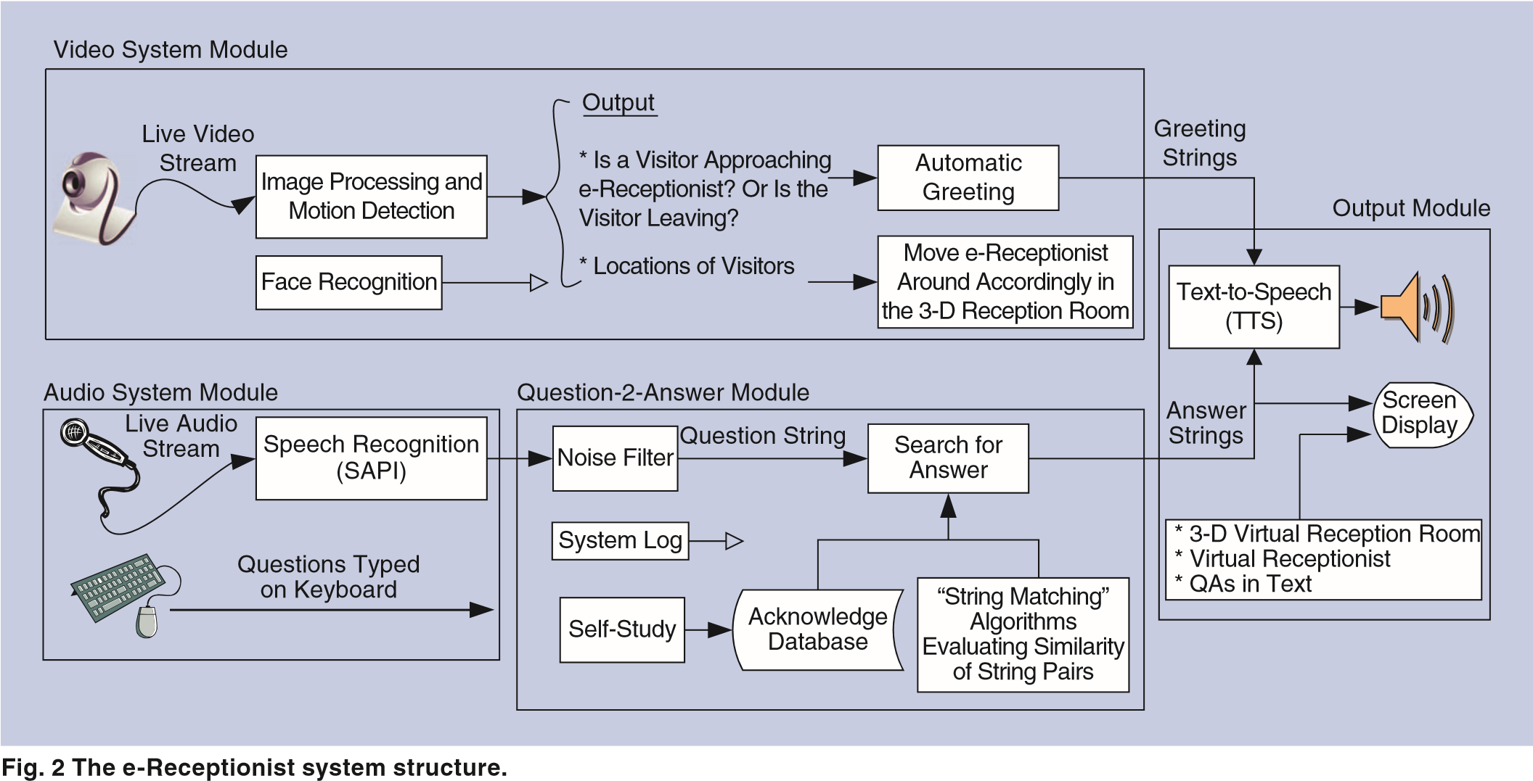
ARCHITECTURE
DESIGN & IMPLEMENTATION OF A SMART E-RECEPTIONIST

Slide 14
IMPLEMENTATION
DESIGN & IMPLEMENTATION OF A SMART E-RECEPTIONIST
Question Answer Knowledge Database
Visitor detection: Background Subtraction
String matching
  Longest Common Strand (LCS)
  SoundEx
  Adjacent Character Pair (ACP)

Slide 15
QUESTION ANSWER KNOWLEDGE DB
DESIGN & IMPLEMENTATION OF A SMART E-RECEPTIONIST
Fields
  SoundEx code
  Question String
  Answer String
  Additional info (image, video)

Slide 16
BACKGROUND SUBTRACTION ALGORITHM
DESIGN & IMPLEMENTATION OF A SMART E-RECEPTIONIST
Video frame- RGB 24 configurable
Convert to gray scale
Current frame – Previous frame
Remove noisy pixel
Check number of black pixels

Slide 17
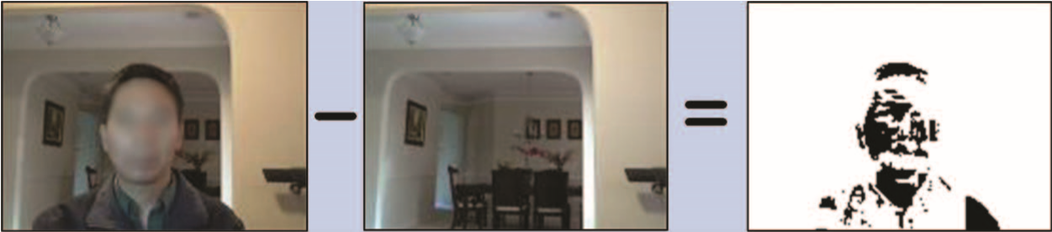
BACKGROUND SUBTRACTION (example)
DESIGN & IMPLEMENTATION OF A SMART E-RECEPTIONIST
(
a
)
(
b
)
(
d
)
Fig 2: Detecting visitor in front of video camera
a) Current frame b)Previous frame c)Difference

Slide 18
LCS ALGORITHM
DESIGN & IMPLEMENTATION OF A SMART E-RECEPTIONIST
Overall similarity
for(i=0;s1[i]!=‘\0’;i++)
for(j=0;s2[j]!=‘\0’;j++)
{ if(i==j==0) LCS[i,j]=0;
else if(s1[i]==s2[j])
LCS[i,j]=LCS[i-1,j-1]+1;
Notes:
finds the longest common base strand
but not necessarily consecutive.
comparing two strings, especially the ones with noises.

Slide 19
LCS ALGORITHM (contd.)
DESIGN & IMPLEMENTATION OF A SMART E-RECEPTIONIST
else LCS[i,j]=max{LCS[i,j-1],LCS[i-1,j]};
}
p1=length(s1)/LCS[i,j]
p2=length(s2)/LCS[i,j];
Compare p1,p2 and threshold value

Slide 20
LCS ALGORITHM (example)
DESIGN & IMPLEMENTATION OF A SMART E-RECEPTIONIST
s1=“kit cat” s2=“kit kat”
  Common base strand = “kit at”
  LCS=85.7% for both

Slide 21
SOUNDEX ALGORITHM
Encoding homophones
First character followed by 3 digits
DESIGN & IMPLEMENTATION OF A SMART E-RECEPTIONIST
Consonant in String | Corresponding Number
b, f, p, v | 1
c, g, j, k, j, q, s, x, z | 2
d, t | 3
l | 4
m, n | 5
r | 6
Table 1.1:
Notes:
phonetic algorithm for indexing names, by sound
encoding homophones to the same rep- resentation so that they can be matched despite minor differences in spelling

Slide 22
SOUNDEX ALGORITHM (contd.)
DESIGN & IMPLEMENTATION OF A SMART E-RECEPTIONIST
Algorithm
Retain first letter of string
Drop all occurrence of a,e,i,o,u,y,b,w
Substitute consonants with digit from table 1.1
Combine 2 adjacent letters having same number

Slide 23
SOUNDEX ALGORITHM (contd.)
DESIGN & IMPLEMENTATION OF A SMART E-RECEPTIONIST
Combine 2 letters separated by h or w having same number
Letters with same number separated by vowels coded twice
Compare code

Slide 24
SOUNDEX ALGORITHM (example)
DESIGN & IMPLEMENTATION OF A SMART E-RECEPTIONIST
Consonant in String | Corresponding Number
b, f, p, v | 1
c, g, j, k, j, q, s, x, z | 2
d, t | 3
l | 4
m, n | 5
r | 6
s1=“Robert” R163
s2=“Rupert” R163
S3=“Rubin” R150

Slide 25
ACP ALGORITHM
DESIGN & IMPLEMENTATION OF A SMART E-RECEPTIONIST
Substring and ordering
Algorithm
Break strings into letter pairs
P(s1)= set of letter pairs in string s1
P(s2)= set of letter pairs in string s2
P(s1+s2)= number of common pairs in two strings
Similarity= 2*|P(s1+s2)|/(|P(s1)|+|P(s2)|)
Notes:
evaluates the simi- larity of two strings, S1 and S2, by consider- ing two factors: substring and ordering

Slide 26
ACP ALGORITHM (example)
DESIGN & IMPLEMENTATION OF A SMART E-RECEPTIONIST
s1= “American people s2=“people of America”
P(s1)={Am,me,er,ri,ic,ca,an,np,pe,eo,op,pl,le}
P(s2)={pe,eo,op,pl,le,eo,of,fA,Am,me,er,ri,ic,ca}
P(s1+s2)={Am,me,er,ri,ic,ca,pe,eo,op,pl,le}
LCP= 41.18 and 46.67 ACP= 91.67

Slide 27
CONCLUSION
DESIGN & IMPLEMENTATION OF A SMART E-RECEPTIONIST
Virtual receptionist
Vivid and friendly
Changeable, replaceable and expandable

Slide 28
REFERENCES
DESIGN & IMPLEMENTATION OF A SMART E-RECEPTIONIST
• S. Sik, K. Jeong, and S. Hwa, “De- velopment of information architecture for user-centered hospital kiosk,” Oct. 2011, pp. 201–203.
• J. Gauvain, J. Gangolf, and L. Lamel. “Speech recognition for an in- formation kiosk” in Proc. IEEE 4th Int. Conf. Spoken Language, Oct. 1996, pp. 849–852.
•Microsoft speech SDK. Available: http://www.microsoft.com/en-us/ download/details.aspx?id=10121

Slide 29
REFERENCES (contd.)
DESIGN & IMPLEMENTATION OF A SMART E-RECEPTIONIST
• National Archives and Records Administration. (2007, May). The Soun- dex system. [Online]. Available: http:// www.archives.gov/research/census/ soundex.html
• D. E. Knuth, The Art of Computer Programming: Sorting and Searching, vol. 3. Reading, MA: Addison-Wesley, 1973.
• A. Yilmaz, O. Javed, and M. Shah, “Object tracking: A survey,” ACM Com- put. Surveys, vol. 38, no. 4, pp. 1–45, Dec. 2006.

Slide 30
QUESTIONS ?
DESIGN & IMPLEMENTATION OF A SMART E-RECEPTIONIST

Slide 31
THANK YOU….

