Slide 1
WELCOME

Slide 2
Efficient Processing of Semantic Web Queries in
Hbase and MySQL
Presented by,
Naima Mepurath
S7R
39
Topic Approval:12/07/13
Slide Approval :25/07/13
Slide Approved by:
Ms.Jisha.P.Abraham
Topic Approved by :
Eldo.P.Alias

Slide 3
CONTENTS
Efficient Processing of Semantic Web Queries in Hbase and MySQL
Introduction
Semantic Web
HBase
MySQL
Architecture
Performance Study
Conclusion
References

Slide 4
INTRODUCTION
Efficient Processing of Semantic Web Queries in Hbase and MySQL
Semantic descriptions
Management of Resource Description Framework(RDF) data
Scalable RDF
Focus on Hbase and MySQL

Slide 5
SEMANTIC WEB
Efficient Processing of Semantic Web Queries in Hbase and MySQL
Web with a meaning
Web of data
Find, share, and combine information easily
Flexible

Slide 6
RESOURCE DESCRIPTION FRAMEWORK
Efficient Processing of Semantic Web Queries in Hbase and MySQL
Standard model for data interchange
Describe information and resources
subject-predicate-object expressions
Directed labelled graph

Slide 7
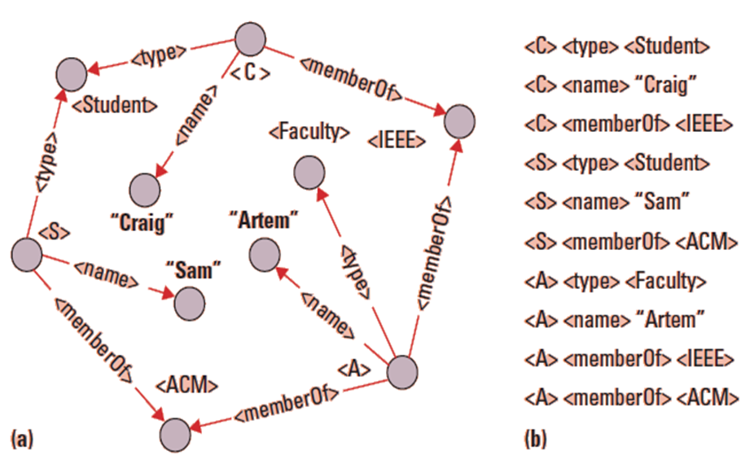
RESOURCE DESCRIPTION FRAMEWORK(Contd..)
Courtesy:Efficient processing of semantic Web Queries
Figure 1

Slide 8
SPARQL
Efficient Processing of Semantic Web Queries in Hbase and MySQL
Retrieve and manipulate data
Triple patterns and graphs
Eg.,?X <type> <UndergraduateStudent>

Slide 9
HBASE
Efficient Processing of Semantic Web Queries in Hbase and MySQL
Column-oriented
Family:qualifier
Attributes grouped
Flexible

Slide 10
HBASE Contd..
Efficient Processing of Semantic Web Queries in Hbase and MySQL
Table scan and Row key method
Sparse nature
Efficient retrieval-
          Schema using two tables

Slide 11
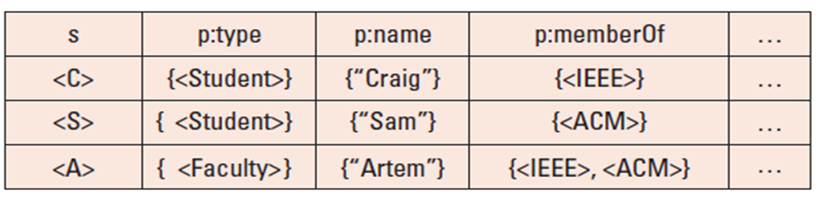
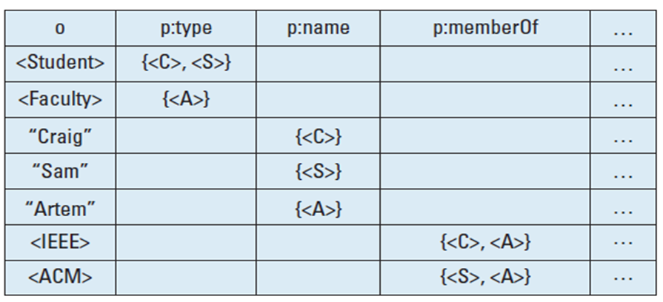
Efficient Processing of Semantic Web Queries in Hbase and MySQL
T(sp)HBase and T(op)HBase
Courtesy:Efficient processing of semantic Web Queries

Slide 12
MySQL
Efficient Processing of Semantic Web Queries in Hbase and MySQL
High availability and high throughput
Relational database
No single point of failure
Partitioning

Slide 13
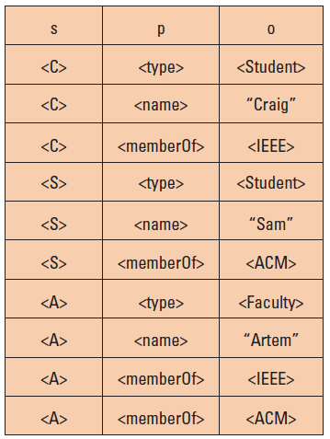
Efficient Processing of Semantic Web Queries in Hbase and MySQL
T(MySQL)
Courtesy:Efficient processing of semantic Web Queries
Figure 3.(b)

Slide 14
FEATURES
Efficient Processing of Semantic Web Queries in Hbase and MySQL
Evolution
Horizontal partitioning
Lossless storage

Slide 15
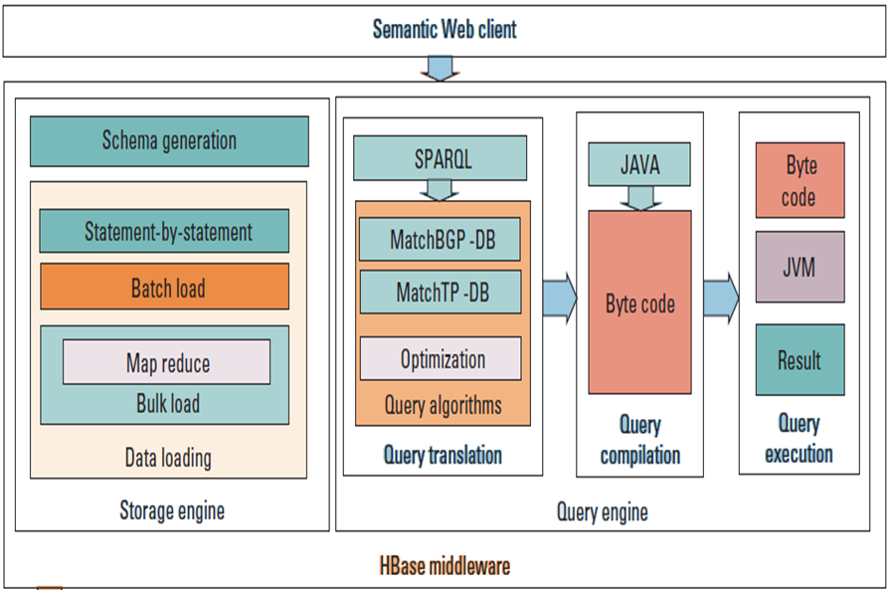
ARCHITECTURE
Courtesy:Efficient processing of semantic Web Queries

Slide 16
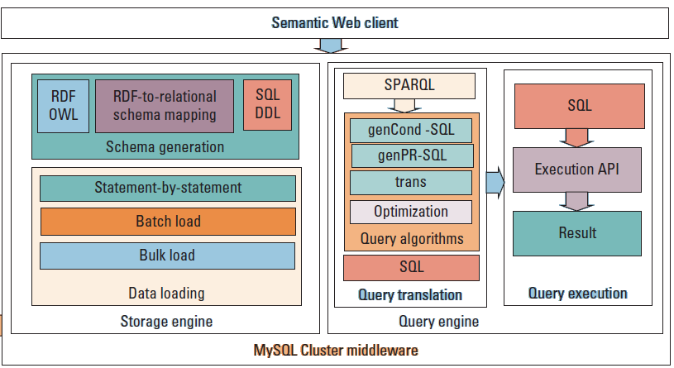
Courtesy:Efficient processing of semantic Web Queries

Slide 17
Efficient Processing of Semantic Web Queries in Hbase and MySQL
DEPLOYMENT IN CLOUD
A workload manager
A data index
A query planner

Slide 18
PERFORMANCE STUDY
Efficient Processing of Semantic Web Queries in Hbase and MySQL
Data loading performance
Query evaluation performance

Slide 19
CONCLUSION
Efficient Processing of Semantic Web Queries in Hbase and MySQL
Distributed data management
HBase and MySQL
HBase showed superior query performance

Slide 20
REFERENCES
Efficient Processing of Semantic Web Queries in Hbase and MySQL
C. Franke et al., “Distributed Semantic Web Data Management in HBase and MySQL Cluster,” Proc. IEEE Int’l Conf. Cloud Computing, 2011,pp. 105112;http://dx.doi.org/10.1109/CLOUD.2011.9.
J. Abraham et al., “Distributed Storage and Querying Techniques for a Semantic Web of Scientific Workflow Provenance,” Proc. IEEE Int’l Conf. on Services Computing, IEEE, 2010, pp. 178–185; http://dx.doi.

Slide 21
REFERENCES CONTD..
Efficient Processing of Semantic Web Queries in Hbase and MySQL
A. Chebotko, S. Lu, and F. Fotouhi, “Semantics Preserving SPARQL-to-SQL Translation,” Data & Knowledge Eng., vol. 68, no. 10, 2009, pp. 973–1000.
A. Chebotko and S. Lu, Querying the Semantic Web: An Efficient Approach Using Relational Databases, Lambert Academic Publishing, 2009.

Slide 22
QUESTIONS?

Slide 23
THANK YOU!

