Slide 1
WELCOME

Slide 2
TASK MIGRATION ON
MANY-CORE DISTRIBUTED OPERAING SYSTEM
Topic Approval:1/07/2013
Slide Approval:25/07/2013
Topic approved by: Mr.Eldho P. Alias
Slide approved by: Ms.Jisha P. Abraham
Merin Paul
Roll NO:36
S7 R

Slide 3
CONTENTS
Task migration on many-core distributed OS
Introduction
Platform
Task migration methodology
Implementation
Evaluation
Conclusion
Reference

Slide 4
INTRODUCTION
Task migration on many-core distributed OS
Many core
Task migration
  Thermal balance
  System performance

Slide 5
PRESENT STRATEGIES
Task migration on many-core distributed OS
Replication strategy
    Creation of replicas
Recreation strategy
    Copy original task

Slide 6
STRUCTURE OF PLATFORM
Task migration on many-core distributed OS
Distributed operating system
Many core
Shared memory
Advanced RISC Machines(ARM) Cortex-A9

Slide 7
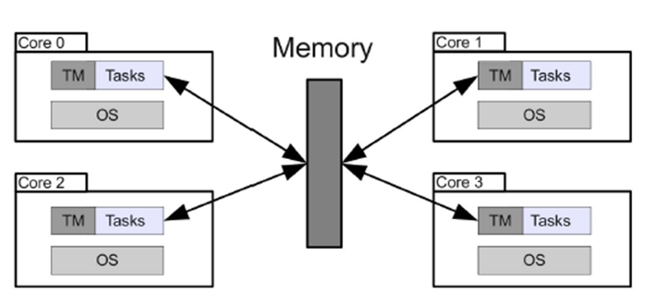
STRUCTURE OF PLATFORM
Task migration on many-core distributed OS
ARM Cortex-A9
Fig 1. Courtesy: Task Migration on Many-Core
Distributed Operating Systems

Slide 8
TASK MIGRATION METHODOLOGY
Task migration on many-core distributed OS
Notion of task migration
Use-case

Slide 9
NOTION OF TASK MIGRATION
Task migration on many-core distributed OS
Ensure Safe state
Checkpointing Mechanism

Slide 10
PROCEDURE FOR TASK MIGRATION
Task migration on many-core distributed OS
Requests migration of task T1
Request hook called
Set Migration_request flag
Checks migration_requests flag
Task 1 migrated

Slide 11
USE-CASE
Task migration on many-core distributed OS
Request Lag
Void looptask()
{ while(1){
for(i=0;i<MAX;i++){
foo(); /*call to function*/
If(migration_requested)
/*Go into safe state and suspend*/
TASK_IN_SAFE_STATE();
}
}
}
Checkpointing example

Slide 12
IMPLEMENTATION
Task migration on many-core distributed OS
Virtual memory mapping
Context transfer

Slide 13
VIRTUAL MEMORY MAPPING
Task migration on many-core distributed OS
Virtual memory
Globally Visible Memory(GVM)
Inter Core Communication(ICC)

Slide 14
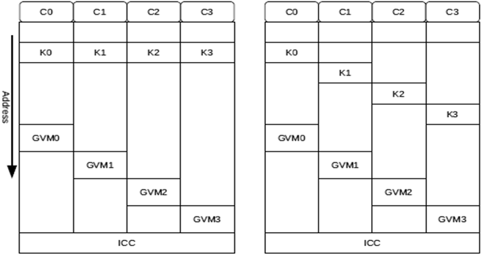
VIRTUAL MEMORY LAYOUT FOR QUAD CORE
Task migration on many-core distributed OS
Virtual memory layout
Physical memory layout
Fig 2. Courtesy: Task Migration on Many-Core Distributed Operating Systems

Slide 15
CONTEXT TRANSFER
Task migration on many-core distributed OS
Stack state
  Only pointer is moved
Heap state
  Only pointer is moved
Function references
Inter-task communication

Slide 16
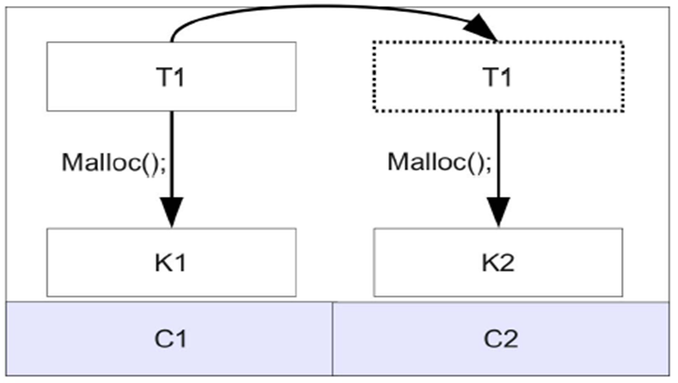
FUNCTION REFERENCES
Task migration on many-core distributed OS
Migrate to C2
Fig 3. Courtesy: Task Migration on Many-Core
Distributed Operating Systems

Slide 17
EVALUATION
Task migration on many-core distributed OS
Performance evaluation
Power evaluation
Migration overhead

Slide 18
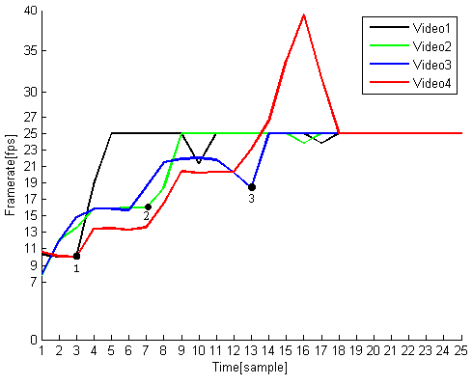
PERFORMANCE EVALUATION
Task migration on many-core distributed OS
Fig 4. Courtesy: Task Migration on Many-Core
Distributed Operating Systems

Slide 19
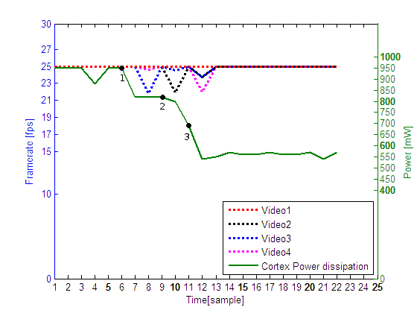
POWER EVALUATION
Task migration on many-core distributed OS
Fig 5. FigCourtesy:Task Migration on Many-Core
Distributed Operating Systems

Slide 20
MIGRATION OVERHEAD
Task migration on many-core distributed OS
Task detachment and activation of inter-core communication
Moving data over inter core channel
Arrival of inter core data and the attachment of the task

Slide 21
CONCLUSION
Task migration on many-core distributed OS
Maximum system performance
Power conservation
Utilize spatial location

Slide 22
REFERENCES
Task migration on many-core distributed OS
M. T. Jones, “Inside the Linux scheduler,” Jun2006.Available:http://www.ibm.com/developerworks/linux/library/l-scheduler/
(2009) Cortex a9 technical reference manual.http://infocenter.arm.com/help/topic/com.arm.doc.ddi0388e/DDI0388E cortex a9 r2p0 trm.pdf

Slide 23
REFERENCES CONTD...
Task migration on many-core distributed OS
A. Kleen, “Linux multi-core scaleability,” in Linux Kongress 2009, Dresden, 2009
A. Aguiar, S. J. Filho, T. G. dos Santos, C. Marcon, and F. Hessel, “Architectural support for task migration conserning mpsoc,” in SBC, 2008

Slide 24
THANK YOU…
Task migration on many-core distributed OS

Slide 25
QUESTIONS??
Task migration on many-core distributed OS

