Slide 1
Incremental Lifecycle Validation of Knowledge-Based Systems Through CommonKADS
Topic Approval:12/09/13
Slide Approval:/09/13 Merin Davis
Topic and Slide Approved by: Roll no:35
Mrs.Jisha.P.Abraham S7R

Slide 2
CONTENTS
Incremental lifecycle validation of Knowledge-Based system Through CommonKADS
Knowledge Based Systems(KBS)
CommonKADS
Existing Method
MAVERICK
Experimental Evaluation of MAVERICK
Conclusion
References

Slide 3
UNCERTAIN DATABASES AND SKYLINE
Incremental validation of knowledge-Based systems Through CommonKADS
Data Uncertainty
Tuples not dominated
Tuple p dominates q( p q)
    p not worse than q on all attributes
    p better than q on at least one attribute

Slide 4
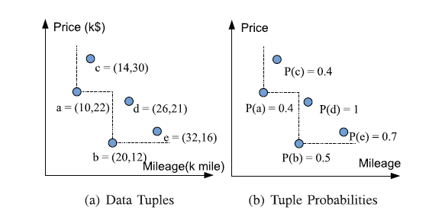
AN EXAMPLE
Incremental validation of knowledge-Based systems Through CommonKADS
Fig.1: Graph for vehicle data set
COURTESY:IEEE TRANSACTIONS ON KNOWLEDGE AND DATA ENGINEERING

Slide 5
SKYLINE-PROPERTIES
Incremental validation of knowledge-Based systems Through CommonKADS
Non-dominance
Incomparability
Coverage

Slide 6
P-SKYLINE
Incremental validation of knowledge-Based systems Through CommonKADS
Possible world
P({ a, b, d})=P(a). P(b). P(c). P(d). P(e)=0.036
Non-dominance probability
    Aggregating all possible worlds where tuple not dominated
    P_{non-dom} (d)= P(b). P(d)= 0.5

Slide 7
P-SKYLINE(Contd..)
Incremental validation of knowledge-Based systems Through CommonKADS
Non-dominance probability>= threshold value
Skyline set in vehicle set: {b,d} when threshold = 0.5

Slide 8
ISSUES
Incremental validation of knowledge-Based systems Through CommonKADS
Interplay/relationship - not considered
Can be an invalid skyline
Users not aware of proper threshold

Slide 9



U-SKYLINE
Incremental validation of knowledge-Based systems Through CommonKADS
U-Skyline probability
P_{u-sky}(S)= P(t_{i}). P(t_{j} ). 1
U-Skyline query
      Maximum U-Skyline probability

Slide 10
U-SKYLINE PROCESSING ALGORITHMS
Incremental validation of knowledge-Based systems Through CommonKADS
Candidate Skyline Search Algorithm
Dynamic Search Algorithm
Pruning and Early Termination Algorithm (P&ET)

Slide 11
CANDIDATE SKYLINE SEARCH ALGORITHM
Incremental validation of knowledge-Based systems Through CommonKADS
For any candidate skyline S in dataset D
    Compute P_{u-sky}(S )
Return S with max P_{u-sky}(S )

Slide 12
DYNAMIC PROGRAMMING CONCEPTS
Incremental validation of knowledge-Based systems Through CommonKADS
Tuple access order
Monotonic function- f(.)
      ∀t_{i} t_{j} , f(.) guarantees that f(t_{i}) ≤ f(t_{j})
f(t)=min_{i} (t.a_{i} )
SC_{i}-candidate skylines created while accessing t_{i}
SC-set of all SC_{i}

Slide 13
DYNAMIC PROGRAMMING ALGORITHM
Incremental validation of knowledge-Based systems Through CommonKADS
Sort dataset D based on monotonic function
Initialize candidate skyline sets as ϕ
Compare each tuple t_{i} with each tuple t_{x} lying above t_{i} in sorted dataset for dominating property
  For each candidate S_{j} in SC_{x} ,check dominance between S_{j} & t_{i}

Slide 14
DYNAMIC PROGRAMMING ALGORITHM(Contd..)
Incremental validation of knowledge-Based systems Through CommonKADS
    If S_{j} does not dominate t_{i} then
      Create new candidate including t_{i} with S_{j}
      U-skyline probability of new set:
      P_{u-sky} (S _{j}). P(t_{i})
      P_{u-sky} (S _{j}) modified as P_{u-sky} (S_{j}). P(t_{i})
      Add new set to candidate set SC_{i}
  Update SC as SC U SC_{i}
Return S_{i} in SC with max P_{u-sky}(S_{i})

Slide 15
SKYLINE PRUNING AND EARLY TERMINATION
Incremental validation of knowledge-Based systems Through CommonKADS
Prune and early terminate search
Score lower bound
L(S_{j} )=min_{ti€Sj} (max_{1≤m≤d} t_{i}.a_{m})
For t_{i} € D with f(t_{i})>L(S_{j}),
S_{j} t_{i}
bestUSky, bestUSkyP

Slide 16
PRUNING AND EARLY TERMINATION ALGORITHM
Incremental validation of knowledge-Based systems Through CommonKADS
Sort(D)
Initialize skyline sets as ϕ, L(ϕ) as ∞ & bestUSkyP as 0
Compare each tuple t_{i} with each tuple t_{x} lying above t_{i} in sorted dataset for dominating property
  For each candidate S_{j} in SC_{x}

Slide 17
P&ET(Contd..)
Incremental validation of knowledge-Based systems Through CommonKADS
    If f(t_{i}) is greater than L(S_{j}), then
        Delete S_{j} from SC_{x}
        Update bestUSkyP, bestUSky<- S_{j}
    Else-if P_{u-sky}(S_{j}) is lesser than bestUSkyP, then
        Delete S_{j} from SC_{x}
    Else-if S_{j} does not dominate t_{i}, then

Slide 18
P&ET(Contd..)
Incremental validation of knowledge-Based systems Through CommonKADS
      Create new candidate including t_{i} with S_{j}
      U-skyline probability of new set: P_{u-sky} (S_{j}). P(t_{i})
      P_{u-sky} (S_{j}) modified as P_{u-sky} (S_{j}). P(t_{i})
      Add new set to candidate set SC_{i}
  Update SC as SC U SC_{i}
Return bestUSky

Slide 19
DATASET REDUCTION AND PARTITION
Incremental validation of knowledge-Based systems Through CommonKADS
Improve efficiency
Two improvements
    Reduced Set Pruning Algorithm
        Reduced set
    Reduced Set Independent Partition Algorithm
        Divide-and-conquer strategy

Slide 20
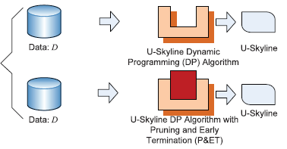
OVERVIEW- QUERY PROCESSING
Incremental validation of knowledge-Based systems Through CommonKADS
COURTESY:IEEE TRANSACTIONS ON KNOWLEDGE AND DATA ENGINEERING
Fig.2: U-skyline
Processing
Algorithms

Slide 21
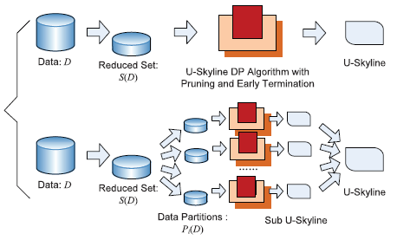
OVERVIEW-DATASET REDUCTION AND PARTITION
Incremental validation of knowledge-Based systems Through CommonKADS
COURTESY:IEEE TRANSACTIONS ON KNOWLEDGE AND DATA ENGINEERING
Fig.3: Input
Dataset
Reduction
And Partition

Slide 22
CONCLUSION
Incremental validation of knowledge-Based systems Through CommonKADS
Better coverage
U-skyline processing- NP hard
Alleviate computational strain
10-100 times faster

Slide 23
REFERENCES
Incremental validation of knowledge-Based systems Through CommonKADS
I.Sommerville,SoftwareEngineering,8thed.Reading,MA:Addison-Wesley
A.J Gonzalez and D.Dankel “The Engineering of Knowledge-Based Systems: Theory and Practice”,Englewoods Cliffs,NJ:Prentice-Hall,1993
C.Anderson,T.Thelin,P.runeson,and N.Dzamashvili,”An Experimental Evaluation of inspection and testing for detection of design faults", in proc.ISESE,2003,p.174
C.Larman and V.R.Basili,:Iterative and incremental developments: A brief history”, Computer,vol.36, no.6,pp.47-56,jun 2003

Slide 24
REFERENCES(Contd..)
Incremental validation of knowledge-Based systems Through CommonKADS
J. Weitzel and L.Kerscheberg,”Developing Knowledge-based Systems:Reorganizing the system the system development life cycle”,ACM J,Commun.,vol.32,no.4,pp.481-488,1989
G.Shreiber,H.Akkermans,A. Anjewierden,R.De Hoog,N.Shadbolt,W.Van De Velde,and B.Wielinga,Knowledge Engineering and Management-the CommonKADS Methodology,Cambridge,MA:MIT Press,2000h.
G.Schreiber,B.Wielinga, H.Akkermans

Slide 25
QUESTIONS??
Incremental validation of knowledge-Based systems Through CommonKADS

