Slide 1
JOB DATA SCHEDULING USING BEE COLONY IN GRID ENVIRONMENTS
Topic approval : 22/07/2013
Slide approval : 26 /07/2013
Topic and slides approved by : Jisha P Abraham
Meera Jose
Roll no:34
S7 R

Slide 2
Content
Introduction
Existing system
Proposed system
Framework
Data aware job scheduling
JDSBC flowchart
Job scheduling algorithm
Data files replication algorithm
Conclusion

Slide 3
Introduction
Grid computing
Grid scheduler
Scheduling phases
  Resource discovery
  Matchmaking
  Job execution

Slide 4
Existing System
Minimizes
  either makespan
  or transfer time

Slide 5
Disadvantages
Both factors not considered
Generalization impossible

Slide 6
PROPOSED SYSTEM
Job Data Scheduling Using Bee Colony-JDSBC
Generalized framework
Concurrently minimize
  Make-span
  Transfer time

Slide 7
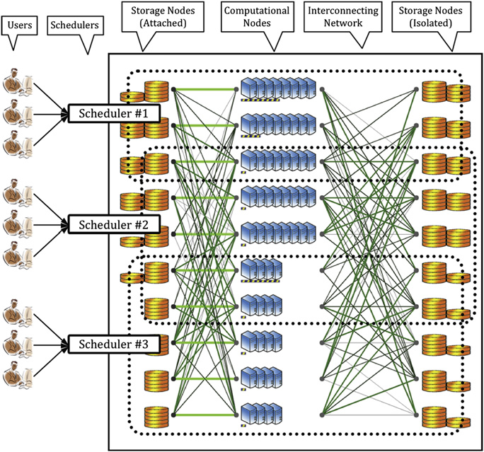
FRAMEWORK
Figure 1
Courtesy:J. Taheri et al. / Computers & Operations Research 40 (2013)

Slide 8
Schedulers
Independent entities
Decision makers
Accept jobs and datafiles
Schedule/replicate

Slide 9
Storage nodes(SNs)
Storage elements
Hosts data files
2 types
  Isolated SNs
  Attached SNs

Slide 10
Computational nodes(CNs)
Each CN
  Homogeneous processors
  Local storage capability
Characterised by
  Processing speed
  Number of processors

Slide 11
Job Characteristics
Width
Height
Number of processors
Execution time

Slide 12
Data Aware Job Scheduling
Bi-objective optimisation problem
  Assign jobs
  replicate datafiles
Concurrently minimises
  Makespan
  Transfer time

Slide 13
Bee Colony Optimisation
Behaviour of bees
  Scouting
  Dancing
  Following
Waggle dance
Report findings

Slide 14
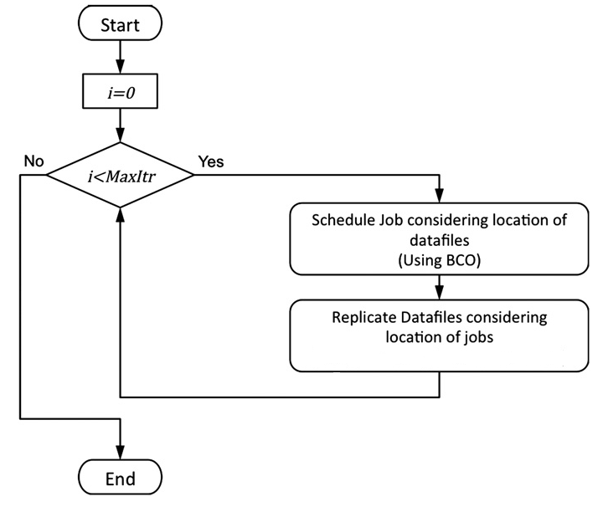
JDS-BC Flowchart
Courtesy: J. Taheri et al. / Computers & Operations Research 40 (2013)
Figure 2

Slide 15

Benefit
2 parts
  Execution benefit
  Transfer benefit
Courtesy: J. Taheri et al. / Computers & Operations Research 40 (2013)

Slide 16
Dance Floor
Host limited bees
Powerful CNs
Wider range of jobs

Slide 17
Similarity
Job characteristics compared
Similar jobs chosen

Slide 18
Estimated Benefit
Scouting benefit
  Free processors-(execution time/total processors)
Following benefit
  Most similar executed job
Maximum chosen

Slide 19
Estimated make-span
For each node
  Expected makespan +(Execution time/speed )
Minimum chosen

Slide 20
Job Scheduling Algorithm
Sort jobs
Initialize dance floor
For each job
  Calculate estimated make-span
  Calculate estimated benefit

Slide 21
Job Scheduling Algorithm(Contd.)
  Save results into an array
  Choose a CN from the array and schedule/assign job to it
  Calculate exact benefit
Repeat above step until all jobs are scheduled.

Slide 22
Datafiles replication algorithm
Sort data files
For each data file Dx
  Find total upload time of Dx to all its dependent jobs if it is replicated on each SN
  Store this result into an array Arr[]

Slide 23
Datafiles replication algorithm(Contd.)
Sort array in ascending order
For k=1 to Total replicas
  If(Arr[k]/MinUpTime(Dx ))<2 )
    Replicate Dx on SNk
Repeat above step until all data files are replicated

Slide 24
Conclusion
Novel BCO approach
New research possible
Extending to clouds

Slide 25
REFERENCES
A Bee Colony based optimization approach for simultaneous job scheduling and data replication in grid environments ,Javid Taheri a.n, Young Choon Lee a, Albert Y Zomaya a, Howard Jay Siegel
Feitelson D, Rudolph L, editors. Job scheduling strategies for parallel processing, vol. 1291. Berlin/Heidelberg: Springer; 1997.

Slide 26
REFERENCES(Contd.)
Tang M, Lee B-S, Tang X, Yeo C-K. The impact of data replication on job scheduling performance in the data grid. Future Generation Computer Systems 2006
Strazdins PE Uhlmann J. A comparison of local and gang scheduling on a bee wulf cluster.

Slide 27
REFERENCES(Contd.)
Basney J, Livny M, Mazzanti P. Utilizing widely distributed computational resources efficiently with execution domains. Computer Physics Communications 2001

Slide 28
THANKYOU

Slide 29
QUESTIONS ??

