Slide 1
WELCOME

Slide 2
EFFICIENT AND EFFECTIVE DUPLICATE DETECTION IN HIERARCHICAL DATA
Topic Approval On:02/09/2013
Slide Approval On:02/09/2013
Topic and Slide Approved By:
Mrs Jisha P Abraham
Sandra Achu George
Roll no:49
S7R

Slide 3
CONTENTS
Efficient and effective Duplicate Detection In Hierarchical Data
Introduction
Current system
Proposed system
Bayesian Network Construction
Computing Probabilities
Network Pruning
Conclusion
References

Slide 4
INTRODUCTION
Efficient and effective Duplicate Detection In Hierarchical Data
Fuzzy duplicates
Duplicates not exactly equal
Detect duplicates despite differences in data
Hierarchical relationships in xml

Slide 5
CURRENT SYSTEM
Efficient and effective Duplicate Detection In Hierarchical Data
Vector of terms
DogmatiX
Overlays
Sorted XML Neighborhood Method(SXNM)

Slide 6
PROPOSED SYSTEM
Efficient and effective Duplicate Detection In Hierarchical Data
Hierarchical data-XML
Xml features
Pruning
  Efficiency
  Precision

Slide 7
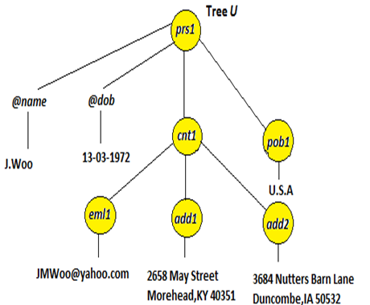
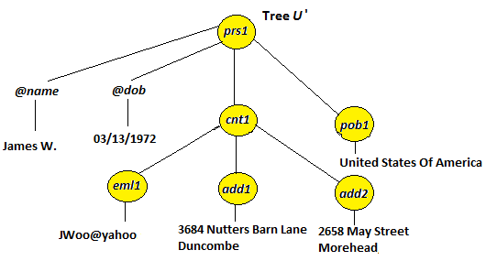
DUPLICATES EXAMPLE
Efficient and effective Duplicate Detection In Hierarchical Data

Slide 8
BAYESIAN NETWORK
Efficient and effective Duplicate Detection In Hierarchical Data
Directed acyclic graph
Nodes-random variables
Edges-dependencies
Compute similarity

Slide 9
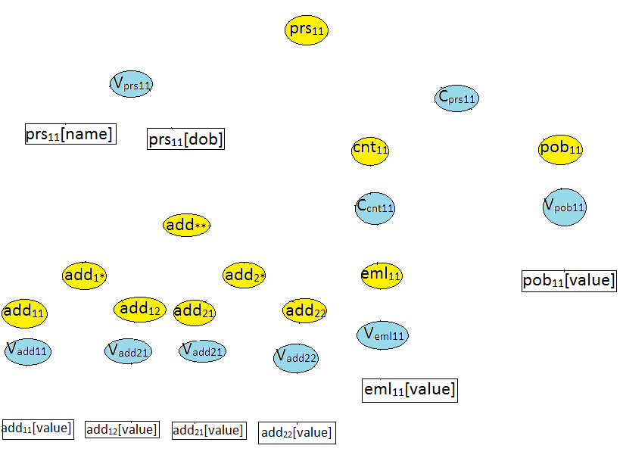
BAYESIAN NETWORK(Cont..)

Slide 10
COMPUTING PROBABILITIES
Efficient and effective Duplicate Detection In Hierarchical Data
Prior probabilities
Conditional probabilities
        CP1
        CP2
        CP3
        CP4
Final Probability
Notes:
ji

Slide 11
Efficient and effective Duplicate Detection In Hierarchical Data
CONDITIONAL PROBABILITY
CP | FORMULA | EXAMPLE
1 | P(V_{tij}|t_{ij}[a₁],…t_{ij}[a_{n}])=Ʃ_{1≤k≤n|tij[ak]=1}w_{ak} subject to Ʃ_{1≤k≤n}w_{ak} =1 | P(V_{prs11}|prs₁₁[name],prs₁₁[dob]) P(V_{pob11}|pob₁₁[value]) P(V_{eml11}|eml₁₁[value]) P(V_{addij}|add_{ij}[value])
2 | P(C_{tij}|t¹_{ij},t²_{ij},…,t^{n}_{ij})=1/n* Ʃ^{n}_{k=1} t^{k}_{ij} | P(C_{prs11}|pob₁₁,cnt₁₁) P(C_{cnt11}|eml₁₁,add**)

Slide 12
Efficient and effective Duplicate Detection In Hierarchical Data
CONDITIONAL PROBABILITY(Cont..)
CP | FORMULA | EXAMPLE
3 | P(t_{ij}|V_{tij},C_{tij})={1 iff V_{tij}=C_{tij}=1 0 Otherwise | P(prs₁₁|V_{prs11},C_{prs11}) P(pob_{11|}V_{pob11}) P(cnt₁₁|C_{cnt11}) P(eml₁₁|V_{eml11}) P(add_{ij}|V_{addij})
4 | P(t**|t_{1*} ,t_{2*},…,t_{n*})=1/nƩ^{n}_{k=1}t_{k*} P(t_{i*}|t_{i1},t_{i2},…,t_{in})={1 iff Ǝ_{j}|t_{ij}=1 0 Otherwise | P(add**|add_{1*},add_{2*}) P(add_{1*}|add_{i1})

Slide 13
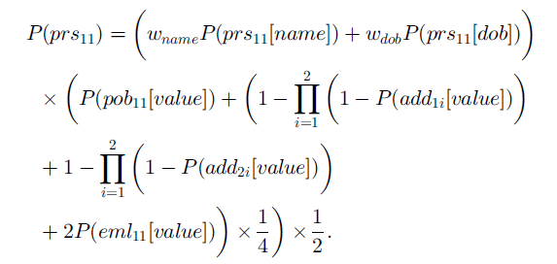
FINAL PROBABILITY
Efficient and effective Duplicate Detection In Hierarchical Data
COURTESY:IEEE TRANSACTIONS ON KNOWLEDGE AND DATA ENGINEERING

Slide 14
ACCELERATING NETWORK EVALUATION
Efficient and effective Duplicate Detection In Hierarchical Data
Complexity-O(n1×n2)
Analyze whole network
Time consuming

Slide 15
NETWORK PRUNING
Efficient and effective Duplicate Detection In Hierarchical Data
Lossless pruning strategy
Optimize network evaluation
Threshold

Slide 16
PRUNING ALGORITHM
Efficient and effective Duplicate Detection In Hierarchical Data
Input: The node N, threshold T
Get ordered list of parents in N
Assign maximum probability of each node as 1 currentscore←0
for each node n in L do
If n is a value node then
Compute similarities
else
Determine newthreshold

Slide 17
PRUNING ALGORITHM (Cont..)
Efficient and effective Duplicate Detection In Hierarchical Data
Call NetworkPruning recursively
end if
ComputeProbability
if currentscore < T then
End network evaluation
End for
Return currentScore

Slide 18
EFFECT OF NODE ORDER ON PRUNING
Efficient and effective Duplicate Detection In Hierarchical Data
Accelerate network evaluation
Heuristic for sorting
  Depth
  Average string size
  Distinctiveness

Slide 19
VARYING PRUNING FACTOR
Efficient and effective Duplicate Detection In Hierarchical Data
Pruning factor
Lower pruning factor
Faster

Slide 20
ADVANTAGES OF PROPOSED SYSTEM
Efficient and effective Duplicate Detection In Hierarchical Data
Flexible
Pruning-efficiency
Precision

Slide 21
CONCLUSION
Efficient and effective Duplicate Detection In Hierarchical Data
Duplicate detection
Bayesian network
Compute probabilities
Pruning Strategy-Efficiency

Slide 22
REFERENCES
Efficient and effective Duplicate Detection In Hierarchical Data
L. Leita˜o, P. Calado, and M. Weis, “Structure-Based Inference ofXML Similarity for Fuzzy Duplicate Detection,” Proc. 16th ACMInt’l Conf. Information and Knowledge Management, pp. 293-302,2007
P. Calado, M. Herschel, and L. Leita˜o, “An Overview of XML Duplicate Detection Algorithms,” Soft Computing in XML Data Management, Studies in Fuzziness and Soft
Computing,vol. 255,pp. 193-224, 2010

Slide 23
REFERENCES(Cont..)
Efficient and effective Duplicate Detection In Hierarchical Data
L. Leita˜o and P. Calado, “Duplicate Detection through Structure Optimization,” Proc. 20th ACM Int’l Conf. Information and Knowledge Management, pp. 443-452, 2011

Slide 24
THANK YOU…
Efficient and effective Duplicate Detection In Hierarchical Data

Slide 25
QUESTIONS ?
Efficient and effective Duplicate Detection In Hierarchical Data

