Slide 1
WELCOME...

Slide 2
A NOVEL CRYPTOGRAPHY METHOD BASED ON IMAGE FOR KEY GENERATION
Topic approval : 6/09/2013
Slide approval : 18/10/2013
Topic and slides approved by : Jisha P Abraham
Mebin Mathew
Roll no:33
S7 R
Notes:
WE ALL KNOW WATS CRYPTO & IT INCLUDES ENCRY & DECRY ..& NEED A KEY FOR THE PURPOSE OF SECURITY…<TOPC> MORE SECURE AND SIMPLE

Slide 3
CONTENTS
Introduction
Existing system
Proposed system
Materials & Methods
Framework
Algorithms
Conclusion

Slide 4
INTRODUCTION
Cryptography
Need for cryptography
Key generation
Cipher text
Encryption
Decryption
Notes:
CRYPTO DEFNTION ,
NEED :- CONFIDENTIALITY,AUTHENTICITY,INTEGRITY,ACCESS CONTROL
KEY : INFO GNRTD TO ENCRYP& DECRY..NUMRC ALPHA NUMRC OR SYMBOL
CIPHR TXT
ENCRY:PLAINT TXT TO CIPHR
ENCRYPT ALGO & KEY
SENDR SIDE
DECRY:
OPST OF ENCRY

Slide 5
EXISTING SYSTEM
Biometric finger print method
Biometric iris detection method

Slide 6
DISADVANTAGES
Security issues
Storage of key
Notes:
KEY GENERATED B4 ENCRY & DECRY THRFRE NED TO BE STORED/REMEMBERED

Slide 7
PROPOSED SYSTEM
Key generation using images
Key generated during encryption & decryption
RGB image is used for key generation
Key varies depending on size of message & session used
Flexible,secure & easy to implement

Slide 8
MATERIALS & METHODS
Binary messages
RGB images
LSB of image
Key

Slide 9
BINARY MESSAGES
Original message converted into binary
Stored in multidimensional array Data[N,N]
N is the number of bits in original message
N*N is the number of bits in binary message

Slide 10
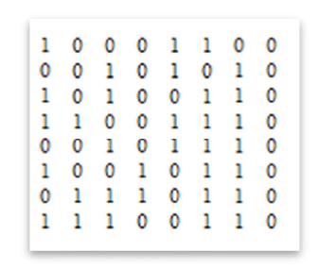
TEXT TO BINARY
Original message into binary
1testing

Slide 11
RGB IMAGES
Contain 3 channels
Red,Green,Blue
24 bit RGB image is used
Each channel of 8 bit

Slide 12
LSB OF IMAGES
Least Significant Bit
Unit place of a binary value
Pixel colors are converted into its corresponding ASCII
ASCII further converted into binary form
LSB of that binary form is taken

Slide 13
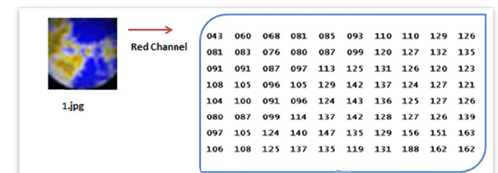
LSB OF RGB
Select picture and is converted into corresponding ASCII values

Slide 14
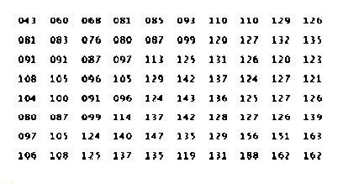
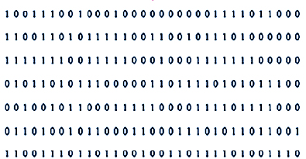
LSB OF RGB
LSB of pixels are stored into an array

Slide 15
KEY
Numeric or alpha numeric text or a symbol
Infomartion generated to encrypt and decrypt
Represented as binary array
KEY[ N,K ]
N is the size of text and K is even number between 2 and N

Slide 16
FRAMEWORK(SENDER)
  Image database Message
  Image selection
  Binary message
  LSB of RGB
  Key generation Message encryption
  Send encrypted message

Slide 17
FRAMEWORK(RECEIVER)
  Image database Encrypted Message
  Image selection
  Binary message
  LSB of RGB
  Key generation Message decryption
  Original message

Slide 18
ALGORITHMS
Proposed system divided into 4 phase
        Database creation
        Key generation
        Encryption
        Decryption

Slide 19
DATABASE CREATION
Create database for RGB images
Sender & Receiver have same database
Number of images depends on session used

Slide 20
KEY GENERATION
Get values of K & N from binaries message step
Select image from database according to the session and current date or time
Retrieve the image and create array Img[x,y] as LSB of pixels
Create array Key[N,k] to represent encryption key
Loop i=0 to N-1
Loop c=0 to k/2-1 step

Slide 21
KEY GENERATION
Scan the LSB Img[x,y] to find two neighbor values where the absolute difference between them is one.
Key[i,c] = First LSB value.
Key[i,c+1] = Second LSB value.
End loop
End loop

Slide 22
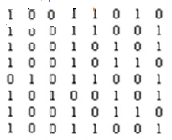
KEY GENERATION EXAMPLE

Slide 23
ENCRYPTION
Get the value of K variable.
Read a message to encrypt
Binaries the message and store the binary data in array Data[N,N] where message bits<= N*N
Generate the key using key generation algorithm and create Key [N, k]
Create array EncData [N, N] to store the encrypted data
c=0

Slide 24
ENCRYPTION(Cont..)
Loop i=0 to N-1
Loop j=0 to N-1
If Data[i,j] = Key[j,c]
EncData[i,j]=0
Else
EncData[i,j]=1
End loop
c=c+2

Slide 25
ENCRYPTION (Cont..)
If c >= K then c=0
End loop
Convert the EncData from binary data to text.

Slide 26
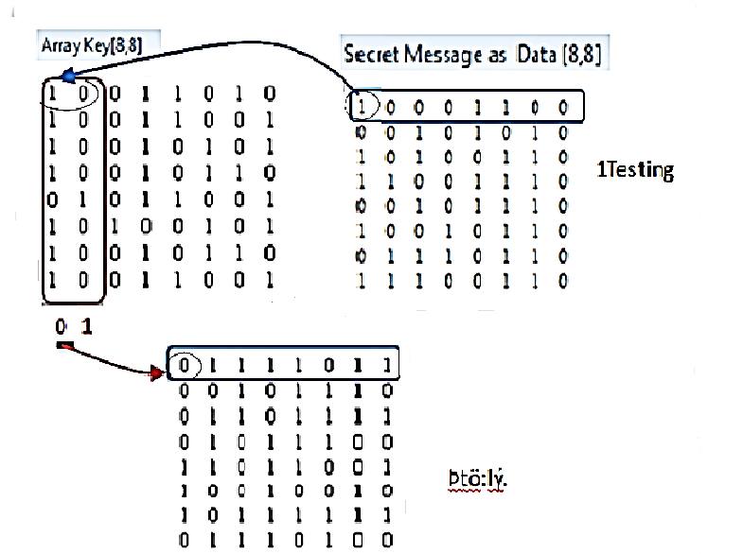
ENCRYPTION EXAMPLE

Slide 27
DECRYPTION
Get the value of K variable
Binaries the encrypted message and store the binary data in array EncData[N,N]
Generate the key using key generation algorithm and create Key [N, k]
Create Data[N, N] to store the original data
c=0
Loop i=0 to N-1

Slide 28
DECRYPTION(Contd.)
Loop j=0 to N-1
If Encdata[i,j]=0 then
Data[i,j]=Key[j,c]
Else
Data[i,j] =Key[j,c+1]
End loop
c=c+2

Slide 29
DECRYPTION(Contd.)
If c >= K then c=0
End loop
Convert the EncData from binary data to text.

Slide 30
CONCLUSION
Experimental results revealed that this method is more secure
Key length varies according to message length
Guessing of key is difficult

Slide 31
REFERENCES
Santhi.b,K.S Ravichandran,A.P Arun and L.Chakrapani,”A novel cryptographic key generation using image features”,:88-92,2012
Wikipedia, Channel(digital image)
Seshadri,R. and T.RaghuTrivedi, “Efficient Cryptographic key generation using biometrics

Slide 32
THANKYOU

Slide 33
QUESTIONS ??

