Slide 1
welcome

Slide 2
SPANNER: GOOGLE’S GLOBALLY-DISTRIBUTED DATABASE
\
TOPIC APPROVAL:23/8/2013 Manu Joy
SLIDE APPROVAL:29/8/2013 S7R 32
TOPIC AND SLIDE APPROVED BY:
Mr. Abi Abahai T

Slide 3
CONTENTS
Spanner: Google’s Globally-Distributed Database
  Introduction
  Implementation
  Concurrency System
  True time API
  Evaluation
  Conclusion
  References

Slide 4
INTRODUCTION
Spanner: Google’s Globally-Distributed Database
  Essential Properties for a global database
  Globally distributed
  Scalable, multi-version
  Synchronously replicated
  External consistency

Slide 5
Existing system
Spanner: Google’s Globally-Distributed Database
  Big Table And Megastore
  Distributed storage system
  Manages structured data
  High scalability and avaliability

Slide 6
BIGTABLE
Spanner: Google’s Globally-Distributed Database
  Advantages
  Wide applicability
  Scalability and avaliability
  High performance
  Disadvantages
  Difficult to use for complex, evolving schemas
  Can’t give strong consistency guarantees for geo-replicated sites

Slide 7
MEGA STORE
Spanner: Google’s Globally-Distributed Database
  Advantages
  Combination of NoSQL and RDBMS
  Full ACID properties
  Provides semi-relational data model
  Disadvantages
  Poor write throughput

Slide 8
Proposed system
Spanner: Google’s Globally-Distributed Database
    Distributed multiversion database
    General-purpose transactions (ACID)
    SQL query language
    Sharding
    Semi-relational data model
Running in production
    Storage for Google’s ad data
    Replaced a sharded MySQL database

Slide 9
IMPLEMENTATION
Spanner: Google’s Globally-Distributed Database
  Universe
  Zone
  Universe master
  Placement driver

Slide 10
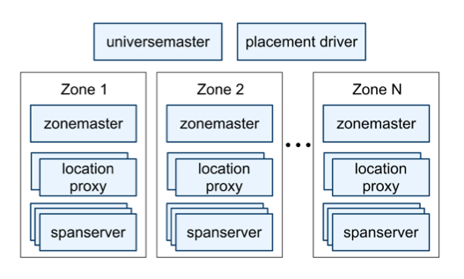
IMPLEMENTATION(contd..)
Spanner: Google’s Globally-Distributed Database
Figure 1: Spanner Server organization
Courtesy: 2012 Google research paper: Spanner

Slide 11
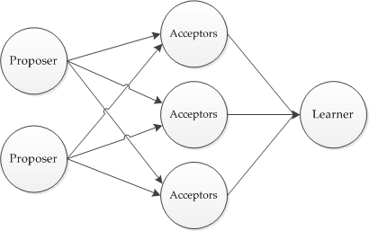
PAXOS
Spanner: Google’s Globally-Distributed Database
Figure 2: Paxos implementation
Courtesy: 1998 Lamport’s Paxos Made symbol

Slide 12
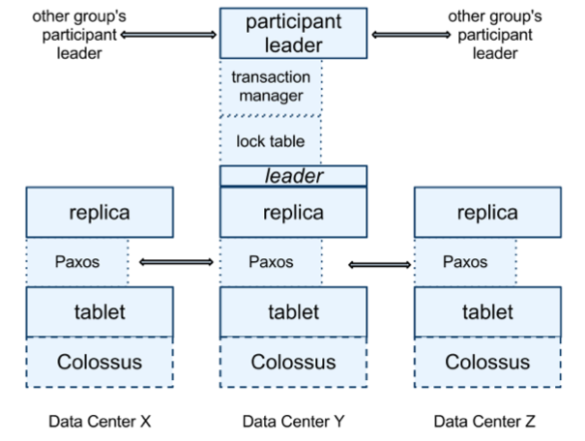
span server
Spanner: Google’s Globally-Distributed Database
Figure 3: Spanserver software stack
Courtesy: 2012 Google research paper: Spanner

Slide 13
Example: Social Network
Spanner: Google’s Globally-Distributed Database
Sao Paulo
Santiago
Buenos Aires
x1000
San Francisco
Seattle
Arizona
Brazil
User posts
Friend lists
User posts
Friend lists
User posts
Friend lists
User posts
Friend lists
User posts
Friend lists
x1000
US
London
Paris
Berlin
Madrid
Lisbon
Moscow
Berlin
Krakow
x1000
x1000
Russia
Spain
Dept. Of CSE, MA College of Engineering, Kothamangalam

Slide 14
Overview
Spanner: Google’s Globally-Distributed Database
Feature: Lock-free distributed read transactions
Property: External consistency of distributed transactions
  First system at global scale
Implementation: Integration of concurrency control, replication, and 2PC
  Correctness and performance
Enabling technology: TrueTime
  Interval-based global time
Dept. Of CSE, MA College of Engineering, Kothamangalam

Slide 15
CONCURRENCY SYSTEM
Spanner: Google’s Globally-Distributed Database
Generate a page of friends’ recent posts
  Consistent view of friend list and their posts
Why consistency matters
Remove untrustworthy person X as friend
Post P: “My government is repressive…”
Dept. Of CSE, MA College of Engineering, Kothamangalam

Slide 16
Single Machine
Spanner: Google’s Globally-Distributed Database
Block writes
Generate my page
Friend1 post
User posts
Friend lists
User posts
Friend lists
Friend2 post
…
Friend999 post
Friend1000 post
Dept. Of CSE, MA College of Engineering, Kothamangalam

Slide 17
Multiple Machines
Spanner: Google’s Globally-Distributed Database
Block writes
User posts
Friend lists
User posts
Friend lists
Friend1 post
Friend2 post
…
Generate my page
User posts
Friend lists
Friend999 post
User posts
Friend lists
Friend1000 post
Dept. Of CSE, MA College of Engineering, Kothamangalam

Slide 18
Multiple Datacenters
Spanner: Google’s Globally-Distributed Database
User posts
Friend lists
Friend1 post
x1000
US
User posts
Friend lists
Friend2 post
x1000
Spain
…
Generate my page
User posts
Friend lists
Friend999 post
x1000
Brazil
User posts
Friend lists
Friend1000 post
x1000
Russia
Dept. Of CSE, MA College of Engineering, Kothamangalam

Slide 19
Version Management
Spanner: Google’s Globally-Distributed Database
Transactions that write use strict 2PL
  Each transaction T is assigned a timestamp s
  Data written by T is timestamped with s
Time
<8
8
15
My friends
[X]
[]
My posts
[P]
X’s friends
[me]
[]
Dept. Of CSE, MA College of Engineering, Kothamangalam

Slide 20
Synchronizing Snapshots
Spanner: Google’s Globally-Distributed Database
Global wall-clock time
==
External Consistency:
Commit order respects global wall-time order
==
Timestamp order respects global wall-time order
given
timestamp order == commit order
Dept. Of CSE, MA College of Engineering, Kothamangalam

Slide 21
Timestamps, Global Clock
Spanner: Google’s Globally-Distributed Database
Strict two-phase locking for write transactions
Assign timestamp while locks are held
Acquired locks
Release locks
T
Pick s = now()
Dept. Of CSE, MA College of Engineering, Kothamangalam

Slide 22
Timestamp Invariants
Spanner: Google’s Globally-Distributed Database
Timestamp order == commit order
T₁
T₂
Timestamp order respects global wall-time order
T₃
T₄
Dept. Of CSE, MA College of Engineering, Kothamangalam

Slide 23
True Time
Spanner: Google’s Globally-Distributed Database
“Global wall-clock time” with bounded uncertainty
TT.now()
time
earliest
latest
2*ε
Dept. Of CSE, MA College of Engineering, Kothamangalam

Slide 24
Timestamps and TrueTime
Spanner: Google’s Globally-Distributed Database
Acquired locks
Release locks
T
Pick s = TT.now().latest
s
Wait until TT.now().earliest > s
Commit wait
average ε
average ε
Dept. Of CSE, MA College of Engineering, Kothamangalam

Slide 25
Commit Wait and Replication
Spanner: Google’s Globally-Distributed Database
Start consensus
Achieve consensus
Notify slaves
Acquired locks
Release locks
T
Pick s
Commit wait done
Dept. Of CSE, MA College of Engineering, Kothamangalam

Slide 26
2-phase commit
Spanner: Google’s Globally-Distributed Database
Start logging
Done logging
Acquired locks
Release locks
T_{C}
Committed
Notify participants of s
Acquired locks
Release locks
T_{P1}
Acquired locks
Release locks
T_{P2}
Prepared
Send s
Compute s for each
Commit wait done
Compute overall s
Dept. Of CSE, MA College of Engineering, Kothamangalam

Slide 27
Example
Spanner: Google’s Globally-Distributed Database
Remove X from my friend list
Risky post P
T_{C}
T₂
s_{C}=6
s=8
s=15
Remove myself from X’s friend list
T_{P}
s_{P}=8
s=8
Time
<8
8
15
My friends
[X]
[]
My posts
[P]
X’s friends
[me]
[]
Dept. Of CSE, MA College of Engineering, Kothamangalam

Slide 28
What Have We LEARNED?
Spanner: Google’s Globally-Distributed Database
Lock-free read transactions across datacenters
External consistency
Timestamp assignment
TrueTime
  Uncertainty in time can be waited out
Dept. Of CSE, MA College of Engineering, Kothamangalam

Slide 29
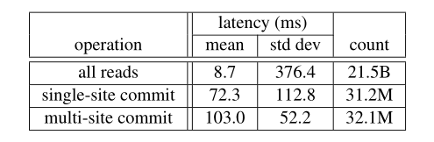
Evaluation
Spanner: Google’s Globally-Distributed Database
F1( google advertising backend)
Previously used MySQL
Synchronous replication and automatic failover
Enabled F1 to specify data placement
Figure 4– Operation latencies over 24 hours
Courtesy: 2012 Google research paper: Spanner
Dept. Of CSE, MA College of Engineering, Kothamangalam

Slide 30
Conclusions
Spanner: Google’s Globally-Distributed Database
Reify clock uncertainty in time APIs
Stronger semantics are achievable
  Greater scale != weaker semantics
Dept. Of CSE, MA College of Engineering, Kothamangalam

Slide 31
REFERENCES
Spanner: Google’s Globally-Distributed Database
Azza Abouzeid et al. “HadoopDB: an architectural hybrid ofMapReduce and DBMS technologies for analytical workloads”.Proc. of VLDB. 2009, pp. 922–933.
Fay Chang et al. “Bigtable: A Distributed Storage System forStructured Data”. ACM TOCS 26.2 (June 2008), 4:1–4:26.
Leslie Lamport. “The part-time parliament”. ACM TOCS 16.2(May 1998), pp. 133–169.Jason Baker et al. “Megastore: Providing Scalable, HighlyAvailable Storage for Interactive Services”. Proc. of CIDR.2011, pp. 223–234.
Dept. Of CSE, MA College of Engineering, Kothamangalam

Slide 32
QUESTIONS??
Spanner: Google’s Globally-Distributed Database

Slide 33
THANK YOU
Spanner: Google’s Globally-Distributed Database

