Slide 1
WELCOME

Slide 2
SCIDB:A DATABASE MANAGEMENT SYSTEM FOR APPLICATIONS WITH COMPLEX ANALYTICS
Topic Approval : 05-09-13
Slide Approval :09-10-13
Presented By
JOASH JOSE
CLASS N O: 28
S7R,DEPT.CS

Slide 3
SCIDB: a DATABASE MANAGEMENT SYSTEM FOR APPLICATIONS WITH COMPLEX ANALYTICS
CONTENTS
Introduction
Existing System
Proposed System
Data Model
Architecture
Query Language
Conclusion
Reference
Dept. of CSE,MACE,Kothamangalam

Slide 4
SCIDB: a DATABASE MANAGEMENT SYSTEM FOR APPLICATIONS WITH COMPLEX ANALYTICS
INTRODUCTION
Support data management need of scientists.
Representing Scientific data (series of spatial and temporal data).
SCIDB(Scientific Database):Open source software platform.
Dept. of CSE,MACE,Kothamangalam

Slide 5
SCIDB: a DATABASE MANAGEMENT SYSTEM FOR APPLICATIONS WITH COMPLEX ANALYTICS
EXISTING SYSTEMS
Relational Database Management System(RDBMS)
-Microsoft SQL server
-MySQL
File Systems
Dept. of CSE,MACE,Kothamangalam

Slide 6
SCIDB: a DATABASE MANAGEMENT SYSTEM FOR APPLICATIONS WITH COMPLEX ANALYTICS
DRAWBACKS RDBMS
The wrong data model
-Tables not arrays
Missing required capabilities
-No overwrite storage
- A requirement of provenance
- Represent uncertain data
Requirement of open source.
Dept. of CSE,MACE,Kothamangalam

Slide 7
SCIDB: a DATABASE MANAGEMENT SYSTEM FOR APPLICATIONS WITH COMPLEX ANALYTICS
DRAWBACKS FILE SYSTEMS
Searching metadata problematic
File accessing routines written manually
Lack of standard file format
Dept. of CSE,MACE,Kothamangalam

Slide 8
SCIDB: a DATABASE MANAGEMENT SYSTEM FOR APPLICATIONS WITH COMPLEX ANALYTICS
PROPOSED SYSTEM
Scientific Database Management System
Open source
Array data model
Shared nothing architecture
Array Query Language(AQL)
Dept. of CSE,MACE,Kothamangalam

Slide 9
SCIDB: a DATABASE MANAGEMENT SYSTEM FOR APPLICATIONS WITH COMPLEX ANALYTICS
ARRAY DATA MODEL
Multidimensional arrays for storage and processing.
Array created by specifying
1.Array name
2.Dimensions
-N dimensional array has dimensions (d1,d2,d3,…dn).
3.Attributes
-A cell is a combination of dimension values
-Cell hold multiple data values ie, attributes
Dept. of CSE,MACE,Kothamangalam

Slide 10
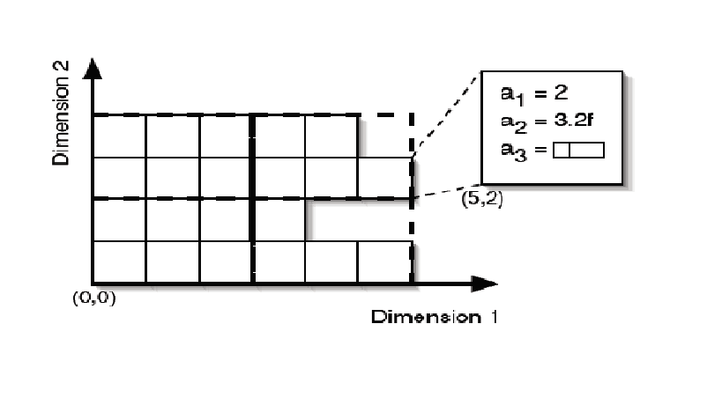
SCIDB: a DATABASE MANAGEMENT SYSTEM FOR APPLICATIONS WITH COMPLEX ANALYTICS
ILLUSTRATION
Courtesy scidb userguide.
Illustration is 2D, data can have unlimited dimensions.
Dept. of CSE,MACE,Kothamangalam

Slide 11
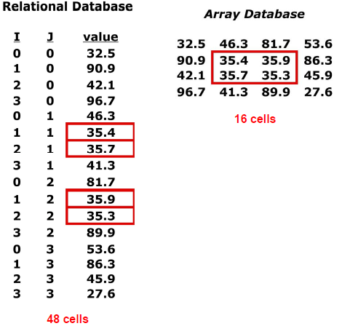
SCIDB: a DATABASE MANAGEMENT SYSTEM FOR APPLICATIONS WITH COMPLEX ANALYTICS
STORAGE EFFICIENCY
Dramatic storage efficiency as the attributes and dimensions increases
Dept. of CSE,MACE,Kothamangalam

Slide 12
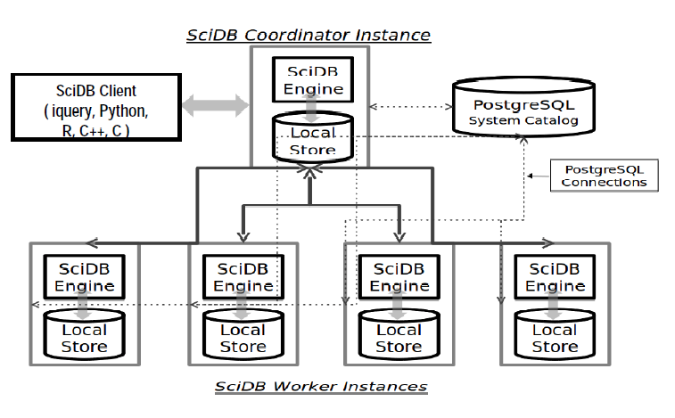
SCIDB: a DATABASE MANAGEMENT SYSTEM FOR APPLICATIONS WITH COMPLEX ANALYTICS
BASIC ARCHITECTURE
Courtesy Architecture of scidb :Paradigm 4
Dept. of CSE,MACE,Kothamangalam

Slide 13
SCIDB: a DATABASE MANAGEMENT SYSTEM FOR APPLICATIONS WITH COMPLEX ANALYTICS
ARCHITECTURE
Shared nothing architecture
Interconnected with standard TCP/IP network
Coordinator instance
-Query execution and result fetching
-Mediate communication between clients and database
Worker Instance
-Perform local query processing
System catalog
-Implemented as PostgreSQL tables
-Tables shared between instance of cluster
Dept. of CSE,MACE,Kothamangalam

Slide 14
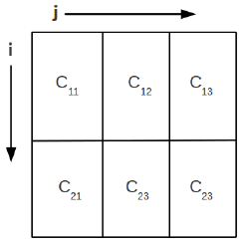
SCIDB: a DATABASE MANAGEMENT SYSTEM FOR APPLICATIONS WITH COMPLEX ANALYTICS
STORAGE MANAGEMENT
Array stored as fixed logical size chunks
Chunks distributed across instances(Linux Clusters)
Example :An array with dimensions i and j.
i of length 10 and chunk size 5
j of length 30 and chunk size10
courtesy SCIDB user guide
Dept. of CSE,MACE,Kothamangalam

Slide 15
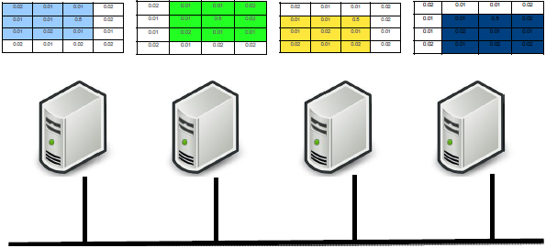
SCIDB: a DATABASE MANAGEMENT SYSTEM FOR APPLICATIONS WITH COMPLEX ANALYTICS
CHUNK OVERLAP
Neighboring chunks of array overlap
Courtesy paradigm 4
Advantages:
Improve data availability
Parallel execution of nearest neighbor queries
Dept. of CSE,MACE,Kothamangalam

Slide 16
SCIDB: a DATABASE MANAGEMENT SYSTEM FOR APPLICATIONS WITH COMPLEX ANALYTICS
QUERY LANGUAGE
Array Query Language: Data retrieval and storage.
Array Functional language: To perform operations on database
Dept. of CSE,MACE,Kothamangalam

Slide 17
SCIDB: a DATABASE MANAGEMENT SYSTEM FOR APPLICATIONS WITH COMPLEX ANALYTICS
CREATE AN ARRAY
Syntax:
CREATE ARRAY array_name<attributes>[dimensions].
Array Name: Uniquely identify array in database
Attribute : Contain actual data. Components are,
Attribute name
Attribute type
Specifying NULL
Specifying DEFAULT
Dept. of CSE,MACE,Kothamangalam

Slide 18
SCIDB: a DATABASE MANAGEMENT SYSTEM FOR APPLICATIONS WITH COMPLEX ANALYTICS
CREATE AN ARRAY
Dimension :Forms coordinates system of array.
Dimension name
Dimension start
Dimension end
Dimension Chunk size
Dimension Chunk Overlap
Example:
CREATE ARRAY array_name
<x: double NULL, y: double DEFAULT=10.0 > [i=0:99,10,0, j=0:99,10,0];
Dept. of CSE,MACE,Kothamangalam

Slide 19
SCIDB: a DATABASE MANAGEMENT SYSTEM FOR APPLICATIONS WITH COMPLEX ANALYTICS
LOAD FORMATTED FILE
A scidb formatted file loaded using LOAD command.
Syntax: load(array_name, ‘path’);
.scidb file format:
[{index1,index2,…..}(attr1,attr2,attr3),…
.
.
{index m,index n,… ..}(attr1,attr2,attr3)];
Dept. of CSE,MACE,Kothamangalam

Slide 20
SCIDB: a DATABASE MANAGEMENT SYSTEM FOR APPLICATIONS WITH COMPLEX ANALYTICS
CODES FOR MISSSING DATA
Support missing reason codes
Specify multiple types of null.
Example:
[{0,0}(10,4.4,”My String”,’C’)
{0,1}(1-,5.1,?1,’D’)
];
Dept. of CSE,MACE,Kothamangalam

Slide 21
SCIDB: a DATABASE MANAGEMENT SYSTEM FOR APPLICATIONS WITH COMPLEX ANALYTICS
ARRAY VERSIONING
To implement no overwrite storage
A special dimension called version is used
Example:
Select * from scan(array_name@datetime
(“yyyy-mm-dd” “hh-mm-ss”));
Dept. of CSE,MACE,Kothamangalam

Slide 22
SCIDB: a DATABASE MANAGEMENT SYSTEM FOR APPLICATIONS WITH COMPLEX ANALYTICS
USE CASES
Satellite Imagery
Astronomy Applications
Genomics
Commercial application
-Analytics on location based data
Dept. of CSE,MACE,Kothamangalam

Slide 23
SCIDB: a DATABASE MANAGEMENT SYSTEM FOR APPLICATIONS WITH COMPLEX ANALYTICS
CONCLUSION
Improved storage efficiency as dimension and attribute grows
10 to 100 times faster than RDBMS in both dense and sparse data.
Dept. of CSE,MACE,Kothamangalam

Slide 24
SCIDB: a DATABASE MANAGEMENT SYSTEM FOR APPLICATIONS WITH COMPLEX ANALYTICS
REFERENCES
1. J. Becla and K.-T. Lim, “Report from the First Workshop on Extremely Large Databases,” Data Science J., vol. 7, 2008, pp. 1–13.
2. M. Stonebraker et al., “The Architecture of SciDB,”Proc. Scientific and Statistical Data Management Conf., Springer-Verlag, 2011, pp. 1–16.
3. A.S. Szalay et al., “Designing and Mining Multi-Terabyte Astronomy Archives: The Sloan Digital Sky Survey,”Proc. Sigmod Conf., ACM, 2000, pp. 451–462.
Dept. of CSE,MACE,Kothamangalam

Slide 25
SCIDB: a DATABASE MANAGEMENT SYSTEM FOR APPLICATIONS WITH COMPLEX ANALYTICS
REFERENCES
4. A. Pavlo and et al., “A Comparison of Approaches to Large-scale Data Analysis,” Proc. Sigmod Conf., ACM, 2009, pp. 165–178.
5. P.A. Boncz, S. Manegold, and M.L. Kersten, “Database Architecture Evolution: Mammals Flourished Long Before Dinosaurs Became Extinct,” Proc. Conf. Very Large Data Bases (VLDB), VLDB Endowment, 2009, pp. 1648–1653.
6. J. Duggan, “Compression and Execution in SciDB,” in preparation.
Dept. of CSE,MACE,Kothamangalam

Slide 26
QUESTIONS?

Slide 27
THANK YOU

