Slide 1
WELCOME

Slide 2
A PRACTCAL DATABASE
SECURITY MODEL USING PURPOSE BASED DATABASE ACCESS CONTROL AND GROUP CONCEPT
Topic approval:26/08/2013 JIJU JOSE
Slide approval:31/08/2013 Roll no-27
Topic and slide approved by: S7 R
Mrs Jisha P Abraham

Slide 3
A DATABASE SECURITY MODEL USING PGDM+G
TABLE OF CONTENTS
INTRODUCTION
REQUIREMENTS
EXISTING SYSTEM
PURPOSE BASED DATABASE MODEL(PBDM)
GROUPING CONCEPT
METADATA SCHEMA
QUERY MODIFICATION ALGORITHM
CONCLUSION
REFERENCES

Slide 4
A DATABASE SECURITY MODEL USING PGDM+G
INTRODUCTION
Misuse of personal information collected online
Data collected along with purpose
Data used for purposes specified by user
Hippocratic Database Model

Slide 5
A DATABASE SECURITY MODEL USING PGDM+G
REQUIREMENTS
Purposes of data usage must be collected
All personal information must be collected
Cell level protection
Simple
Metadata size must be minimum
Introduction of new users must be easier

Slide 6
A DATABASE SECURITY MODEL USING PGDM+G
EXISTING SYSTEM
HIPPOCRATIC DATABASE MODEL
LIMITING DISCLOSURE IN HIPPOCRATIC DATABASES(LDHD)

Slide 7
A DATABASE SECURITY MODEL USING PGDM+G
DRAWBACKS
Limits data collection
Record level data protection
Metadata larger than actual data
Introduction of new user is difficult
Not practical

Slide 8
A DATABASE SECURITY MODEL USING PGDM+G
PBDM
Purpose based database model
Preference for usage purpose
Data users not considered
Lesser metadata

Slide 9


A DATABASE SECURITY MODEL USING PGDM+G
EXAMPLE
Courtesy: IEEE PAPER

Slide 10
A DATABASE SECURITY MODEL USING PGDM+G
PBDM+G
Purpose based database model + Group Concept
Metadata size exceeds the actual size in PBDM
Duplicates exist in PBDM
Normalization is used in group concept

Slide 11
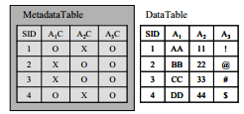
A DATABASE SECURITY MODEL USING PGDM+G
GROUPING CONCEPT
Courtesy: IEEE PAPER

Slide 12
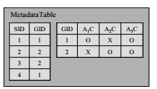
A DATABASE SECURITY MODEL USING PGDM+G
GROUPING CONCEPT(contd)
Courtesy: IEEE PAPER

Slide 13
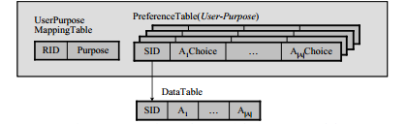
A DATABASE SECURITY MODEL USING PGDM+G
METADATA SCHEMA
LDHD MODEL
Courtesy: IEEE PAPER

Slide 14
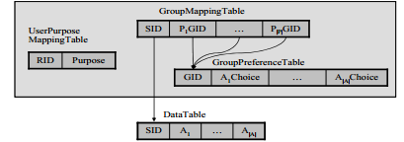
A DATABASE SECURITY MODEL USING PGDM+G
METADATA SCHEMA(contd..)
PBDM+G MODEL
Courtesy: IEEE PAPER

Slide 15
A DATABASE SECURITY MODEL USING PGDM+G
METADATA VOLUME
|S| - No of tuples
|A| - Attributes
|P| - No of usage purposes
|R| - No of data users
Metadata volume between
|R| x (|A|+1) x |S| and |P| x |R| x (|A|+1) x |S|
LDHD MODEL

Slide 16
A DATABASE SECURITY MODEL USING PGDM+G
METADATA VOLUME(contd.)
|S| - No of tuples
|A| - Attributes
|P| - No of usage purposes
|G| - No of privacy preference groups
Metadata volume between
(|S| x (|P|+1)) + (|G| x (|A|+1))
PBDM+G

Slide 17
A DATABASE SECURITY MODEL USING PGDM+G
QUERY MODIFICATION ALGORITHM
GMT - Group Mapping Table
GPT - Group Preference Table
Step 0:Start
Step 1: Read key , attribute and purpose
Step 3: if key not found in GMT goto step 7
Step 4: get Group ID for the purpose
Step5: select choice with Group ID as key from GPT if choice=0 goto step 7
Step6:select attribute from data table for the key
Step7:Stop

Slide 18
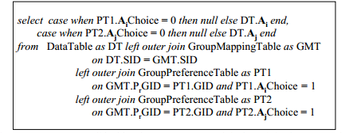
A DATABASE SECURITY MODEL USING PGDM+G
QUERY MODIFICATION
“Select Ai , Aj from Data Table” for purpose Pr
modified as
Courtesy: IEEE PAPER

Slide 19
ARCHITECTURE
A DATABASE SECURITY MODEL USING PGDM+G
Query
Query Modifier
Privacy Meta-Data
Data Table

Slide 20
A DATABASE SECURITY MODEL USING PGDM+G
CONCLUSION
Model collects metada for only usage purpo
Metada need not be collected for new users
Reduces size of metadata by grouping – 10% of size taken by LDHD
Grouping simplifies process of preference gathering
Efficient privacy checking using “left outer join” – Query processing time lesser by 23.6%

Slide 21

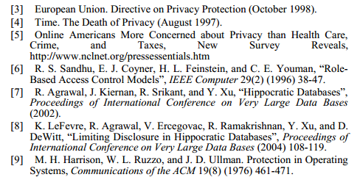
A DATABASE SECURITY MODEL USING PGDM+G
REFERENCES

Slide 22
THANK YOU

Slide 23
QUESTIONS?

