Slide 1
WELCOME

Slide 2
BOOMERANG PROTOCOL FOR GEOCACHE ANCHORING IN MOBILE DISCONNECTED NETWORKS
Topic approval:25/07/2013 Hisana SVM
Slide approval:09/09/2013 Roll no-26
Topic and slide approved by: S7R
Mrs Jisha P Abraham

Slide 3
CONTENTS
BOOMERANG PROTOCOL FOR GEOCACHE ANCHORING IN MOBILE DISCONNECTED NETWORKS
Introduction
Existing Systems
Proposed System
Implementation
Conclusion
References

Slide 4
INTRODUCTION
BOOMERANG PROTOCOL FOR GEOCACHE ANCHORING IN MOBILE DISCONNECTED NETWORKS
Geo-cache
Anchor location
Geo-cache anchoring
Need for boomerang protocol

Slide 5
EXISTING SYSTEMS
BOOMERANG PROTOCOL FOR GEOCACHE ANCHORING IN MOBILE DISCONNECTED NETWORKS
Server centric approach
Upload and download
Use of directories

Slide 6
DISADVANTAGES
BOOMERANG PROTOCOL FOR GEOCACHE ANCHORING IN MOBILE DISCONNECTED NETWORKS
Not for anytime anywhere personal sensing
Uploading overheads
Privacy issues

Slide 7
PROPOSED SYSTEM
BOOMERANG PROTOCOL FOR GEOCACHE ANCHORING IN MOBILE DISCONNECTED NETWORKS
Retaining geo-cache
Each mobile node is carrier
Challenging for remote locations
Behaves like a boomerang
Inter vehicle communication

Slide 8
CHALLENGES
BOOMERANG PROTOCOL FOR GEOCACHE ANCHORING IN MOBILE DISCONNECTED NETWORKS
Two challenges
1.Temporarily disconnected carriers
2.Communication overheads

Slide 9
SOLUTIONS
BOOMERANG PROTOCOL FOR GEOCACHE ANCHORING IN MOBILE DISCONNECTED NETWORKS
Trajectory based approach
Keeping geo-cache by nodes

Slide 10
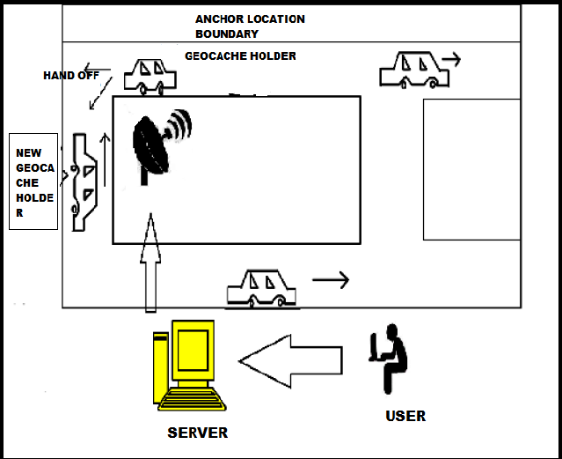
SYSTEM ARCHITECTURE
BOOMERANG PROTOCOL FOR GEOCACHE ANCHORING IN MOBILE DISCONNECTED NETWORKS
Courtesy:IJETAE,JAN 2013

Slide 11
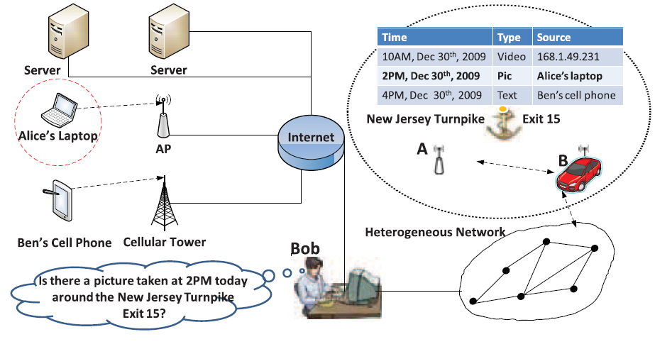
A SCENARIO
BOOMERANG PROTOCOL FOR GEOCACHE ANCHORING IN MOBILE DISCONNECTED NETWORKS
Courtesy:IEEE TRANSACTION in mobile computing

Slide 12
SYSTEM IMPLEMENTATION
BOOMERANG PROTOCOL FOR GEOCACHE ANCHORING IN MOBILE DISCONNECTED NETWORKS
Selection of carrier
Hand of criteria
Shortest path approach
Trajectory based approach

Slide 13
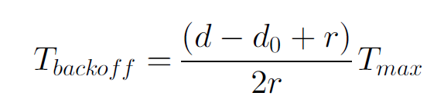
SHORTEST PATH APPROACH
BOOMERANG PROTOCOL FOR GEOCACHE ANCHORING IN MOBILE DISCONNECTED NETWORKS
Max-progress algorithm

Slide 14
TRAJECTORY BASED APPROACH
BOOMERANG PROTOCOL FOR GEOCACHE ANCHORING IN MOBILE DISCONNECTED NETWORKS
Reverse trajectory(RevTraj) approach
Node from opposite direction
GPS traces or segmented trajectory

Slide 15
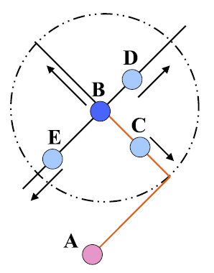
EXAMPLE
BOOMERANG PROTOCOL FOR GEOCACHE ANCHORING IN MOBILE DISCONNECTED NETWORKS

Slide 16
HAND OFF PROCEDURE
BOOMERANG PROTOCOL FOR GEOCACHE ANCHORING IN MOBILE DISCONNECTED NETWORKS
1.Hand off initiation
2.Candidate identification
3.Candidate prioritization
4.Carrier selection
5.No acknowledgement

Slide 17
TRAJECTORY CONSTRUCTION IN REVTRAJ
BOOMERANG PROTOCOL FOR GEOCACHE ANCHORING IN MOBILE DISCONNECTED NETWORKS
Data preprocessing
Trajectory recording
Divergence detection(DD)

Slide 18
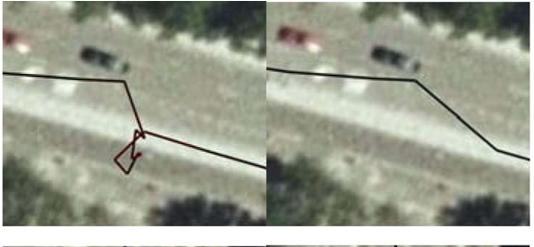
DATA PREPROCESSING
BOOMERANG PROTOCOL FOR GEOCACHE ANCHORING IN MOBILE DISCONNECTED NETWORKS
Courtesy:IEEE TRANSACTION in mobile computing

Slide 19
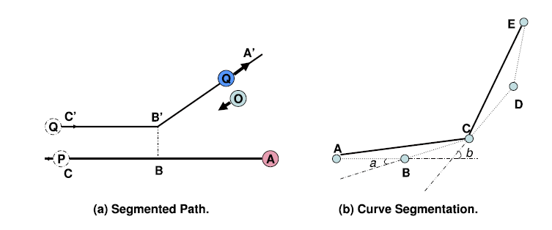
TRAJECTORY RECORDING
BOOMERANG PROTOCOL FOR GEOCACHE ANCHORING IN MOBILE DISCONNECTED NETWORKS

Slide 20
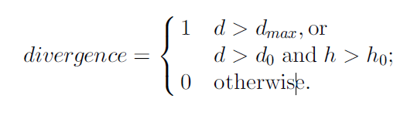
DIVERGENCE DETECTION
BOOMERANG PROTOCOL FOR GEOCACHE ANCHORING IN MOBILE DISCONNECTED NETWORKS

Slide 21
ADVANTAGES
BOOMERANG PROTOCOL FOR GEOCACHE ANCHORING IN MOBILE DISCONNECTED NETWORKS
Efficiency
Useful in mobile disconnected networks
Privacy
Support for location based queries
Less overheads

Slide 22
CONCLUSION
BOOMERANG PROTOCOL FOR GEOCACHE ANCHORING IN MOBILE DISCONNECTED NETWORKS
Efficiently retaining information
Periodic return of geo-cache
Trajectory based approach
High performance

Slide 23
REFERENCES
BOOMERANG PROTOCOL FOR GEOCACHE ANCHORING IN MOBILE DISCONNECTED NETWORKS
P. Juang, H. Oki, Y. Wang, M. Martonosi, L.S. Peh, and D
Design Tradeoffs and Early Experiences with Zebranet,” ACM
SIGOPS Operating Systems Rev., vol. 8, pp. 96-107, 2002

Slide 24
BOOMERANG PROTOCOL FOR GEOCACHE ANCHORING IN MOBILE DISCONNECTED NETWORKS
REFERENCES
C. Maihofer, T. Leinmller, and E. Schoch, “Abiding Geocast: Time
M. Mauve and J. Widmer, “A Survey on Position-Based Routing
In Mobile Ad Hoc Networks,” IEEE Network, vol. 15, no. 6, pp. 30

Slide 25
THANK YOU

Slide 26
QUESTIONS?

