Slide 1
BIG DATA
An exploration of the concept
Eric Kalapura
S7 Computer Science
MAR ATHANASIUS COLLEGE OF Engineering

Slide 2
Contents
Introduction
Distributed Computing for Big Data
Cycle of Big Data Management
Big Data Architecture and Analysis
Applications of Big Data
Conclusion
References

Slide 3
Evolution Of Data Management
Computer Centric > Network Centric > Human Centric
Data today
✓ Extremely large Volumes of data
✓ Extremely high Velocity of data
✓ Extremely wide Variety of data

Slide 4
Defining Big Data
Disparate data
Capability to manage
Allow real-time analysis and reaction

Slide 5
Big Data Sources
✓ Computer or machine generated
✓ Human-generated

Slide 6
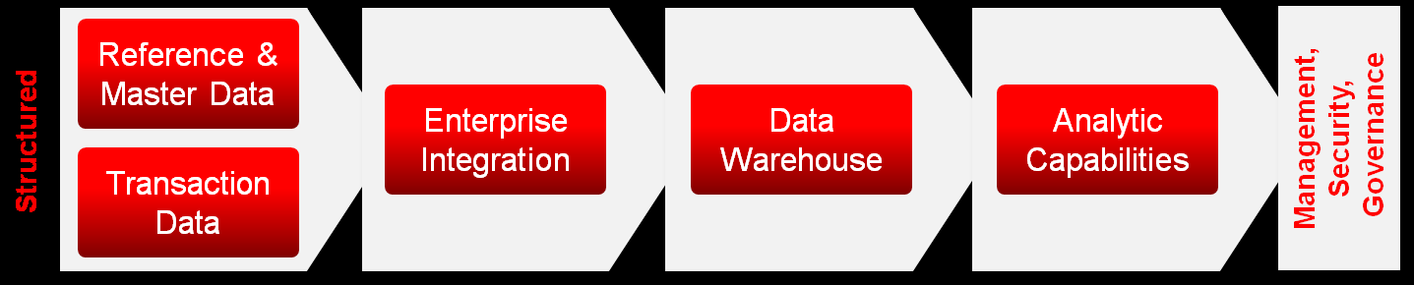
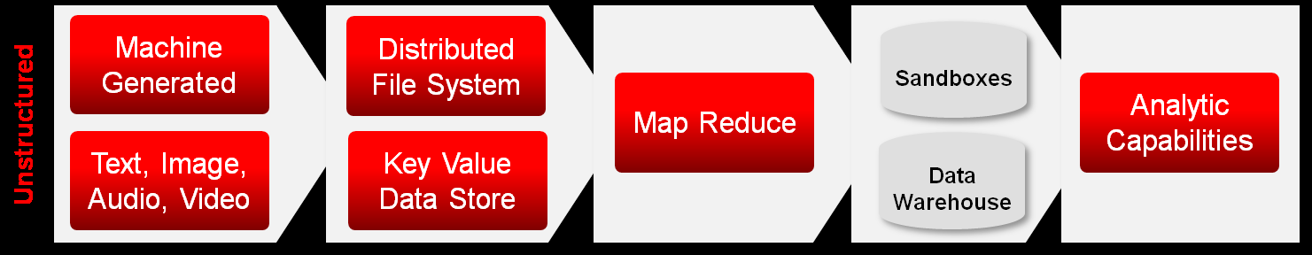
Adding Big Data Capabilities
Structured Data
Unstructured Data

Slide 7
Considerations
✓ Low latency
✓ Scalability
✓ Versatility
✓ Native format

Slide 8
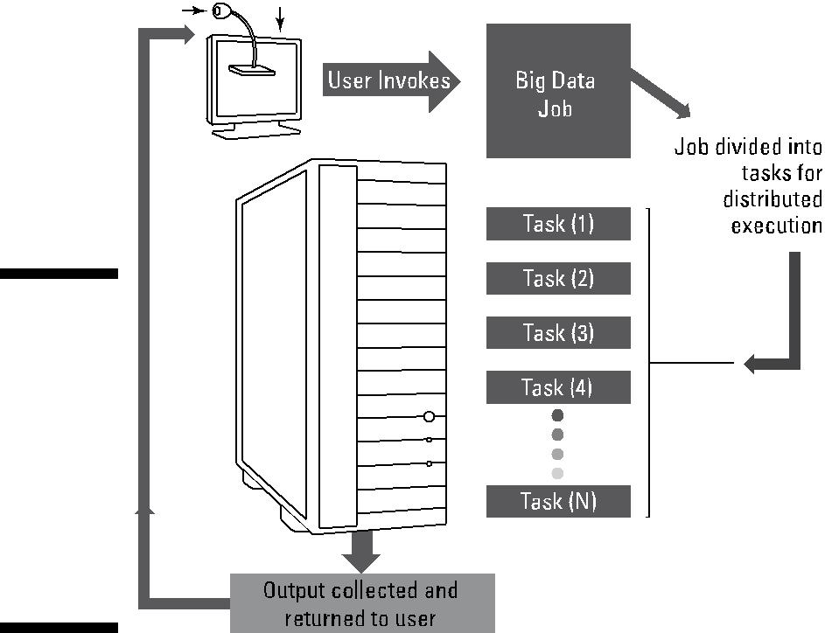
Distributed Computing for Big Data

Slide 9
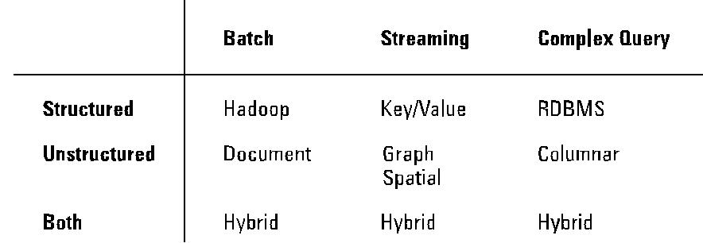
Putting Big Data Together
Managing Different data-types

Slide 10
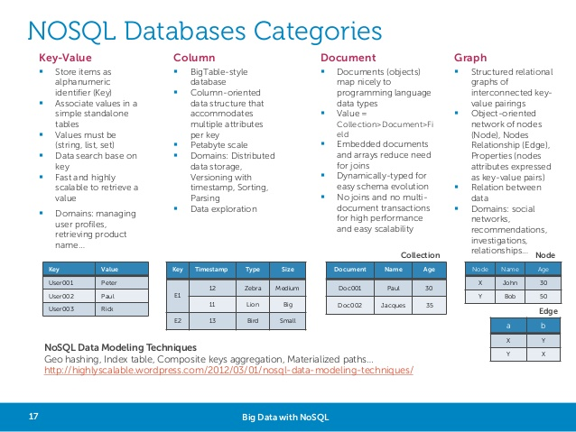

Slide 11
Cycle of Big Data Management
Capture
Organize
Integrate
Analyze
Act

Slide 12
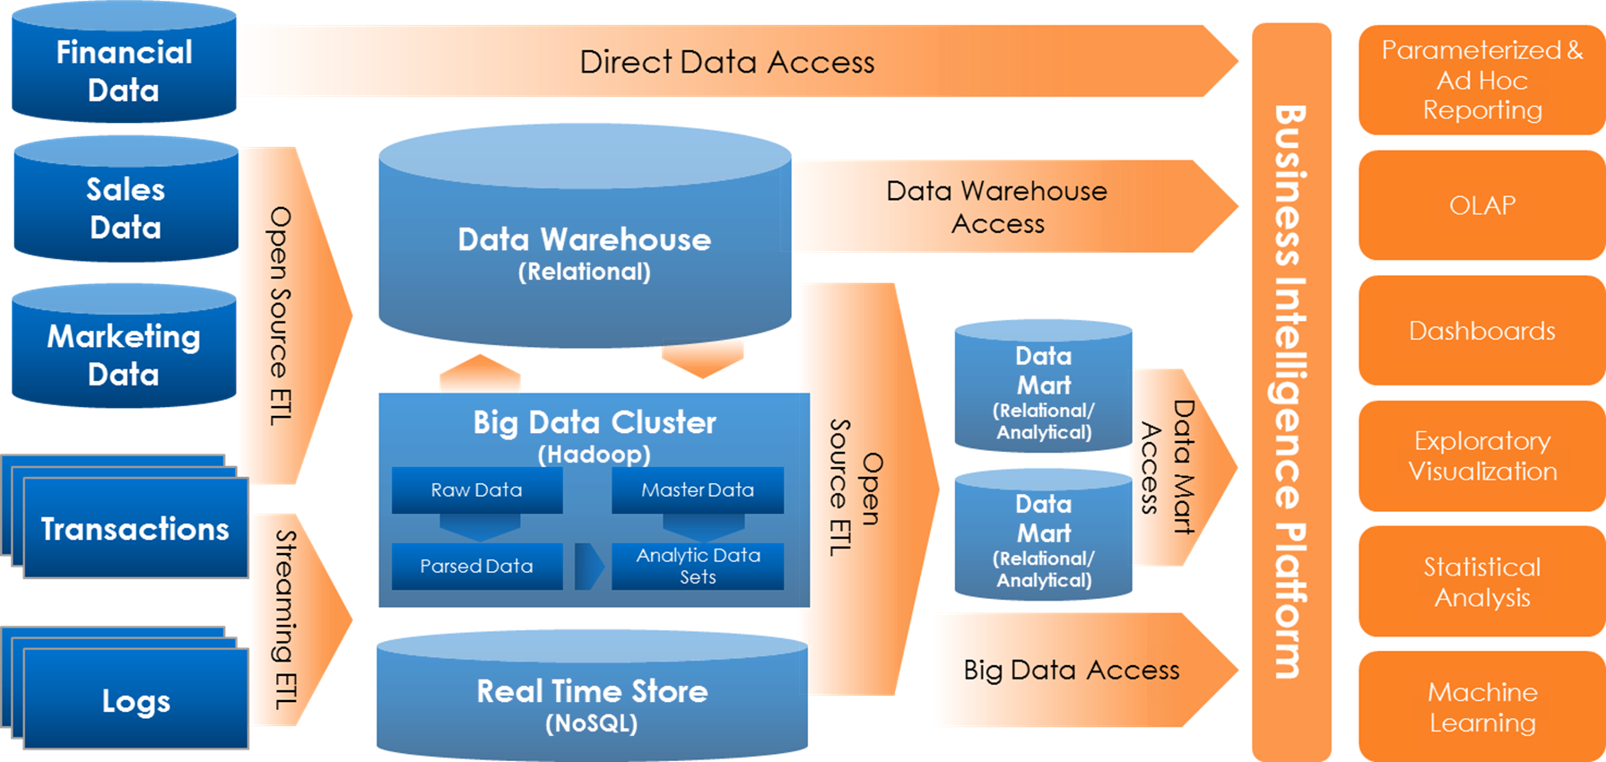
Big Data Analysis Model

Slide 13
Hadoop
✓ Hadoop Distributed File System
✓ MapReduce engine

Slide 14
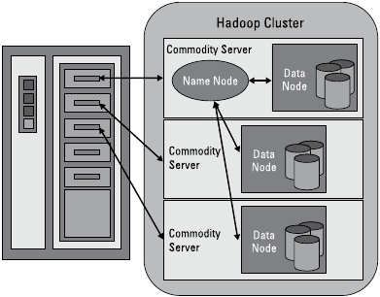
How a Hadoop cluster is mapped to hardware

Slide 15
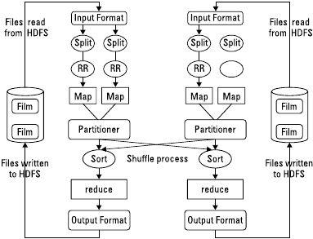
Working of MapReduce

Slide 16
Intelligent Query Streaming
Example Query
FPGA Core
CPU Core
Slice of table – divide and conquer
Uncompress
Complex ∑
Joins, Aggs
Project
Restrict
where
and
group by
select
Notes:
16

Slide 17
Big Data Analysis
Analysis Type Description
-------------------------------------------------------------------
Basic analytics Slicing and dicing of data,
reporting, simple
Advanced analytics Predictive modelling and pattern-matching techniques
Operationalized Business process
Analytics

Slide 18
Big Data Implementation
Real Time Data Streams
Complex Event Processing

Slide 19
Virtualization
Partitioning
Isolation
Encapsulation
Use of Hypervisor

Slide 20
Applications of Big Data
  Internet of Things
  Big science
  Social Networks
  Finance and business Informatics
  Augmented Intelligence
  Education

Slide 21
Conclusion
Big Data
  Size of available data for analysis
  Access methods and manipulation technologies
Fundamental research must be encouraged

Slide 22
References
Big Data: Issues and Challenges Moving Forward - 2013 46th International Conference on System Sciences (Kaisler S)
Big Data, Deep Impact: Forum for Information and Analytics
Architecting A Big Data Platform for Analytics: Intelligent Business Strategies

Slide 23
IBM Big Data Platform: Information Management
Integrating PureData System for Analytics: IBM Developer Works
Challenges and Opportunities with Big Data: collaborative white paper, 2012
Taming The Big Data Tidal Wave – by Bill Franks

Slide 24
Thank You
Questions?

