Slide 1
WELCOME

Slide 2
MONITORING SYSTEM INTEGRITY USING LIMITED LOCAL MEMORY
Topic Approved on : 22/07/13
Slides Approved on :26/07/13
Topic and Slides Approved by:
Jisha P Abraham
Elizabeth Maria Joseph
Roll No: 24
S7R

Slide 3
contents
Monitoring system integrity using Limited Local Memory
Introduction
System integrity monitor
Present system
Proposed system
LLM architecture
Monitors with LLM
Implementation
Conclusion

Slide 4
introduction
Monitoring system integrity using Limited Local Memory
Malicious software-rootkit
Target Operating System
Integrity
Virtualization technology

Slide 5
System integrity monitors
Monitoring system integrity using Limited Local Memory
Checks integrity
Isolation
Not compromisable

Slide 6
Present system
Monitoring system integrity using Limited Local Memory
Virtual Machine Monitors(VMM)
NoHype
Dept. of CSE, MACE, Kothamangalam

Slide 7
Problems
Monitoring system integrity using Limited Local Memory
VMMS
  complex code
  prone to attacks
  not implementable in embedded systems
NoHype
  no inter processor communication

Slide 8
Limited local memory
Monitoring system integrity using Limited Local Memory
Similar to scratchpads
Hardware centric
Reduces Trusted Computing Base
Extends multicore
Isolation

Slide 9
Proposed system
Monitoring system integrity using Limited Local Memory
Multicore is extended
Limited Local Memory (LLM) with a
paging mechanism
Secure Memory Paging Mechanism (SMPM)
Monitor operation implemented

Slide 10
Monitors with Llm
Monitoring system integrity using Limited Local Memory
Hardware platform
Setup
Bootstrap Selection Procedure
Secure Operating System (SOS)
User Operating System (UOS)

Slide 11
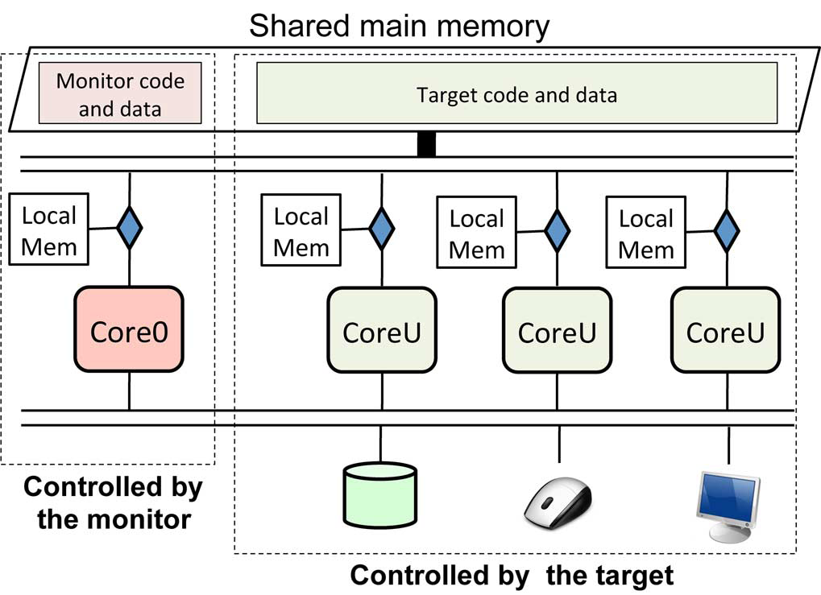
Monitors with llm
Monitoring system integrity using Limited Local Memory
Courtesy: Monitoring system integrity using LLM ,IEEE

Slide 12
Llm architecture
Monitoring system integrity using Limited Local Memory
On-chip local memory
Privileged core0
Bootstrap process
Halts execution
Deployable

Slide 13
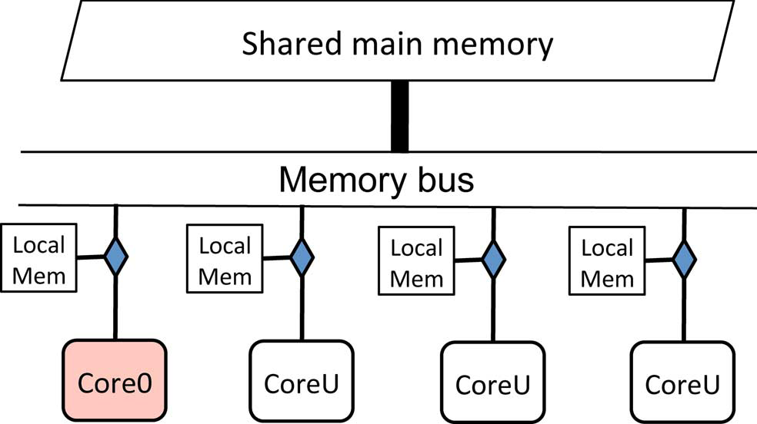
Llm in multicore system
Monitoring system integrity using Limited Local Memory
Courtesy: Monitoring system integrity using LLL,IEEE

Slide 14
Llm with Smpm
Monitoring system integrity using Limited Local Memory
Implemented in core0
Similar to scratchpad memory
Checks integrity
Hash values or checksums
Handles page fault

Slide 15
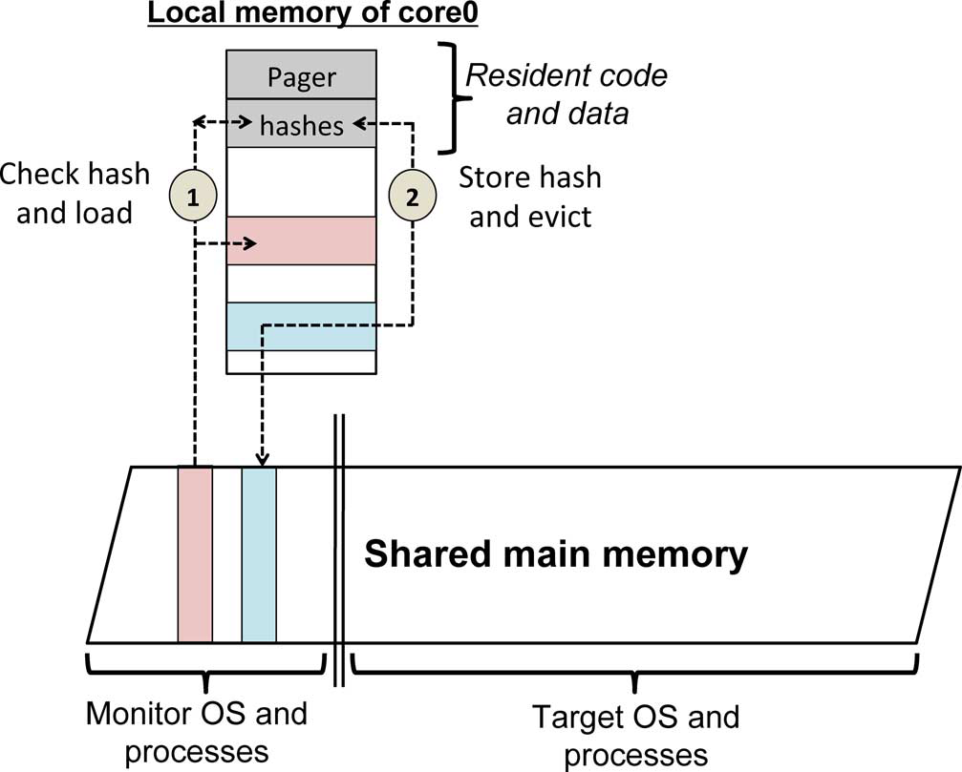
Llm with Smpm
Monitoring system integrity using Limited Local Memory
Courtesy: Monitoring system integrity using LLM,IEEE

Slide 16
Monitor operation
Monitoring system integrity using Limited Local Memory
Normal execution
  local code : ensures local code execution
  local data : ensures local data access
  Authload : verifies integrity before loading

Slide 17
Monitor operation(contd...)
Monitoring system integrity using Limited Local Memory
Monitor OS performs the main operation
Execution under attack

Slide 18
Security analysis
Monitoring system integrity using Limited Local Memory
Ability
  protect itself
  protect target
Inability
  register state attacks
  checkpoint targets

Slide 19
implementation
Monitoring system integrity using Limited Local Memory
SOS-xv6 OS
UOS-linux-2.6.26
Adore, knark, hideme etc

Slide 20
conclusion
Monitoring system integrity using Limited Local Memory
Hardware centric approach
Monitors not affected
First class isolator
Migration
System which protects target and itself

Slide 21
references
Monitoring system integrity using Limited Local Memory
Monitoring Integrity Using Limited Local Memory, Yuki Kinebuchi, Shakeel Butt, Vinod Ganapathy, Liviu IEEE transactions on forensics and security ,vol 8,no 7, July 2013
A. Baliga, V.Ganapathy, and L. Iftode, “Detecting kernel-level rootkits using data structure invariants,” IEEE Trans.Depend.Secure Comput vol8

Slide 22
references
Monitoring system integrity using Limited Local Memory
Subvirt: Implementing malware with virtual machines, Proc. IEEE Symp. Security and Privacy
Enhancing security of embedded Linux on a multi-core processor in Proc.IEEE 27Int.Conf. Embedded and Real-time
Efficient monitoring of untrusted kernelmode execution,Proc. Networked and Distributed Syst

Slide 23
Questions...??

Slide 24
THANK YOU....

