Slide 1
WELCOME

Slide 2
Efficient Data Migration to Conserve Energy in Streaming Media Storage Systems
Topic approval : 2-9-2013
Slide approval : 2-9-2013
Topic approved by : Mr. Aby Abahai
Slide approved by : Mrs. Jisha P Abraham
Elizabeth James
Roll no:23
S7 R

Slide 3
CONTENT
Efficient Data Migration to Conserve Energy in Streaming Media Storage Systems
Introduction
Existing system
Proposed system
Implementation
Benefits
Conclusion

Slide 4
INTRODUCTION
Efficient Data Migration to Conserve Energy in Streaming Media Storage Systems
Reducing Energy Consumption
Disk Storage System
Cost Effective System

Slide 5
EXISTING SYSTEM
Efficient Data Migration to Conserve Energy in Streaming Media Storage Systems
  Popular Data Concentration scheme
    Data Popularity
    Decreasing order

Slide 6
DISADVANTAGES
Efficient Data Migration to Conserve Energy in Streaming Media Storage Systems
Data migration overhead
Limited IO bandwidth for data migration

Slide 7
PROPOSED SYSTEM
Efficient Data Migration to Conserve Energy in Streaming Media Storage Systems
Explicit Energy Saving Disk Cooling(EESDC)
Explicit Energy Saving Disks(EESD)
Explicit Working Disks(EWD)
Hot blocks
Cold blocks

Slide 8
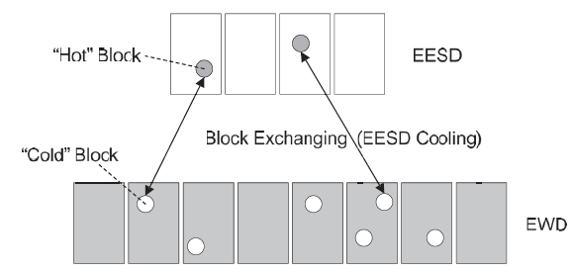
PRINCIPLE
Efficient Data Migration to Conserve Energy in Streaming Media Storage Systems
EESD Cooling
Fig.1 Explicit energy saving disk cooling
COURTESY:IEEE TRANSACTIONS ON PARALLEL AND DISTRIBUTED SYSTEMS

Slide 9
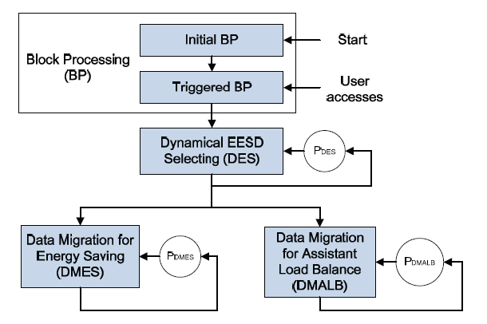
ARCHITECTURE
Efficient Data Migration to Conserve Energy in Streaming Media Storage Systems
Fig.2 Workflow of the EESDC mechanism
COURTESY:IEEE TRANSACTIONS ON PARALLEL AND DISTRIBUTED SYSTEMS

Slide 10
IMPLEMENTATION(CONTD)
Efficient Data Migration to Conserve Energy in Streaming Media Storage Systems
Block Processing (BP)
Dynamical EESD Selecting (DES)
Data Migrations for Energy Saving (DMES)
Data Migrations for Assistant Load Balance
(DMALB)

Slide 11
BLOCK PROCESSING(BP)
Efficient Data Migration to Conserve Energy in Streaming Media Storage Systems
Data Splitting and Distributions
    Sorted Block List-SBL
Temperatures of Data Blocks

Slide 12
Efficient Data Migration to Conserve Energy in Streaming Media Storage Systems
BLOCK PROCESSING(CONT)
Heap sort
Heap is built
Largest element moved to array

Slide 13
BLOCK PROCESSING (BP)
Efficient Data Migration to Conserve Energy in Streaming Media Storage Systems
Temperatures of Data Blocks
Ati- Access Time
Sizei-Size of the block
Tpi-Temperature of the block
  Tpi=δ×Ati / Sizei
Dept. of CSE , MACE , Kothamangalam

Slide 14
DYNAMICAL EESD SELECTING (DES)
Efficient Data Migration to Conserve Energy in Streaming Media Storage Systems
Two phases
Number of EESD and EWD disks
Choose EESD and EWD disks

Slide 15
DYNAMICAL EESD SELECTING (DES)
Efficient Data Migration to Conserve Energy in Streaming Media Storage Systems
µ :
The proportion of disks serving as EESD
SBL:
Sorted Block List

Slide 16
DATA MIGRATIONS FOR ENERGY SAVING
Efficient Data Migration to Conserve Energy in Streaming Media Storage Systems
  Boundary temperature (BOT)
  BOT=Block Temperature of SBL[x]
  x=µ×len(SBL)

Slide 17
DATA MIGRATIONS FOR LOAD BALANCE
Efficient Data Migration to Conserve Energy in Streaming Media Storage Systems
Strategies
Individual EWD disks load higher
Some disks have extremely heavy loads

Slide 18
Efficient Data Migration to Conserve Energy in Streaming Media Storage Systems
BENEFITS
Reducing Data Migration Overheads
Easy Controlling the I/O Load of EESD

Slide 19
CONCLUSION
Efficient Data Migration to Conserve Energy in Streaming Media Storage Systems
Data migration efficiency
Improves energy efficiency and QoS
Meet the characteristics of streaming media applications

Slide 20
REFERENCES
Efficient Data Migration to Conserve Energy in Streaming Media Storage Systems
[1]: D. Colarelli and D. Grunwald, “Massive Arrays of Idle Disks for Storage Archives,” Proc. ACM/IEEE Conf. Supercomputing, pp. 1-11,Nov. 2002.
[2]: E. Pinheiro and R. Bianchini, “Energy Conservation Techniques for Disk Array-Based Servers,” Proc. 18th Int’l Conf. Supercomputing,pp. 68-78, June 2004.

Slide 21
REFERENCES(Contd.)
Efficient Data Migration to Conserve Energy in Streaming Media Storage Systems
[3] :J. Wang, H. Zhu, and D. Li, “ eRAID : Conserving Energy in Conventional Disk-Based RAID System” IEEE Trans. Computers vol. 57, no. 3, pp. 359-374, Mar. 2008.

Slide 22
Efficient Data Migration to Conserve Energy in Streaming Media Storage Systems
  THANK YOU

Slide 23
Efficient Data Migration to Conserve Energy in Streaming Media Storage Systems
  QUESTIONS ??

