Slide 1
WELCOME

Slide 2
A PRACTICAL APPROACH
TOWARD ACHIEVING MINIMUM DATA SETS STORAGE COST IN CLOUD
Topic Approval:2/9/2013
Slides Approval:24/9/2013
Topic And Slides Approved By:
Mr. Aby Abahai
Elina Ann Mathew
Roll no:22
S7R

Slide 3
CONTENTS
A HIGHLY PRACTICAL APPROACH TOWARD ACHIEVING MINIMUM DATA SETS STORAGE COST IN CLOUD
Introduction
Important concepts
Cost model of datasets storage
Existing system
Proposed system
Implementation
Evaluation
Conclusion
References
Dept.of computer science, MACE Kothamangalam

Slide 4
INTRODUCTION
A HIGHLY PRACTICAL APPROACH TOWARD ACHIEVING MINIMUM DATA SETS STORAGE COST IN CLOUD
Scientific applications
  Large computation intensive tasks
  Intermediate data sets
Cloud computing
  Pay-as-you-go model
  Storing and regeneration
Dept.of computer science, MACE Kothamangalam

Slide 5
EXISTING SYSTEM
A HIGHLY PRACTICAL APPROACH TOWARD ACHIEVING MINIMUM DATA SETS STORAGE COST IN CLOUD
Balance of storage and regeneration of data set
Tradeoff between computation and storage
Disadvantage
  Not highly cost effective
  Impractical for runtime storage strategy
Dept.of computer science, MACE Kothamangalam

Slide 6
PROBLEM ANALYSIS
A HIGHLY PRACTICAL APPROACH TOWARD ACHIEVING MINIMUM DATA SETS STORAGE COST IN CLOUD
Cost of storage same as tradeoff
User’s preferences on storage into consideration
Dept.of computer science, MACE Kothamangalam

Slide 7
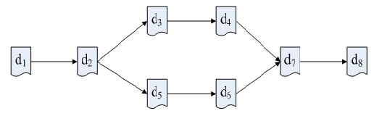
IMPORTANT CONCEPTS
A HIGHLY PRACTICAL APPROACH TOWARD ACHIEVING MINIMUM DATA SETS STORAGE COST IN CLOUD
COURTESY:IEEE TRANSACTIONS ONS ON PARALLEL AND DISTRIBUTED SYSTEMS
Data Dependency Graph (DDG)
  Classification of application data
    Original data and generated data
  Data provenance
Fig 1: A Simple DDG
Dept.of computer science, MACE Kothamangalam

Slide 8
ATTRIBUTES
A HIGHLY PRACTICAL APPROACH TOWARD ACHIEVING MINIMUM DATA SETS STORAGE COST IN CLOUD
Attributes : <x_{i}, y_{i}, f_{i}, v_{i}, provSet_{i}, CostR_{i}>
  x_{i} : Regeneration cost
  y_{i} : Cost of storing data
  f_{i} : Status of data set d_{i}
  v_{i} : Usage frequency
Dept.of computer science, MACE Kothamangalam

Slide 9


ATTRIBUTES(CONTD..)
A HIGHLY PRACTICAL APPROACH TOWARD ACHIEVING MINIMUM DATA SETS STORAGE COST IN CLOUD
COURTESY:IEEE TRANSACTIONS ONS ON PARALLEL AND DISTRIBUTED SYSTEMS
  provSet_{i} :Set of stored provenance
  CostR_{i} :Cost rate of dataset d_{i}
Dept.of computer science, MACE Kothamangalam

Slide 10

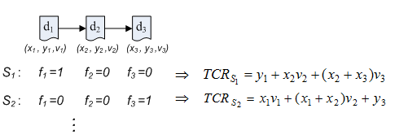
COST MODEL OF DATASET STORAGE
A HIGHLY PRACTICAL APPROACH TOWARD ACHIEVING MINIMUM DATA SETS STORAGE COST IN CLOUD
COURTESY:IEEE TRANSACTIONS ONS ON PARALLEL AND DISTRIBUTED SYSTEMS
Total cost rate of DDG:
Dept.of computer science, MACE Kothamangalam

Slide 11
PROPOSED SYSTEM
A HIGHLY PRACTICAL APPROACH TOWARD ACHIEVING MINIMUM DATA SETS STORAGE COST IN CLOUD
Enhanced Cost Transitive Tournament Shortest Path (CTT-SP) based algorithm
Local Optimization based strategy
Dept.of computer science, MACE Kothamangalam

Slide 12

CTT-SP ALGORITHM
A HIGHLY PRACTICAL APPROACH TOWARD ACHIEVING MINIMUM DATA SETS STORAGE COST IN CLOUD
COURTESY:IEEE TRANSACTIONS ONS ON PARALLEL AND DISTRIBUTED SYSTEMS
  Minimum cost strategy for a DDG
  T_{i} : tolerance of dataset d_{i}’s accessing delay
  λ_{i} : cost related tolerance of dataset d_{i}’s
  accessing delay
Dept.of computer science, MACE Kothamangalam

Slide 13
ALGORITHM
A HIGHLY PRACTICAL APPROACH TOWARD ACHIEVING MINIMUM DATA SETS STORAGE COST IN CLOUD
  Step 1: for(every dataset in DDG)
  Step 2: for every dataset ,dj where di dj ){
  Step 3: {genCost=0;
  Step 4: for(every dataset du ,where di du dj){
  Step 5:gencost=genCost+ xu ;
  Step 6:if(genCost / costCPU> Tj-1 )
  Step 7: break for;
  Step 8: else{
  Step 9: create e< di,dj > ;
Dept.of computer science, MACE Kothamangalam

Slide 14
ALGORITHM(CONTD..)
A HIGHLY PRACTICAL APPROACH TOWARD ACHIEVING MINIMUM DATA SETS STORAGE COST IN CLOUD
  Step 10:Weight=0;
  Step 11: for(every dataset dk ,where di dk dj ){
  Step 12: genCost=0;
  Step 13: for(every dataset dh ,where di dh dk )
  Step 14: genCost= genCost + xh ;
  Step 15: Consider yi for each of dataset
  Step 16: If yi greater than genCost then delete;
  Step 17:set w<di,dj> = weight;}}
  Step 18:dijkstra algorithm,S=set of datasets traversed
  Step 19: return S;
Dept.of computer science, MACE Kothamangalam

Slide 15
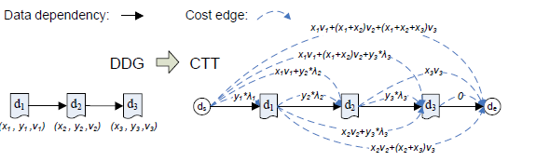
IMPLEMENTATION
A HIGHLY PRACTICAL APPROACH TOWARD ACHIEVING MINIMUM DATA SETS STORAGE COST IN CLOUD
COURTESY:IEEE TRANSACTIONS ONS ON PARALLEL AND DISTRIBUTED SYSTEMS
Fig 2: Example of CTT-SP Algorithm
Dept.of computer science, MACE Kothamangalam

Slide 16
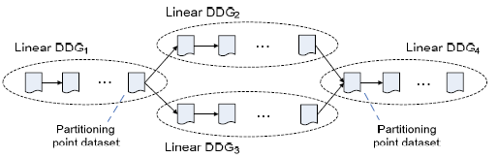
LOCAL OPTIMIZATION BASED STRATEGY
A HIGHLY PRACTICAL APPROACH TOWARD ACHIEVING MINIMUM DATA SETS STORAGE COST IN CLOUD
COURTESY:IEEE TRANSACTIONS ONS ON PARALLEL AND DISTRIBUTED SYSTEMS
  Efficiency and scalability
  Partition of large DDG into small linear segments
  Utilize CTT-SP algorithm to obtain localized optimum DDG
Fig 3:Dividing a DDG into linear DDG segments
Dept.of computer science, MACE Kothamangalam

Slide 17
EVALUATION
A HIGHLY PRACTICAL APPROACH TOWARD ACHIEVING MINIMUM DATA SETS STORAGE COST IN CLOUD
Simulation environment and strategies
  Usage-based strategy
  Generation cost-based strategy
  Cost storage strategy
  Store all datasets
  Store none
Dept.of computer science, MACE Kothamangalam

Slide 18
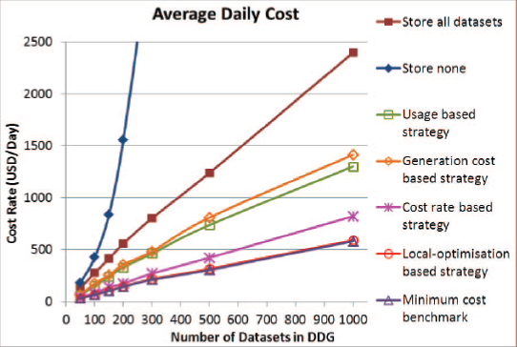
PERFORMANCE EVALUATION
A HIGHLY PRACTICAL APPROACH TOWARD ACHIEVING MINIMUM DATA SETS STORAGE COST IN CLOUD
COURTESY:IEEE TRANSACTIONS ONS ON PARALLEL AND DISTRIBUTED SYSTEMS
  Cost effectiveness
Fig 4: Cost-Effectiveness Comparison Of Storage Strategies
Dept.of computer science, MACE Kothamangalam

Slide 19
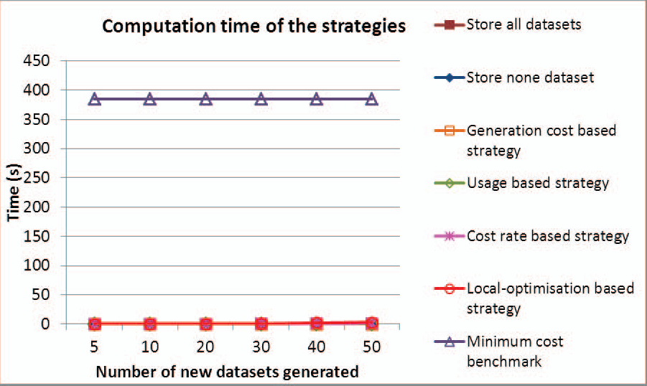
PERFORMANCE EVALUATION(CONTD..)
Efficiency
COURTESY:IEEE TRANSACTIONS ONS ON PARALLEL AND DISTRIBUTED SYSTEMS
Fig 5: Efficiency Comparison Of Different Strategies

Slide 20
CONCLUSION
A HIGHLY PRACTICAL APPROACH TOWARD ACHIEVING MINIMUM DATA SETS STORAGE COST IN CLOUD
Considers user’s preference on storage
Local optimization for the trade-off
Highly cost-effective
High practical runtime efficiency
Dept.of computer science, MACE Kothamangalam

Slide 21
REFERENCES
A HIGHLY PRACTICAL APPROACH TOWARD ACHIEVING MINIMUM DATA SETS STORAGE COST IN CLOUD
I. Adams, D.D.E. Long, E.L. Miller, S. Pasupathy, and M.W. Storer,“Maximizing Efficiency by Trading Storage for Computation,”Proc. Workshop Hot Topics in Cloud Computing, 2009.
S. Agarwala, D. Jadav, and L.A. Bathen, “iCostale: Adaptive CostOptimization for Storage Clouds,” Proc. IEEE Int’l Conf. CloudComputing, pp. 436-443, 2011.
Dept.of computer science, MACE Kothamangalam

Slide 22
REFERENCES
A HIGHLY PRACTICAL APPROACH TOWARD ACHIEVING MINIMUM DATA SETS STORAGE COST IN CLOUD
M. Armbrust, A. Fox, R. Griffith, A.D. Joseph, R. Katz, A.Konwinski, G. Lee, D. Patterson, A. Rabkin, I. Stoica, and M.Zaharia, “A View of Cloud Computing,” Comm. ACM, vol. 53,pp. 50-58, 2010.
Dept.of computer science, MACE Kothamangalam

Slide 23
A HIGHLY PRACTICAL APPROACH TOWARD ACHIEVING MINIMUM DATA SETS STORAGE COST IN CLOUD
THANK YOU
Dept.of computer science, MACE Kothamangalam

Slide 24
A HIGHLY PRACTICAL APPROACH TOWARD ACHIEVING MINIMUM DATA SETS STORAGE COST IN CLOUD
QUESTIONS??
Dept.of computer science, MACE Kothamangalam

