Slide 1
WELCOME

Slide 2
DETECTING And RESOLVING FIREWALL POLICY ANOMALIES
Topic approval:26/08/2013 Beemon Bose
Slide approval:29/08/2013 Roll no-17
Topic and slide approved by: S7 R
Mrs. Jisha P Abraham

Slide 3
Contents
DETECTING And RESOLVING FIREWALL POLICY ANOMALIES
Introduction
Existing System
Anomalies in Firewall Policies
Anomaly Representation
Anomaly Management Framework
Conclusion
References

Slide 4
Introduction
DETECTING And RESOLVING FIREWALL POLICY ANOMALIES
Firewall
  Between Private And Public Network
  Examines all packets
  Rules - <condition, action>
  Policy Management

Slide 5
Existing System
DETECTING And RESOLVING FIREWALL POLICY ANOMALIES
Firewall Policy Advisor
  Pairwise Anomalies
FIREMAN
  Anomalies Among Multiple Rules
    Ignores Subsequent Rules
    Cannot Indicate All Rules in an Anomaly

Slide 6
Anomaly Categorization
DETECTING And RESOLVING FIREWALL POLICY ANOMALIES
Shadowing (r4 shadowed by r3)
Generalization (r5 generalization of r4)
Correlation (r2 correlates with r5)
Redundancy (r1 is redundant wrt r2)

Slide 7
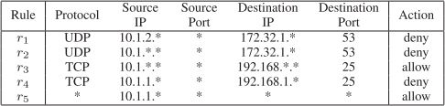
An Example Firewall Policy
DETECTING And RESOLVING FIREWALL POLICY ANOMALIES
TABLE 1 :An Example Firewall Policy
Courtesy:IEEE TRANSACTIONS ON DEPENDABLE AND SECURE COMPUTING, VOL. 9, NO. 3, MAY/JUNE 2012

Slide 8
Anomaly Representation
DETECTING And RESOLVING FIREWALL POLICY ANOMALIES
Packet Space Segmentation
  Rule Based Segmentation Technique
    Segment Pairwise Disjoint
    Packet-Same Segment-Same Rules

Slide 9
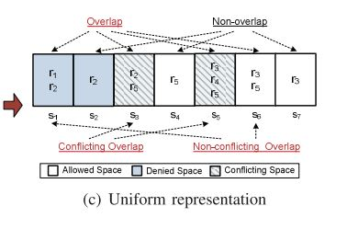
Packet Space Representation
DETECTING And RESOLVING FIREWALL POLICY ANOMALIES
Fig. 1. Packet space representation derived from the example policy
Courtesy:IEEE TRANSACTIONS ON DEPENDABLE AND SECURE COMPUTING, VOL. 9, NO. 3, MAY/JUNE 2012

Slide 10
Grid Representation
DETECTING And RESOLVING FIREWALL POLICY ANOMALIES
Matrix Based Visualization
  Space Segment along Horizontal Axis
  Rules along Vertical Axis

Slide 11
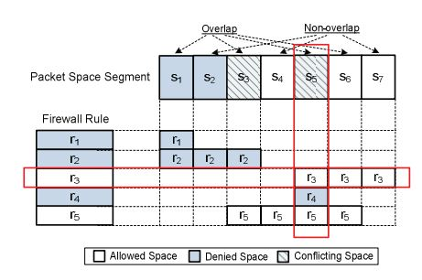
Grid Representation (contd..)
DETECTING And RESOLVING FIREWALL POLICY ANOMALIES
Fig. 2. Grid representation of policy anomaly
Courtesy:IEEE TRANSACTIONS ON DEPENDABLE AND SECURE COMPUTING, VOL. 9, NO. 3, MAY/JUNE 2012

Slide 12
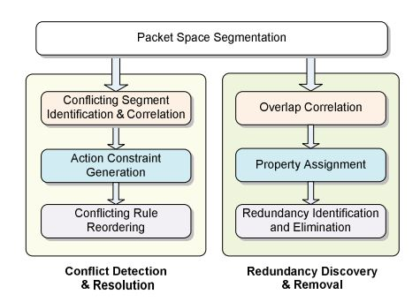
Anomaly Management Framework
DETECTING And RESOLVING FIREWALL POLICY ANOMALIES
Conflict Detection and Resolution
Redundancy Discovery and Removal
Fig. 3. Policy anomaly management framework
Courtesy: IEEE TRANSACTIONS ON DEPENDABLE AND SECURE COMPUTING, VOL. 9, NO. 3, MAY/JUNE 2012

Slide 13
Conflict Detection and Resolution
DETECTING And RESOLVING FIREWALL POLICY ANOMALIES
3 Steps
  Conflicting Segments Identified
  Generates an Action Constraint
  Rule Reordering

Slide 14
Action Constraint Generation
DETECTING And RESOLVING FIREWALL POLICY ANOMALIES
Strategy-Based Conflict Resolution Method
Minimal Interaction
  Automated Strategy
  Manual Strategy

Slide 15
Automated Strategy Selection
DETECTING And RESOLVING FIREWALL POLICY ANOMALIES
Conflicts Discovered
Risk Assessment
Risk Level Low Allow
Risk Level High Deny

Slide 16
Manual Strategy Selection
DETECTING And RESOLVING FIREWALL POLICY ANOMALIES
Network Situation-Aware Strategy
  Based on Risk Assessment
Policy-Oriented Strategy
  Based on Policy Definition

Slide 17
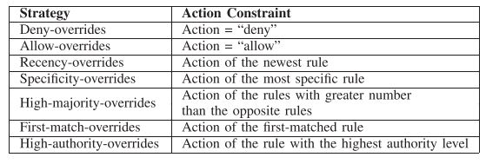
Constraint Generation from Conflict Resolution Strategy
DETECTING And RESOLVING FIREWALL POLICY ANOMALIES
TABLE 1:Constraint Generation from Conflict Resolution Strategy
Courtesy:IEEE TRANSACTIONS ON DEPENDABLE AND SECURE COMPUTING, VOL. 9, NO. 3, MAY/JUNE 2012

Slide 18
Strategy-Based Conflict Resolution
DETECTING And RESOLVING FIREWALL POLICY ANOMALIES
Risk Assessment of Conflicts
Threshold Setup
(UT and LT)
RL>UT
Yes
RS=Deny Overrides
No
Automated Strategy Selection
RL<LT
Yes
RS=Allow Overrides
No
Risk Levels of Conflicts
Resolution Strategy Selection
Conflicting Rule & Rule
Associated Information
Strategy Repository
Refine
Manual Strategy Selection
No
Determined
Yes
Action Constraint Generation
Conflicting Rule Reordering

Slide 19
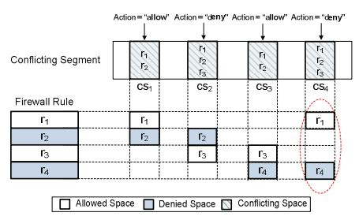
Rule Reordering
DETECTING And RESOLVING FIREWALL POLICY ANOMALIES
Reorder Conflicting Rules
  Satisfies all Action Constraints
Fig. 4. Partial satisfaction of action constraints
Courtesy:IEEE TRANSACTIONS ON DEPENDABLE AND SECURE COMPUTING, VOL. 9, NO. 3, MAY/JUNE 2012

Slide 20
Rule Reordering Algorithm
DETECTING And RESOLVING FIREWALL POLICY ANOMALIES
Permutation Algorithm
  Time Consuming
  Small Set of Conflicting Rules
Greedy Algorithm
  Greatest Resolving Score
  Position Range Identified
  Moving to New Position

Slide 21
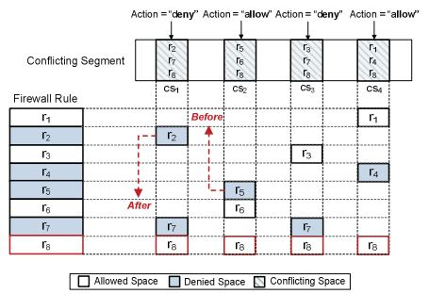
Rule Reordering Algorithm
DETECTING And RESOLVING FIREWALL POLICY ANOMALIES
Fig. 5. Example of position indicators for a rule
Courtesy: IEEE TRANSACTIONS ON DEPENDABLE AND SECURE COMPUTING, VOL. 9, NO. 3, MAY/JUNE 2012

Slide 22
Redundancy Elimination
DETECTING And RESOLVING FIREWALL POLICY ANOMALIES
Assign Property Values
  Removable (R)
  Strong Irremovable (SI)
  Weak Irremovable (WI)
  Correlated (C)

Slide 23
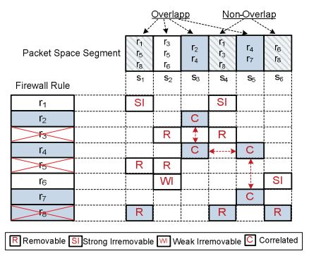
Property Assignment
DETECTING And RESOLVING FIREWALL POLICY ANOMALIES
Non-Overlapping Segments
Conflicting Segments
Assign Property Values Segments
Fig. 6. Example of property assignment
Courtesy:IEEE TRANSACTIONS ON DEPENDABLE AND SECURE COMPUTING, VOL. 9, NO. 3, MAY/JUNE 2012

Slide 24
Implementation
DETECTING And RESOLVING FIREWALL POLICY ANOMALIES
Firewall Anomaly Management Environment (FAME)
  Framework Realized
  Implemented in Java

Slide 25
Firewall Anomaly Management Environment
DETECTING And RESOLVING FIREWALL POLICY ANOMALIES
Visualization Layer
  Policy Conflict Viewer
  Policy Redundancy Viewer
  Functionality Layer

Slide 26
Components of FAME
DETECTING And RESOLVING FIREWALL POLICY ANOMALIES
Segmentation Module
Correlation Module
Risk Assessment Module
Action Constraint Generation Module
Rule Reordering Module
Property Assignment Module

Slide 27
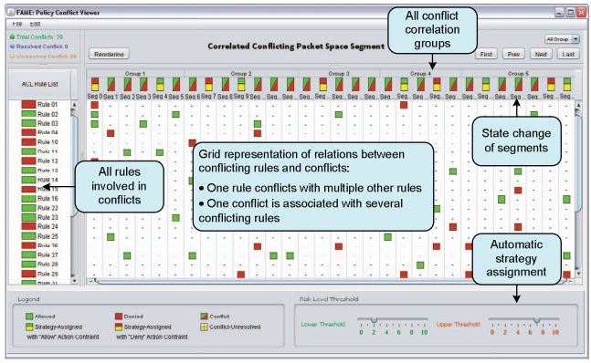
Interface of FAME Conflict Viewer
DETECTING And RESOLVING FIREWALL POLICY ANOMALIES
Fig. 7.Conflict Viewer for all Conflicts
Courtesy:IEEE TRANSACTIONS ON DEPENDABLE AND SECURE COMPUTING, VOL. 9, NO. 3, MAY/JUNE 2012

Slide 28
Conclusion
DETECTING And RESOLVING FIREWALL POLICY ANOMALIES
Rule-Based Segmentation mechanism
Grid-Based Representation Technique
FAME

Slide 29
References
DETECTING And RESOLVING FIREWALL POLICY ANOMALIES
E. Al-Shaer and H. Hamed, “Discovery of Policy Anomalies in Distributed Firewalls”,IEEE INFOCOM ’04,vol. 4, pp. 2605-2616, 2004.
A. Wool, “Trends in Firewall Configuration Errors: Measuring the Holes in Swiss Cheese,”IEEE Internet Computing, vol. 14, no. 4, pp. 58-65, July/Aug. 2010.
J. Alfaro, N. Boulahia-Cuppens, and F. Cuppens, “Complete Analysis of Configuration Rules to Guarantee Reliable Network Security Policies,”Int’l J. Information Security,vol. 7, no. 2, pp. 103-122, 2008

Slide 30
References
DETECTING And RESOLVING FIREWALL POLICY ANOMALIES
F. Baboescu and G. Varghese, “Fast and Scalable Conflict Detection for Packet Classifiers,”Computer Networks,vol. 42, no. 6, pp. 717-735, 2003.
L. Yuan, H. Chen, J. Mai, C. Chuah, Z. Su, P. Mohapatra, and C. Davis, “Fireman: A Toolkit for Firewall Modeling and Analysis,” Proc. IEEE Symp. Security and Privacy,p. 15, 2006.
E. Lupu and M. Sloman, “Conflicts in Policy-Based Distributed Systems Management,”IEEE Trans. Software Eng., vol. 25, no. 6, pp. 852-869, Nov./Dec. 1999.

Slide 31
QUESTIONS???

Slide 32
THANK YOU

