Slide 1
Scalable Scheduling of Updates in Streaming Data Warehouses
Topic approval:20|08|2013
Slide approval: 26|08|2013
Topic and Slide approved by: Miss Jisha P Abraham
Aswathy Santhosh
S7R
Roll No:16

Slide 2
Contents
Scalable Scheduling of Updates in Streaming Data Warehouses
Introduction
Present system
Proposed system
Scheduling challenges
Scheduling algorithms
Conclusion
References

Slide 3
Introduction
Scalable Scheduling of Updates in Streaming Data Warehouses
Data warehouse
Streaming data warehouse
Applications
        Online stock trading
        Network data warehouses
Notes:
Use multiple points, if necessary.

Slide 4
Present System
Scalable Scheduling of Updates in Streaming Data Warehouses
Immediate update
Deferred update
Periodic update
Notes:
Use brief bullets and discuss details verbally.

Slide 5
Drawbacks
Scalable Scheduling of Updates in Streaming Data Warehouses
Degrade performance
Thrashing
Context switching

Slide 6
Proposed System
Scalable Scheduling of Updates in Streaming Data Warehouses
Prioritized EDF(Earliest Deadline First)
Max Benefit
Job partitioning algorithms
          EDF-Partitioned strategy
          Proportional Partitioning Strategy

Slide 7
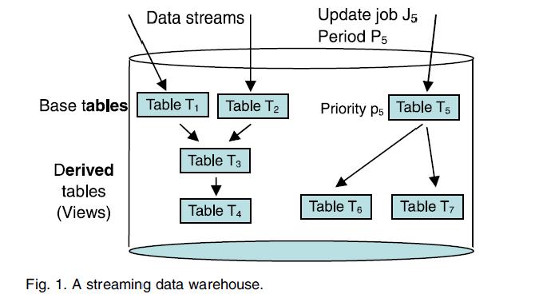
Architecture
Scalable Scheduling of Updates in Streaming Data Warehouses
Courtesy: IEEE transaction on knowledge and data engineering,2012

Slide 8
Scheduling Challenges
Scalable Scheduling of Updates in Streaming Data Warehouses
Scheduling metric- Data staleness
Hierarchies and priorities
Heterogeneity and non-preemptibility
Transient overload

Slide 9
Hierarchies and Priorities
Scalable Scheduling of Updates in Streaming Data Warehouses
Inheriting priority
      Max
      Sum
      Max-plus

Slide 10
Heterogeneity and Nonpreemptibility
Scalable Scheduling of Updates in Streaming Data Warehouses
Allow preemption-Not possible
Parallel scheduling
      Partitioned scheduling
      Global scheduling
Partition with degree of global

Slide 11
Prioritized EDF
Scalable Scheduling of Updates in Streaming Data Warehouses
Orders jobs by priorities
Breaking ties by deadlines
Deadline = r_{i}+P_{i}

Slide 12
Max Benefit
Scalable Scheduling of Updates in Streaming Data Warehouses
Benefit = p_{i} ΔF_{i}
Marginal benefit
      Benefit per unit execution time

Slide 13
EDF-Partitioned strategy
Scalable Scheduling of Updates in Streaming Data Warehouses
Sort the jobs
For each job J_{i} -sorted order
    J_{i} ‘s home track is available, schedule
    Else, available free track, schedule
    Else, track to which J_{i} can be promoted
Else, execution of J_{i}

Slide 14
Terminology used
Scalable Scheduling of Updates in Streaming Data Warehouses
Schedulablity condition for track r
U_{r}<=1-Emax_{r}/Pmin_{r}
Promotability condition for track r
U_{r}<=1-Emax_{r}(J_{i})/Pmin_{r}(J_{i})
U_{r}=E_{i}(P_{i})/P_{i} U_{r}=Σu_{i}

Slide 15
Terminology Used(Continued)
Scalable Scheduling of Updates in Streaming Data Warehouses
Emax_{r}=max(E_{i}(P_{i}))
Pmin_{r}=min(Pi)
Emaxr(J_{i})=max(Emax_{r},E_{i}(P_{i}))
Pminr(J_{i})=min(Pmin_{r},P_{i})

Slide 16
Proportional Partitioning Strategy
Scalable Scheduling of Updates in Streaming Data Warehouses
Steps
        Identify clusters of similar jobs
        Allocate resources to clusters
        Scheduling algorithm

Slide 17
Identify clusters of similar jobs
Scalable Scheduling of Updates in Streaming Data Warehouses
Order jobs -increasing execution time
Create initial cluster C₀
For each job J_{i} in order,
      If E_{i}(Pi)<k*minimum period in cluster
      Add J_{i} to cluster
Else, make new cluster, add J_{i} to it

Slide 18
Allocating resources to clusters
Scalable Scheduling of Updates in Streaming Data Warehouses
For each C_{j,} compute UC_{j}=ΣE_{i}(P_{i})/P_{i}
Compute U_{tot} and adjustment factor M
Set track_lo[c]=0,track_hi[c]=M*UC_{c}
For each j, find
      Track_lo[j]=track_lo[j+1]
      Track_hi[j]=track_hi[j+1]+M*UC_{j}

Slide 19
Scheduling algorithm
Scalable Scheduling of Updates in Streaming Data Warehouses
Sort jobs using local algorithm
For each Ji,schedule Ji
      On track_lo[j]+1…track_hi[j]
      Else on track_lo[j]
      Else on a free track
      Else on 0 to track_lo[j]-1
Else delay Ji

Slide 20
Dealing with transient overload
Scalable Scheduling of Updates in Streaming Data Warehouses
During overload
        low priority jobs deferred
After overload
        low priority jobs accumulates
Update chopping

Slide 21
Results
Scalable Scheduling of Updates in Streaming Data Warehouses
Hierarchies and Priorities
      Prioritized EDF
      Max Benefit
Heterogeneity and non-preemptibility
      Job partitioning algorithms

Slide 22
Conclusion
Scalable Scheduling of Updates in Streaming Data Warehouses
Staleness as scheduling metric
4 scheduling algorithms
Reserve resources for short jobs

Slide 23
References
Scalable Scheduling of Updates in Streaming Data Warehouses
B. Adelberg, H. Garcia-Molina, and B. Kao, “Applying Update Streams in a Soft Real-Time Database System”, Proc. ACM SIGMOD Int’l Conf. Management of Data, pp. 245-256,1995.
S. Baruah, "The Non-preemptive Scheduling of Periodic Tasks upon Multiprocessors," Real Time Systems, vol. 32, nos. 1/2, pp. 9-20, 2006.

Slide 24
References Continued
Scalable Scheduling of Updates in Streaming Data Warehouses
S. Babu, U. Srivastava, and J. Widom, "Exploiting K-constraints to Reduce Memory Overhead in Continuous Queries over Data Streams," ACM Trans. Database Systems, vol. 29, no. 3, pp. 545-580, 2004.
S. Baruah, N. Cohen, C. Plaxton, and D. Varvel, "Proportionate Progress: A Notion of Fairness in Resource Allocation," Algorithmica, vol. 15, pp. 600-625, 1996.

Slide 25
References Continued
Scalable Scheduling of Updates in Streaming Data Warehouses
M.H. Bateni, L. Golab, M.T. Hajiaghayi, and H. Karloff, "Scheduling to Minimize Staleness and Stretch in Real-time Data Warehouses," Proc. 21st Ann. Symp. Parallelism in Algorithms and Architectures (SPAA), pp. 29-38, 2009.
D. Carney, U. Cetintemel, A. Rasin, S. Zdonik, M. Cherniack, and M. Stonebraker, "Operator Scheduling in a Data Stream Manager," Proc. 29th Int'l Conf. Very Large Data Bases (VLDB), pp. 838-849, 2003.

Slide 26
Thank you
Scalable Scheduling of Updates in Streaming Data Warehouses

Slide 27
Questions?
Scalable Scheduling of Updates in Streaming Data Warehouses

