Slide 1

WELCOME
MAR ATHANASIUS COLLEGE OF ENGINEERING, KOTHAMANGALAM

Slide 2

YouTube
CLASSIFYING
YOUTUBE CHANNELS
- A PRACTICAL SYSTEM
Presented by:
ASHWIN NAIR
S7R
MACE.
TITLE APPROVAL : 22/07/2013
SLIDE APPROVAL : 22/07/2013
APPROVED BY : Mrs. Jisha P. Abraham
MAR ATHANASIUS COLLEGE OF ENGINEERING, KOTHAMANGALAM

Slide 3
Contents
Introduction
Problem
Manual system
Solution
Annotating videos
Classifying entities
Classifying channels
Conclusion
References
MAR ATHANASIUS COLLEGE OF ENGINEERING, KOTHAMANGALAM

Slide 4
Introduction
Video sharing site
View, upload and share
In over 50 countries
Millions of videos
MAR ATHANASIUS COLLEGE OF ENGINEERING, KOTHAMANGALAM

Slide 5
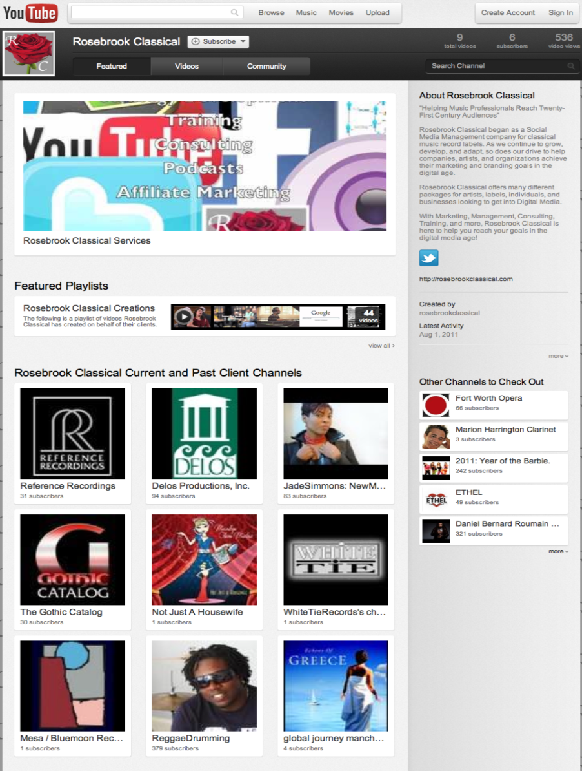
Introduction (Contd..)
CHANNELS
Home page for each user
Any common property
  Uploader
  Topic
  Event
Courtesy: www.youtube.com
MAR ATHANASIUS COLLEGE OF ENGINEERING, KOTHAMANGALAM

Slide 6
Introduction (Contd..)
Algorithm formulation
Sorts video into categories
High accuracy
Scalable
MAR ATHANASIUS COLLEGE OF ENGINEERING, KOTHAMANGALAM

Slide 7
The Problem Tackled
Classifying videos
Algorithmically
On the scale of YouTube corpus
MAR ATHANASIUS COLLEGE OF ENGINEERING, KOTHAMANGALAM

Slide 8
Manual Classification
Only a dozen categories
Manually curation
Many problems
MAR ATHANASIUS COLLEGE OF ENGINEERING, KOTHAMANGALAM

Slide 9
Problems Faced
  Limits channels
  Maintenance required
  Different versions
  Questionable method
MAR ATHANASIUS COLLEGE OF ENGINEERING, KOTHAMANGALAM

Slide 10
Alternative
Creators and curators classify channels
Problems :
  Additional action
  Back-fill
  Prevents taxonomical changes
MAR ATHANASIUS COLLEGE OF ENGINEERING, KOTHAMANGALAM

Slide 11
Solution
Three steps :
  Mapping
    Videos to semantic entities
    Semantic entities to taxonomic categories
  Combining first two steps
MAR ATHANASIUS COLLEGE OF ENGINEERING, KOTHAMANGALAM

Slide 12
Metrics
Precision – Central, Relevant, Off-topic
Recall and coverage
Subscription rate
MAR ATHANASIUS COLLEGE OF ENGINEERING, KOTHAMANGALAM

Slide 13
Annotating Videos
Semantic entities – using Freebase
Entity names
Annotation process:
  Conversion of video to text
  Annotation by entities
MAR ATHANASIUS COLLEGE OF ENGINEERING, KOTHAMANGALAM

Slide 14
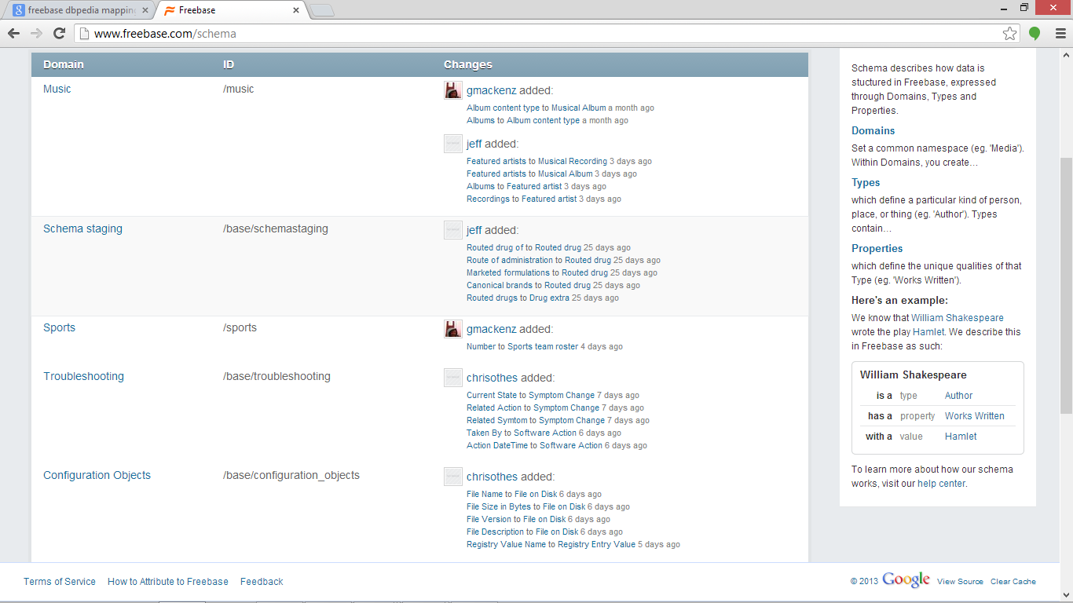
Freebase Structure
Courtesy: www.freebase.com
MAR ATHANASIUS COLLEGE OF ENGINEERING, KOTHAMANGALAM

Slide 15
Annotation Process
Entity identification
Ranking entities
3 additional signals:
  Top search queries
  Same user videos
  Upload history
MAR ATHANASIUS COLLEGE OF ENGINEERING, KOTHAMANGALAM

Slide 16
SEARCH QUERIES
UPLOADER HISTORY
CO-WATCHES
VIDEO METADATA
CREATION OF COMPOSITE DOCUMENT
ANNOTATING WITH ENTITIES
FILTERING AND RANKING ENTITIES
ANNOTATION PROCESS
MAR ATHANASIUS COLLEGE OF ENGINEERING, KOTHAMANGALAM

Slide 17
Classifying Entities
A specific taxonomy
Extract features about entities
  Entity types
    Notable
    Other
MAR ATHANASIUS COLLEGE OF ENGINEERING, KOTHAMANGALAM

Slide 18
Algorithm
One entity at a time
Function entity → categories
3 steps:
    Collect entity and allot weight
    Map features to categories and build a tree
    Tree traversal
MAR ATHANASIUS COLLEGE OF ENGINEERING, KOTHAMANGALAM

Slide 19
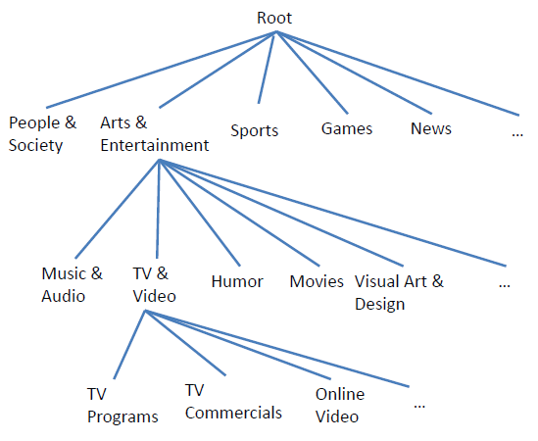
Taxonomy Of Categories
CATEGORIES →
SUB-CATEGORIES →
MAR ATHANASIUS COLLEGE OF ENGINEERING, KOTHAMANGALAM

Slide 20
Model
Map taxonomy to Freebase entity
Features
Manual curation
Develop trainer
MAR ATHANASIUS COLLEGE OF ENGINEERING, KOTHAMANGALAM

Slide 21
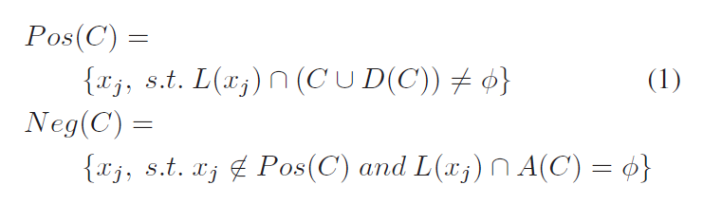
Trainer
Input – entities, initial model
Algorithm
Computes probability
Training sets
MAR ATHANASIUS COLLEGE OF ENGINEERING, KOTHAMANGALAM

Slide 22
To Improve Precision
Multiple feature
Consistent categories
MAR ATHANASIUS COLLEGE OF ENGINEERING, KOTHAMANGALAM

Slide 23
Metrics
Coverage
  Relevant entities considered
Precision
  Human based evaluation
  Decision on the algorithm
    Best
    Relevant
    Wrong
MAR ATHANASIUS COLLEGE OF ENGINEERING, KOTHAMANGALAM

Slide 24
Classifying Channels
User generated channels
  By human creators
    Entities for channel
    Videos mapped to categories
    Associate weight
MAR ATHANASIUS COLLEGE OF ENGINEERING, KOTHAMANGALAM

Slide 25
User Generated Channels
Precision
  Consider classifications supported by both steps
  Classifications consistent with most prominent video
  Videos about unrelated topics processed later
  Multiple classification, or
  Exclusion
MAR ATHANASIUS COLLEGE OF ENGINEERING, KOTHAMANGALAM

Slide 26
Algorithmic channels
Entity-centered channels
Channels from blogs
MAR ATHANASIUS COLLEGE OF ENGINEERING, KOTHAMANGALAM

Slide 27
Internationalization
In over 50 countries
Freebase internationalized
Probabilistic language detector used in first step
MAR ATHANASIUS COLLEGE OF ENGINEERING, KOTHAMANGALAM

Slide 28
Applications
Channels browser
  Cross-country distribution
  Country-specific interests
  Boosting score of every channel
MAR ATHANASIUS COLLEGE OF ENGINEERING, KOTHAMANGALAM

Slide 29
Conclusion
Framework for classifying channels
Definition of product
Actual implementation
First large scale thematic video content classification

Slide 30
References
Classifying YouTube channels by Vincent Simonet, Google Inc.
Taxonomic Classification for Web-based Videos by Yang Song, Ming Zhao, Jay Yagnik, and Xiaoyun Wu, Google Inc.
resources.google.com
http://wikipedia.com
MAR ATHANASIUS COLLEGE OF ENGINEERING, KOTHAMANGALAM

Slide 31
QUESTIONS ???
MAR ATHANASIUS COLLEGE OF ENGINEERING, KOTHAMANGALAM

Slide 32
THANK YOU
MAR ATHANASIUS COLLEGE OF ENGINEERING, KOTHAMANGALAM

