Slide 1
Supporting
Search-As-You-Type
Using SQL in Databases
Topic approval date:02-08-2013
Slide approval date:24-09-2013
Topic and Slide approved by:
Miss. Jisha P Abraham
Ashmi George
S7R
Roll No:13

Slide 2
Contents
Supporting Search-As-You-Type Using SQL in Databases
Introduction
Existing System
Proposed System
Exact search
Fuzzy search
Conclusion
References

Slide 3
Introduction
Supporting Search-As-You-Type Using SQL in Databases
Provides instant feedback
Autocompletion
Suggested queries or even answers
Search-as-you-type
Using SQL - built-in query engine
Solution developed portable

Slide 4
Existing System
Supporting Search-As-You-Type Using SQL in Databases
Boolean Searching
Example:education and employ
Truncation
Example:employ*
Nesting
Example:education and(employment or jobs)

Slide 5
Drawbacks
Supporting Search-As-You-Type Using SQL in Databases
Require to submit a complete query
Difficult if limited knowledge
Try-and-see method

Slide 6
Proposed system
Supporting Search-As-You-Type Using SQL in Databases
Exact
Fuzzy
  Allow minor mismatches
  Find answer despite the typo in query
  Improve user search experiences
Eg:aggraw,agrawal

Slide 7
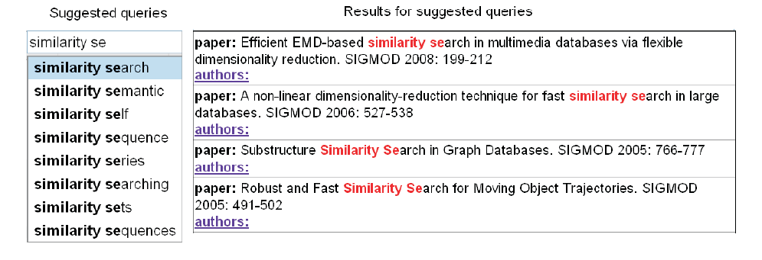
Exact search
Supporting Search-As-You-Type Using SQL in Databases
Courtesy: IEEE transactions on Knowledge and Data Engineering 2013

Slide 8
Implementation
Supporting Search-As-You-Type Using SQL in Databases
Index based method
    Auxiliary tables
    Inverted index table
    Prefix table
No index based
    No auxiliary tables

Slide 9
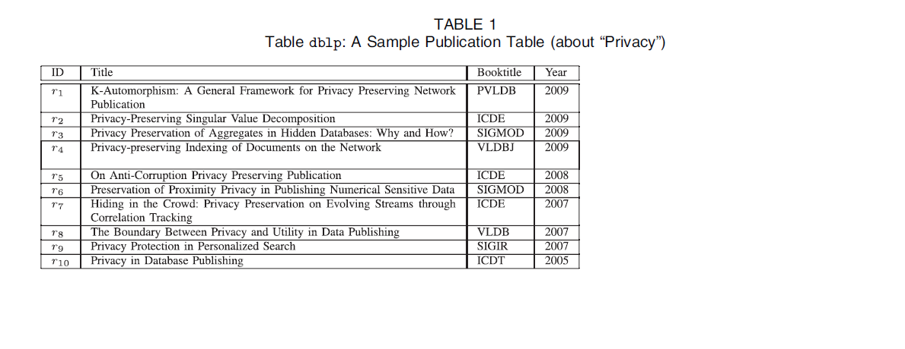
Sample Table
Supporting Search-As-You-Type Using SQL in Databases
Courtesy: IEEE transactions on knowledge and Data Engineering 2013

Slide 10
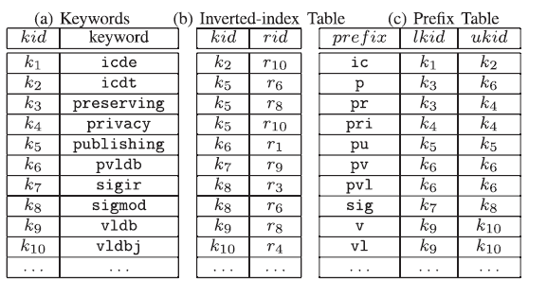
Inverted index table and prefix table
Supporting Search-As-You-Type Using SQL in Databases
Courtesy: IEEE transactions on Knowledge and Data Engineering 2013

Slide 11
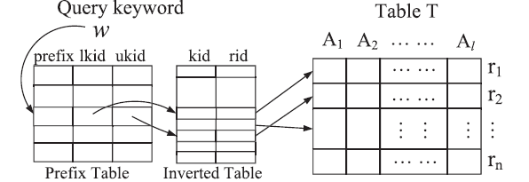
Index Based method
Supporting Search-As-You-Type Using SQL in Databases
Courtesy: IEEE transactions on Knowledge and Data Engineering 2013
  SELECT T.* FROM P_{T}, I_{T}, T
WHERE P_{T}.prefix = “sig” AND
P_{T}.ukid >= I_{T}.kid AND P_{T}.lkid <=I_{T}.kid
AND I_{T}.rid=T.rid

Slide 12
No index based method
Supporting Search-As-You-Type Using SQL in Databases
Using User defined function
Using LIKE predicate

Slide 13
Fuzzy Search-Single Keyword
Supporting Search-As-You-Type Using SQL in Databases
No-Index method
    User defined function PED(w,s)
    Eg:PED(“pvb”,”privacy in database
    publishing”)=1
    ed(s1,s2)-min number of edit operation
    Eg:ed(corelation,correlation)=1

Slide 14
Index based method
Supporting Search-As-You-Type Using SQL in Databases
Using user defined function
Gram-Based method
Neighborhood-Generation-Based Method

Slide 15
User Defined Function-UDF
Supporting Search-As-You-Type Using SQL in Databases
UDF to find similar prefixes from P_{T}
steps
  Issue SQL query
  Scans each prefix in P_{T}
  Calls UDF PEDTH(w, P_{T,} prefix,t)

Slide 16
Using UDF(continued)
Supporting Search-As-You-Type Using SQL in Databases
SELECT T.* FROM P_{T}, I_{T}, T
WHERE PEDTH(W, P_{T ,} prefix,t) AND
P_{T}.ukid >= I_{T}.kid AND P_{T}.lkid <=I_{T}.kid
AND I_{T}.rid=T.rid

Slide 17
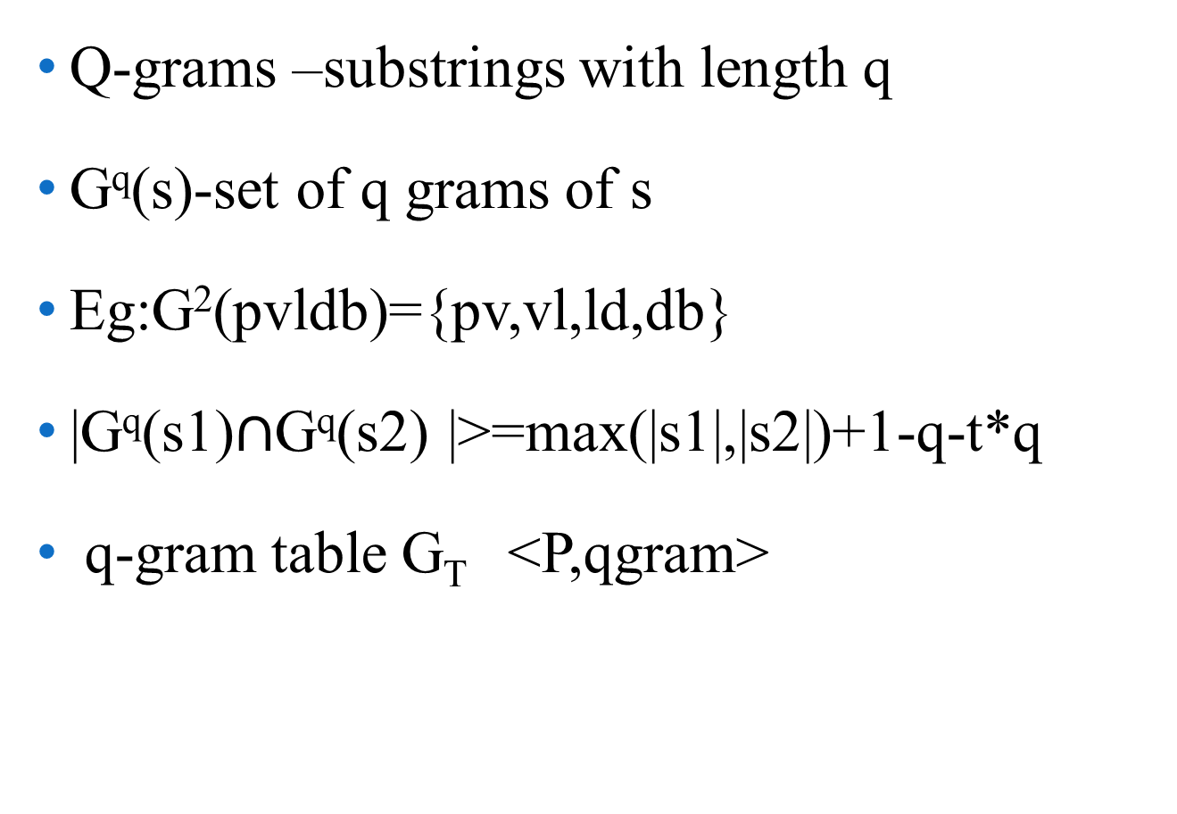
Gram-Based Method
Supporting Search-As-You-Type Using SQL in Databases
Q-grams –substrings with length q
G^{q}(s)-set of q grams of s
Eg:G²(pvldb)={pv,vl,ld,db}
|G^{q}(s1)$∩$G^{q}(s2) |>=max(|s1|,|s2|)+1-q-t*q
q-gram table G_{T} <P,qgram>

Slide 18
Implementation
Supporting Search-As-You-Type Using SQL in Databases
|w|+1-q-t*q grams in G^{q}(w)
SELECT P_{T} .prefix FROM P_{T ,}G_{T}
WHERE P_{T} .prefix = G_{T} .prefix AND
G_{T} .qgram in G^{q}(w)
GROUP BY G_{T} .prefix
HAVING COUNT(G_{T} .qgram) >= |w|+1-q-t*q

Slide 19
Neighborhood-generation method
Supporting Search-As-You-Type Using SQL in Databases
i-deletion neighborhood
D_{i}(w)-Set of i-deletion neighborhoods
Dˆ_{T}(w)= U^{t}_{i=0} D_{i}(w)
Eg:D₁(pvldb)={vldb,pldb,pvdb,pvlb,pvld}
Create neighborhood-generation table
D_{T} –records in the form <p,i-deletion,i>

Slide 20
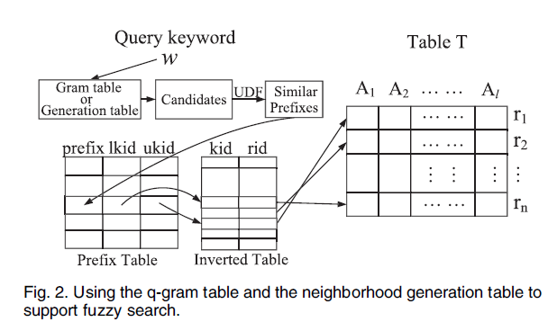
Implementation
Supporting Search-As-You-Type Using SQL in Databases
prefix | i-deletion | i
vldb | vldb | 0
vldb | ldb | 1
vldb | vdb | 1
Courtesy: IEEE transactions on Knowledge and Data Engineering 2013

Slide 21
Implementation(continued)
Supporting Search-As-You-Type Using SQL in Databases
SELECT DISTINCT prefix FROM D_{T}
WHERE D_{T}.i-deletion IN Dˆ_{T}(w)
Disadvantage
    Inefficient for long strings
    Needs large space

Slide 22
Multikeyword queries
Supporting Search-As-You-Type Using SQL in Databases
Using INTERSECT operator
Using CONTAINS command
Word-level incremental computation
      Previous computed results
      Temporary table C_{Q}
      Cache results

Slide 23
Incremental computation
Supporting Search-As-You-Type Using SQL in Databases
Query Q :w1,w2,…wm
Create temporary table CQ
Cache record id’s
New query Q’:w1,w2,…wm,wm+1
Use CQ to incrementally answer

Slide 24
Example
Supporting Search-As-You-Type Using SQL in Databases
Q:privacysigmod
CQ={r3,r6}
Q’:privacysigmodpub
Result:{r6}

Slide 25
First-N Queries
Supporting Search-As-You-Type Using SQL in Databases
First N results as instant feedback
SELECT T.* FROM P_{T}, I_{T}, T
WHERE P_{T}.prefix = “sig” AND
P_{T}.ukid >= I_{T}.kid AND P_{T}.lkid <=I_{T}.kid
AND I_{T}.rid=T.rid
LIMIT 0,2

Slide 26
Data update
Supporting Search-As-You-Type Using SQL in Databases
Trigger to support data update
Insertion
Deletion

Slide 27
Conclusion
Supporting Search-As-You-Type Using SQL in Databases
Proposed methods for exact search
Extended techniques for fuzzy search
Proposed incremental computation
Data update

Slide 28
References
Supporting Search-As-You-Type Using SQL in Databases
S. Agrawal, K. Chakrabarti, S. Chaudhuri, and V. Ganti, “Scalable Ad-Hoc Entity Extraction from Text Collections,” Proc. VLDB Endowment, vol. 1, no. 1, pp. 945-957, 2008.
S. Agrawal, S. Chaudhuri, and G. Das, “DBXplorer: A System for Keyword-Based Search over Relational Data Bases,” Proc. 18th
Int’l Conf. Data Eng. (ICDE ’02), pp. 5-16, 2002.
A. Arasu, V. Ganti, and R. Kaushik, “Efficient Exact Set-Similarity Joins,” Proc. 32nd Int’l Conf. Very Large Data Bases (VLDB ’06),
pp. 918-929, 2006.

Slide 29
References(continued)
Supporting Search-As-You-Type Using SQL in Databases
H. Bast, A. Chitea, F.M. Suchanek, and I. Weber, “ESTER: Efficient Search on Text, Entities, and Relations,” Proc. 30th Ann. Int’l ACM SIGIR Conf. Research and Development in Information Retrieval (SIGIR ’07), pp. 671-678, 2007.
H. Bast and I. Weber, “Type Less, Find More: Fast AutocompletionS earch with a Succinct Index,” Proc. 29th Ann. Int’l ACM SIGIR Conf. Research and Development in Information Retrieval
(SIGIR ’06), pp. 364-371, 2006.

Slide 30
Questions?
Supporting Search-As-You-Type Using SQL in Databases

Slide 31
Thank you..
Supporting Search-As-You-Type Using SQL in Databases

