Slide 1
DASH : A Novel Search Engine for Database - Generated Dynamic Web Pages
DASH : A Novel Search Engine for Database - Generated Dynamic Web Pages
ARUN RAVI
ROLL NO:12
S₇ R
TOPIC APPROVAL - 08/10/2013
SLIDE APPROVAL - 18/10/2013
TOPIC AND SLIDE APPROVED
By : Mrs. JISHA P ABRAHAM

Slide 2
CONTENTS
DASH : A Novel Search Engine for Database - Generated Dynamic Web Pages
Introduction
Existing System
Proposed System
Dash Architecture
Algorithms
Conclusion
Reference

Slide 3
INTRODUCTION
DASH : A Novel Search Engine for Database - Generated Dynamic Web Pages
Search Engine
Static Web Pages
Database Generated Web Pages (db pages)
  Eg.: Social networking sites, e-commerce sites
  Unreachable by search engines

Slide 4
DB PAGE EXAMPLE
DASH : A Novel Search Engine for Database - Generated Dynamic Web Pages
Consider www.hotel.com
Search restaurants with American cuisine
Budget between 10$ and 15$
Search query :‘c=American&l=10&u=15’
URL formed : www.hotel.com/search? c=American&l=10&u=15

Slide 5
DB PAGE EXAMPLE (Cont.)
DASH : A Novel Search Engine for Database - Generated Dynamic Web Pages
Db-page generated
www.hotel.com/search? c=American&l=10&u=15
Resturants | Budget | Rate | User comments
Burger Queen | $10 | 4.3 | Burger experts by David on 06/10
Wandy’s | $12 | 4.1
Wandy’s | $12 | 4.2 | Unique burgers By Bill on 05/10; Bad fries by Bill on 06/10

Slide 6
EXISTING SYSTEM
DASH : A Novel Search Engine for Database - Generated Dynamic Web Pages
Search engine activities
  Crawling : aggregating data from World Wide Web
  Indexing : easy searching
  Search : Returns most relevant results

Slide 7
EXISTING SYSTEM(Cont.)
DASH : A Novel Search Engine for Database - Generated Dynamic Web Pages
Db page crawling techniques - 2 types
  Collect cached db pages
  Trial queries to web application
Term Frequency (TF)/Inverse Document Frequency (IDF)
Inverted file

Slide 8
EXISTING SYSTEM PROBLEMS
DASH : A Novel Search Engine for Database - Generated Dynamic Web Pages
Problems of crawling techniques
  Incompleteness of db pages
  Need web application invocation
  Content overlapping
Notes:
many db-pages, even generated by different query strings, would share similar (or even identical) contents. This is mainly because they are generated from some common records in a database

Slide 9
PROPOSED SYSTEM
DASH : A Novel Search Engine for Database - Generated Dynamic Web Pages
DASH – Db pAge SearcH
Specialized for db pages
MapReduce (MR) paradigm
Top-k search
Notes:
URL+query for queried keywords… Analyzes appctn, SE technique (data flow analysis,symbolic execution), logic of web app as parameterised query.
Map –distribute to nodes& parses, Reduce- intermediate to final..Result key value pairs..

Slide 10
MAP REDUCE
DASH : A Novel Search Engine for Database - Generated Dynamic Web Pages
Partitions and distributes data
Performs job in parallel
Map phase: node parses input
Reduce phase: processes intermediate result
Notes:
Map : node extracts keyword, reduce:gathers & sorts TFw(id) for w, Lw-inverted list

Slide 11
MAP REDUCE(Cont.)
DASH : A Novel Search Engine for Database - Generated Dynamic Web Pages
Example: creating inverted file
Document : <id,text>
Map phase :<w,TFw(id)>
Reduce phase : Lw=<w,(TFw(id1),TFw(id2)…TFw(id|Lw|))>
Notes:
Map : node extracts keyword, reduce:gathers & sorts TFw(id) for w, Lw-inverted list

Slide 12
DASH ARCHITECTURE
DASH : A Novel Search Engine for Database - Generated Dynamic Web Pages
Db-page fragments
Three algorithms
  Database crawling algorithm
  Fragment indexing algrithm
  Search algorithm
Notes:
Disjoint part of db page

Slide 13
DASH ARCHITECTURE(Cont.)
DASH : A Novel Search Engine for Database - Generated Dynamic Web Pages
Web application A
Reverse query string parsing logic
Web Application Analysis
Application queries
Queried keywords W
Application queries
Top-k
search
Fragment
Indexing
fragments
Database
Crawling
Fragment Index
k- URLs of db-pages
Database D

Slide 14
DASH WORKING
DASH : A Novel Search Engine for Database - Generated Dynamic Web Pages
Analyses the web application code
Database crawling for db-page fragments
Fragments are indexed
Performs top-k search

Slide 15
APPLICATION CODE ANALYSIS
DASH : A Novel Search Engine for Database - Generated Dynamic Web Pages
Search Implementation
Involves 3steps
  Query string parsing
  Application query evaluation
  Query result presentation
Notes:
Web app-A, web server-W,

Slide 16
APPLICATION CODE ANALYSIS(Cont)
DASH : A Novel Search Engine for Database - Generated Dynamic Web Pages
Example
public class Search extends HttpServlet{ public void doGet(HttpServletRequestResponse p)..{
Query string Parsing | 1.String cuisine=q.getParameter(‘c’); 2.String min=q.getParameter(‘l’); 3.String max=q.getParameter(‘u’);
4.Connection cn=DriverManager.getConnection(fooddb);
Application Query Evaluation | 5.Q=‘SELECT name,budget,rate,comment,uname’+‘date FROM (restaurant LEFT JOIN comment)’+ ‘JOIN customer WHERE (cuisine=“’+cuisine+‘”) and (budget BETWEEN’+min+‘AND’+max+‘)’; 6.ResultSet r=cn.createStatement().executeQuery(Q);
Result Presentation | 7. output(p,r)}}
Notes:
Parameters from query is derived and is used f

Slide 17
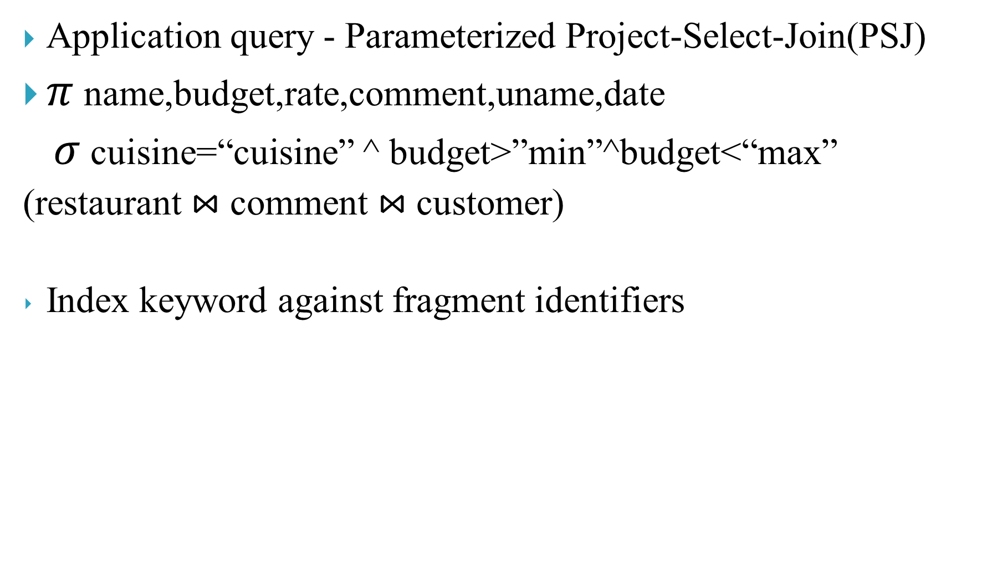
DATABASE CRAWLING & FRAGMENT INDEXING
DASH : A Novel Search Engine for Database - Generated Dynamic Web Pages
Application query - Parameterized Project-Select-Join(PSJ)
$π$ name,budget,rate,comment,uname,date
$σ$ cuisine=“cuisine” ^ budget>”min”^budget<“max”
(restaurant ⋈ comment ⋈ customer)
Index keyword against fragment identifiers

Slide 18
STEPWISE ALGORITHM
DASH : A Novel Search Engine for Database - Generated Dynamic Web Pages
MapReduce based algorithm
Crawling & Indexing as separate steps
Step1 : crawling
  All records & attributes are exported to MR cluster
  Retrieved records grouped

Slide 19
STEPWISE ALGORITHM(Cont.)
DASH : A Novel Search Engine for Database - Generated Dynamic Web Pages
Step2 : indexing
  Indexed against contained keywords
  Same as building inverted file
  < keyword, fragment >

Slide 20
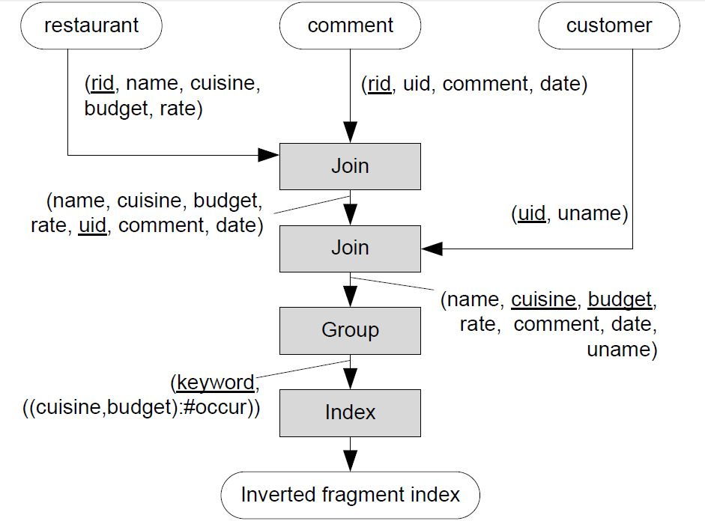
STEPWISE ALGORITHM(Example)
DASH : A Novel Search Engine for Database - Generated Dynamic Web Pages
Courtesy: IEEE International Conference on
Distributed Computing Systems
Notes:
records from the three operand relations: restaurant,comment and customer are joined through two MR jobs.

Slide 21
STEPWISE ALGORITHM(Example)
DASH : A Novel Search Engine for Database - Generated Dynamic Web Pages
Identifier (cuisine,budget) | Projection attributes
 | Name | budget | rate | Comment | uname | date
(American,9) | Bond’s café | 9 | 4.3 | Nice coffee | James | 01/11
(American,10) | Burger queen | 10 | 4.3 | Burger experts | David | 06/10
(American,12) | Wandy’s | 12 | 4.1
 | Wandy’s | 12 | 4.2 | Unique burger | Bill | 05/10
 | Wandy’s | 12 | 4.2 | Bad fries | Bill | 06/10
(American,18) | Mc’Donald’s | 18 | 2.2 | Regret taking it | David | 06/10
(Thai,10) | Thai food | 10 | 4.8
 | bankok | 10 | 3.9 | Thai burger | Alan | 08/11
Db-page fragments
Notes:
records from the three operand relations: restaurant,comment and customer are joined through two MR jobs.

Slide 22
STEPWISE ALGORITHM(Example)
DASH : A Novel Search Engine for Database - Generated Dynamic Web Pages
Keyword | (identifier):occurrence
Burger | (American,10):2, (American,12):1, (Thai,10):1
Coffee | (American,9):1
Fries | (American,12):1
Inverted fragment index
Notes:
records from the three operand relations: restaurant,comment and customer are joined through two MR jobs.

Slide 23
DEMERITS OF STEPWISE ALGORITHM
DASH : A Novel Search Engine for Database - Generated Dynamic Web Pages
  All records are exported
  Inefficient : high data transmission
  Input /Output overheads
Notes:
records from the three operand relations: restaurant,comment and customer are joined through two MR jobs.

Slide 24
INTEGRATED ALGORITHM
DASH : A Novel Search Engine for Database - Generated Dynamic Web Pages
  Query parameter derivation
  Keyword extraction & occurrence calculation
  Consolidation of all keywords & sorting
Notes:
For each operand relation Ri, extract a selection attribute (ci) and a join attribute (ji), which is used to join other operand relations, together with counts (θi) of records sharing the same ci and ji values.

Slide 25
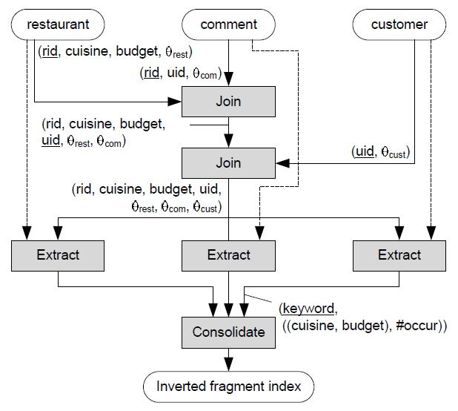
INTEGRATED ALGORITHM(Example)
DASH : A Novel Search Engine for Database - Generated Dynamic Web Pages
Courtesy: IEEE International Conference on
Distributed Computing Systems

Slide 26
TOP-k DB-PAGE SEARCH
DASH : A Novel Search Engine for Database - Generated Dynamic Web Pages
  Search & Combines db-page fragments
  Returns most relevant k db-pages
  Modified TF/IDF scheme used
  Fragment graph
Notes:
Since no db-pages are physically derived, the exact IDF is not available. Rather, Dash approximates the IDF of a keyword w as the inverse of the number of dbpage fragments containing w… To facilitate the determination of a dbpage’s size and a query string, a fragment graph is derived

Slide 27
FRAGMENT GRAPH
DASH : A Novel Search Engine for Database - Generated Dynamic Web Pages
  Relationship between db-page fragments
  Node : db-page fragment
  If edge present, nodes are combined

Slide 28
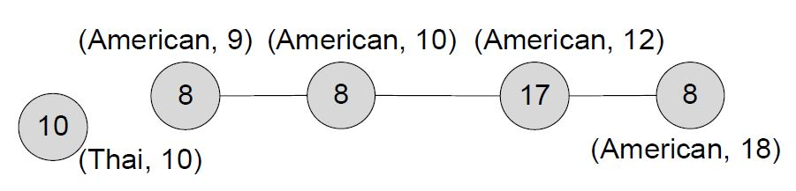
FRAGMENT GRAPH(Example)
DASH : A Novel Search Engine for Database - Generated Dynamic Web Pages
  Connected fragments can combined to form pages
Courtesy: IEEE International Conference on
Distributed Computing Systems
Notes:
Node value shows no.of keywords in page

Slide 29
TOP –k SEARCH ALGORITHM
DASH : A Novel Search Engine for Database - Generated Dynamic Web Pages
  Accepts three parameters
    Queried keywords(W)
    URLs of db-pages(k)
    Threshold Db-page size(S)
Notes:
Node value shows no.of keywords in page

Slide 30
TOP –k SEARCH ALGORITHM(Cont.)
DASH : A Novel Search Engine for Database - Generated Dynamic Web Pages
  1.Determine db-page fragments F relevant to W from I;
  2.Initialize a priority queue Q with F output set O= { }
  3.while (Q not empty and |O|<k ) do{
  dequeue Q to get head entry E

Slide 31
TOP –k SEARCH ALGORITHM(Cont.)
DASH : A Novel Search Engine for Database - Generated Dynamic Web Pages
  if E not expandable w.r.t S then
  add E to O; goto 4
  expand E based on G to E’
  add E’ to Q;}
  4.Output URLs of db-page in O;

Slide 32
CONCLUSION
DASH : A Novel Search Engine for Database - Generated Dynamic Web Pages
  A novel search engine called Dash is developed.
Dash can deduce db-pages and their query URLs to
answer keyword search.

Slide 33
REFERENCE
R. Baeza-Yates and B. Ribeiro-Neto. Modern Information Retrieval.Pearson, 1999.
J. Challenger, P. Dantzig, A. Iyengar, and K. Witting. A Fragment-Based Approach for Efficiently Creating Dynamic Web Content. ACM Trans. Internet Technology, 5(2):359–389, 2005.
B. Croft, D. Metzler, and T. Strohman. Search Engines: Information Retrieval in Practice. Addison Wesley, 2009.

Slide 34
REFERENCE
Google Database Crawling and Serving, 2011. http://code.google.com/apis/searchappliance/documentation/52/databasecrawl serve.html.
V. Hristidis and Y. Papakonstantinou. DISCOVER: Keyword Search in Relational Databases. In VLDB, pages 670–681, 2002.
[17] W.-S. Li, W.-P. Hsiung, and K. S. Candan. Multitiered Cache Management and Acceleration for Database-Driven Websites. Concurrent Engineering: R&A, 12(3):221–235, 2004.

Slide 35
THANK YOU

Slide 36
QUESTIONS???

Slide 37
STEPWISE ALGORITHM(Example)
DASH : A Novel Search Engine for Database - Generated Dynamic Web Pages
rid | Name | cuisine | budget | rate
001 | Burger Queen | American | 10 | 4.3
002 | McRonald’s | American | 18 | 2.2
003 | Wandy’s | American | 12 | 4.1
004 | Wandy’s | American | 12 | 4.2
005 | Thaifood | Thai | 10 | 4.8
006 | Bangkok | Thai | 10 | 3.9
007 | Bond’s café | American | 9 | 4.3
restaurant(rid,name,cuisine,budget,rate)
Notes:
records from the three operand relations: restaurant,comment and customer are joined through two MR jobs.

Slide 38
STEPWISE ALGORITHM(Example)
DASH : A Novel Search Engine for Database - Generated Dynamic Web Pages
cid | rid | uid | Comment | date
201 | 001 | 109 | Burger exports | 06/10
202 | 004 | 132 | Unique burger | 05/10
203 | 004 | 132 | Bad fries | 06/10
204 | 002 | 109 | Regret taking it | 06/10
205 | 006 | 180 | Thai burger | 08/11
206 | 007 | 171 | Nice cofee | 01/11
comment(cid,rid,uid,comment,date)
Notes:
records from the three operand relations: restaurant,comment and customer are joined through two MR jobs.

Slide 39
STEPWISE ALGORITHM(Example)
DASH : A Novel Search Engine for Database - Generated Dynamic Web Pages
uid | uname
109 | David
120 | Ben
132 | Bill
171 | James
180 | Alan
customer(uid,uname)
Back
Notes:
records from the three operand relations: restaurant,comment and customer are joined through two MR jobs.

