Slide 1
WELCOME

Slide 2
WALLDROID: CLOUD ASSISTED VIRTUALIZED APPLICATION
SPECIFIC FIREWALLS FOR THE ANDROID OS
TOPIC APPROVAL ON : 24/6/2013
SLIDE APPROVAL ON : 22/7/2013
APPROVED BY : Ms. JISHA P ABRAHAM
ARJUN MENON
ROLL NO-11
S7R

Slide 3
CONTENT
WALLDROID: CLOUD ASSISTED VIRTUALIZED APPLICATION SPECIFIC FIREWALLS FOR THE ANDROID OS
INTRODUCTION
ANDROID OS
CLOUD TO DEVICE MESSAGE FRAMEWORK
WALLDROID
SOLUTION ARCHITECTURE
CONCLUSION
REFERENCE

Slide 4
GROWTH OF ANDROID
WALLDROID: CLOUD ASSISTED VIRTUALIZED APPLICATION SPECIFIC FIREWALLS FOR THE ANDROID OS
Android users increasing
Price reduction for phones and internet access

Slide 5
INFECTED!!!
WALLDROID: CLOUD ASSISTED VIRTUALIZED APPLICATION SPECIFIC FIREWALLS FOR THE ANDROID OS
Malware apps increasing
Removal of malicious apps improper
App removal - too late
Identification of malware is difficult.

Slide 6
ISSUES OF APPS
WALLDROID: CLOUD ASSISTED VIRTUALIZED APPLICATION SPECIFIC FIREWALLS FOR THE ANDROID OS
Any programmer can develop Android apps
Hackers develop malware
Apps – improper security measures
Authentication tokens can be easily accessed
Kill switches – Performed too late

Slide 7
ANDROID OS
WALLDROID: CLOUD ASSISTED VIRTUALIZED APPLICATION SPECIFIC FIREWALLS FOR THE ANDROID OS
Android is a Linux based software stack
Android architecture consists of 4 layers
  Linux Kernel
  Libraries and the Run Time Environment
  Application Framework
  Application layer

Slide 8
WALLDROID: CLOUD ASSISTED VIRTUALIZED APPLICATION SPECIFIC FIREWALLS FOR THE ANDROID OS
ARCHITECTURE OF ANDROID OS
APPLICATIONS
HOME
CONTACTS
BROWSER
APPLICATION FRAMEWORK
ACTIVITY MANAGER
WINDOW MANAGER
CONTENT PROVIDERS
PACKAGE MANAGER
TELEPHONY MANAGER
RESOURCE MANAGER
LIBRARIES
ANDROID RUNTIME
SURFACE MANAGER
MEDIA FRAMEWORK
CORE LIBRARIES
SQLite
WebKit
DALVIK VM
LINUX KERNEL
DISPLAY DRIVER
WiFi DRIVER
BINDER(IPC) DRIVER
Image Courtesy : WallDroid - IEEE Publications 2012

Slide 9
SECURITY POLICIES
WALLDROID: CLOUD ASSISTED VIRTUALIZED APPLICATION SPECIFIC FIREWALLS FOR THE ANDROID OS
Manifest.xml file - Permissions
The Android Security Policy consists of
  Permission Granting Policy
  Interaction Policy

Slide 10
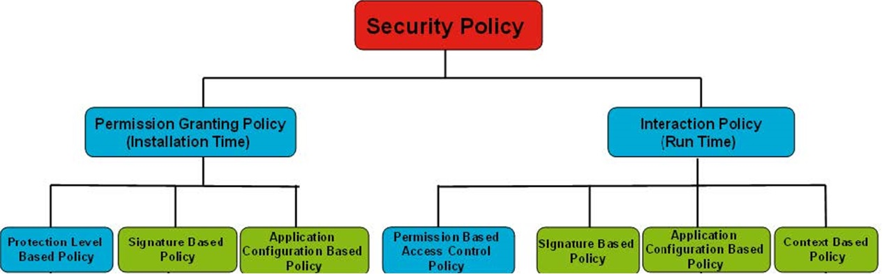
WALLDROID: CLOUD ASSISTED VIRTUALIZED APPLICATION SPECIFIC FIREWALLS FOR THE ANDROID OS
SECURITY POLICIES
Image Courtesy : WallDroid - IEEE Publications 2012

Slide 11
ANDROID CLOUD TO DEVICE MESSAGING FRAMEWORK
WALLDROID: CLOUD ASSISTED VIRTUALIZED APPLICATION SPECIFIC FIREWALLS FOR THE ANDROID OS
C2DM - lightweight communication mechanism
C2DM helps to reduce battery usage
Allows applications to share TCP connection
C2DM handles queuing of messages

Slide 12
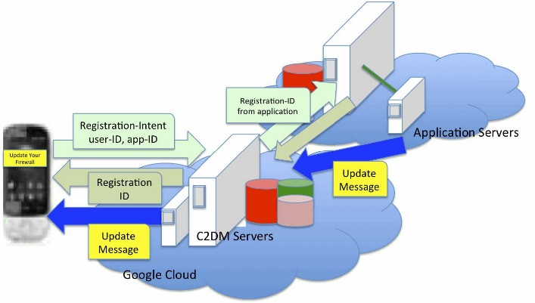
WALLDROID: CLOUD ASSISTED VIRTUALIZED APPLICATION SPECIFIC FIREWALLS FOR THE ANDROID OS
C2DM
Image Courtesy : WallDroid - IEEE Publications 2012

Slide 13
STEPS INVOLVED
WALLDROID: CLOUD ASSISTED VIRTUALIZED APPLICATION SPECIFIC FIREWALLS FOR THE ANDROID OS
Application must register with the C2DM servers
Registration done by sending an Intent-register
C2DM server sends a registration ID to the app
Finally, app sends registration ID to its own app server

Slide 14
PRESENT CONDITION
WALLDROID: CLOUD ASSISTED VIRTUALIZED APPLICATION SPECIFIC FIREWALLS FOR THE ANDROID OS
Android uses permission based architecture
Users are unaware about permissions
Malwares obtain sensitive data
Present strategies are far too general

Slide 15
WALLDROID
WALLDROID: CLOUD ASSISTED VIRTUALIZED APPLICATION SPECIFIC FIREWALLS FOR THE ANDROID OS
WallDroid - Android Firewall
Application-ID based solution

Slide 16
ARCHITECTURE OF WALLDROID
WALLDROID: CLOUD ASSISTED VIRTUALIZED APPLICATION SPECIFIC FIREWALLS FOR THE ANDROID OS
The components of WallDroid consist of
  An ordinary VPN server
  The WallDroid Application Server
  The WallDroid application

Slide 17
WALLDROID APPLICATION SERVER
WALLDROID: CLOUD ASSISTED VIRTUALIZED APPLICATION SPECIFIC FIREWALLS FOR THE ANDROID OS
Certificate ID | Hash Result | Vendor | Application | Number of Installs | Reputation | Status
67e2… | 3d17… | Skype | Skype | 1,667,224 | Known-Good | Direct Internet Ok
78a2… | 67ac… | Unknown | Game_X | 672 | Unknown | See Below
78a2… | 8a59… | Unknown | Game_Y | 52 | Unknown | See Below
8c22.. | b62a… | SocialNet | The SocialNet | 8,767 | Known-Bad | Block Internet
729b.. | c87d… | Games4You | Angry Birds | 578,913 | Known-Good | Direct Internet Ok
Table Courtesy : WallDroid - IEEE Publications 2012

Slide 18
CLASSIFICATIONS OF ANDROID APPLICATIONS
WALLDROID: CLOUD ASSISTED VIRTUALIZED APPLICATION SPECIFIC FIREWALLS FOR THE ANDROID OS
The Good
The Bad
The Unknown

Slide 19
WALLDROID APPLICATION
WALLDROID: CLOUD ASSISTED VIRTUALIZED APPLICATION SPECIFIC FIREWALLS FOR THE ANDROID OS
WallDroid application - run on the device
During installation - sends application hash values to the cloud

Slide 20
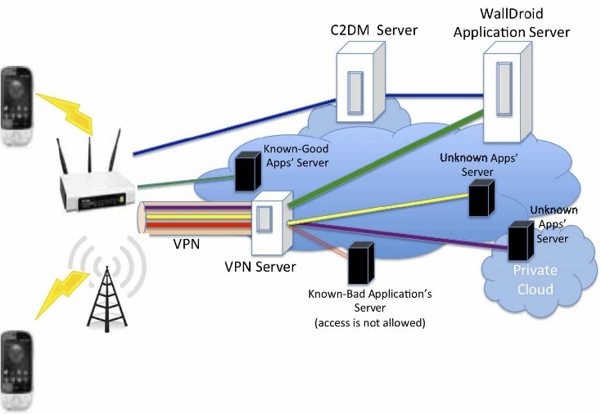
WALLDROID: CLOUD ASSISTED VIRTUALIZED APPLICATION SPECIFIC FIREWALLS FOR THE ANDROID OS
SOLUTION ARCHITECTURE
Image Courtesy : WallDroid - IEEE Publications 2012

Slide 21
FURTHER DETAILS
WALLDROID: CLOUD ASSISTED VIRTUALIZED APPLICATION SPECIFIC FIREWALLS FOR THE ANDROID OS
Finer classification
Use of Hash Result
Interaction between apps

Slide 22
CONCLUSION
WALLDROID: CLOUD ASSISTED VIRTUALIZED APPLICATION SPECIFIC FIREWALLS FOR THE ANDROID OS
Existing systems are far too general
WallDroid provides Cloud based analysis of data
Being cloud assisted WallDroid is robust and quick

Slide 23
REFERENCE
WALLDROID: CLOUD ASSISTED VIRTUALIZED APPLICATION SPECIFIC FIREWALLS FOR THE ANDROID OS
K. H. Khan and M. N. Tahir. Android Security, A survey. So far so good. Available: http://imsciences.edu.pk/serg/2010/07/androidsecurity-a-survey-so-far-so-good.
I. Rassameeroj and Y. Tanahashi. Various Approaches in Analyzing Android Applications with its Permission-Based Security Models. Proceedings of 2011 IEEE International Conference on Electro/Information Technology (EIT), Mankato, MN, USA, May 2011
D. Barrera and P. Van Oorschot. Secure Software Installation on Smartphones, IEEE Security & Privacy 9(3), pp. 42-48, May-June 2011

Slide 24
REFERENCE
WALLDROID: CLOUD ASSISTED VIRTUALIZED APPLICATION SPECIFIC FIREWALLS FOR THE ANDROID OS
W. Enck, M. Ongtang, and P. McDaniel. Understanding Android Security. IEEE Security and & Privacy 7(1), pp. 50-57, January-February 2009
Google. Android Cloud to Device Messaging Framework. Available:http://code.google.com/android/c2dm

Slide 25
THANK YOU
WALLDROID: CLOUD ASSISTED VIRTUALIZED APPLICATION SPECIFIC FIREWALLS FOR THE ANDROID OS

Slide 26
QUESTIONS?
WALLDROID: CLOUD ASSISTED VIRTUALIZED APPLICATION SPECIFIC FIREWALLS FOR THE ANDROID OS

