Slide 1
WELCOME

Slide 2
QueRIE: COLLABORATIVE DATABASE EXPLORATION
Topic Approval:02/09/2013
Slide Approval:06/09/2013
Topic And Slides Approved By:Mr.Aby Abhai T.
Anjana.C.S
Roll num:6
S7 R

Slide 3
CONTENTS
QueRIE: Collaborative Database Exploration
Introduction
QueRIE System
Existing System
Proposed System
Implementation
Conclusion
References

Slide 4
INTRODUCTION
QueRIE : Collaborative Database Exploration
Query Recommendation
Need of Query Recommendation
    Lack of SQL expertise
    Lack of knowledge of the schema
    Time consuming
    Growing size of data

Slide 5
EXAMPLE
QueRIE : Collaborative Database Exploration
SELECT count(*) FROM region WHERE type like ‘tiprimary’
SELECT count(distinct id) FROM region WHERE type like ‘tiprimary’

Slide 6
EXAMPLE(Cont..)
QueRIE : Collaborative Database Exploration
SELECT id,count(*) FROM region WHERE type like ‘tiprimary’ GROUP BY id
SELECT id,count(*) FROM region WHERE type like ‘tiprimary’ GROUP BY id HAVING count(*)>1

Slide 7
QueRIE SYSTEM
QueRIE: Collaborative Database Exploration
Query Recommendations for Interactive data Exploration
Use Queries of past users

Slide 8
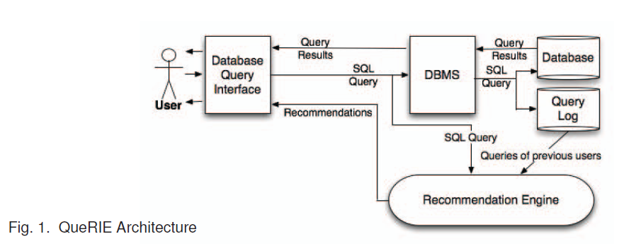
ARCHITECTURE
Querie: Collaborative Database Exploration
COURTESY; IEEE TRANSACTIONS ON KNOWLEDGE AND DATA ENGINEERING

Slide 9
STEPS IN RECOMMENDATION
QueRIE : Collaborative Database Exploration
Generate the session summary,S_{i}
Computes predicted summary S^{pred}
    S^{pred}=f(α,S₀,S₁,S₂…..S_{n})
    α: mixing factor
Using S^{pred} generate recommendation queries

Slide 10
EXISTING SYSTEM
QueRIE : Collaborative Database Exploration
Query recommendation
    Tuple-Based Query Recommendation
Notes:
ji

Slide 11
TUPLE-BASED
QueRIE : Collaborative Database Exploration
Find S_{Q}[T]
    S_{Q}[T]-importance of tuple T in query Q
    S_{Q}[T]=0,1
        0- T is not a witness
        1-T is a witness
    Drawback:all tuples have same importance

Slide 12

TUPLE-BASED(cont..)
QueRIE: Collaborative Database Exploration
    S_{Q}[T]=0,1/|ans(Q)|
Finding S_{i}[T]
Compute S^{pred}
    S^{pred}=α.S₀+(1-α). ∑ sim(S_{i,}S₀).S_{i}
Recommend Queries using S^{pred}

Slide 13
DRAWBACKS
QueRIE : Collaborative Database Exploration
Complicated
Real time similarity calculations
Large memory needed

Slide 14
PROPOSED SYSTEM
QueRIE: Collaborative Database Exploration
Query recommendation
    Fragment-Based Query Recommendation

Slide 15
FRAGMENT BASED(contd..)
QueRIE : Collaborative Database Exploration
Use fragments for finding S^{pred}
    Fragments : Attribute references,tables references etc.
Find S_{Q}[ø]
    S_{Q}[ø]=0,1

Slide 16


FRAGMENT BASED(contd..)
QueRIE : Collaborative Database Exploration
Find S_{i}[ø]
    Binary scheme
    Weighted scheme
Compute sim(p, ø) for all fragment pairs

Slide 17
FRAGMENT BASED(cntd..)
QueRIE : Collaborative Database Exploration
Compute S^{pred}
S^{pred} [ø]= ∑_{pᵋR} S₀[p]*sim(p,ø)
∑_{pᵋR} sim(p,ø)
Using S^{pred} recommend queries

Slide 18
IMPLEMENTATION
QueRIE : Collaborative Database Exploration
Query Preprocessing
Similarity calculations
The QueRIE system prototype

Slide 19
Query Preprocessing
QueRIE : Collaborative Database Exploration
Converting all WHERE clause to generic strings
Eg:
    Before preprocessing
    SELECT id,count(*) FROM region WHERE type like ‘tiprimary’ GROUP BY id HAVING count(*)>1

Slide 20
Query Preprocessing(contd..)
QueRIE : Collaborative Database Exploration
    After preprocessing
    SELECT id,count(*) FROM region WHERE region.type PATMATCH GROUP BY id HAVING count(*) COMPARE NUM
  Fragments are:
    Count(*),region,region.type PATMATCH,count(*) COMPARE NUM

Slide 21
SIMILARITY CALCULATION
QueRIE : Collaborative Database Exploration
Session summaries stored in noSQL
Three hash tables used
    Session summary hash table
    Fragment hash table
    Similarity hash table
Auotomatic updation of hash table

Slide 22
QueRIE SYSTEM PROTOTYPE
QueRIE : Collaborative Database Exploration
User can select Recommendation Engine
User can accept,edit or reject the recommended query

Slide 23
CONCLUSION
QueRIE : Collaborative Database Exploration
Fragment based have more efficiency
Less memory and time needed
More helpful for large database like SkyServer

Slide 24
REFERENCES
QueRIE : Collaborative Database Exploration
A. Thusoo, J. Sarma, N. Jain, Z. Shao, P. Chakka, S. Antony, and R. Murthy, “Hive - a petabyte scale data warehouse using hadoop,” in Data Engineering (ICDE), 2010 IEEE 26th International Conference on, March
G. Chatzopoulou, M. Eirinaki “Collaborative filtering for interactive database exploration,” in Proc. Of the 21st Intl.

Slide 25
REFERENCES
QueRIE: Collaborative Database Exploration
S. Mittal, J. S. V. Varman, G. Chatzopoulou, M. Eirinaki, and N. Polyzotis, “QueRIE: A Recommender System supporting Interactive Database Exploration,”
J. Akbarnejad, G. Chatzopoulou, M. Eirinaki, S. Koshy, S. Mittal,D. On, N. Polyzotis, and J. S. V. Varman, “SQL QueRIERecommendations,” in Proc. of the 36th Intl. Conf. on Very LargeDataBases (VLDB 2010), 2010.

Slide 26
QueRIE
THANK YOU

Slide 27
QueRIE
QUESTIONS ?

