Slide 1
WELCOME

Slide 2
GPU COMPUTING FOR PARALLEL LOCAL SEARCH METAHEURISTICS ALGORITHM
Topic approval:19/07/2013 Anishka Abraham
Slide approval:22/07/2013 Roll no-8
Topic and slide approved by: S7 R
Mrs Jisha P Abraham
Dept. of CSE,MACE,Kothamangalam

Slide 3
CONTENTS
INTRODUCTION
PARALLEL LOCAL SEARCH METAHEURISTICS(LSM)
EXISTING SYSTEM
GPU COMPUTING BASICS
PROPOSED GPU BASED ALGORITHM
CONCLUSION
REFERENCES
Dept. of CSE,MACE,Kothamangalam

Slide 4
INTRODUCTION
Real world optimization problems-NP hard,complex
Eg-Knapsack problem, traveling salesman problem(TSP) etc
LSM-Local Search Metaheuristics
Graphics Processing Unit(GPU) computing
Dept. of CSE,MACE,Kothamangalam

Slide 5
PARALLEL LOCAL SEARCH METAHEURISTICS ALGORITHM
Principle-”walks through neighborhoods”
1: Generate(s0);
2: repeat
3: m(t) := SelectMove(s(t));
4: s(t+1) := ApplyMove(m(t), s(t));
5: t := t+1;
6: until Termination_criterion(s(t))
Dept. of CSE,MACE,Kothamangalam

Slide 6
PARALLEL MODELS OF LSM
Solution-level parallel model
Iteration-level parallel model
Algorithmic-level parallel model
Dept. of CSE,MACE,Kothamangalam

Slide 7
EXISTING SYSTEMS
Clusters of workstations(COWs)
Grid
Massively parallel processors
Dept. of CSE,MACE,Kothamangalam

Slide 8
DRAWBACKS
Exploit asynchronous parallelism, network stealing
Network latency
Execution Speed
Limited memory
Limit degree of parallelism
Dept. of CSE,MACE,Kothamangalam

Slide 9
GPU COMPUTING
GPU-Graphics Processing Unit
Iteration level parallel model
Master-Worker model
Picture courtesy -GPU Computing with NVIDIA CUDA
Ian Buck, NVIDIA
Dept. of CSE,MACE,Kothamangalam

Slide 10
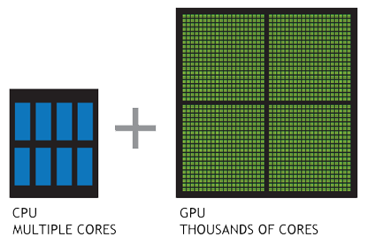
GPU COMPUTING DETAILS
Hyper –threading(massively parallel multithreading)
SPMD-Single Program Multiple Data
GPU computing-CPU+GPU
Picture courtesy -GPU Computing with NVIDIA CUDA Ian Buck, NVIDIA
Dept. of CSE,MACE,Kothamangalam

Slide 11
DESIGN OF LSMs ON GPU
Solution encoding
Binary encoding.eg-knapsack problem
Permutation representation.eg-TSP
Generation of the neighborhood
Generation on CPU, evaluation on GPU
Generation and evaluation on GPU
Dept. of CSE,MACE,Kothamangalam

Slide 12
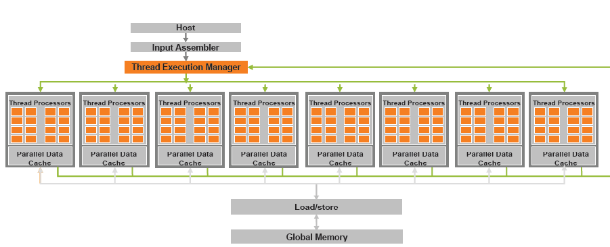
GPU BASED ARCHITECTURE
Picture courtesy-Computers and Mathematics with Applications 59 (2010) 23802392
Dept. of CSE,MACE,Kothamangalam

Slide 13
PROPOSED GPU BASED ALGORITHM
Initial solution
Fitness structure
Find neighbors
For each neighbor map to threads
Copy fitness structure to CPU
Dept. of CSE,MACE,Kothamangalam

Slide 14
THREAD CONTROL
Control total number of threads
Number of threads=number of neighborhood solutions
Thread execution manager
Dept. of CSE,MACE,Kothamangalam

Slide 15
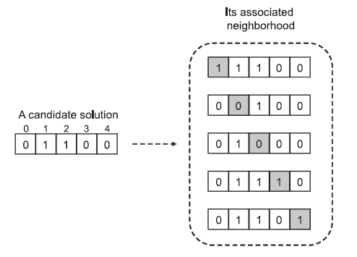
EFFICIENT MAPPING OF NEIGHBORHOOD STRUCTURES ON GPU
1.Binary Encoding
Picture courtesy- IEEE TRANSACTIONS
ON COMPUTERS, VOL. 62, NO. 1, 2013
Dept. of CSE,MACE,Kothamangalam

Slide 16
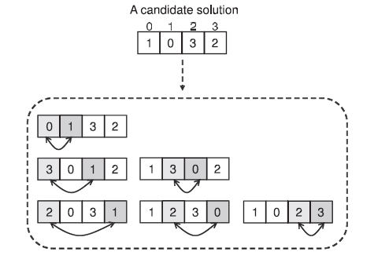
2.Permutation representation
Neighborhood solution size=n*(n-1)/2
n-solution size
Picture courtesy-IEEE TRANSACTIONS ON COMPUTERS, VOL. 62, NO. 1, JANUARY 2013
Dept. of CSE,MACE,Kothamangalam

Slide 17
2.Permutation representation(Contd..)
Neighbor two indexes
Threads unique id
Proposition 1:Two-to-One Index Transformation
      f(i,j)=i*(n-1)+(j-1)-(i*(i+1))/2
Proposition 2:One-to-Two Index Transformation
      i=n-2-(8*(n-f(i,j)-1)+1)/2
      j=f(i,j)-i*(n-1)+i*(i+1)/2+1
Dept. of CSE,MACE,Kothamangalam

Slide 18
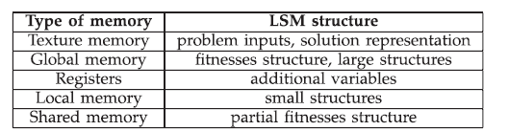
MEMORY MANAGEMENT
Dept. of CSE,MACE,Kothamangalam

Slide 19
ADVANTAGES OF GPU COMPUTING ON LSMs
Hyper-threading, SPMD
General global memory access
Offer a substantial horsepower
High memory bandwidth
Dept. of CSE,MACE,Kothamangalam

Slide 20
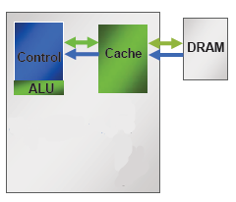
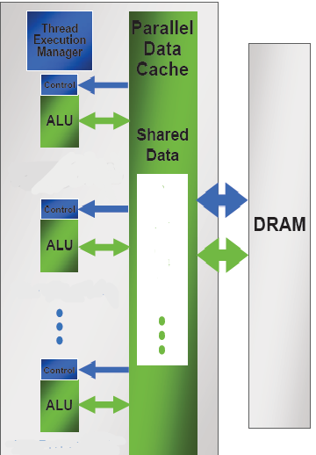
COMPARISON
CPU BASED EXECUTION
GPU BASED EXECUTION
Picture courtesy-GPU Computing with NVIDIA CUDA,Ian Buck, NVIDIA
Dept. of CSE,MACE,Kothamangalam

Slide 21
CONCLUSION
Good computational power.
The device is the GPU
The host is the CPU
The kernel –function called from host - runs on device
Gives high performance than COWs or grids
Dept. of CSE,MACE,Kothamangalam

Slide 22
REFERENCES
An Analysis of GPU Parallel Computing
Song Jun Park US Army Research Laboratory (ARL), Aberdeen Proving Ground, MD,2010,IEEE
On the Efficacy of a Fused CPU+GPU Processor
(or APU) for Parallel Computing Mayank Daga, Ashwin M. Aji, and Wu-chun Feng Dept. of Computer Science
Virginia Tech Blacksburg, USA,2011,IEEE
Dept. of CSE,MACE,Kothamangalam

Slide 23
REFERENCES (Contd..)
Experiments With Single Core, Multi Core, and GPU-based Computation by Stefan Rybacki, Institute of Computer Science University of Rostock 18051 Rostock, Germany, 2009 IEEE
GPU Computing-Graphics Processing -purpose computing applications.By John D. Owens, Mike Houstonand James C. Phillips, vol 96 No. 5, May 2008 Proceedings of the IEEE
Dept. of CSE,MACE,Kothamangalam

Slide 24
THANK YOU

Slide 25
QUESTIONS?

