Slide 1
WELCOME

Slide 2
HAILS: PROTECTING DATA PRIVACY IN UNTRUSTED WEB APPLICATION
TOPIC APPROVAL - 26/08/2013
SLIDE APPROVAL - 29/08/2013
TOPIC AND SLIDE APPROVED
By : Mrs. JISHA P ABRAHAM
AMITH KUMAR
ROLL NO:5
S₇ R

Slide 3
CONTENTS
Introduction
Existing System
Proposed System
Operational Algorithms
Improvement Methods
System Performance
Conclusion
Reference

Slide 4
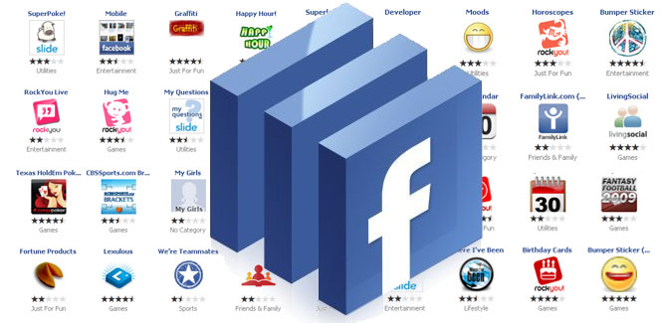
INTRODUCTION
Web Platform??
Software environment that run’s web application.
Allow third party developers to build apps

Slide 5
INTRODUCTION
Wed application use our personal data
They provide different web services
Developed by third party developers
Third party application

Slide 6
WEB
USERS
WEB
PLATFORM
WEB APPLICATION

Slide 7
TRUST CONCERNS
Don’t know the developer
Cannot determine the trustworthiness of the app
They may be malicious or security-unaware
Building secure web applications is hard
Trust concerns about personal data

Slide 8
EXISTING SYSTEM
Web application designed by third party developer
Web platform run the application
Web application build on mvc architecture
(model view controller)

Slide 9
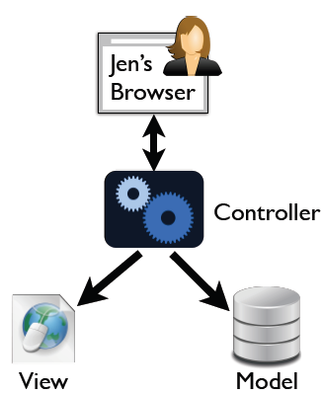
EXISTING SYSTEM
Model: Interface to data
View: renders pages
Controller: handles and
responds to HTTP requests

Slide 10
EXISTING SYSTEM
SECURITY???
WEB APPLICATION SIDE
WEB PLATFORM SIDE

Slide 11
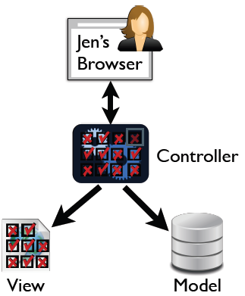
WEB APPLICATION SIDE

Slide 12
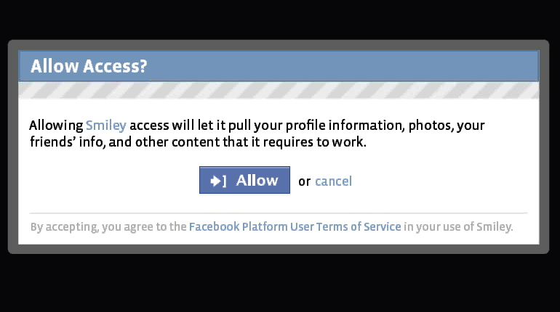
WEB PLATFORM SIDE
Can decide to give an app access to data, but
can’t control how the app uses your data.

Slide 13
PROPOSED SYSTEM
HAILS
Platform provider hosts apps
Platform enforces security: information flow
control
Makes platform implement security seriously

Slide 14
Language-level information flow control
guarantees apps always obey policy
access policies should be specified declaratively alongside data schemas
access policies are mandatory once code has obtained access to data.

Slide 15
New paradigm: Model-Policy-View-Controller
Policy ??
Policy is a security check given before data base access
Security given first class role
specified alongside data model

Slide 16
Hails uses a form of mandatory access control (MAC)
enforce end-to-end policies

Slide 17
Web app 1
Web app2
Data & policy

Slide 18
IMPLEMENTATION
MP
VC
M-P-V-C
platform
Web application

Slide 19
MP
Specify data model
VC
Implement UI and
and policy on data
other functionality
Users need not
trust VCs

Slide 20
Data model
Web application
policy

Slide 21
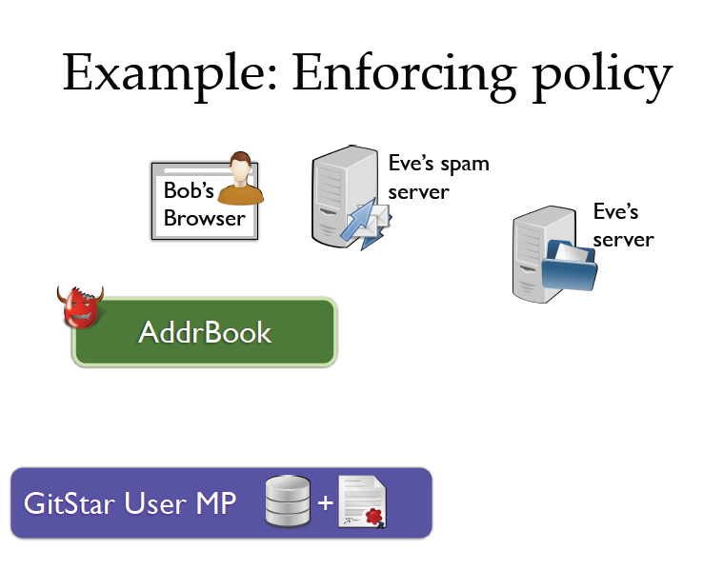

Slide 22
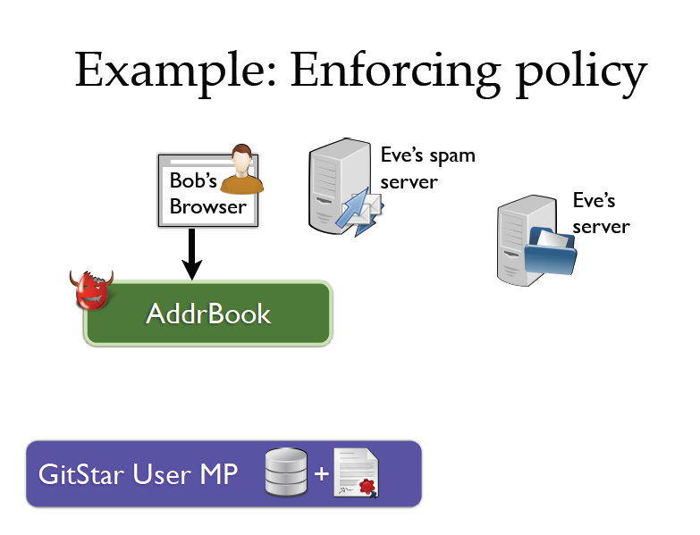

Slide 23
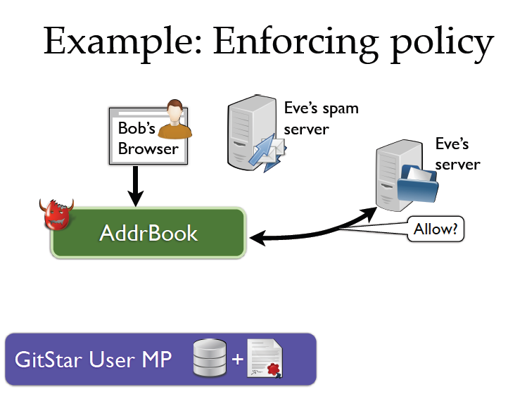

Slide 24
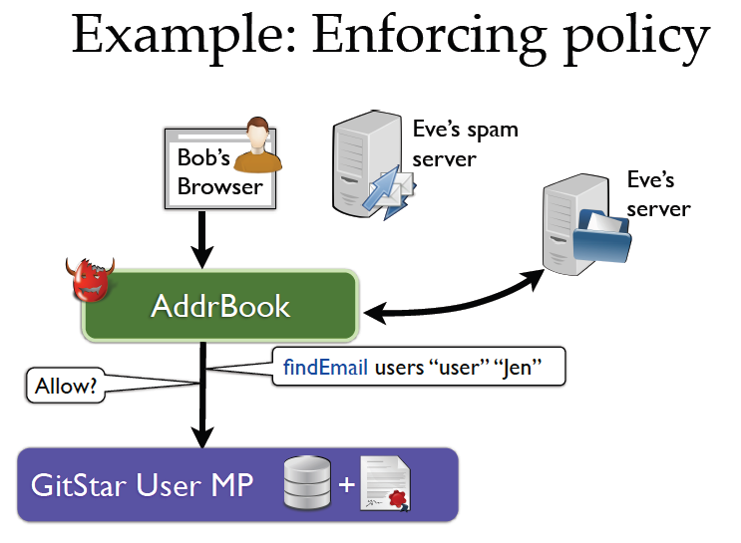

Slide 25
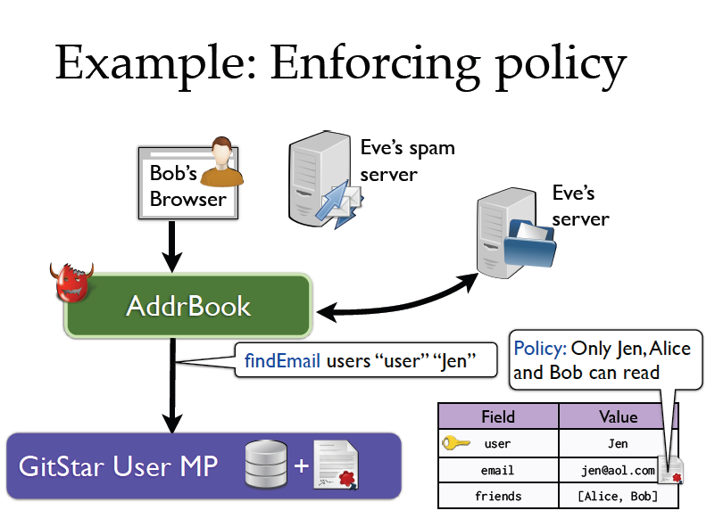

Slide 26
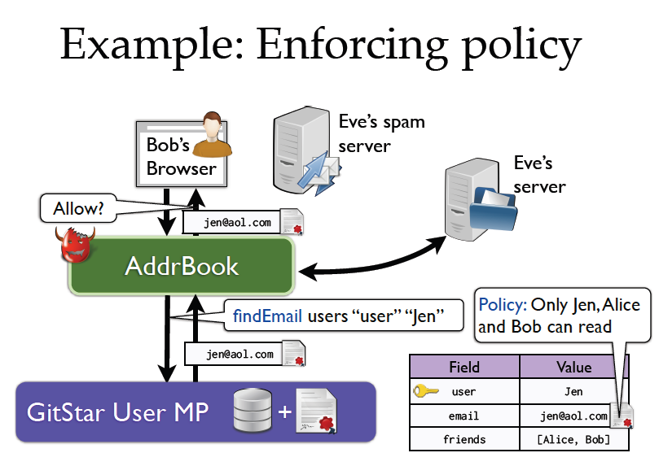

Slide 27
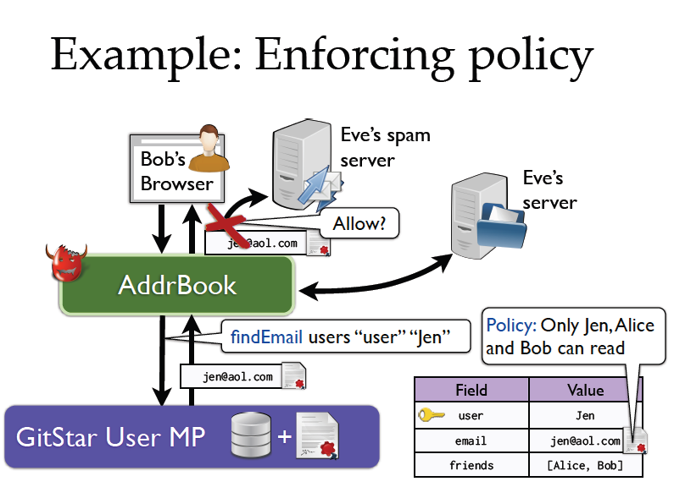

Slide 28
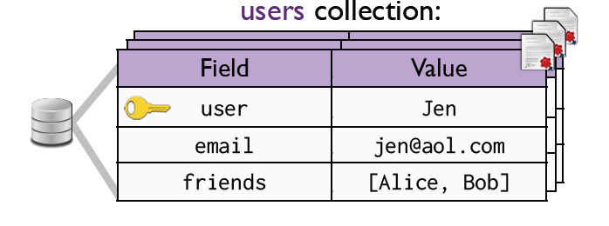
Data model: document-oriented
Collection: set of documents
Document: set of field-value pairs

Slide 29
VC
A VC is a request handler
• Provide application functionality
➤ E.g., source code browser, blog editor, …
• Invoke MPs to store/fetch user data
• Bugs in VCs are never vulnerabilities
➤ Runtime enforces security policy

Slide 30
collection “users” $ do
access $ do
readers ==> anybody
writers ==> anybody
field “user” key
document $ λdoc -> do
readers ==> anybody
writers ==> (“user” `from` doc)
field “email” $ labeled $ λdoc -> do
readers ==> (“user” `from` doc)
⋁ fromList (“friends” `from` doc)
writers ==> anybody

Slide 31
Hails is a Haskell library
➤ Quick turnaround on API design
➤ Developers can use existing tools and libraries
Hails runtime system
➤ Provides HTTP server that invokes VC
➤ Enforces information flow at the
language-level

Slide 32
Conclusions
• Current platforms: functionality vs. privacy
• Hails platforms guarantee security across apps
➤ Host apps on platform
➤ Make policy explicit
➤ Enforce policy with information flow control

