Slide 1
WELCOME

Slide 2
BUILDING A SCALABLE DATABASE-DRIVEN REVERSE DICTIONARY
Topic Approval:26/8/2013
Slide Approval:29/8/2013
Topic And Slides Approved By:
Mrs Jisha P Abraham
Shamily V A
Roll no:56
S7R

Slide 3
CONTENTS
Building A Scalable Database-Driven Reverse Dictionary
Introduction
Current system
Proposed system
Solution overview
Solution architecture
Conclusion
References

Slide 4
INTRODUCTION
Building A Scalable Database-Driven Reverse Dictionary
Reverse dictionary
Concept Similarity Problem(CSP)

Slide 5
CURRENT SYSTEM
Building A Scalable Database-Driven Reverse Dictionary
Dictionary.com
OneLook.com

Slide 6
CURRENT SYSTEM (Cont..)
Building A Scalable Database-Driven Reverse Dictionary
CSP
Poor online responsiveness
Poor Scalability

Slide 7
PROPOSED SYSTEM
Building A Scalable Database-Driven Reverse Dictionary
Wordster Reverse Dictionary
Maximum scalability
Parallel processing
Separate databases
Faster

Slide 8
SOLUTION OVERVIEW
Building A Scalable Database-Driven Reverse Dictionary
Building Reverse Mapping Set (RMS)
Querying the RMS

Slide 9
BUILDING RMS
Building A Scalable Database-Driven Reverse Dictionary
input :a dictionary D
for all mapping from Word→Definition
      do
      Extract the set of terms {t1,t2,t3,..t},tk€Definition;
      For all tk apply stemming and convert to general form tk^.

Slide 10
BUILDING RMS(Contd…)
Building A Scalable Database-Driven Reverse Dictionary
Forward dictionary
Reverse dictionary mapping
Word_id | Word | meaning
1 | Speluking | Exploring caves
2 | Mine | ..caves
Token_id | Token | word_id
1 | Explore | 1
2 | cave | {1,2}

Slide 11
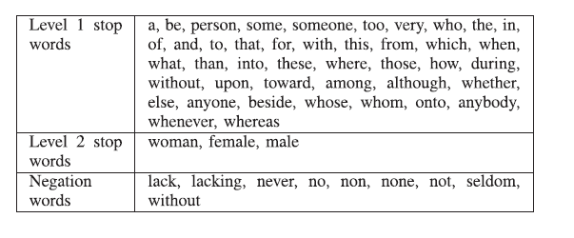
STOP WORDS
Building A Scalable Database-Driven Reverse Dictionary
COURTESY:IEEE TRANSACTIONS ON KNOWLEDGE AND DATA ENGINEERING

Slide 12
QUERYING RMS
Building A Scalable Database-Driven Reverse Dictionary
Algorithm GenerateQuery(U,α,β)
    U=U-{t€L1}
    Form a Boolean expression Q, of the U.
    If t is negated
    Replace t with its antonym.
    Apply stemming to t€U.
    Find R(t) for each term.
    If result > α
    Sort the result.

Slide 13
QUERYING RMS (cont..)
Building A Scalable Database-Driven Reverse Dictionary
    Else
    expand t €U by checking synonyms,hypernym and hyponyms.
    Do steps till result>α
    sort the result.

Slide 14
RANK CANDIDATE WORDS
Building A Scalable Database-Driven Reverse Dictionary
SortResults algorithm
      Term similarity
      Term importance

Slide 15
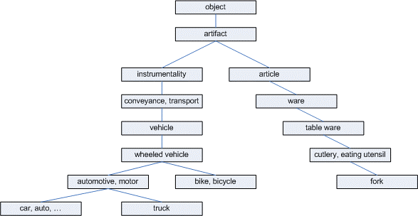
WORDNET
Building A Scalable Database-Driven Reverse Dictionary
COURTESY:IEEE TRANSACTIONS ON KNOWLEDGE AND DATA ENGINEERING

Slide 16

TERM SIMILARITY
Building A Scalable Database-Driven Reverse Dictionary
COURTESY:IEEE TRANSACTIONS ON KNOWLEDGE AND DATA ENGINEERING

Slide 17

TERM IMPORTANCE
Building A Scalable Database-Driven Reverse Dictionary
COURTESY:IEEE TRANSACTIONS ON KNOWLEDGE AND DATA ENGINEERING

Slide 18
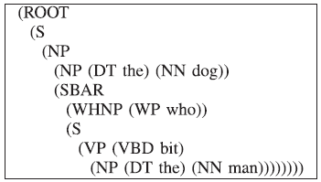

TERM IMPORTANCE(Cond..)
Building A Scalable Database-Driven Reverse Dictionary
P1: “the dog who bit the man”
    P2:”the man who bit the dog”
OURTESY:IEEE TRANSACTIONS ON KNOWLEDGE AND DATA ENGINEERING

Slide 19
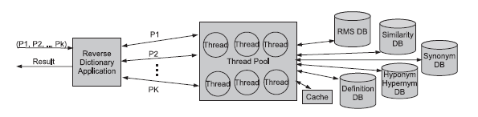
SOLUTION ARCHITECTURE
Building A Scalable Database-Driven Reverse Dictionary
Fig. 1 Architecture for reverse dictionary.
COURTESY:IEEE TRANSACTIONS ON KNOWLEDGE AND DATA ENGINEERING

Slide 20
CACHE SIZE
Building A Scalable Database-Driven Reverse Dictionary
Cache size for synonyms:7.2MB
Cache size for antonyms:69KB
Cache size for RMS:15.5MB

Slide 21
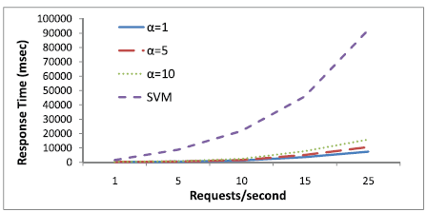
RESPONSE TIME RESULT
Building A Scalable Database-Driven Reverse Dictionary
FIG2: Response time performance as request rate increases.
COURTESY:IEEE TRANSACTIONS ON KNOWLEDGE AND DATA ENGINEERING

Slide 22
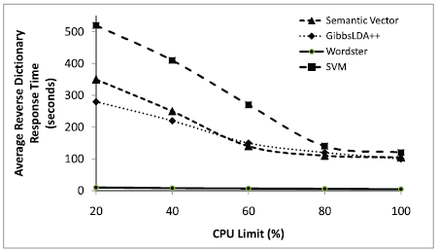
SCALABILITY RESULTS
Building A Scalable Database-Driven Reverse Dictionary
Fig. 3. Scalability as CPU limit increases.
COURTESY:IEEE TRANSACTIONS ON KNOWLEDGE AND DATA ENGINEERING

Slide 23
CONCLUSION
Building A Scalable Database-Driven Reverse Dictionary
Resolve CSP
Good solution quality

Slide 24
REFERENCES
Building A Scalable Database-Driven Reverse Dictionary
[1]: D. Lin, “An Information-Theoretic Definition of Similarity,” Proc. Int’l Conf. Machine Learning, 1998.
[2]: C. Manning, P. Raghavan, and H. Schutze, Introduction to Information Retrieval. Cambridge Univ. Press, 2008.
[3]: R. Zwick, E. Carlstein, and D. Budescu, “Measures of SimilarityAmong Fuzzy Concepts: A Comparative Analysis,”

Slide 25
REFERENCES
Building A Scalable Database-Driven Reverse Dictionary
[4] :J. Ponte and W. Croft, “A LanguageModeling Approach to Information Retrieval,” Proc. 21st Ann. Int’l ACM SIGIR Conf.Research and Development in Information Retrieval, pp. 275-281, 1998.

Slide 26
THANK YOU

Slide 27
QUESTIONS ?

