Slide 1
WELCOME
FoCUS:Learning to Crawl Web Forums

Slide 2
FoCUS:LEARNING TO CRAWL WEB FORUMS
FoCUS:Learning to Crawl Web Forums
TOPIC APPROVAL:06/09/2013 Vishnu Prasad V S
SLIDE APPROVAL:23/09/2013 S7R 64
TOPIC AND SLIDE APPROVED BY:
Mr. Abhi Abhai

Slide 3
CONTENTS
FoCUS:Learning to Crawl Web Forums
Introduction
Existing System
Terminologies
Proposed System
Evaluation
Conclusion

Slide 4
INTRODUCTION
FoCUS:Learning to Crawl Web Forums
Web Forums
Knowledge mining
Download contents
Forum crawlers

Slide 5
EXISTING SYSTEM
FoCUS:Learning to Crawl Web Forums
Generic crawlers
  Ineffective and inefficient
  Duplicate links
  Uninformative pages
  Page flipping links
  Entry URL discovery

Slide 6
EXISTING SYSTEM
FoCUS:Learning to Crawl Web Forums
iRobot
  More comprehensive
  URL location
    Invalid when page structure changes
  Only one path is chosen

Slide 7
TERMINOLOGY
FoCUS:Learning to Crawl Web Forums
Page type
  Entry, Index, Thread
URL Type
  Index, Thread, Page-flipping
EIT Path
ITF Regex

Slide 8
PROPOSED SYSTEM
FoCUS:Learning to Crawl Web Forums
FoCUS
  Forum Crawler Under Supervision
Crawl relevant content
URL type recognition problem
Deduplication

Slide 9
SYSTEM OVERVIEW
FoCUS:Learning to Crawl Web Forums
Learning and crawling part
Entry URL discovery
Index/Thread URL detection
Page-flipping URL detection
ITF Regex learning

Slide 10
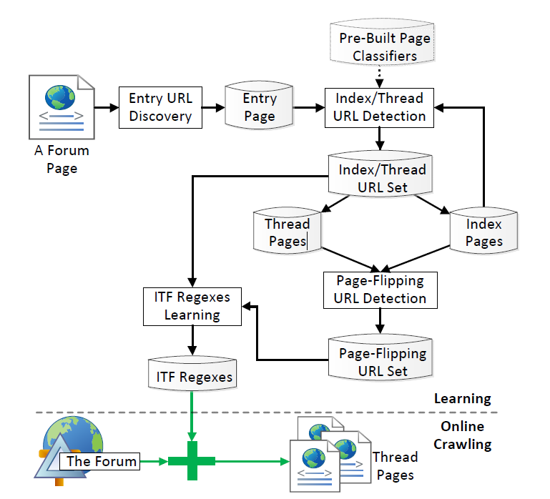
SYSTEM OVERVIEW
FoCUS:Learning to Crawl Web Forums
Courtesy:IEEE 2013:FoCUS:Learning to Crawl Web Forums

Slide 11
PAGE CLASSIFICATION
FoCUS:Learning to Crawl Web Forums
Page layout
Timestamp order
Page contents are irrelavant
Support Vector Machine

Slide 12
SUPPORT VECTOR MACHINE
FoCUS:Learning to Crawl Web Forums
Sample pages are supplied
Features are extracted
Input page features compared with training set
Classified into matching group

Slide 13
INDEX/THREAD URL TRAINING SETS
FoCUS:Learning to Crawl Web Forums
Leverage structured layout
Group URLS
Longest total anchor text
Destination page type
Aggregated classification result
  Strong page type classifiers not needed

Slide 14
DETECTION ALGORITHM
FoCUS:Learning to Crawl Web Forums
Collect URL groups
For each calculate total anchor text
Select group with max total anchor text
Set dest page type=majority of page type of destination pages
If page type=index/thread page set URL type=index/thread URL type

Slide 15
PAGE-FLIPPING URL TRAINING SETS
FoCUS:Learning to Crawl Web Forums
Digit or special text as anchor text
Same location at source and destination
Similar layout for source and destination
Single page flipping URLs
  Same anchor but different URL strings

Slide 16
DETECTION ALGORITHM
FoCUS:Learning to Crawl Web Forums
Collect URL groups
If anchor text is digit
  If source and dest layout are same, select
If none selected check targets of all
  Extract URLs in same location
  Select URL with same anchor and differenct URL strings

Slide 17
ENTRY URL DISCOVERY
FoCUS:Learning to Crawl Web Forums
Present in almost all pages
Home page contain entry URL
Index URL is not entry URL
Have most index URL

Slide 18
DISCOVERY ALGORITHM
FoCUS:Learning to Crawl Web Forums
b_url=Get Naive Entry URL
urls=extract URLs beginning with b_url and host URL
Randomly sample and download urls
For each sampled URLs urls=urls∩outgoing URLs
Let entryurl be b_url,index_urls=null and count=0

Slide 19
DISCOVERY ALGORITHM (contd)
FoCUS:Learning to Crawl Web Forums
Foreach u in urls
  If u is index url continue
  i_urls=detect index urls in u
  index_urls=index_urls∩i_urls
  If count<|i_urls|
    count=|i_url|
    entry_url=u;
Return entry_url

Slide 20
DEEP TOKENIZATION
FoCUS:Learning to Crawl Web Forums
URL is tokenized
Basic tokenization
Tokens are further divided
  Based on host specific delimiters
Eg:http://360.yahoo.com/friends-lttU7d6kIuGq
  {http,360.yahoo.com,friends lttU7d6kIuGq}

Slide 21
DEEP TOKENIZATON(contd)
FoCUS:Learning to Crawl Web Forums
Deep tokenization example
Courtesy:Learning URL Patterns By H.S. Koppula

Slide 22
LEARNING ITF REGEX
FoCUS:Learning to Crawl Web Forums
Start with “*”
Specific pattern is further refined
Recursive till no more specific patterns
Refined pattern is retained only if number exceeds a threshold
Session ID is excluded by multiple requests

Slide 23
LEARNING ITF REGEX
FoCUS:Learning to Crawl Web Forums
http://www.gardenstew.com/about20152.html
http://www.gardenstew.com/about18282.html
http://www.gardenstew.com/about19741.html
http://www.gardenstew.com/user-34.html
http://www.gardenstew.com/post-180803.html

Slide 24
LEARNING ITF REGEX
FoCUS:Learning to Crawl Web Forums
http://www.gardenstew.com/about*.html
http://www.gardenstew.com/user-*.html
http://www.gardenstew.com/post-*.html

Slide 25
EVALUATION
FoCUS:Learning to Crawl Web Forums
  160 forums with 160 packages
  2 failed
  Effectiveness 98% for 156
    91% for 2
  Coverage 97% for 154
    4 to 58% on remaining

Slide 26
CONCLUSION
FoCUS:Learning to Crawl Web Forums
Reduced to URL type detection
Collect index, thread and page-flipping urls training sets
ITF regexes are learned
Applied to unseen forums

Slide 27
REFERENCES
FoCUS:Learning to Crawl Web Forums
H.S. Koppula, K.P. Leela, A. Agarwal, K.P. Chitrapura, S. Garg, and A. Sasturkar, “Learning URL Patterns for Webpage De-Duplication”
R. Cai, J.-M. Yang, W. Lai, Y. Wang, and L. Zhang, “iRobot: An Intelligent Crawler for Web Forums”

Slide 28
THANK YOU
FoCUS:Learning to Crawl Web Forums

Slide 29
QUESTIONS
FoCUS:Learning to Crawl Web Forums

