Slide 1
WELCOME

Slide 2
TRUST MECHANISMS FOR
CLOUD COMPUTING
Topic approval:30/08/2013 Eldho George
Slide approval:31/08/2013 Roll no-21
Topic and slide approved by: S7 R
Mrs. Jisha P Abraham

Slide 3
Contents
Trust Mechanisms For Cloud Computing
Introduction
Existing System
Policy-Based Trust
Evidence Based Trust
Attribute Assessment and Certification
An Integrated View
Conclusion
References

Slide 4
Introduction
Trust Mechanisms For Cloud Computing
Cloud Computing
  Trust in cloud computing
  Issues and challenges
  Trust mechanisms
  Semantics of trust

Slide 5
Semantics of Trust
Trust Mechanisms For Cloud Computing
Trust – mental state
  Expectancy
  Belief
  Willings to take risk

Slide 6
Existing System
Trust Mechanisms For Cloud Computing
Reputation Based Trust
  High reputation is trusted many entities
  Used in e-commerce and P2P networks
SLA Verification Based Trust
  SLA-Service Level Agreement
  QoS-Quality of Services

Slide 7
Drawbacks
Trust Mechanisms For Cloud Computing
Focus only visible elements
The third party is needed
Formal accredation and audit

Slide 8
Policy Based Trust
Trust Mechanisms For Cloud Computing
Public Key Infrastructure - PKI
  Key certification and validation
  Attribute certification and validation
  Issuing and maintaining public key

Slide 9
Evidence – Based Trust
Trust Mechanisms For Cloud Computing
Attributes as evidence
  Sources of Trust
    Competency
    Goodwill
    Integrity
  Domain-Specific expectation

Slide 10
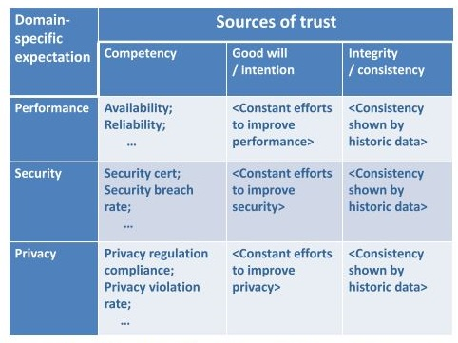
Spectrum of Attributes
Trust Mechanisms For Cloud Computing
Figure 2 Attributes of Evidence based trust
Courtesy : Journal of Cloud Computing: Advances, Systems and Applications2013,2:9

Slide 11
Attribute Assessment and Certification
Trust Mechanisms For Cloud Computing
Sources of Attribute Assessment
  Cloud user observation
  Opinions of other peer users
      Social network based approach
      Reputation based approach

Slide 12
Attribute Assessment
Trust Mechanisms For Cloud Computing
Statements from cloud service provider
    Elements of transperency
Assessment of cloud auditor/accreditor
    Reliable information source
Observation of cloud brokers
    Service intermediation
    Service aggregation
    Service arbitrage

Slide 13
Attribute Certification
Trust Mechanisms For Cloud Computing
Public key certification
Attribute certificate(AC)
  Identity
  Authentication information

Slide 14
An Integrated View
Trust Mechanisms For Cloud Computing
Trust Judgment
    Societal trust
    Trust judgment on a cloud auditor
    Trust judgment on a cloud broker
    Trust judgment on a cloud service provider
    Trust judgment on a cloud service

Slide 15
    Trust Judgment on a Cloud Auditor
Trust Mechanisms For Cloud Computing
Accreditation
Policy compliance audit
Certified attributes

Slide 16
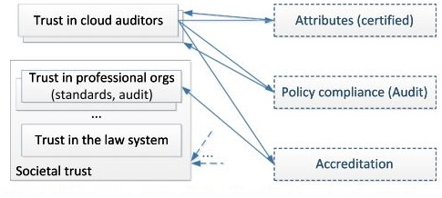
    Trust Judgment on a Cloud Auditor
Trust Mechanisms For Cloud Computing
Figure 3 Evidence and chains for trust judgment on a cloud auditor
Courtesy : Journal of Cloud Computing: Advances, Systems and Applications2013,2:9

Slide 17
    Trust Judgment on a Cloud Broker and Service Provider
Trust Mechanisms For Cloud Computing
Accreditation
Policy compliance audit
Attributes(assessed or certified)
Self-assessment and information revealing
Reputation/recommendation

Slide 18
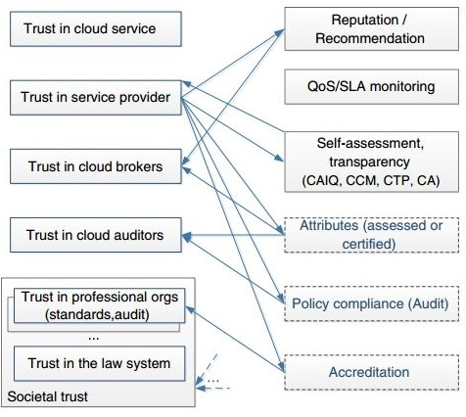
    Trust Judgment on a Cloud Broker
Trust Mechanisms For Cloud Computing
Figure 4 Evidence and chains for trust judgment on a cloud broker
Courtesy : Journal of Cloud Computing: Advances, Systems and Applications2013,2:9

Slide 19
    Trust Judgment on a Cloud Service Provider
Trust Mechanisms For Cloud Computing
Figure 5 Evidence and chains for trust judgment on a cloud service provider
Courtesy : Journal of Cloud Computing: Advances, Systems and Applications2013,2:9

Slide 20
    Trust Judgment on a Cloud Service
Trust Mechanisms For Cloud Computing
Trust based on the service provider
Policy compliance audit
Attributes (assessed or certified)
Self-assessment and information revealing
QoS monitoring and SLA verification
Reputation/recommendation

Slide 21
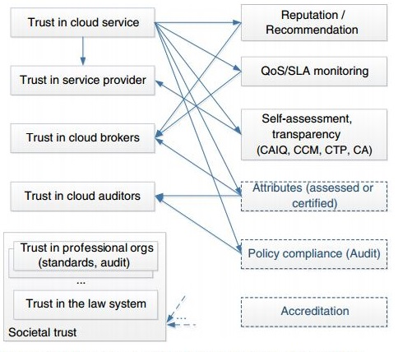
    Trust Judgment on a Cloud Service
Trust Mechanisms For Cloud Computing
Figure 6 Evidence and chains for trust judgment on a cloud service
Courtesy : Journal of Cloud Computing: Advances, Systems and Applications2013,2:9

Slide 22
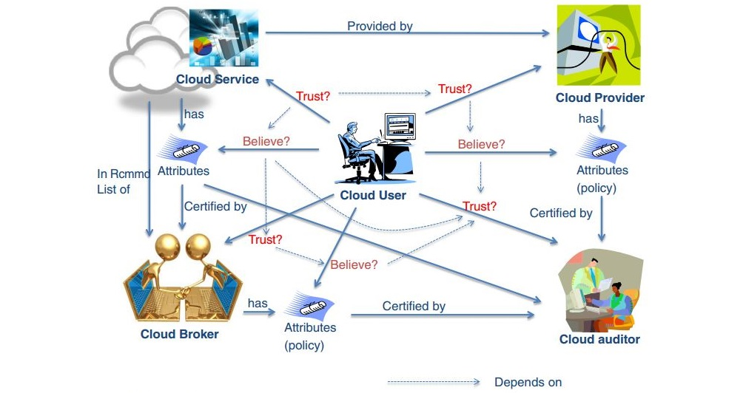
    Chains of Trust Relations in Clouds
Trust Mechanisms For Cloud Computing
Figure 6 Evidence and chains for trust judgment on a cloud service
Courtesy : Journal of Cloud Computing: Advances, Systems and Applications2013,2:9

Slide 23
Conclusion
Trust Mechanisms For Cloud Computing
Trust is a critical aspect of cloud computing
A policy-based approach of trust judgment
A “formal” attribute-based approach of trust

Slide 24
References
Trust Mechanisms For Cloud Computing
Michael B (2009) In clouds shall we trust? IEEE Security and Privacy 7(5)
Everett C (2009) Cloud computing: A question of trust. Computer Fraud
Security 2009(6): 5–7. http://dx.doi.org/10.1016/S1361
Garrison G, Kim S, Wakefield RL (2012) Success factors for deploying cloud computing.
Commun ACM 55(9): 62–68.

Slide 25
References
Trust Mechanisms For Cloud Computing
Ghosh A, Arce I (2010) Guest editors’ introduction: In cloud computing we trust - but should we? Secur Privacy, IEEE 8(6): 14–16.
Habib S, Hauke S, Ries S, Muhlhauser M (2012) Trust as a facilitator in cloud computing: a survey. J Cloud Comput Adv Syst Appl 1(1): 19. doi:10.1186/2192-113X-1-19, http://www.journalofcloudcomputing.com/content/1/1/19

Slide 26
QUESTIONS???
Trust Mechanisms For Cloud Computing

Slide 27
THANK YOU

