Slide 1
WELCOME

Slide 2
FAULT TOLERANCE IN DISTRIBUTED SYSTEMS USING FUSED DATA STRUCTURES
Topic Approval: 31.08.13
Slide Approval: 03.09.13
Topic and Slide approved by:
Mrs. Jisha P. Abraham
Dahlia George
Roll no: 20
S7R
Mar Athanasius College of Engineering

Slide 3
Contents
Fault Tolerance in Distributed Systems using Fused Data Structures
Introduction
Existing System
Proposed System
Implementing Fusion
Crash Fault
Byzantine Fault
Conclusion
References

Slide 4
Introduction
Fault Tolerance in Distributed Systems using Fused Data Structures
Fault Tolerant Distributed System
Types of Faults
  Crash Faults
  Byzantine Faults
Data Fusion

Slide 5
Existing System
Fault Tolerance in Distributed Systems using Fused Data Structures
Active Replication
  f crash faults – f replicas
  n primaries – nf backups
  f byzantine faults – 2f replicas
  n primaries – 2nf backup structures

Slide 6
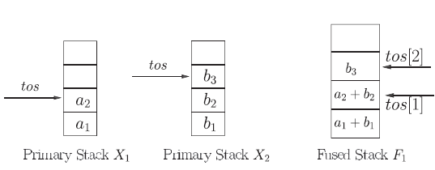
Proposed System
Fault Tolerance in Distributed Systems using Fused Data Structures
Fusion
  Space efficient
  Minimal update overhead
Courtesy: IEEE Paper

Slide 7
Implementing Fusion
Fault Tolerance in Distributed Systems using Fused Data Structures
Crash faults
  f faults
  n primaries – f fused structures
Byzantine faults
  f faults – f fused structures
  n primaries – f replicas
  nf + f additional backups

Slide 8
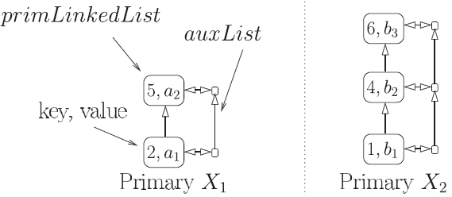
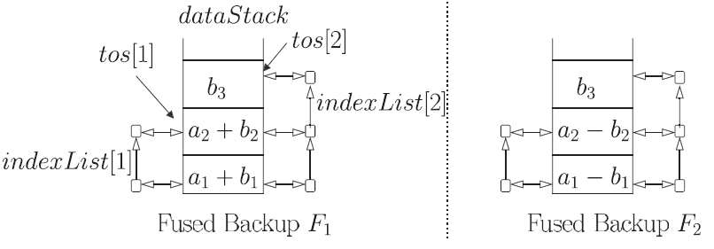
Crash Faults
Fault Tolerance in Distributed Systems using Fused Data Structures
Courtesy: IEEE Paper

Slide 9
Insertion
Fault Tolerance in Distributed Systems using Fused Data Structures
5,a2
6,b3
b3
a3 + b3
a2 + b2
3,a3
4,b2
a1 + b1
2, a1
1,b1

Slide 10
Insert at Primaries
Fault Tolerance in Distributed Systems using Fused Data Structures
Insert at Primaries Xi:i=1..n
Input: key k, data value d
if key is already present
  update value
  send (k,d,old) to all fused backups
Courtesy: IEEE Paper

Slide 11
Insert at Primaries (contd)
Fault Tolerance in Distributed Systems using Fused Data Structures
else
  create a new primary node
  assign data value d to the primary node
  create a new auxillary node
  assign primary node to auxillary node
  send (k,d,null) to fused backups
Courtesy: IEEE Paper

Slide 12
Insert at Fused Backups
Fault Tolerance in Distributed Systems using Fused Data Structures
Insert at fused backups Fj, j=1..t
Input: key k, new value d, old value old
if index list already contains k
  update fused node
Courtesy: IEEE Paper

Slide 13
Insert at Fused Backups (contd.)
Fault Tolerance in Distributed Systems using Fused Data Structures
else
  fused node p = tos++
  if p==null
    push (d)
  p.update(0,d);
  increment the refcount variable
  assign an index node a to p
  insert (k,a) to the index list
Courtesy: IEEE Paper

Slide 14
Deletion
Fault Tolerance in Distributed Systems using Fused Data Structures
6,b3
a3 + b3
a3
a2 + b2
4,b2
a1 + b1
a1
a1+b3
1, b1

Slide 15
Delete at Primaries
Fault Tolerance in Distributed Systems using Fused Data Structures
Input: key k
old:=data value of k
delete primary node(k)
tos:=tail element of the auxillary list
send (k,old,tos) to all fused backups
Courtesy: IEEE Paper

Slide 16
Delete at Primaries (contd.)
Fault Tolerance in Distributed Systems using Fused Data Structures
a:=auxillary node of deleted element
(a.prev).next=auxTail
auxTail.next=a.next
delete a
Courtesy: IEEE Paper

Slide 17
Delete at Fused Backups
Fault Tolerance in Distributed Systems using Fused Data Structures
Input: key k, old value, tos
a:=index node of element to be deleted
p:=fused node of element to be deleted
update p(old,tos)
adjust the pointers
Courtesy: IEEE Paper

Slide 18
Byzantine Faults
Fault Tolerance in Distributed Systems using Fused Data Structures
f byzantine faults – f fused structures
n primaries – f replicas
Total: nf + f backups
Pure replication: 2nf backups
Detection by clients
Client invokes recovery algorithm

Slide 19
Steps in Detection
Fault Tolerance in Distributed Systems using Fused Data Structures
Unfused Copies:
  On receiving any message from client
    update local copy;
  Send state update to fused processes
  Send response to the client

Slide 20
Steps in Detection (contd.)
Fault Tolerance in Distributed Systems using Fused Data Structures
Client:
  send update to all unfused f+1 copies;
  if(all f+1 responses identical)
    use the response;
  else invoke recovery algorithm;

Slide 21
Steps in Recovery
Fault Tolerance in Distributed Systems using Fused Data Structures
Acquire all available data structures;
Let t be the number of mismatched primaries;
while( t>1 ) do
  choose a copy of some primary Xi with largest multiplicity;
  retstart unfused copies of Xi with the state of the chosen copy;
  t = t – 1;
endwhile;

Slide 22
Steps in Location:
Fault Tolerance in Distributed Systems using Fused Data Structures
Z: set of unfused copies of Xc;
while ( there are mismatched copies in Z)
  Y : state[key] for each copy in Z;
  while (no value in Y with multiplicity f+1)
    create, v = state[key] using Fj and all Xi, i<>c and add v to Y;
  endwhile;
  delete copies from Z in which state[key]!=v;
endwhile;

Slide 23
Conclusion
Fault Tolerance in Distributed Systems using Fused Data Structures
For crash faults
  only f additional backups
For byzantine faults
  only nf + f additional backups
Space efficient
Minimal update overhead

Slide 24
References
B. Balasubramanian and V.K. Garg, “Fused Data Structures for Handling Multiple Faults in Distributed Systems,” Proc. Int’l Conf. Distributed Computing Systems (ICDCS ’11), pp. 677-688, June 2011.
F.B. Schneider, “Byzantine Generals in Action: Implementing Fail-Stop Processors,” ACM Trans. Computer Systems, vol. 2, no. 2,pp. 145-154, 1984.

Slide 25
References
Fault Tolerance in Distributed Systems using Fused Data Structures
B. Balasubramanian and V.K. Garg, “Fused Data Structure Library(Implemented in Java 1.6),” Parallel and Distributed Systems Laboratory, http://maple.ece.utexas.edu, 2010
V.K. Garg and V. Ogale, “Fusible Data Structures for Fault Tolerance,” Proc. 27th Int’l Conf. Distributed Computing Systems (ICDCS ’07), June 2007.

Slide 26
Questions?
Fault Tolerance in Distributed Systems using Fused Data Structures

Slide 27
Fault Tolerance in Distributed Systems using Fused Data Structures

Slide 28
Fault Tolerance in Distributed Systems using Fused Data Structures

Slide 29
Fault Tolerance in Distributed Systems using Fused Data Structures

