Slide 1
WELCOME

Slide 2
DIRECTORY CACHES WITHOUT TRACKING NONCOHERENT MEMORY BLOCKS
Title approval :24/7/13
Slide approval:1/8/13
by Tr.Jisha P.Abraham
Catherine Lisha A.A.
S7R
Roll no. 19

Slide 3
Directory caches without tracking non-coherent memory blocks
Contents
    Introduction
    Existing System
    Proposed System
    Concepts
    Performance
    Conclusion

Slide 4
Directory caches without tracking non-coherent memory blocks
Introduction
    Caching
    Multiprocessor system
    Directory caches

Slide 5
Directory caches without tracking non-coherent memory blocks
Existing System
    Snoopy cache
        Small scale multiprocessor
    Directory-based
        Large scale multiprocessor

Slide 6
Directory caches without tracking non-coherent memory blocks
Proposed System
    Memory blocks
        Coherent blocks
        Non-coherent blocks

Slide 7
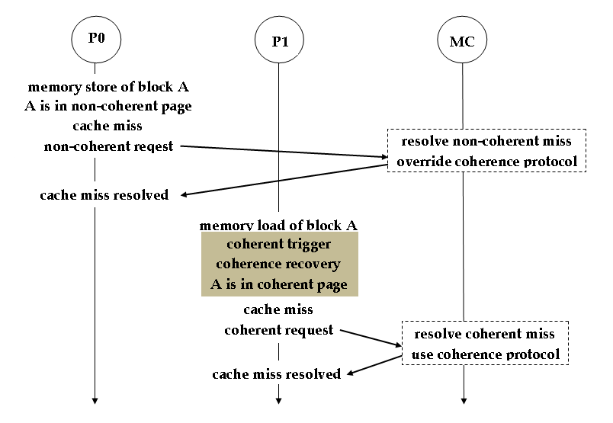
Directory caches without tracking non-coherent memory blocks
Overview
Fig.1 courtesy:IEEE transactions on Computers,2013

Slide 8
Directory caches without tracking non-coherent memory blocks
Basic Concepts
    Non-coherent block identification
    Coherence Deactivation
    Coherence Recovery

Slide 9
Directory caches without tracking non-coherent memory blocks
Page Classification
    Non-coherent block
        Private Read-only (PR)
        Private read-Write (PW)
        Shared Read-only (SR)
    Coherent block
        Shared read-Write (SW)

Slide 10
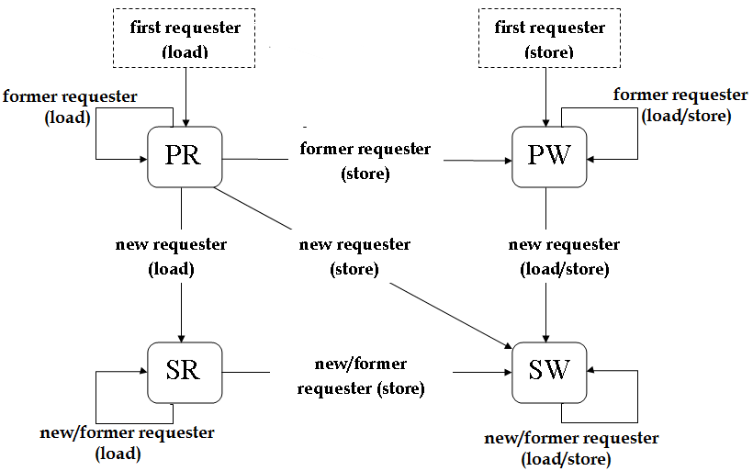
Directory caches without tracking non-coherent memory blocks
State Transition Diagram
Fig.2 courtesy:IEEE transactions on Computers,2013

Slide 11
Directory caches without tracking non-coherent memory blocks
Non-coherent Block
    PR,PW or SR
    Non-coherent requesting
    Coherence Deactivation
    No directory cache entry

Slide 12
Directory caches without tracking non-coherent memory blocks
Coherence Deactivation
    Coherence Protocol
    Coherent Block
        use coherence protocol
    Non-coherent Block
        override coherence protocol

Slide 13

Directory caches without tracking non-coherent memory blocks
Identification of non-coherent blocks
Translation Look-a-side Buffer(TLB) entry
Fig.3 courtesy:IEEE transactions on Computers,2013
Page Table(PT) entry
Fig.4 courtesy:IEEE transactions on Computers,2013

Slide 14
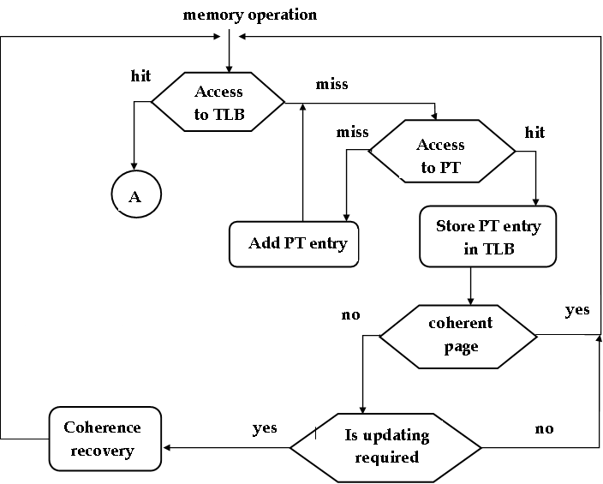
Directory caches without tracking non-coherent memory blocks
Entry in PT & TLB

Slide 15
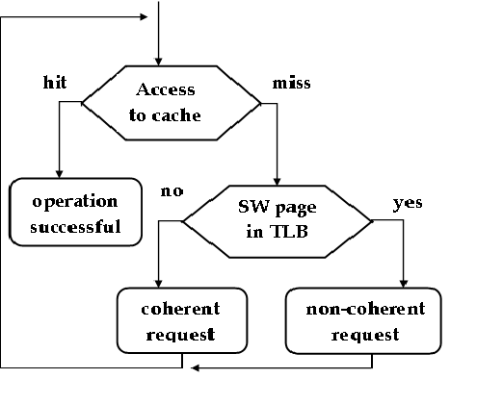
Directory caches without tracking non-coherent memory blocks
A

Slide 16
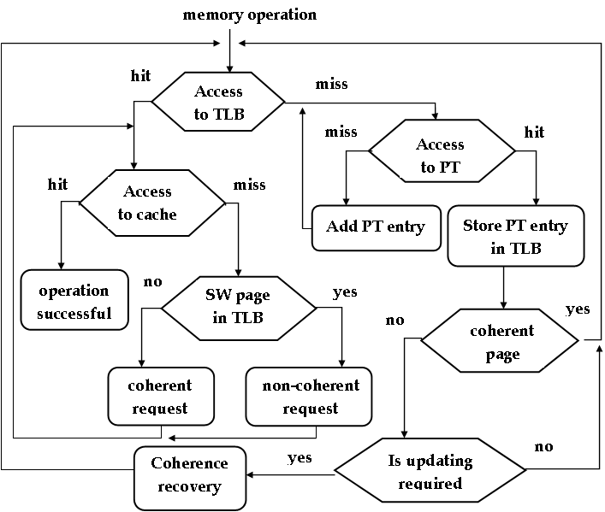
Directory caches without tracking non-coherent memory blocks
Block Diagram
Fig.8 courtesy:IEEE transactions on Computers,2013

Slide 17
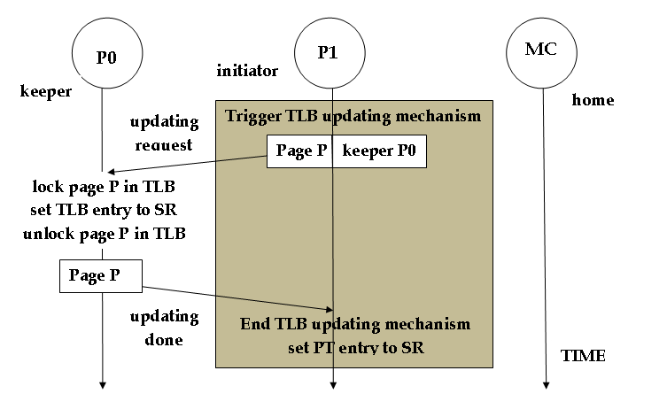
Directory caches without tracking non-coherent memory blocks
TLB Updating Mechanism
Fig.5 courtesy:IEEE transactions on Computers,2013

Slide 18
Directory caches without tracking non-coherent memory blocks
Coherence Recovery
    Occur when
        non-coherent block coherent
    Unicast recovery
    Broadcast recovery

Slide 19
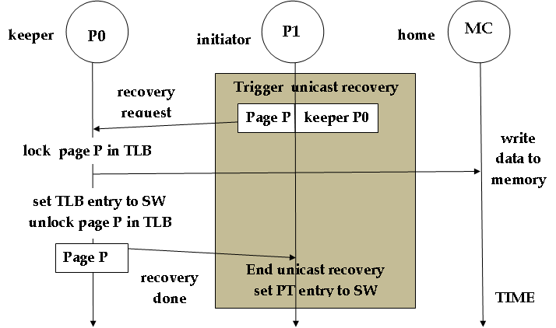
Directory caches without tracking non-coherent memory blocks
Unicast Recovery
Fig.6 courtesy:IEEE transactions on Computers,2013

Slide 20
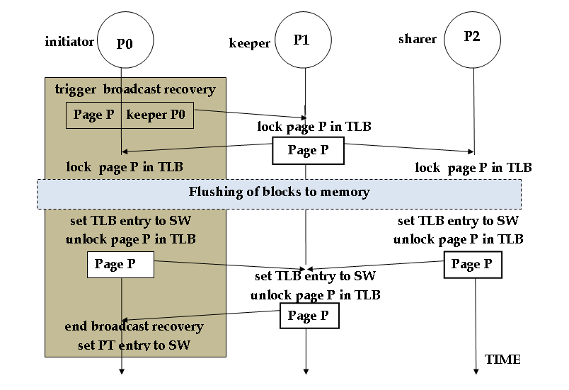
Directory caches without tracking non-coherent memory blocks
Broadcast Recovery
Fig.7 courtesy:IEEE transactions on Computers,2013

Slide 21
Directory caches without tracking non-coherent memory blocks
Performance
    Directory cache size
    Execution time
    Energy consumption

Slide 22
Directory caches without tracking non-coherent memory blocks
Conclusion
    Reduced directory cache occupancy
    Increased efficiency
    No special hardware requirement
    Future development:
        avoid extra bits

Slide 23
Directory caches without tracking non-coherent memory blocks
References
A. Agarwal, R. Simoni, J.L. Hennessy, and M.A. Horowitz, “An Evaluation of Directory Schemes for Cache Coherence,” Proc. 15th Int’l Symp. Computer Architecture (ISCA), pp. 280-289, May 1988.
N. Agarwal, T. Krishna, L.-S. Peh, and N.K. Jha, “GARNET: A Detailed On-Chip Network Model Inside a Full-System Simulator,” Proc. IEEE Int’l Symp. Performance Analysis of Systems and Software (ISPASS), pp. 33-42, Apr. 2009.

Slide 24
Directory caches without tracking non-coherent memory blocks
A.R. Alameldeen, C.J. Mauer, M. Xu, P.J. Harper, M.M. Martin,D.J. Sorin, M.D. Hill, and D.A. Wood, “Evaluating Non- Deterministic Multi-Threaded Commercial Workloads,” Proc. Fifth Workshop CAECW, pp. 30-38, Feb. 2002.
A.R. Alameldeen and D.A. Wood, “Variability in Architectural Simulations of Multi-Threaded Workloads,” Proc. Int’l Symp. High- Performance Computer Architecture (HPCA), pp. 7-18, Feb. 2003.

Slide 25
Directory caches without tracking non-coherent memory blocks
“AMD64 Architecture Programmer’s Manual Volume 2: System Programming,” white paper, Advanced Micro Devices, 2010.
J.F. Cantin, M.H. Lipasti, and J.E. Smith, “Improving Multiprocessor Performance with Coarse-Grain Coherence Tracking,” Proc. Int’l Symp. Computer Architecture (ISCA), pp. 246-257, June 2005.

Slide 26
QUESTIONS ?

Slide 27
THANKYOU…

