Slide 1
WELCOME
Dept. of Computer Science,MACE,Kothamangalam

Slide 2
DIPLOMA: Consistent and Coherent Shared Memory over Mobile Phones
Presented by
BONY THOMAS
CLASS NO:18
S7-R,DEPT.CSE
Topic approval: 26-08-2013
Slide approval : 31-08-2013
Approved by : Mrs. Jisha P Abraham
Dept. of Computer Science,MACE,Kothamangalam

Slide 3
DIPLOMA: Consistent and Coherent Shared Memory over Mobile Phones
Contents
Introduction
Existing system & its drawbacks
Proposed system
Evaluation
Conclusion
References
Dept. of Computer Science,MACE,Kothamangalam

Slide 4
DIPLOMA: Consistent and Coherent Shared Memory over Mobile Phones
Introduction
Smartphones – high end mobile phones
Sense and generate data
Emergence of multicore mobile phones
          Compute intensive tasks
Dept. of Computer Science,MACE,Kothamangalam

Slide 5
DIPLOMA: Consistent and Coherent Shared Memory over Mobile Phones
Existing System
Client-server model using cellular network
        Congestion in server
        Overloading of network
        Long and variable latencies
        Poor battery life
        Monetary cost
Dept. of Computer Science,MACE,Kothamangalam

Slide 6
DIPLOMA: Consistent and Coherent Shared Memory over Mobile Phones
Proposed System
DIPLOMA -Distributed Programming Layer Over Mobile Agents
      Harnessing the compute power locally
      Shared memory programming model
      Free, energy efficient & low-latency adhoc Wi-Fi
      Snoopy & resilient cache-coherence
Dept. of Computer Science,MACE,Kothamangalam

Slide 7
DIPLOMA: Consistent and Coherent Shared Memory over Mobile Phones
Design & Semantics
  The Virtual Core Layer (VCore)
  The DIPLOMA Shared Memory layer (DSMLayer)
  Snoopy and Resilient Cache Coherence (SRCC)
Dept. of Computer Science,MACE,Kothamangalam

Slide 8
DIPLOMA: Consistent and Coherent Shared Memory over Mobile Phones
VCore
Abstraction of static reliable cores
Divide region into zones, one VCore per zone.
VCores coordinates client nodes in its zone.
Mobile Ad-hoc Networks (MANETs) are used.
      Set up temporarily among wireless devices.
      Without the support of any infrastructure.
      No access-point needed.
Dept. of Computer Science,MACE,Kothamangalam

Slide 9
DIPLOMA: Consistent and Coherent Shared Memory over Mobile Phones
Vcore Implementation
Region boot-up
Leader (re)election
State synchronization
Dept. of Computer Science,MACE,Kothamangalam

Slide 10
DIPLOMA: Consistent and Coherent Shared Memory over Mobile Phones
Region boot-up
Fig.1
Dept. of Computer Science,MACE,Kothamangalam

Slide 11
DIPLOMA: Consistent and Coherent Shared Memory over Mobile Phones
Leader (re)election
Fig.2
Dept. of Computer Science,MACE,Kothamangalam

Slide 12
DIPLOMA: Consistent and Coherent Shared Memory over Mobile Phones
The DSMLayer
Implemented as an Application programming interface.
Runs atop VCore abstraction
Shared memory - addressed through variable names.
Dept. of Computer Science,MACE,Kothamangalam

Slide 13
DIPLOMA: Consistent and Coherent Shared Memory over Mobile Phones
The DSMLayer
Atom primitive - Access variables.
        Instructions executed on variables.
        Atomic nature.
        AtomFence.
        At-most-once execution semantics.
Dept. of Computer Science,MACE,Kothamangalam

Slide 14
DIPLOMA: Consistent and Coherent Shared Memory over Mobile Phones
SRCC
Broadcast based protocols- Write update protocol.
    Ensures caches are updated for write processes
    Computational power located at the memory
    Fewer messages exchanged
    Multiple reader – multiple writer
Dept. of Computer Science,MACE,Kothamangalam

Slide 15
DIPLOMA: Consistent and Coherent Shared Memory over Mobile Phones
SRCC
Write through, no-write-allocate cache.
    Ensures cache consistency between local and remote home VCore
Dept. of Computer Science,MACE,Kothamangalam

Slide 16
DIPLOMA: Consistent and Coherent Shared Memory over Mobile Phones
SRCC
Memory operations – same variable –seen by all remote caches in same order
Counters - initialized to 1
    Home VCore – global_order
    Other Vcores – local_order
    Write update is accepted only if
    global_order=local_order
Dept. of Computer Science,MACE,Kothamangalam

Slide 17
DIPLOMA: Consistent and Coherent Shared Memory over Mobile Phones
SRCC
Vcore1
Vcore6
Vcore2
Vcore3
Vcore4
Vcore5
Local_order[5]=1;
Local_order[5]=2;
Local_order[5]=3;
Write_update[5](g_o=1)
Write_update[5](g_o=2)
Write_update[5](g_o=1)
Write_update[5](g_o=2)
Write_update[5](g_o=2)
Local_order[5]=1;
global_order=3;
global_order=1;
global_order=2;
Fig.3
Dept. of Computer Science,MACE,Kothamangalam

Slide 18
DIPLOMA: Consistent and Coherent Shared Memory over Mobile Phones
DIPLOMA Implementation
1. DIPLOMAS’s API(Application Programming interface).
Application programmer implements UserApp
UserApp consists of Atoms
Atoms executed on Variables
Dept. of Computer Science,MACE,Kothamangalam

Slide 19
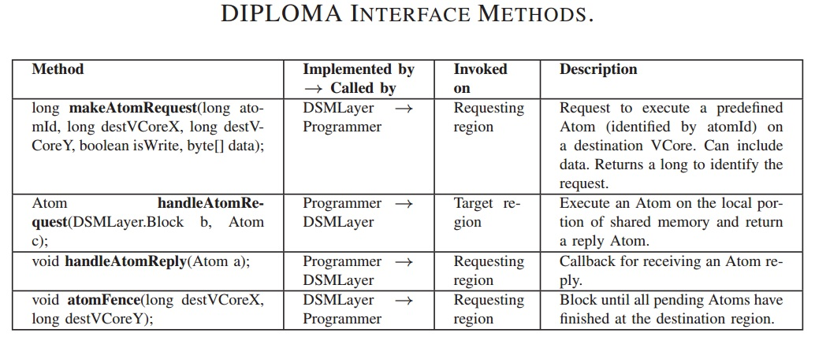
DIPLOMA: Consistent and Coherent Shared Memory over Mobile Phones
Interface Methods
Table 1 – Interface methods
Courtesy : IEEE Transactions march,2013
Dept. of Computer Science,MACE,Kothamangalam

Slide 20
DIPLOMA: Consistent and Coherent Shared Memory over Mobile Phones
DIPLOMA Prototype
UserApp
DSMLayer with SRCC
Vcores Layer
Thread1
Busy-wait loop – to receive packets on ad hoc network
Thread2
MUX – Communication between Thread1 and Thread2
Thread3
Fig.4
Dept. of Computer Science,MACE,Kothamangalam

Slide 21
DIPLOMA: Consistent and Coherent Shared Memory over Mobile Phones
Prototype
3 layers run in single thread
    Eliminate inter-thread communication
Java synchronised – disallow concurrent access
MINT: A front end for efficient simulation of shared memory multiprocessors
Dept. of Computer Science,MACE,Kothamangalam

Slide 22
DIPLOMA: Consistent and Coherent Shared Memory over Mobile Phones
Evaluation
Better response time improvements
Cellular bandwidth reduction
Energy consumption reduced
Better request completion rate
Dept. of Computer Science,MACE,Kothamangalam

Slide 23
DIPLOMA: Consistent and Coherent Shared Memory over Mobile Phones
Conclusion
Shared memory implemented on mobile devices
Powerful mobile computing platform
Offload communications from cellular networks and computation from servers
Dept. of Computer Science,MACE,Kothamangalam

Slide 24
DIPLOMA: Consistent and Coherent Shared Memory over Mobile Phones
References
A Simulation Study on using the Virtual Node Layer to implement efficient and reliable manet protocols by JIANG WU
Scalable atomic primitives for distributed shared memory multiprocessors by Maged M.Michael
Dept. of Computer Science,MACE,Kothamangalam

