Slide 1
WELCOME

Slide 2
A CACHE TUNING HEURISTIC FOR
MULTICORE ARCHITECTURES
Topic approval:11/09/2013 Akhisha E
Slide approval:10/10/2013 Roll no-2
Topic and slide approved by: S7R
Mrs. Jisha P Abraham

Slide 3
CONTENTS
CACHE TUNING HEURISTIC FOR MULTICORE ARCHITECTURES
Introduction
Existing Systems
Proposed System
Challenges
Cache tuning
Implementation
Conclusion
References
MACE, Kothamangalam

Slide 4
INTRODUCTION
CACHE TUNING HEURISTIC FOR MULTICORE ARCHITECTURES
Multicore architectures
Cache
  Data cache
  Instruction cache
Cache tuning
Cache optimization
MACE, Kothamangalam

Slide 5
EXISTING SYSTEMS
CACHE TUNING HEURISTIC FOR MULTICORE ARCHITECTURES
Cooperative caching
Proximity aware caching
  Uses cache to cache transfers
  Disadvantage
  Complexity
  Expensive
  Scalability
MACE, Kothamangalam

Slide 6
PROPOSED SYSTEM
CACHE TUNING HEURISTIC FOR MULTICORE ARCHITECTURES
Application Classification-Guided Cache Tuning Heuristic
  Data cache tuning
  Instruction cache tuning
MACE, Kothamangalam

Slide 7
CHALLENGES
CACHE TUNING HEURISTIC FOR MULTICORE ARCHITECTURES
Heterogeneous configurations
Data Sharing
  Core interactions
MACE, Kothamangalam

Slide 8
CACHE TUNING HEURISTIC FOR MULTICORE ARCHITECTURES
DATA CACHE TUNING
Tunable parameters
  Cache size
  Line size
  Associativity
MACE, Kothamangalam

Slide 9
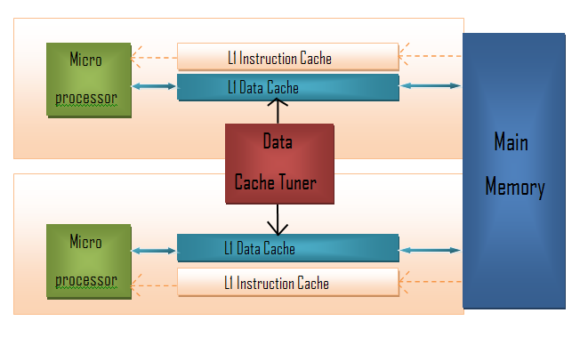
ARCHITECTURE
CACHE TUNING HEURISTIC FOR MULTICORE ARCHITECTURES
Courtesy:IEEE Transactions on Computers
MACE, Kothamangalam

Slide 10
GLOBAL DATA CACHE TUNER
CACHE TUNING HEURISTIC FOR MULTICORE ARCHITECTURES
Execute application
Gather cache statistics
Calculate energy consumption
Fix cache parameter values
MACE, Kothamangalam

Slide 11

ENERGY MODEL
CACHE TUNING HEURISTIC FOR MULTICORE ARCHITECTURES
Total energy = (Energy consumed by each core)
Energy consumed by each core=
(Dynamic energy +
Static energy +
Fill energy +
write back energy +
CPU Stall energy)
MACE, Kothamangalam

Slide 12
ACGCT DETAILS
CACHE TUNING HEURISTIC FOR MULTICORE ARCHITECTURES
Non data sharing applications
  Simpler
  No core interaction
Data sharing applications
  Complex
  Core interaction
  Application classification
MACE, Kothamangalam

Slide 13
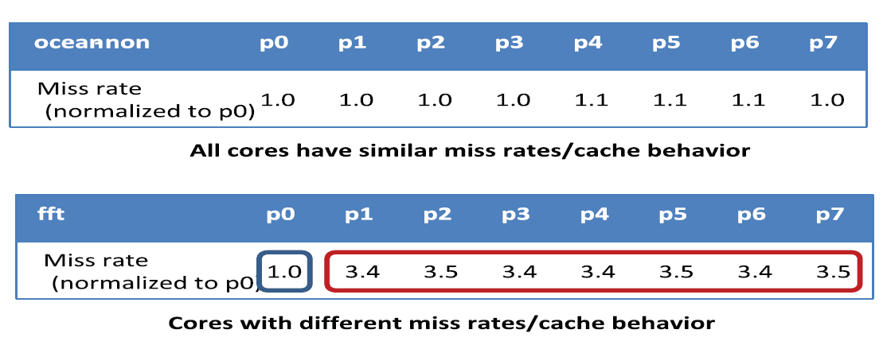
EXAMPLE
CACHE TUNING HEURISTIC FOR MULTICORE ARCHITECTURES
Courtesy:IEEE Transactions on Computers
MACE, Kothamangalam

Slide 14
STEPS
CACHE TUNING HEURISTIC FOR MULTICORE ARCHITECTURES
Steps for tuning
  Initial tuning
  Application classification
  Final tuning activities
MACE, Kothamangalam

Slide 15
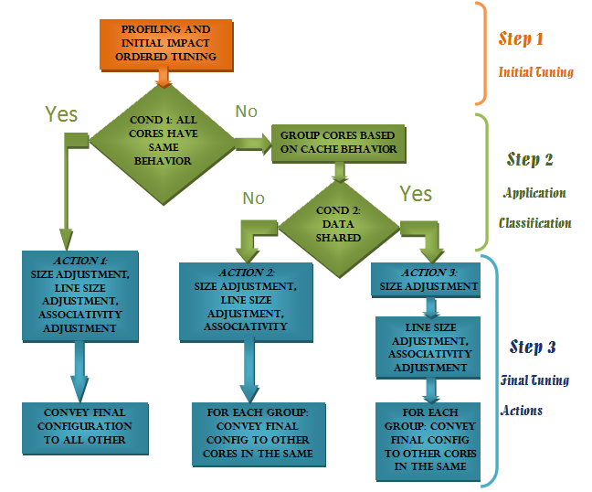
STEPS (cont..)
CACHE TUNING HEURISTIC FOR MULTICORE ARCHITECTURES
Courtesy:IEEE Transactions on Computers
MACE, Kothamangalam

Slide 16
INSTRUCTION CACHE TUNING
CACHE TUNING HEURISTIC FOR MULTICORE ARCHITECTURES
Data parallel architectures
Cores have same function
Same final configuration
MACE, Kothamangalam

Slide 17
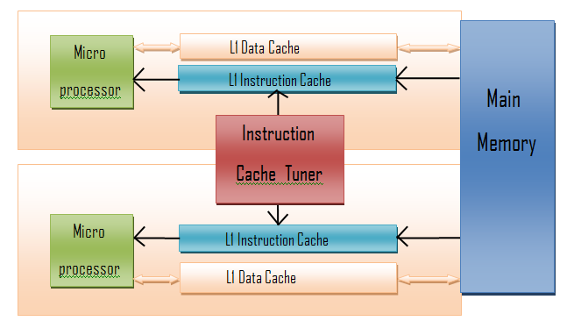
ARCHITECTURE
CACHE TUNING HEURISTIC FOR MULTICORE ARCHITECTURES
Courtesy:IEEE Transactions on Knowledge and Data Engineering
Courtesy:IEEE Transactions on Computers
MACE, Kothamangalam

Slide 18
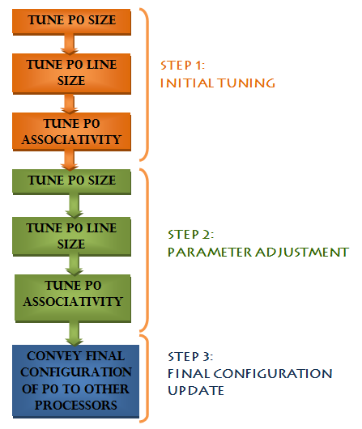
PHASES
CACHE TUNING HEURISTIC FOR MULTICORE ARCHITECTURES
Courtesy:IEEE Transactions on Computers
MACE, Kothamangalam

Slide 19
IMPLEMENTATION
CACHE TUNING HEURISTIC FOR MULTICORE ARCHITECTURES
Combine cache statistics with energy model
Adjust cache parameters
Three methods
  Thread running on one core
  A dedicated coprocessing core
  Cache tuning hardware
MACE, Kothamangalam

Slide 20
IMPLEMENTATION(contd..)
CACHE TUNING HEURISTIC FOR MULTICORE ARCHITECTURES
State machine
  Parameter state
  Value state
  Calculation state
MACE, Kothamangalam

Slide 21
ADVANTAGES
CACHE TUNING HEURISTIC FOR MULTICORE ARCHITECTURES
Good energy savings
Reduce number of cores to be tuned
MACE, Kothamangalam

Slide 22
CONCLUSION
CACHE TUNING HEURISTIC FOR MULTICORE ARCHITECTURES
Cache tuning
Application classification
Parameter adjustments
Hardware configurable cache
Energy savings
MACE, Kothamangalam

Slide 23
REFERENCES
CACHE TUNING HEURISTIC FOR MULTICORE ARCHITECTURES
D.H. Albonesi, “Selective Cache Way: On-Demand Cache Resource Allocation,” Proc. 32nd Ann. ACM/Symp.Microarchitecture, pp. 248-259, 1999.
R. Balasubramonian, D. Albonesi, A. Buyuktosunoglu, and S.Dwarkadas, “Memory Hierarchy Reconfiguration for Energy and Performance”Proc. 33rd Ann. IEEE/ACM Int’l Symp. Microarchitecture, pp. 245-257, 2000.
MACE, Kothamangalam

Slide 24
REFERENCES
CACHE TUNING HEURISTIC FOR MULTICORE ARCHITECTURES
J. Butts and G. Sohi, “A Static Power Model for Architects,” Proc.33rd Ann. ACM/IEEE Int’l Symp. Microarchitecture (MICRO), 2000
E. Seo, J. Jeong and J. Lee, “Energy Efficient Scheduling of Real-Time Tasks on Multicore Processors,” IEEE Trans. Parallel Distributed Systems, vol. 19, no. 11, Nov. 2008.
H. Hajimiri and P. Mishra, “Intra-Task Dynamic Cache Reconfiguration,”Proc. 25th Int’l Conf. VLSI Design (VLSID), 2012
MACE, Kothamangalam

Slide 25
THANK YOU

Slide 26
QUESTIONS?

