Slide 1
WELCOME

Slide 2
ENFFIS:AN ENHANCED NAND FLASH MEMORY FILE SYSTEM FOR MOBILE EMBEDDED MULTIMEDIA SYSTEM
Topic approval:20/08/2013 AKHIL K
Slide approval:21/08/2013 Roll no-1
Topic and slide approved by: S7 R
Mrs. Jisha P Abraham

Slide 3
CONTENTS
INTRODUCTION
EXISTING FILE SYSTEM
MTD DESIGN
MOUNT SCHEME
JOURNALING SCHEME
DIRTY-LAST CACHE POLICY
PERFORMANCE EVALUATION
CONCLUSION
REFERENCE
Dept. of CSE,MACE,Kothamangalam

Slide 4
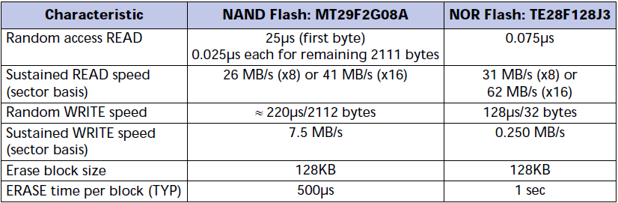
INTRODUCTION
NAND FLASH MEMORY Vs. NOR FLASH MEMORY
COURTESY:TECHNICal note NAND Flash 101:an introduction to nand flash memory MICRON

Slide 5
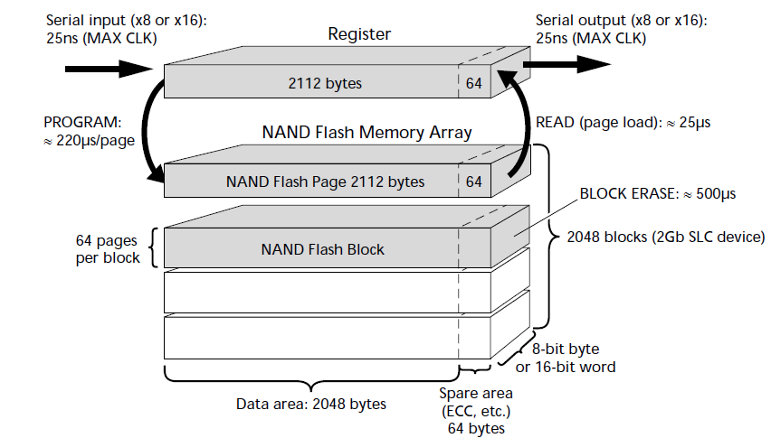
INTRODUCTION CONUT…
2kB NAND FLASH DEVICE
COURTESY:TECHNICal note NAND Flash 101:an introduction to nand flash memory MICRON

Slide 6
EXISTING FILE SYSTEM
YET ANOTHER FLASH FILE SYSTEM(YAFFS)
METADATA
JOURNALING FLASH FLE SYSTEM(JFFS)
DATA COMPRESS AND STORE

Slide 7
MTD DESIGN
Multi-plane operations
Create Mpage
Read/write and operations
MBLOCK

Slide 8
MTD DEIGN
 | Plane 0 | Plane 1 | Plane 2 | Plane 3
 | Block 0 | Block 1 | Block2 | Block 3
Mpage 0 | Page 0 | Page 0 | Page 0 | Page 0
Mpage 1 | Page 1 | Page 1 | Page 1 | Page 1
Mpage 2 | Page 2 | Page 2 | Page 2 | Page 2
Mpage3 | Page 3 | Page 3 | Page 3 | Page 3
…. | …… | ….. | ….. | …..
Mpage31 | Page 31 | Page 31 | Page 31 | Page 31

Slide 9
MTD DESIGN
 | Plane 0 | Plane 1 | Plane 2 | plane3
MBLOCK0 | BLOCK 0 | BLOCK 1 | BLOCK 2 | BLOCK 3
MBLOCK 1 | BLOCK 4 | BLOCK 5 | BLOCK 6 | BLOCK 7
MBLOCK 2 | BLOCK 8 | BLOCK 9 | BLOCK 10 | BLOCK 11
MBLOCK3 | BLOCK 12 | BLOCK 13 | BLOCK 14 | BLOCK 15
…..
MBLOCK m-2 | BLOCK n-8 | BLOCK n-7 | BLOCK n-6 | BLOCK n-5
MBLOCK m-1 | BLOCK n-4 | BLOCK n-3 | BLOCK N-2 | BLOCK N-1

Slide 10
MTD DESIGN
NAND Flash memory layout
Exblock
ExBlock 0 |  |  |  | ExBlock 1 |  |  |  | ….. | ExBlock n-1
MB 0 | MB 2 | MB 3 | MB 4 | MB 5 | MB 6 | MB 7 | MB 7 | ….. | MB 4n-4 | MB 4n-4 | MB 4n-4 | MB 4n-4

Slide 11
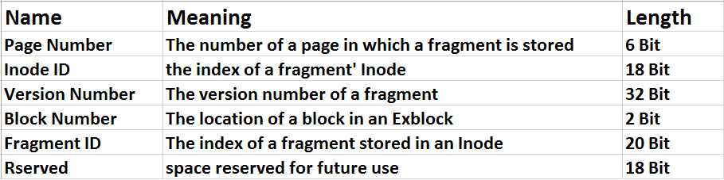
MTD DESIGN
SNode
metadata

Slide 12
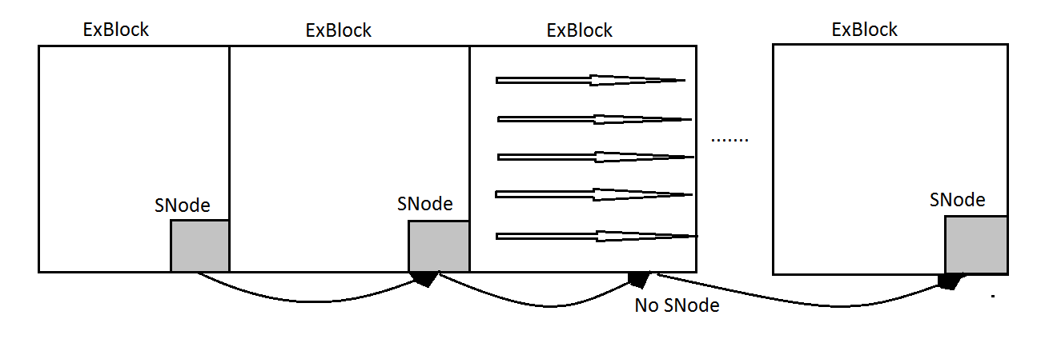
MOUNT SCHEME
Exist SNode
No Snode
COURTESY:ENFFiS Acm transactions and embedded sytems
Picture courtesy-Computers and Mathematics with Applications 59 (2010) 23802392

Slide 13
JOURNALING SCHEME
Version number
Algorithm

Slide 14
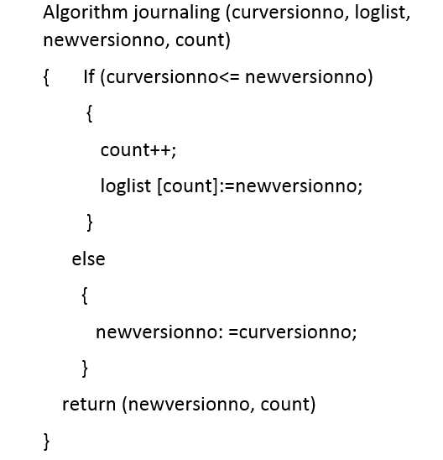
JOURNALING SCHEME

Slide 15
DIRTY-LAST CACHE POLICY
Delay region
Replacement region

Slide 16
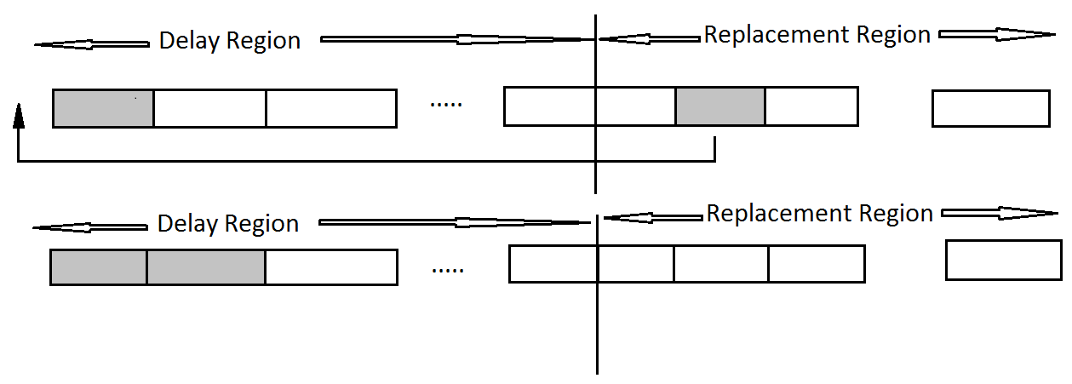
DIRTY-LAST CACHE POLICY
COURTESY:ENFFiS Acm transactions and embedded sytems

Slide 17
PERFORMANCE EVALUATION
MOUNT TIME

Slide 18
PERFORMNCE EVALUTIONS
STABILITY TEST
STRESS TEST
POWER FAILURE TEST

Slide 19
CONCLUSION
REDUCE THE MOUT TIME BY EXBLOCK
AVOID RAPID WEAR PROBLEM
BETTER STABILITY BY JOURNALING SCHEME
BETTER READ WRITE PERFORMANCE

Slide 20
REFERENCES
ALEPH ONE 2006 YAFFS:Yet Another Flash File System.http://www.yaffs.net
Cook,j.2006.Flash memory 102:n introduction to nand flash .rep.,Micron Technology Inc
INTEL CORP.2002.3 volt synchronous intel strataflash memory .http//www.intel.com

Slide 21
THANK YOU

Slide 22
QUESTIONS?

